Slide 1
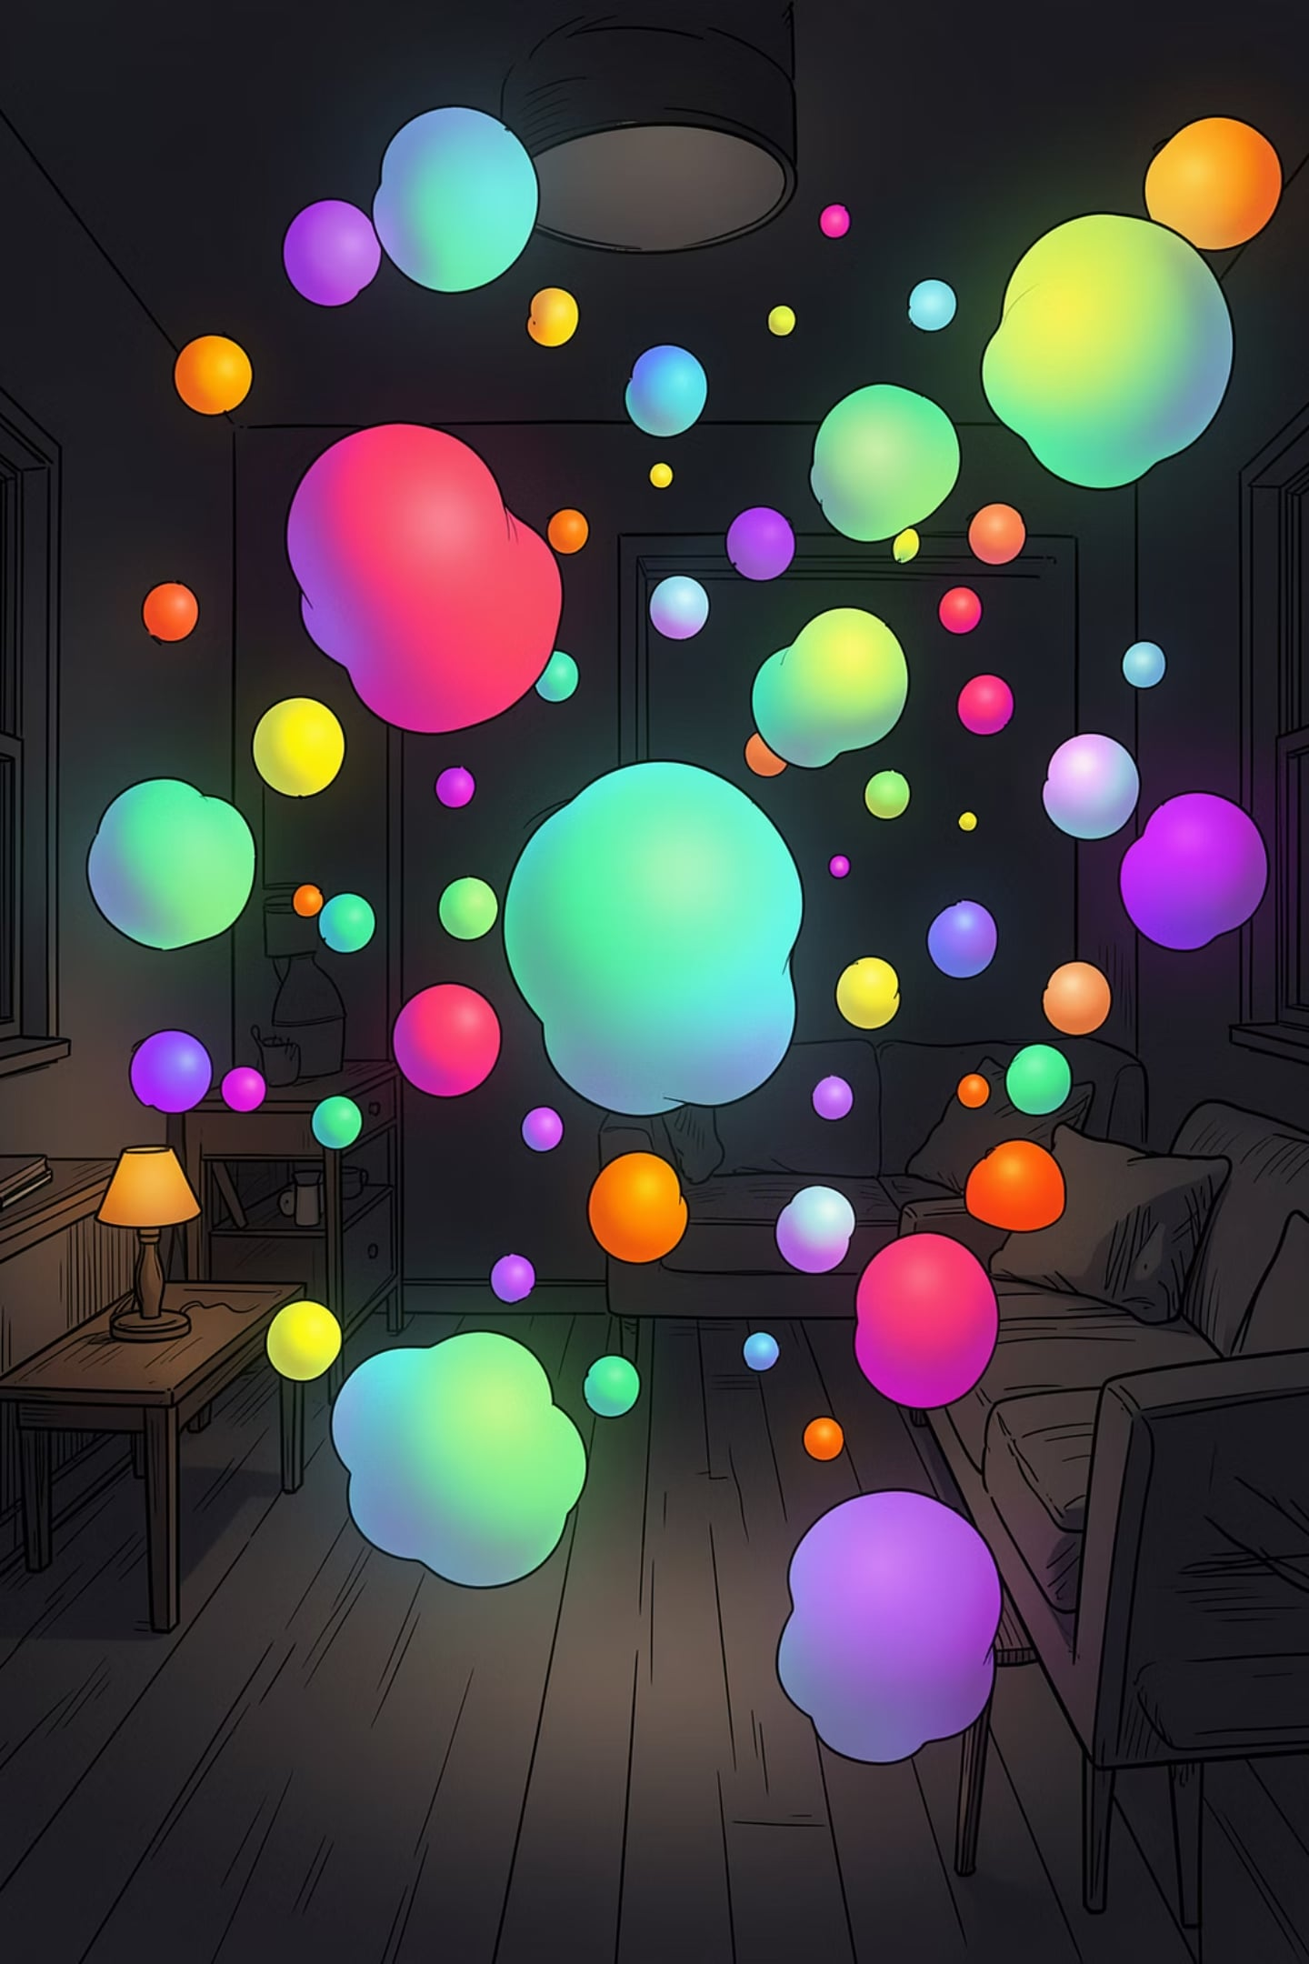
3D Gaussian Splat Scene Editing Pipeline
A comprehensive, end-to-end system for acquiring, segmenting, editing, and exporting 3D Gaussian Splat scenes. This pipeline bridges the gap between raw 3D scan data and interactive, non-destructive scene manipulation — preserving full Gaussian attribute fidelity throughout every stage of processing.

Slide 2
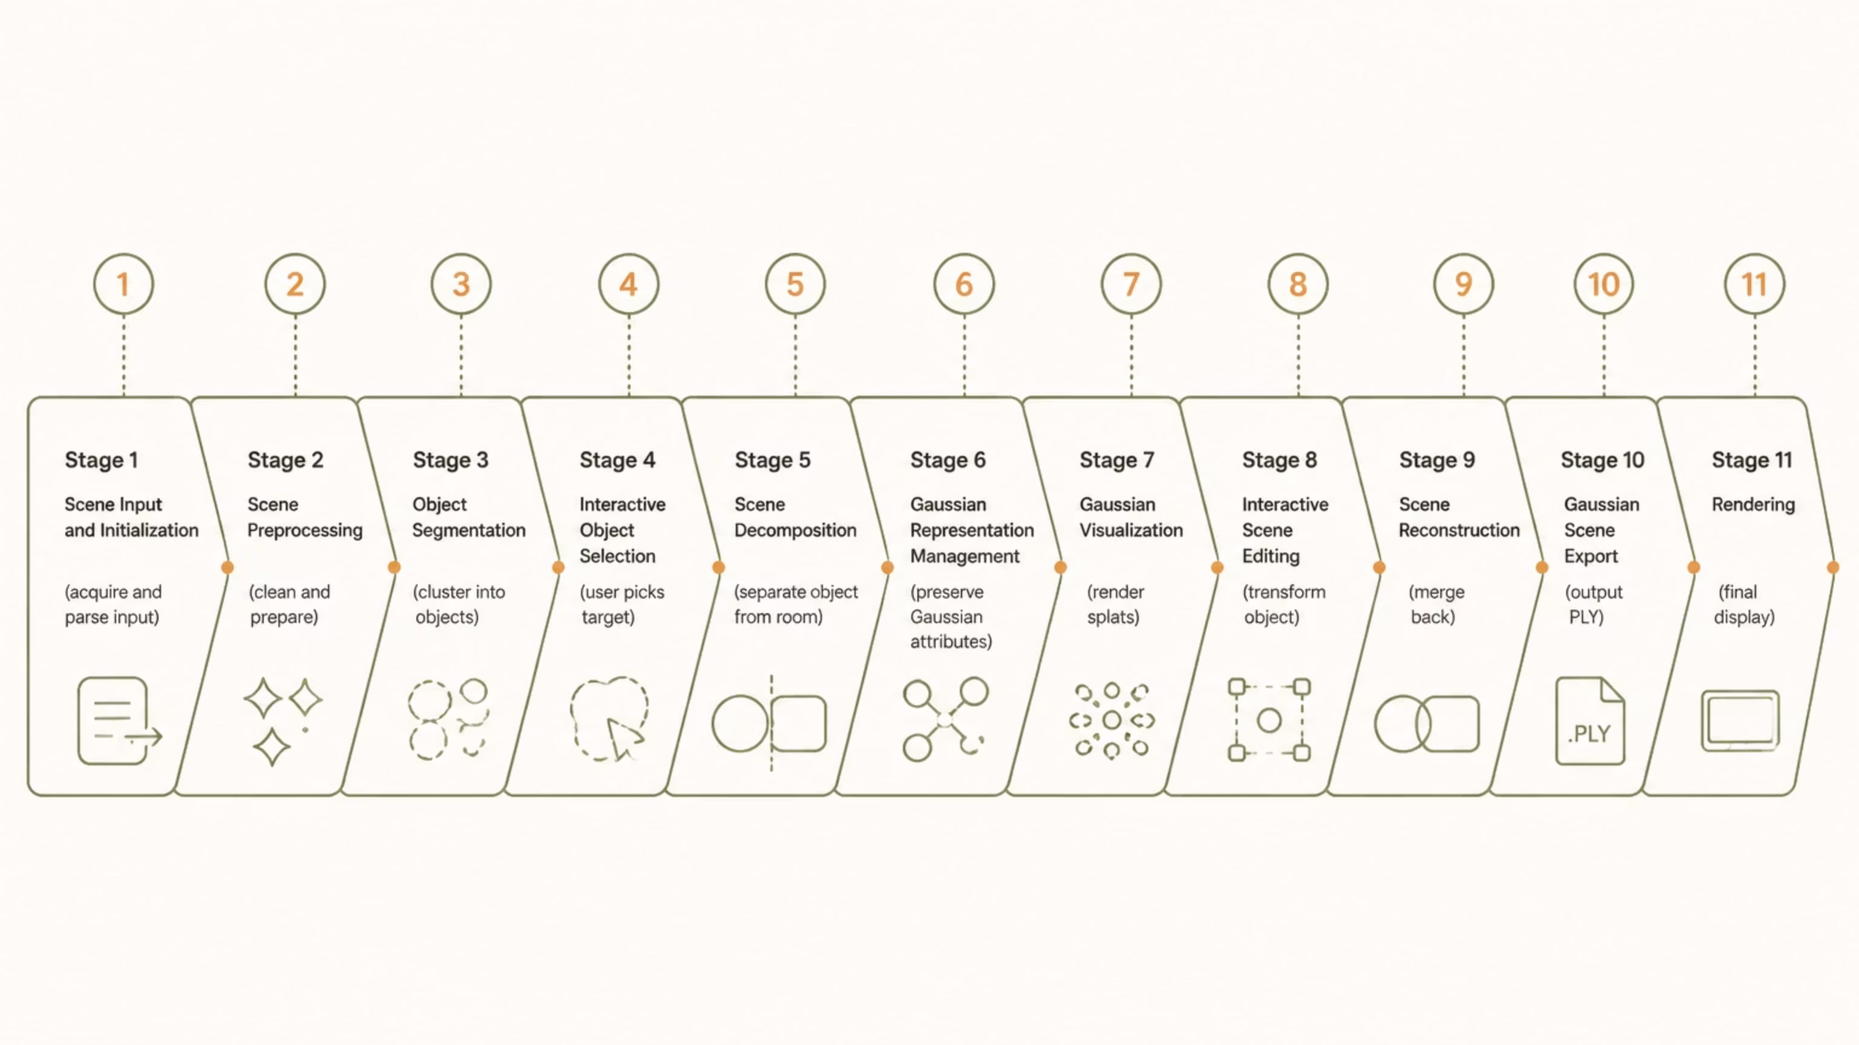
Pipeline Overview
The system is structured as an 11-stage sequential pipeline, each stage building upon the output of the previous. The architecture is designed to handle heterogeneous input formats, perform intelligent scene decomposition, support interactive editing, and export results in a fully standards-compliant 3DGS format. Below is the complete processing flow from raw scene input to final rendered output.
Each stage is designed to be modular and independently testable. The pipeline supports both conventional point clouds and native 3D Gaussian Splat scenes as input, automatically detecting the format and adapting its processing strategy accordingly. The critical innovation lies in Stage 6, where the SourceSplat Architecture ensures zero degradation of Gaussian attributes throughout the entire editing workflow.

Slide 3
STAGE 1
Scene Input & Initialization
Objective
Supported Input Formats
Acquire the input scene and initialize it into a structured internal format that can be processed uniformly by all downstream stages, regardless of the original representation.
PLY
PCD
Standard polygon file format
Point Cloud Data format
The Core Problem
Real-world 3D scenes arrive in fundamentally different representations — standard point clouds store only XYZ positions and optional attributes, while Gaussian Splat scenes encode rich anisotropic Gaussian parameters. The system must identify the input format and extract all relevant information without loss.
XYZ
3DGS PLY
Raw coordinate format
Gaussian Splat PLY
Parsed Attributes
XYZ coordinates — spatial positions for all points
RGB colors — per-point color values
Point normals — surface orientation (if available)
Gaussian parameters (for 3DGS): scale, rotation (quaternion), opacity, and Spherical Harmonic coefficients
Scene Statistics Computed
Bounding box dimensions, scene scale, and centroid are computed automatically. Normals are estimated for inputs where they are unavailable. SH DC coefficients are converted to RGB for initial visualization. The output is a fully initialized scene containing the point cloud representation, original Gaussian attributes, and complete scene metadata.

Slide 4



STAGE 2
Scene Preprocessing
Large indoor scans present a significant challenge: floors, walls, and noise create structural connectivity that prevents meaningful object segmentation. Running clustering algorithms directly on raw scans produces poor results because the floor physically connects multiple independent objects into a single component. Stage 2 systematically removes these confounding elements.
Preprocessing Steps
Algorithms Used
Plane Segmentation (RANSAC)
RANSAC Plane Segmentation
The dominant ground plane is detected using RANSAC-based plane fitting. The floor is temporarily removed from the point cloud, breaking the structural connectivity between objects that would otherwise prevent clean segmentation.
Robust model fitting for dominant plane detection in noisy 3D data
Noise Filtering
KD-Tree
Outlier points and sensor noise are filtered using statistical methods. Points with insufficient local support are removed to improve clustering quality downstream.
Spatial indexing structure for fast nearest-neighbor queries
Normal Estimation
PCA Normal Estimation
For points without pre-computed normals, surface normals are estimated using local neighborhood analysis via KD-Tree queries, enabling geometry-aware processing in later stages.
Local surface normal computation via eigendecomposition of covariance
Key Insight: Automatic epsilon estimation for DBSCAN is computed based on the k-distance graph of the preprocessed point cloud, allowing the pipeline to adapt to scenes of varying density without manual tuning.
KD-Tree Construction
A KD-Tree is built over the cleaned point cloud to enable efficient O(log N) neighborhood searches, which are critical for both DBSCAN clustering and normal estimation.
Color Normalization
RGB values are normalized to a consistent range, ensuring uniform color processing across different capture devices and lighting conditions.

Slide 5
STAGE 3
STAGE 4
Object Segmentation & Interactive Selection
Stage 3 — Automatic Object Segmentation
Stage 4 — Interactive Object Selection
After preprocessing, the scene is still a single unified point cloud. Stage 3 applies DBSCAN (Density-Based Spatial Clustering of Applications with Noise) to automatically partition the scene into independent object clusters. DBSCAN is particularly well-suited for 3D scenes because it does not require a predefined number of clusters and can identify arbitrarily shaped groupings while marking outliers as noise.
Automatic clustering alone cannot determine which object the user intends to edit — large indoor scenes may contain hundreds of clusters representing furniture, decor, fixtures, and structural elements. Stage 4 provides an interactive interface for precise target selection.
Single Selection
Multi Selection
Cluster IDs are assigned to every point in the scene
Cluster masks are generated for efficient indexing
Each cluster is assigned a unique color for visual distinction
Cluster statistics (point count, bounding box, centroid) are computed
Automatic parameter estimation adapts to different scene densities
Pick one cluster for isolated object editing
Select multiple clusters for grouped operations
Manual Refinement
The output is a fully segmented scene where each independent object is identified and labeled, forming the foundation for interactive selection.
Add or remove points from the selection mask
A binary object mask is generated from the selection, and the indices of all selected clusters are stored for use in the decomposition stage. This enables precise, user-directed editing while retaining the efficiency of automatic segmentation.

Slide 6
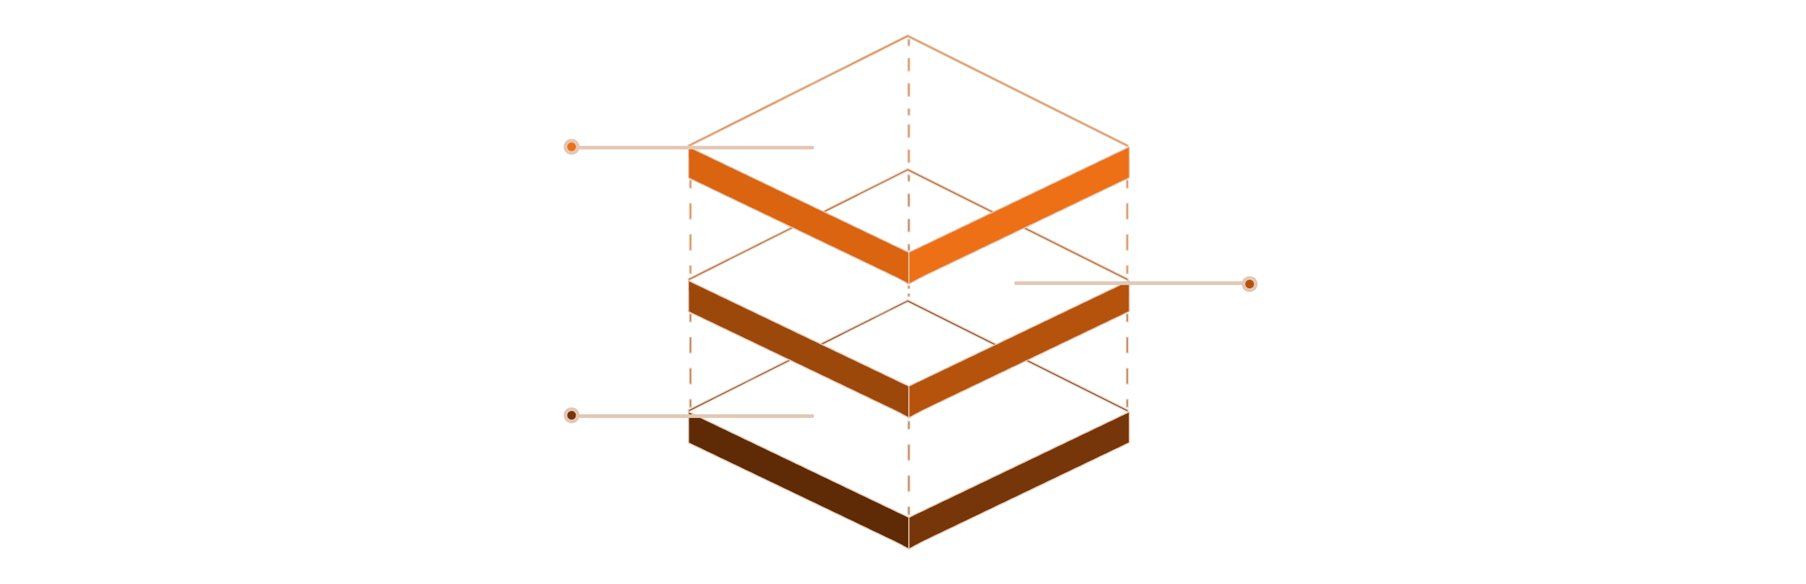
STAGE 5
Scene Decomposition
With the target object(s) selected, Stage 5 performs a clean separation of the scene into two distinct components: the room point cloud (the static environment) and the object point cloud (the editable target). This decomposition is the foundation for non-destructive editing — all subsequent transformations are applied only to the object component while the environment remains completely unchanged.
Object Point Cloud
Editable target, transformed
Room Point Cloud
Static environment preserved
Original Scene
Capture full point-cloud scene
The decomposition is entirely non-destructive. Every piece of metadata required for faithful reconstruction is preserved alongside the split representation.
Preserved Metadata
Why Decomposition Matters
Original point indices — mapping back to the source scene
Cluster masks — for re-merging after editing
Gaussian ownership — which Gaussians belong to which component
Object centroid — pivot point for transformations
Without clean decomposition, any transformation applied to the object would require re-processing the entire scene, introducing numerical instability and potential attribute corruption. By isolating the object, the system can apply arbitrary transformations — translation, rotation, scaling — with complete confidence that the environment remains pristine. The decomposition also enables efficient memory usage, as only the object component needs to be updated during interactive manipulation.

Slide 7

STAGE 6 — CORE CONTRIBUTION
Gaussian Representation Management
This stage represents the primary technical contribution of the system. The challenge is to generate or preserve a complete Gaussian representation of the selected object that maintains full attribute fidelity through editing and export.
Initial Approach — Direct Generation
Improved Solution — SourceSplat Architecture
The original implementation generated Gaussians from the point cloud using KD-Tree neighbor search, PCA, and covariance estimation. Each point was converted into an anisotropic Gaussian with parameters for mean, covariance, scale, rotation, opacity, and color.
The improved architecture eliminates reconstruction entirely. Instead of regenerating Gaussians, the system preserves original Gaussian attributes throughout the entire pipeline:
Original scale parameters retained exactly
Original quaternion rotation preserved
Original opacity values maintained
Full Spherical Harmonic coefficients kept intact
Critical Flaw: During export, the Gaussian scene was reconstructed from point clouds, causing irreversible loss of scale, rotation, opacity, and SH coefficients — resulting in visibly degraded quality.
Only a temporary visualization copy is created for rendering. All editing operations are non-destructive — transformation state is tracked separately from the underlying Gaussian data. This completely eliminated quality degradation in exported scenes.

Slide 8
STAGE 7
STAGE 8
Gaussian Visualization & Interactive Editing
Stage 7 — True Gaussian Rendering
Stage 8 — Interactive Scene Editing
Early visualization attempts using Gaussian means, ellipsoid meshes, and density-sampled point clouds all proved inadequate — they failed to capture the screen-space appearance of true Gaussian splats. The final solution integrates a full GPU-based Gaussian renderer using ModernGL with custom vertex and fragment shaders.
With Gaussians correctly visualized, the user can manipulate the selected object in real time. The system supports translation, rotation, and reset operations, including multi-object editing for grouped selections.
Critically, individual Gaussian parameters are never modified during interaction. Instead, only the transformation state (object centroid, rotation matrix, and 4×4 transformation matrix) is updated. This state-based approach enables efficient real-time interaction at full frame rates, as the expensive Gaussian attribute data remains untouched until final export.
Screen-Space Covariance Projection
EWA Rasterization
Elliptical Weighted Average splatting produces artifact-free, high-quality Gaussian rendering
Each Gaussian's 3D covariance is projected into screen space for correct elliptical footprint computation
Translation
Rotation
Free movement along all three axes
Arbitrary-axis rotation via quaternion
Blinn-Phong Lighting
Reset
Diffuse shading, specular highlights, and rim lighting with interactive light controls
Restore original transform instantly

Slide 9

STAGE 9
STAGE 10
Scene Reconstruction & Gaussian Export
Stage 9 — Scene Reconstruction
Stage 10 — Standards-Compliant Export
After the user completes editing, Stage 9 merges the transformed object back into the original environment. The floor (removed during preprocessing) is restored, and the edited object point cloud is recombined with the room point cloud using the preserved cluster masks and original point indices.
Only the Gaussian parameters of the edited object are updated — position and rotation are transformed according to the accumulated transformation matrix. All untouched Gaussian attributes (scale, opacity, SH coefficients) remain exactly as in the original scene, ensuring complete scene consistency and zero collateral modification of the environment.
The final edited scene is exported in the standard 3D Gaussian Splat PLY format, fully compatible with downstream tools including SuperSplat, Postshot, and gsplat.
Untouched objects: Original scale, rotation, opacity, and SH coefficients copied directly — zero modification
Edited objects: Position and rotation updated via the transformation matrix; all other attributes preserved
Export format: Standard 3DGS PLY with quaternion rotation representation, log-scale parameters, opacity logits, and full SH coefficients
The use of quaternion representation and log-scale parameters in the export ensures numerical stability and compatibility with the official 3DGS training and rendering codebases.

Slide 10



STAGE 11
SUMMARY
Final Rendering & Pipeline Summary
Stage 11 — Rendering Pipeline
Key Achievements
The final stage renders the edited Gaussian scene using a complete per-splat GPU pipeline. For every Gaussian in the scene, the following operations are performed in sequence:
Multi-Format Input
Non-Destructive Editing
01
Supports PLY, PCD, XYZ, and native 3DGS PLY with automatic format detection
SourceSplat Architecture preserves all original Gaussian attributes throughout the pipeline
Covariance Projection
Project 3D covariance into screen space for correct elliptical footprint
02
Standards-Compliant Export
Real-Time Interaction
Billboard Quad Generation
Output compatible with SuperSplat, Postshot, and gsplat without conversion
State-based transformation model enables responsive editing at full frame rates
Generate a screen-aligned quad sized to the Gaussian's projected extent
03
Pipeline Integrity: From raw scene input to final rendered output, every stage maintains data fidelity. No Gaussian attribute is lost, approximated, or reconstructed — the edited scene is mathematically equivalent to the original with only the intended transformations applied.
Alpha Evaluation
Compute per-pixel Gaussian alpha from the projected covariance
04
Depth Sorting
Sort splats back-to-front for correct alpha blending order
05
Lighting & Blending
Apply Blinn-Phong shading, specular reflections, and blend contributions
The result is a photorealistic, real-time render of the edited scene with full camera controls and interactive lighting.

Slide 11

Conclusion
Revolutionizing 3D Editing
Transform your vision into reality with unparalleled fidelity and control.
Our comprehensive pipeline empowers users to manipulate complex Gaussian Splat scenes interactively, from intelligent object segmentation to non-destructive transformations and standards-compliant export. This system ensures creative freedom without compromising on quality or performance.
The 3D Gaussian Splat Scene Editing Pipeline sets a new benchmark for precision, speed, and integrity in digital content creation.

Slide 12
Thank You
For your attention and engagement.
We greatly appreciate your time and interest in our 3D Gaussian Splat Scene Editing Pipeline.
Our Team
Pulla Jagadeeshwar Reddy
Rushil Singh Arora
Chetana V Iyer

