Slide 1
Bank Application
Done By:
Shiva Prasad(21BD1A057J)
Neha(21BD1A0578)
Manasvini(21BD1A056U)
Shiva Rama Krishna(21BD1A057E)
Srinidhi(21BD1A056C)

Slide 2
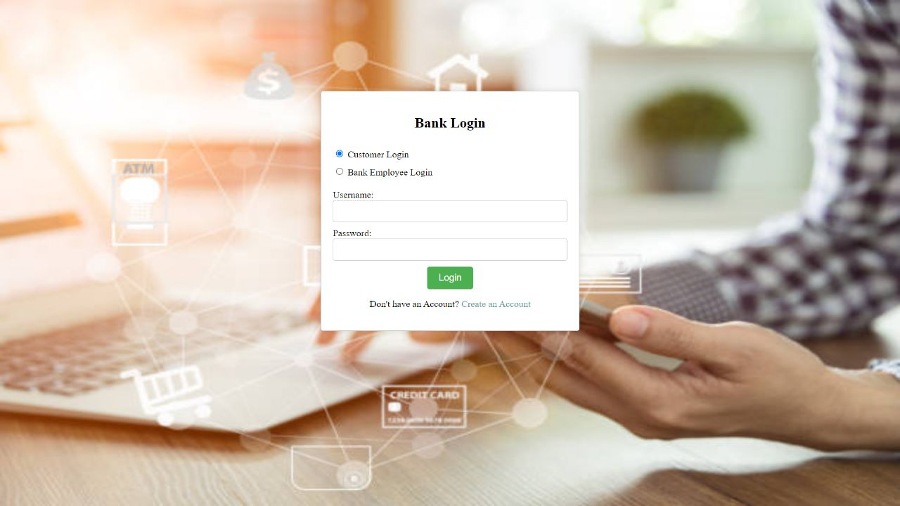
Login page In the bank login page you have customer login and bank employee login and if customer doesn’t have an account they can create an account .

Slide 3
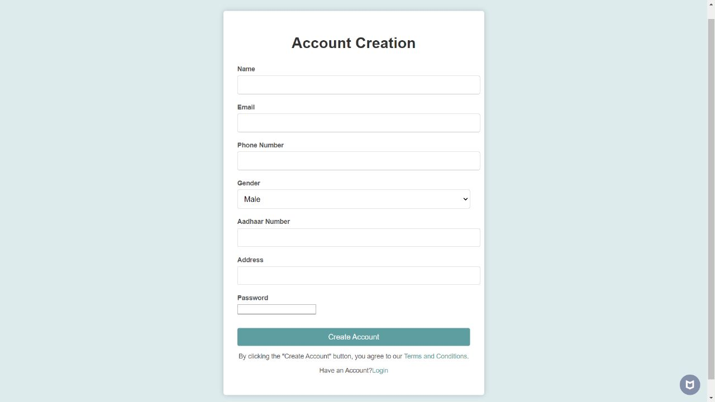
Account Creation In this page if customer is new to the bank they can create an account by providing their details

Slide 4
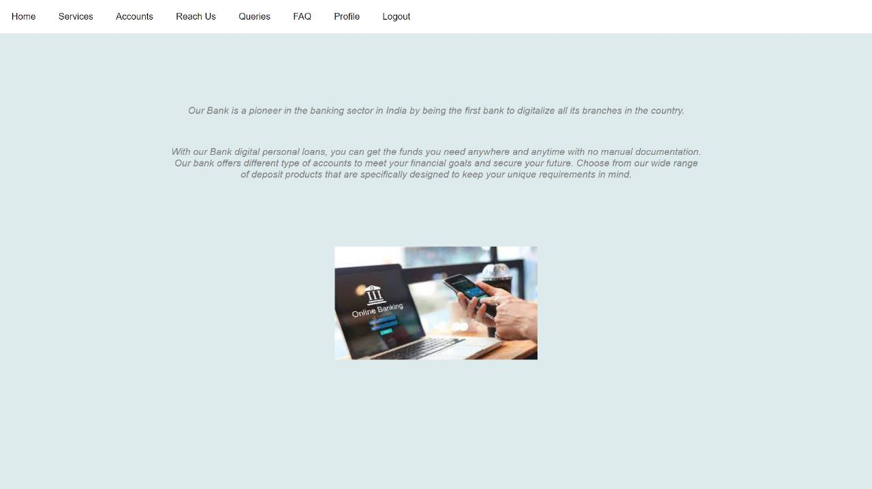
Customer Login page When a customer logs in he can find this home page and can avail the services they require.

Slide 5
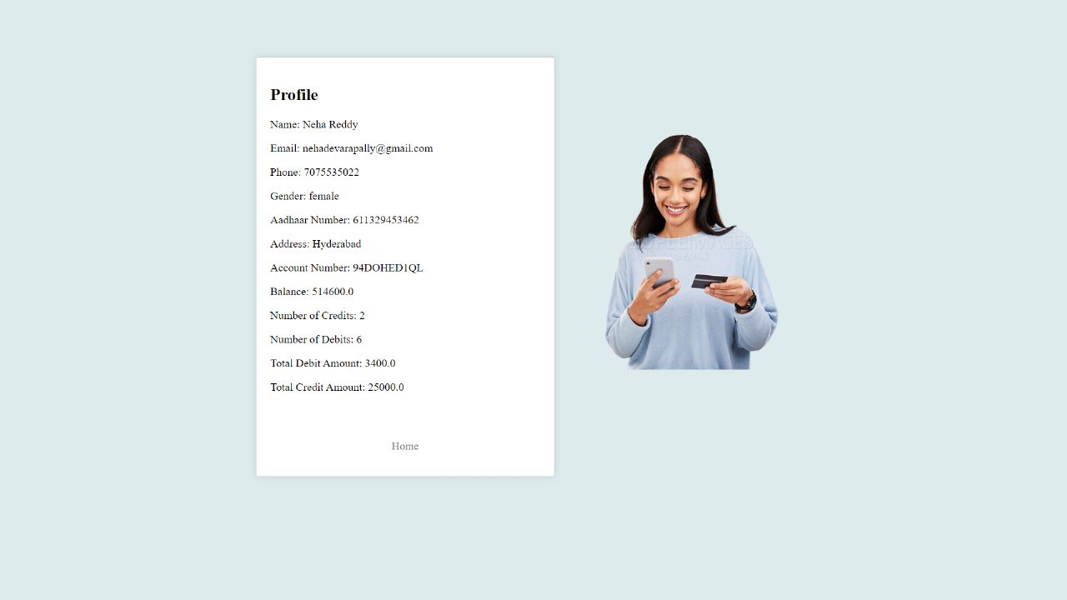
Customer can view his profile by clicking on profile where he can get to know about his balance .

Slide 6
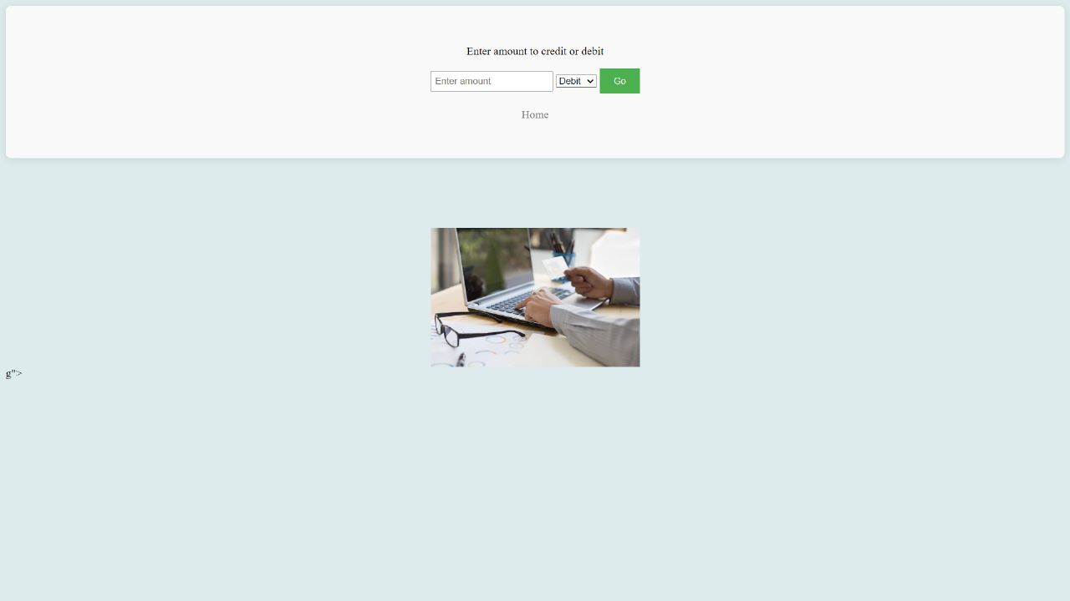
When you click on services you can find transactions and loan. This is a transaction page where you can credit or debit your amount and it will show whether your amount has been credited or debited successfully.

Slide 7
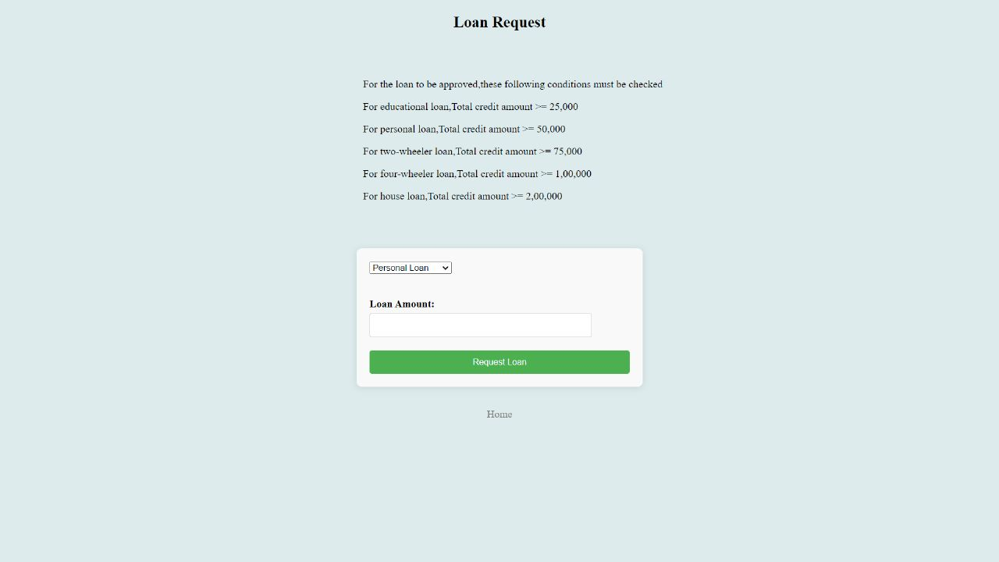
This is a loan page where customer can request a loan and based on the given criteria they can know whether their loan is approved or rejected. Here we have various types of loan provided.

Slide 8
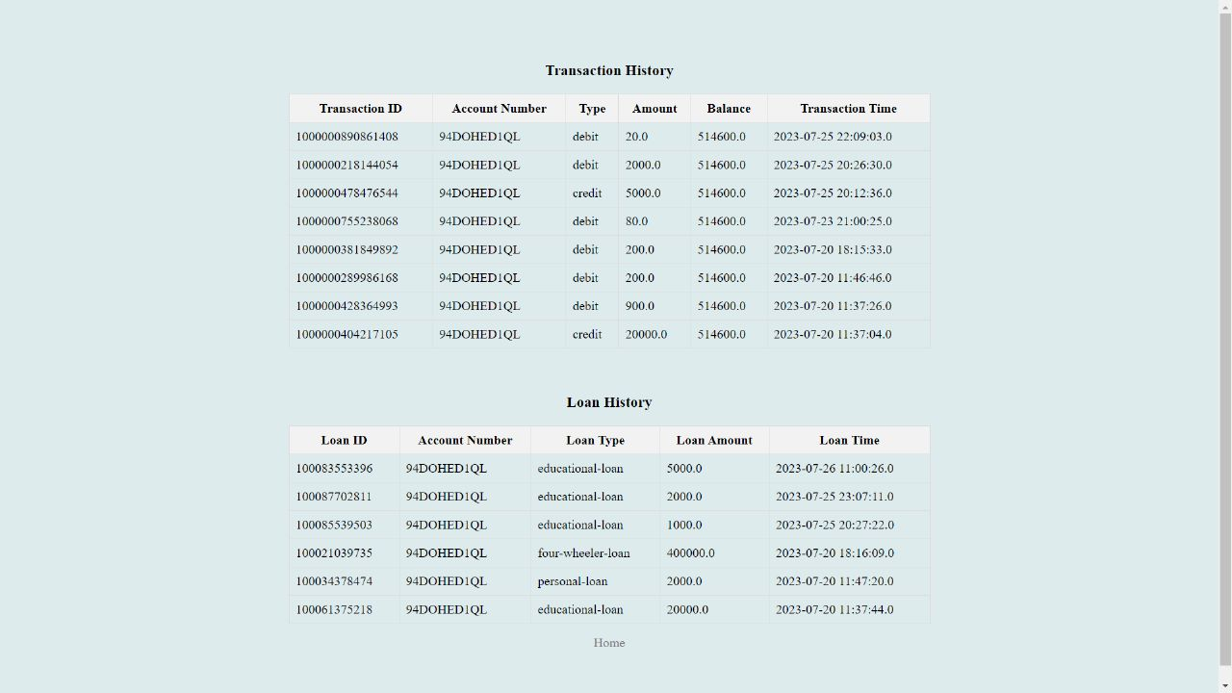
Customer can know his balance and transaction history in the accounts section and they find their type of transaction whether it’s a credit or debit and even their loan history.

Slide 9
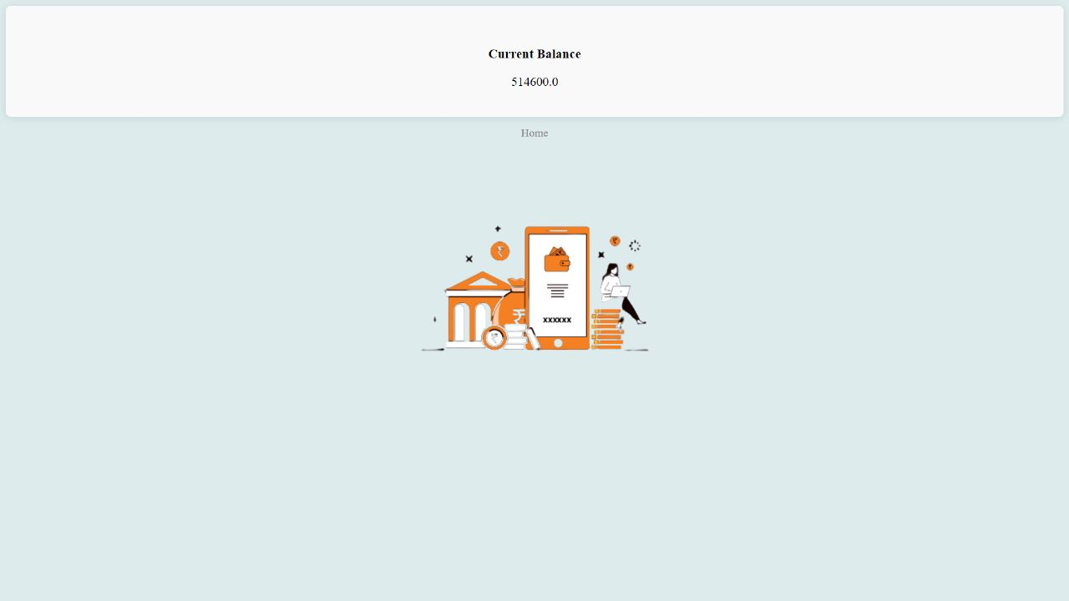
This is where you can know your current balance.

Slide 10
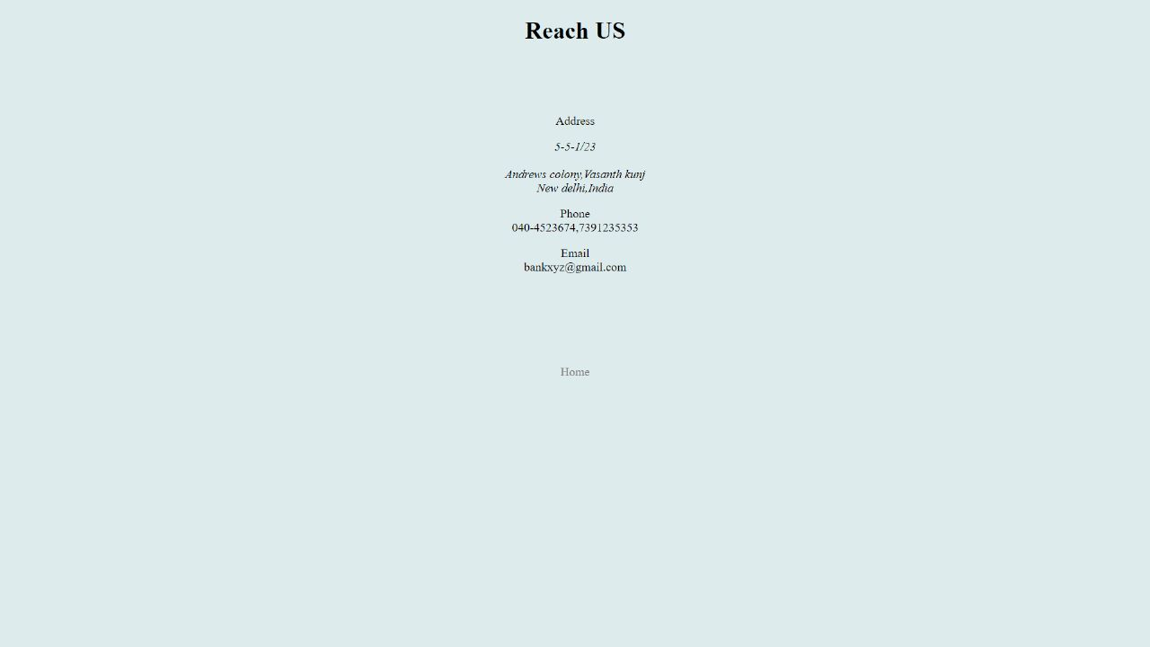
If you want to reach us you can just click on reach us,you can find it on homepage.

Slide 11
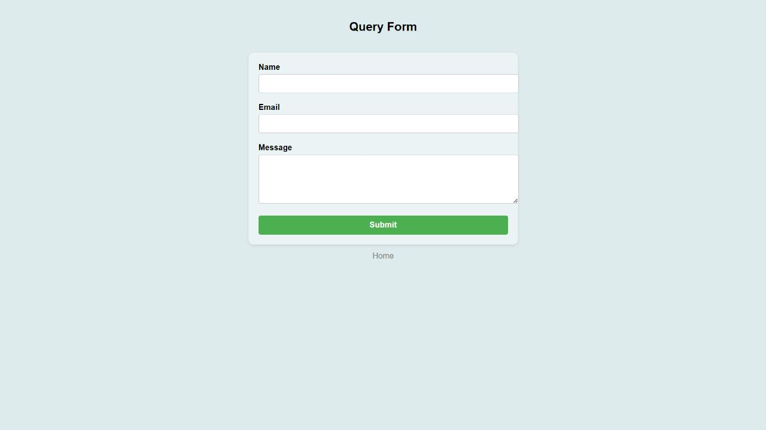
If a customer has any query he can just let us know just by filling a query form .

Slide 12
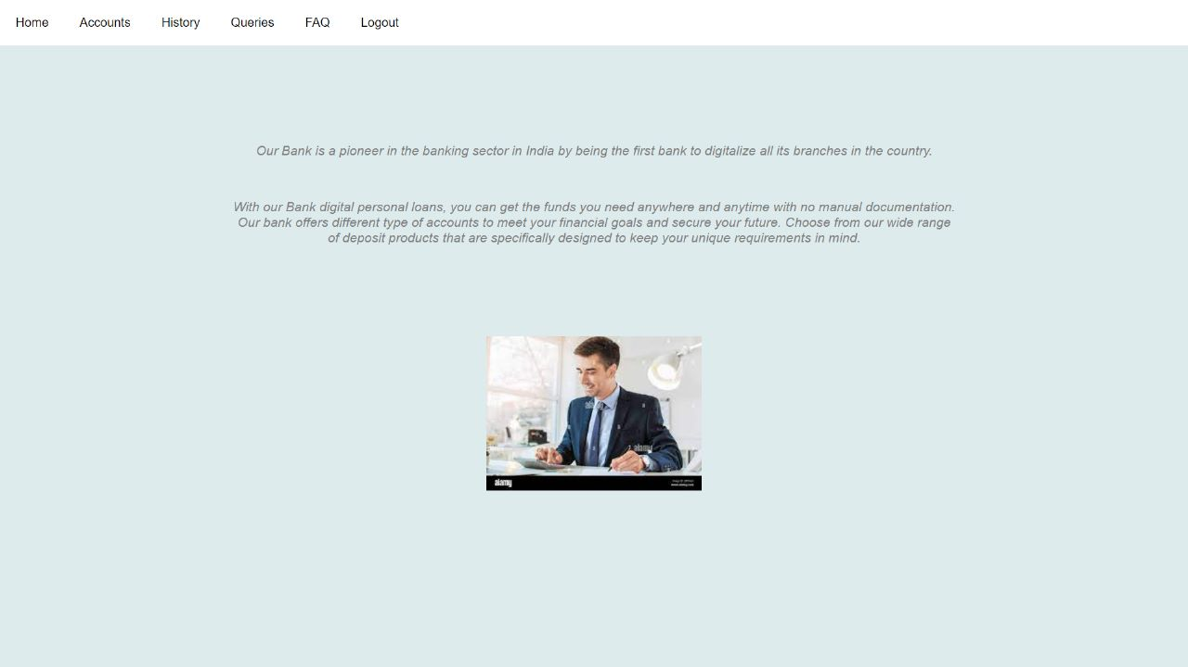
Bank Employee Login page When a bank employee logs In he can find a homepage where he can have access to all the accounts and also can create an account

Slide 13
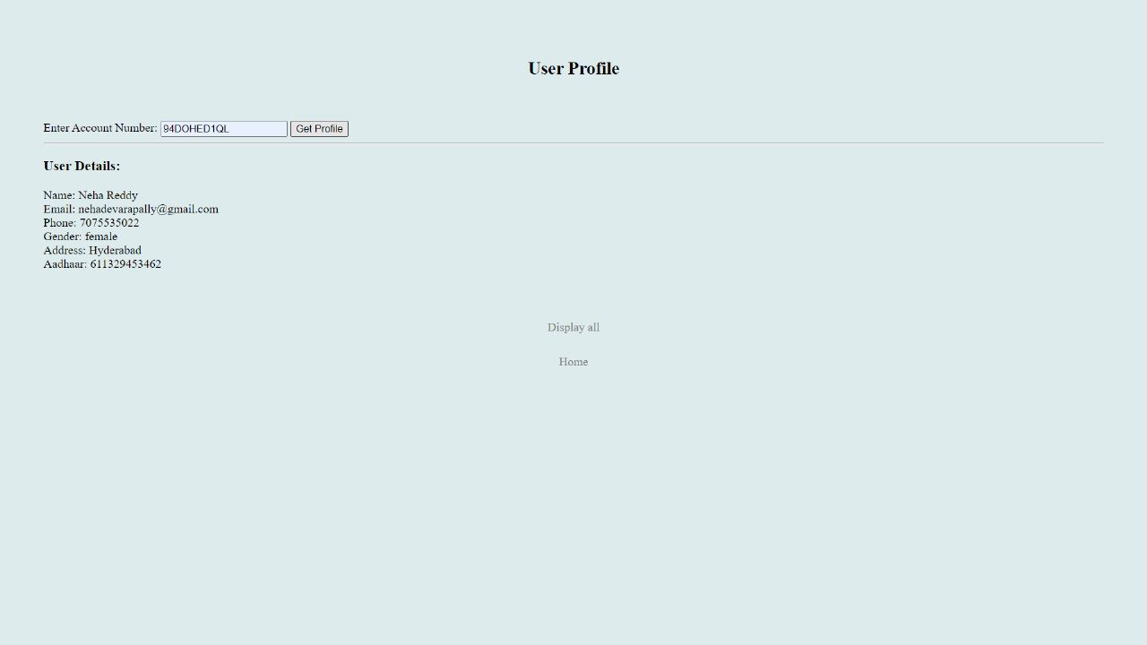
Bank employee can view a user profile.

Slide 14
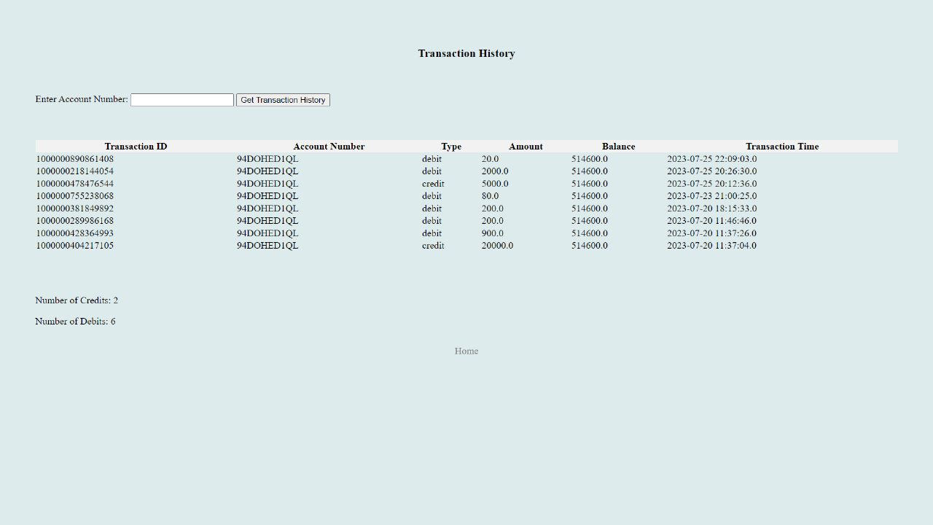
Bank employee can access each customer transactions just by clicking on history .He can easily access just by entering customers account number

Slide 15
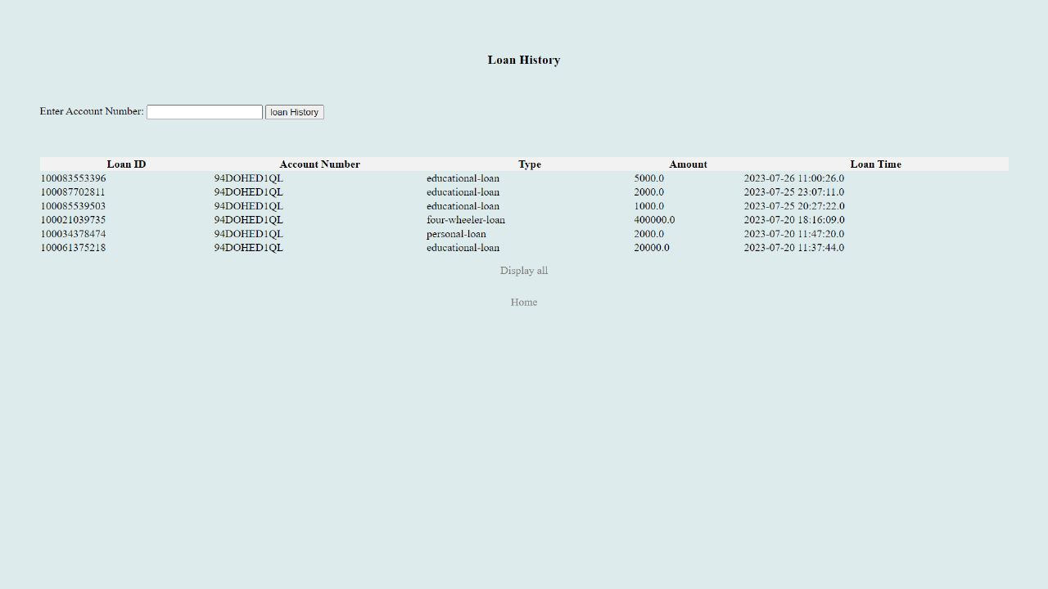
Bank employee can access loan history and transaction history separately

Slide 16
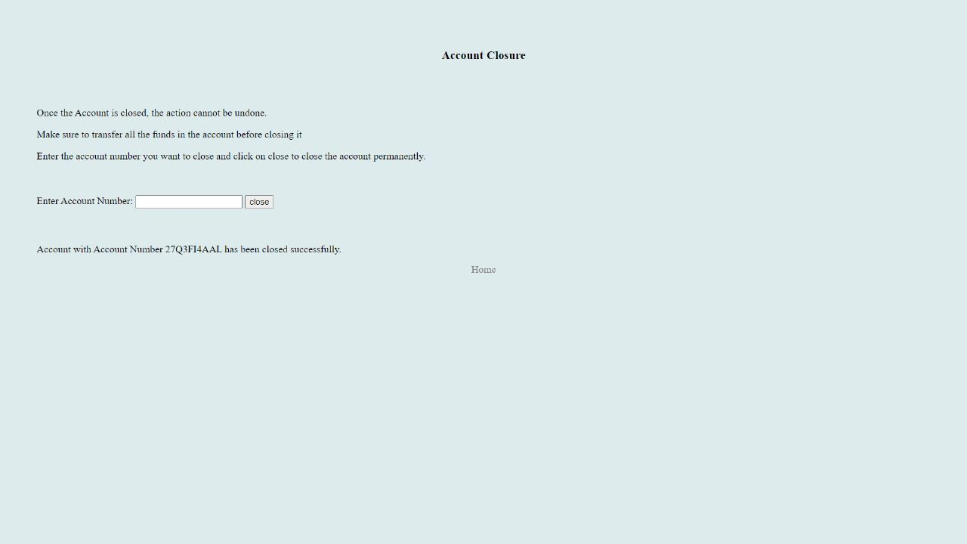
When a bank employee clicks on accounts he can create an account and can also close an account just by entering their account number.

Slide 17
When you click on logout it will just redirect you to login page and you have to enter your credentials again whenever you wanted to avail our bank services.

Slide 18
THANK YOU!!

