Slide 1
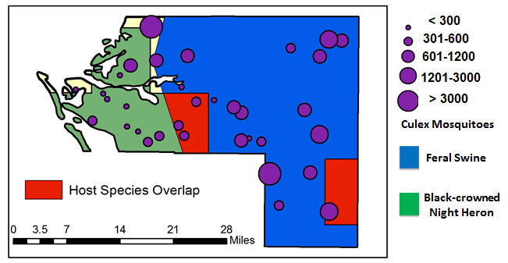
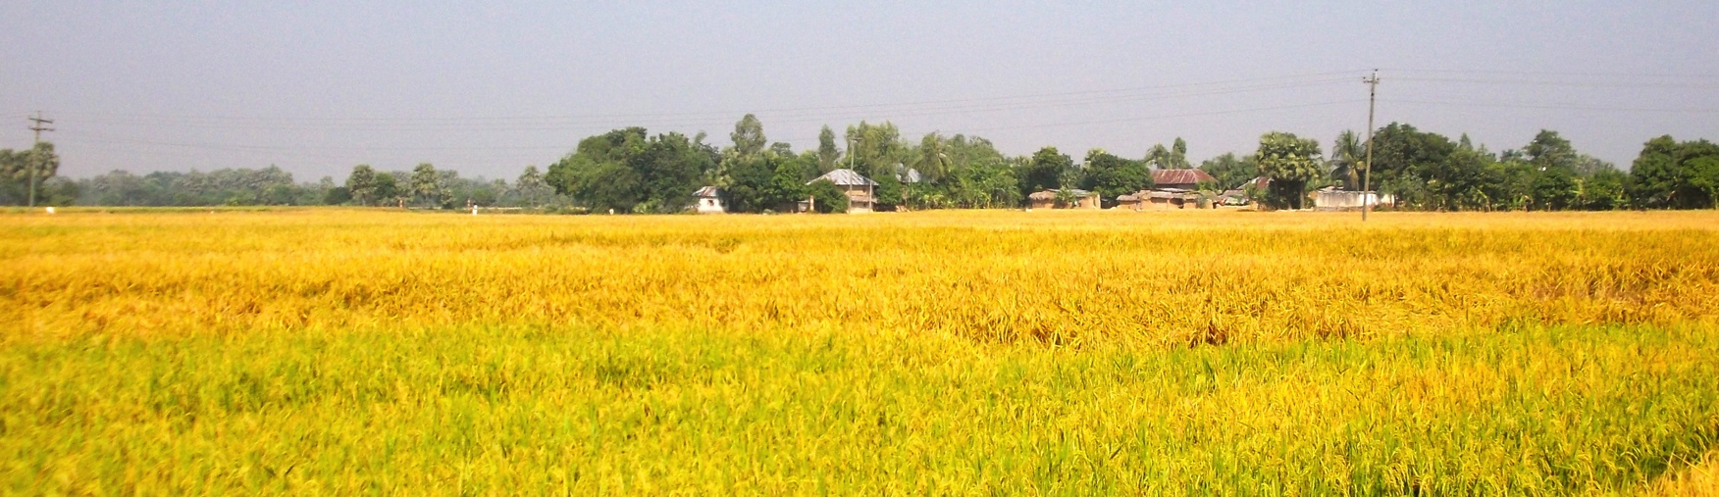
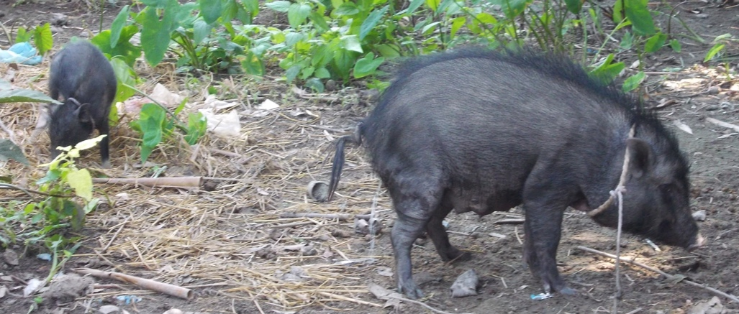
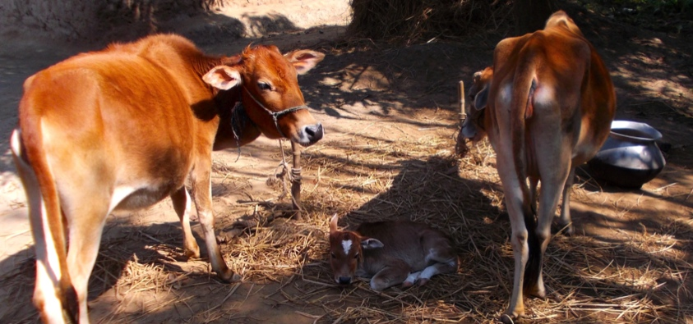
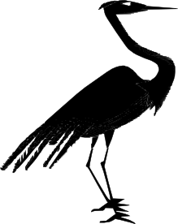
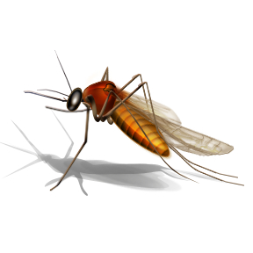

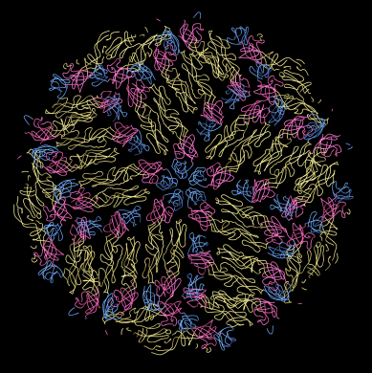

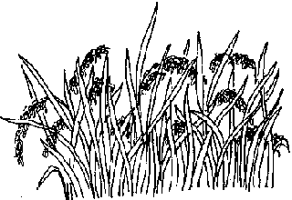

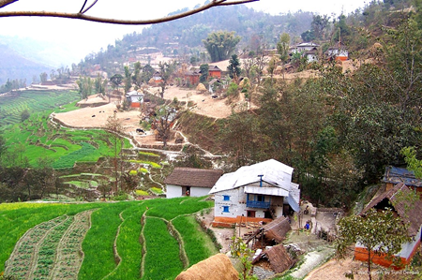
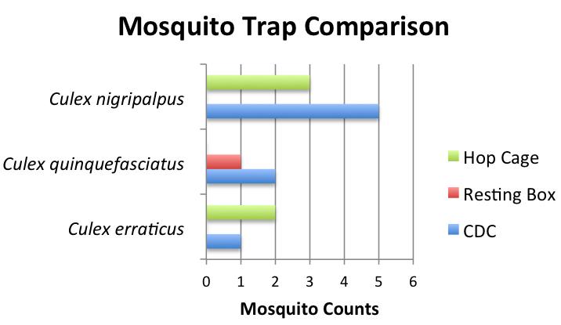
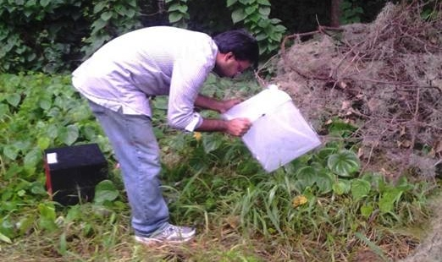
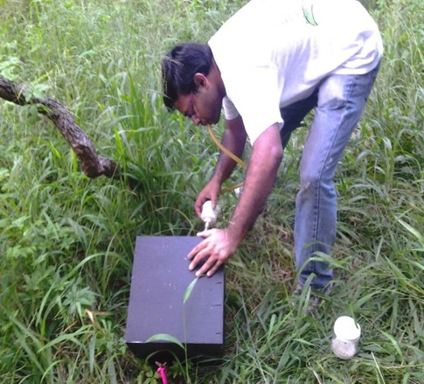
Manatee County Florida
How is Japanese encephalitis virus maintained in a complex transmission context?
Which host and vector species are involved in Japanese encephalitis virus transmission in Bangladesh?
- Jennifer Lord, University of Florida
Figure of Viremia profiles
If introduced, could Japanese encephalitis virus invade Florida?
-Jess Rowland, University of Florida
What are the Japanese encephalitis virus viremia profiles in different hosts?
-Brooke Borgert,
University of Florida
Methods we use:
Field Epidemiology
Mosquito Trapping Techniques
Field Biology
Geographic Information Systems
Molecular Virology
Statistics
Mathematical Modeling
How do changes in nitrogen and phosphorus within a mosquito affect its ability to acquire and transmit West Nile Virus?
What are the effects of phosphorus on the rate of molecular evolution of West Nile Virus?
-Gabriela Blohm, University of Florida
Which trapping method is ideal for collecting blood fed mosquitoes?
-Biswadeep Dhar, University of Florida
Has Japanese encephalitis virus reached to the animal and human community in mountain districts of Nepal?
-Ajit Kumar Karna, Colorado State University

