Slide 1
Influence of Hypothetical Planet 9 on Dwarf Planet Pluto
Baron L

Slide 2
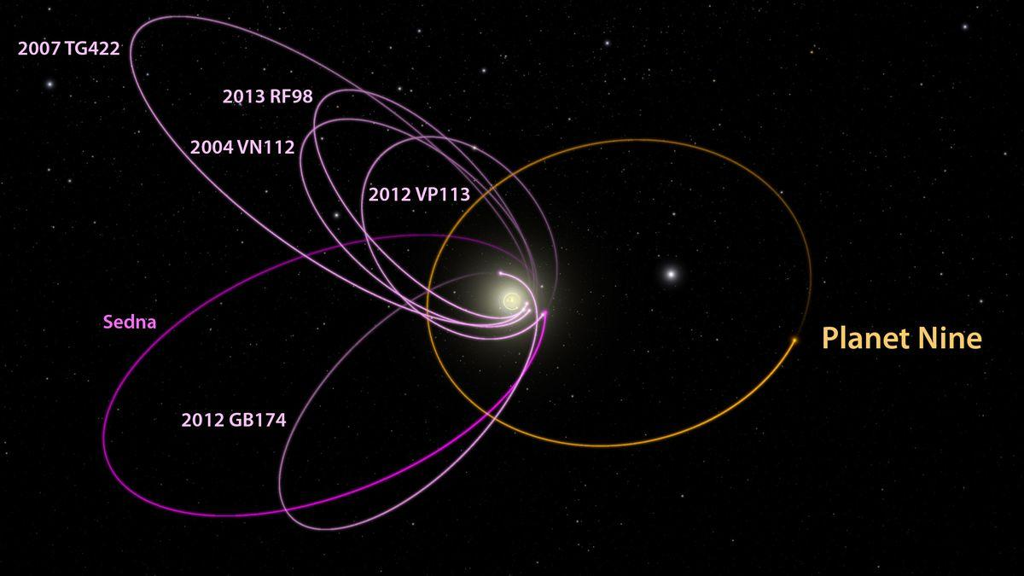
Introduction
Early 2016–Konstantin Batygin and Mike Brown suggested the existence of a “Planet 9”
Supported by irregular movements of objects in the Kuiper Belt
This research aims to determine how a 9th planet would affect other objects in the Solar System.
Fig 1: Hypothesized Orbit of Planet 9 Credit: R. Hurt (IPAC)/Caltech.

Slide 3
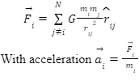
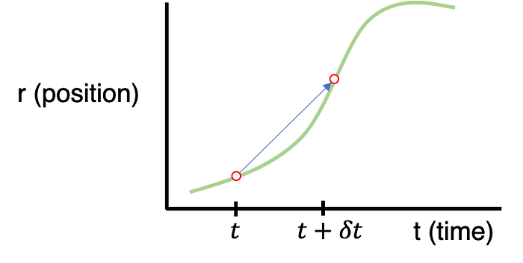

Methods
Used Newton's law of universal gravitation and Newton’s second law of motion:
Velocity Verlet was used in a Github Repository to simulate the Solar System with a new planet:

Slide 4
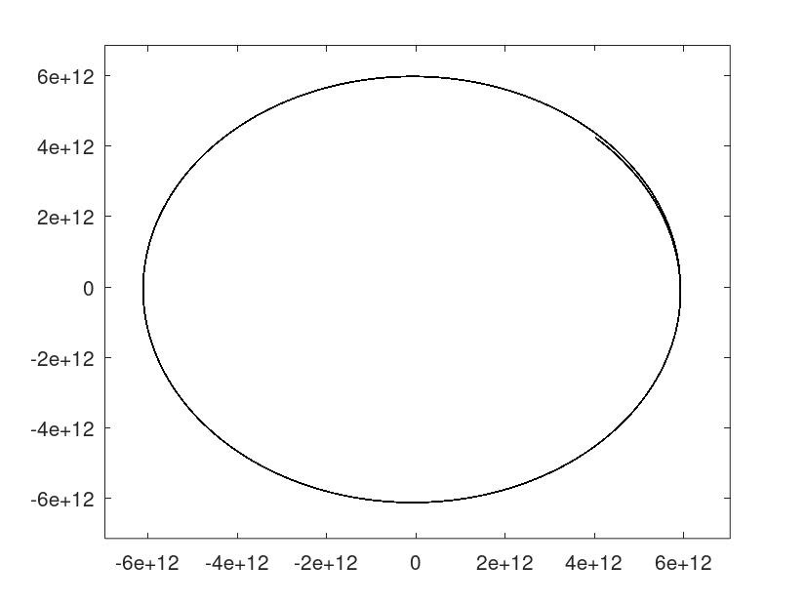
Methods (continued)
We collected the data through a simulation–our control group was with 21 objects (the Sun, 8 planets, and some major moons).
We chose to focus on Pluto for this study because it is far from the Sun, and has a small mass. We printed its position and velocity at each timestep.
We tested the data with Planet 9 being 20 times as far from the Sun as Neptune with a mass of: 20, 50, 100 and 200 times that of Earth.

Slide 5
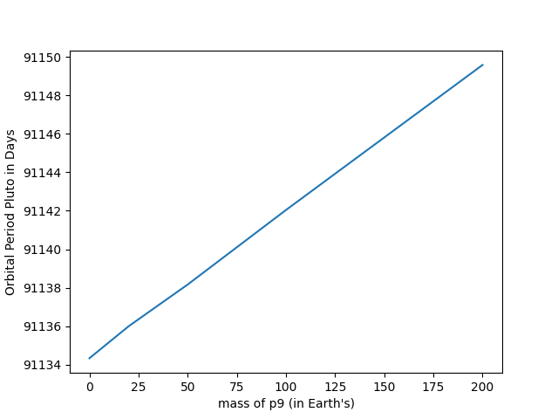
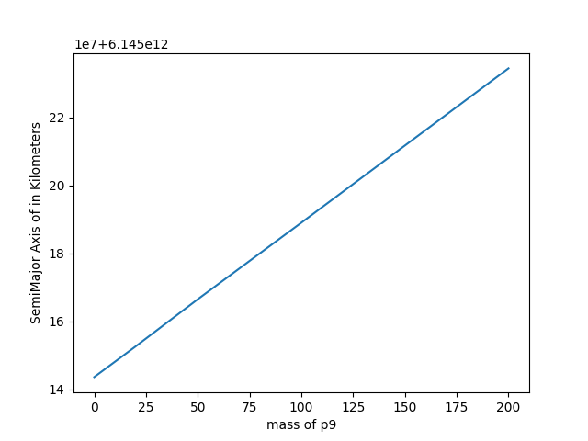
Data Preprocessing
We used code in order to process the data and figure out the relationships between the mass of Planet 9, and: the orbital period of Pluto, the eccentricity of Pluto, and the Semimajor Axis of Pluto.
All the relationships were extremely close to being linear
Given the Orbital Period curve, we can fit the data with linear regression (LMSE):

Slide 6
Conclusions
We researched the effects of a hypothetical Planet 9 on the objects of the Solar System.
We used a simulation to collect data for our study and processed it to find Pluto's orbital period, eccentricity, and semimajor axis with 5 separate masses of Planet 9.
Our findings were that the mass of Planet Nine had a directly proportional relationship to the eccentricity, orbital period, and the Semi-Major axis of Pluto.
This research can help us redefine what we know about the solar system if the existence of a 9th planet is further considered or confirmed in the future.
Further study can also use a similar approach to identify the mass and distance of Planet 9, given the real-time ground truth orbital information of other planets in the Kuiper belt.

Slide 7
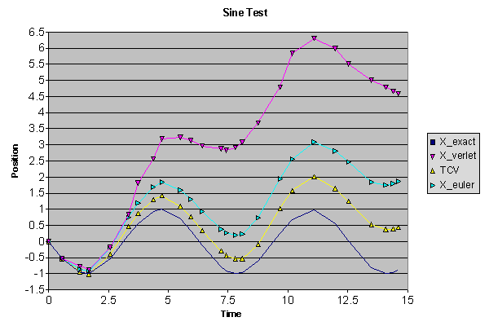
Future Directions
Here is a list of some things that could be done to further this research：
A more precise algorithm, such as Verlet Integration, can be used to calculate the movements of the Solar System objects.
Add more objects to a simulation of the Solar System, such as the rest of the Kuiper Belt
More accurate initial parameters should be added to the study, such as the z-axis.
Use the ground truth of movements observed in our Solar System to reach further conclusions.

Slide 8
Works Cited
Batygin, Konstantin, and Michael E. Brown. “EVIDENCE for a DISTANT GIANT PLANET in the SOLAR SYSTEM.” The Astronomical Journal, vol. 151, no. 2, 20 Jan. 2016, p. 22, arxiv.org/pdf/1601.05438.pdf, https://doi.org/10.3847/0004-6256/151/2/22.
Brown, Michael E, et al. “A Pan-STARRS1 Search for Planet Nine.” ArXiv (Cornell University), 31 Jan. 2024, https://doi.org/10.48550/arxiv.2401.17977. Accessed 30 Dec. 2024.
Naess, Sigurd, et al. “The Atacama Cosmology Telescope: A Search for Planet 9.” The Astrophysical Journal, vol. 923, no. 2, 1 Dec. 2021, p. 224, https://doi.org/10.3847/1538-4357/ac2307. Accessed 25 May 2022.
aromanro. “SolarSystem/README.md at Master · Aromanro/SolarSystem.” GitHub, 2016, github.com/aromanro/SolarSystem/blob/master/README.md.
Verlet, Loup. “Computer “Experiments” on Classical Fluids. I. Thermodynamical Properties of Lennard-Jones Molecules.” Physical Review, vol. 159, no. 1, 5 July 1967, pp. 98–103, https://doi.org/10.1103/physrev.159.98.

