Slide 1
Predictive Analysis for Enhanced Power Production in Combined-Cycle Plants
In a combined-cycle power plant, electricity is generated using a combination of gas turbines, steam turbines, and heat recovery steam generators (HRSG),The process typically starts with gas turbines burning fuel to generate electricity
Project by
Rakesh
Simran
Pavani
Manideep
Shiva
Pragathi,Keerthana
na

Slide 2
To model the energy generated in such a plant, various factors need to be considered. Variables such as exhaust vacuum, ambient temperature, pressure
1)Temperature (in degrees Celsius)
Room temperature: 20-25 degrees Celsius
Operational temperatures in power plants or industrial settings: 100-1000 degrees Celsius depending on the equipment and process.
2)Exhaust Vacuum (in cm Hg):
Low vacuum: Around 50-200 cm Hg
Higher vacuum: Closer to 0 cm Hg (absolute pressure)
3)Ambient Pressure (in millibar)

Slide 3
4)Relative Humidity (in percentage)
Desert regions: 10-30%
Coastal regions: 60-80%
Indoor environments: 30-60%
5)Energy Production (in MW, net hourly electrical energy output)
Small-scale plants: 1-100 MW
Large-scale utility plants: 100-1000+ MW

Slide 4

Exploratory Data Analysis
Welcome to the world of exploratory data analysis. This guide will take you through the essential steps to effectively explore and analyze data sets.

Slide 5

The Foundation
Data Collection
Data Cleaning
Gather raw data from various sources and ensure its accuracy and completeness.
Identify and handle missing or irrelevant data to prepare for analysis.
Exploratory Visualization
Create visualizations to understand the structure and patterns within the data.

Slide 6

Data Exploration Process
Data Exploration Steps
1.Import Python Libraries and Read Data Set.
2.Finding all Variables and Understanding Them.
3. Exploration of the Data
4.Visualizing and Analyzing Results.

Slide 7
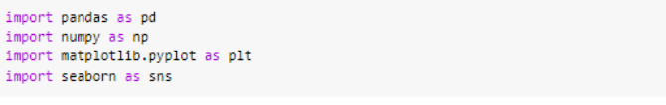
Import Python Libraries and Read Data Set.
Finding all Variables and Understanding them
First, import the necessary Python libraries such as Pandas, NumPy, and Matplotlib. Then, read the dataset using Pandas' 'read_csv' function and assign it to a variable for further analysis.
To find all variables in the dataset, you can use the columns attribute in Pandas, which will give you a list of all the column names. Once you have the list of variables, you can further understand them by examining their data types, range of values, and potential relevance to your analysis. This will help you gain a comprehensive understanding of the data before proceeding to the next steps of the data exploration process.

Slide 8
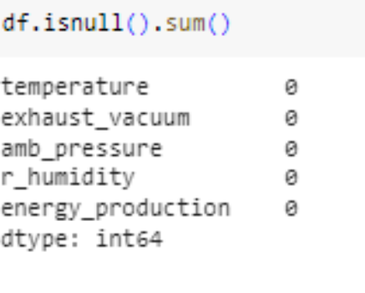
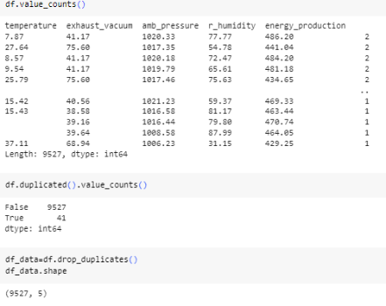
Checking null values and duplicates
Checking null values
Duplicates
and duplicates is an important step in data analysis. It helps ensure the quality and reliability of the data. By identifying and handling null values and duplicates, we can avoid biased or erroneous results.
Checking Duplicates to ensure that there are no duplicate values present in the dataset. If duplicates are present, we will remove or merge them accordingly to avoid any complications while analyzing data.

Slide 9
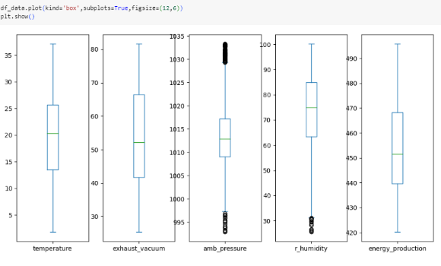
Checking Outliers
Checking for outliers in the dataset is an important step in data analysis. Outliers can significantly impact the results and interpretation of statistical analyses. It is crucial to identify and handle outliers appropriately, either by removing them or by using robust statistical techniques that are less sensitive to their influence.

Slide 10
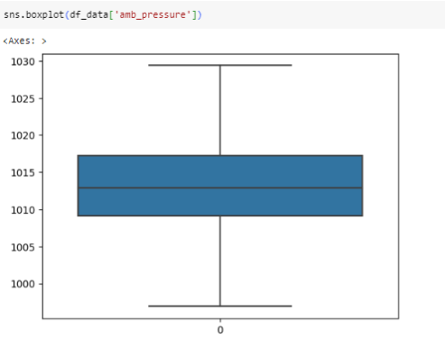
Removing Outliers
Removing outliers can be done by applying various techniques such as using statistical methods like z-score or interquartile range, or by setting thresholds based on domain knowledge. Once the outliers are identified, they can be either removed from the dataset or treated through imputation methods. It is important to carefully consider the impact of removing outliers on the overall analysis and ensure that the chosen approach aligns with the goals of the analysis.

Slide 11
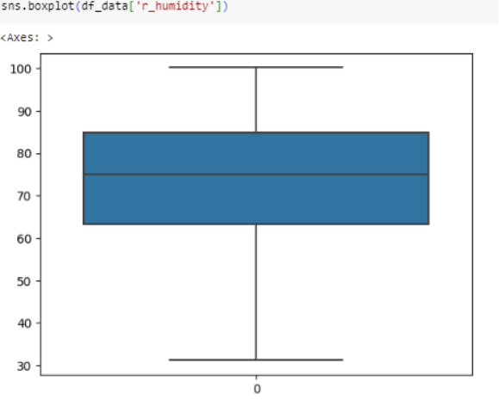
Removal of Outliers
However, it is important to keep in mind that removing outliers can also result in the loss of valuable information that could potentially affect the accuracy of the analysis. Furthermore, depending on the size of the dataset, the removal of outliers can significantly impact the overall results. Therefore, it is recommended to perform the analysis with and without the outliers and compare the results before making a final decision.

Slide 12
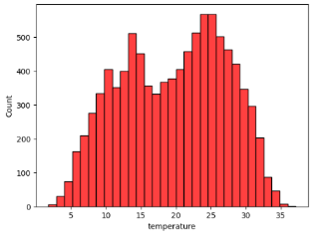
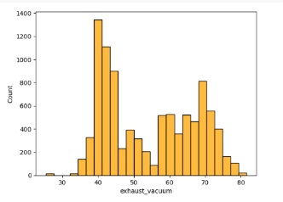
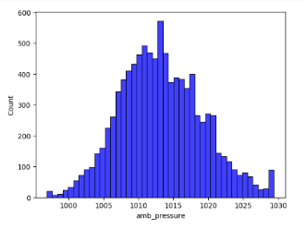
Visualization using Histogram
Histogram of temperature
Histogram of exhaust vacuum
Histogram of amb pressure
As can be seen from the histogram, temperature values are mostly concentrated in the range of 20-25 degrees Celsius. However, there are a few outliers that go beyond the range of 35 degrees Celsius. This emphasizes the importance of handling outliers before drawing any conclusions from the data.
As shown in the histogram, the distribution of the exhaust vacuum values appears to be relatively normal, with a peak around 40-45 units. There are no significant outliers or extreme values observed in the data. This suggests that the exhaust vacuum values are generally stable and consistent throughout the dataset.
As for the ambient pressure values, the distribution appears to be skewed to the right with a peak around 1000 units. There are a few outliers observed in the data that go beyond the range of 1100 units. It is important to handle these outliers before making any conclusions from the dataset.

Slide 13
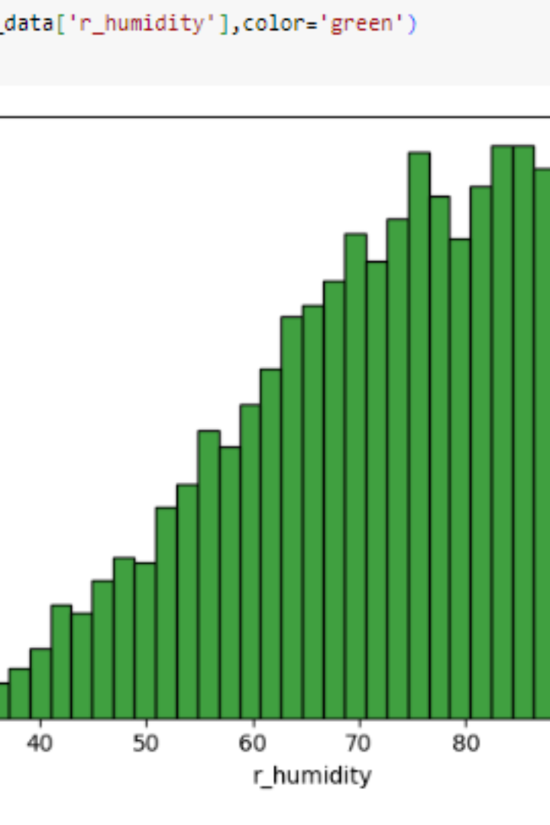
Histogram of R humidity
The histogram of relative humidity values shows a relatively even distribution, with no prominent peaks or skewness. The majority of the values fall within the range of 60-80%, indicating a fairly consistent level of humidity throughout the dataset. There are no significant outliers or extreme values observed in the data.

Slide 14
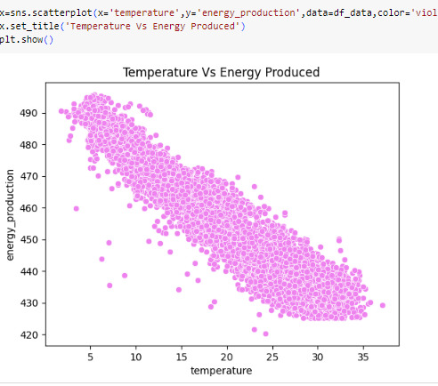
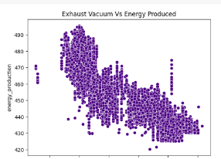
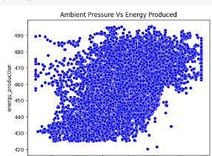
Visualization Using Scatterplot
On the other hand, the scatterplot between ambient pressure and energy production shows a negative correlation between the two variables. As ambient pressure increases, there is a decrease in energy production. This suggests that ambient pressure may have a significant impact on energy production and should be taken into consideration in future analyses.
Scatterplot between temperature and energy production
The scatterplot between temperature and energy production reveals a positive correlation between the two variables. As the temperature increases, there is a noticeable increase in energy production. Overall, the scatterplot suggests that temperature plays a significant role in determining energy production.
Scatterplot between exhaust vacuum and energy production
The scatterplot between exhaust vacuum and energy production does not show a clear pattern or relationship between the two variables. The data points are scattered across the plot without a noticeable trend. This suggests that exhaust vacuum may not be a strong determinant of energy production.
Scatterplot between ambient pressure and energy production

Slide 15
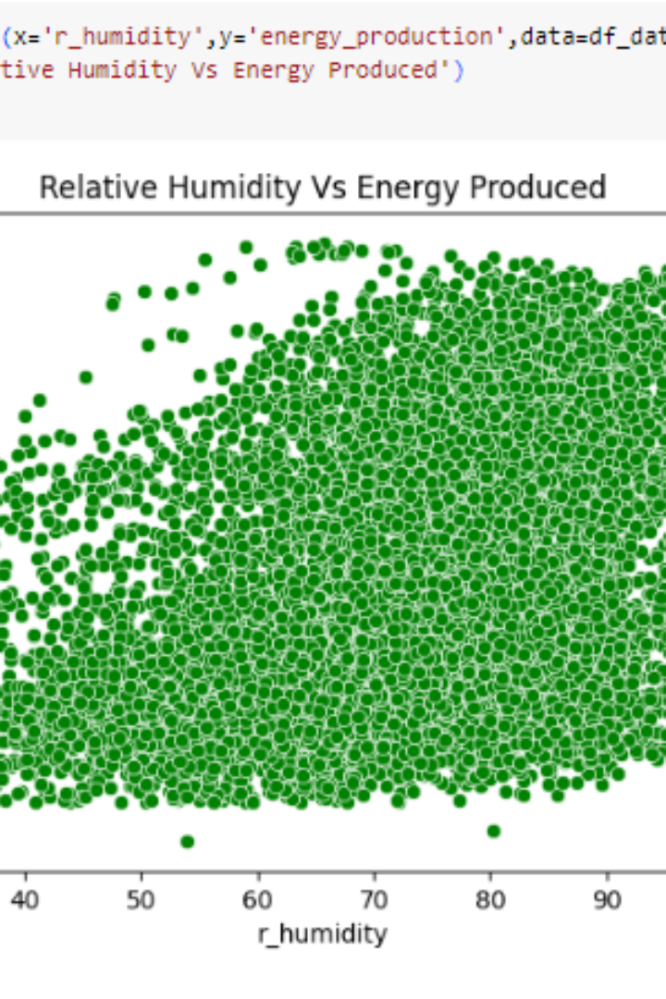
Scatterplot between relative humidity and energy production
The scatterplot between relative humidity and energy production does not reveal a clear relationship between the two variables. The data points appear to be randomly scattered across the plot, without any noticeable trend or pattern. This indicates that relative humidity may not be a strong determinant of energy production in this context.

Slide 16
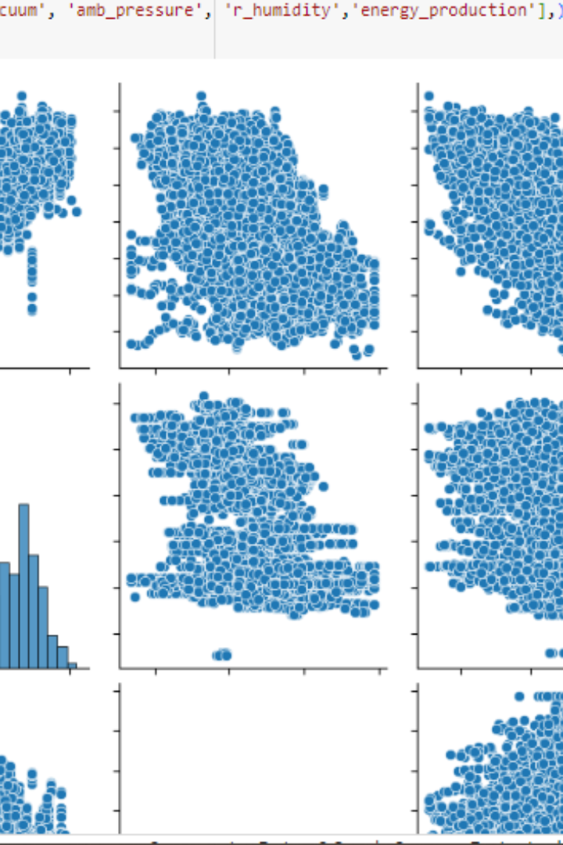
Pairplot
Pairplot is a visual representation that allows us to examine the relationships between multiple variables simultaneously. In this pairplot, we can observe the relationships between ambient pressure, relative humidity, and energy production. It provides a comprehensive view of how these variables interact with one another and their potential impact on energy production.

Slide 17
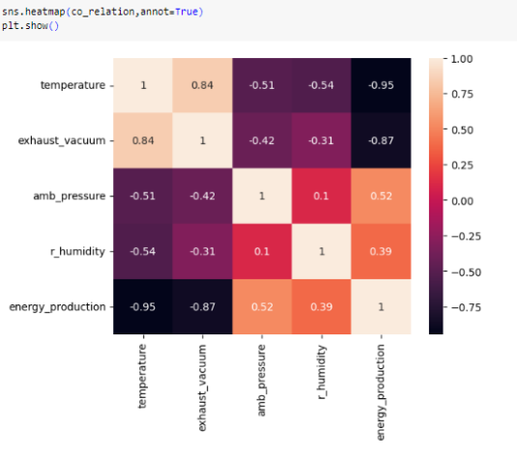
Heat Map of Co-Relation Values

