Slide 1




Usability of Anonymous Web Browsing: An Examination of Tor Interfaces and Deployability
Jeremy Clark¹, P.C. van Oorschot², and Carlisle Adams¹
Presented by Jeremy Clark
1
2

Slide 2
Introduction
A comparison of four deployment methods of Tor for Firefox:
Tor, Privoxy, and Vidalia
Torbutton
FoxyProxy
XeroBank (nee Torpark)
The walkthrough was completed in November 2006. Since then a few things have changed:
Tor now comes bundled with Torbutton.
Torpark is now XeroBank.

Slide 3
Anonymous Web Browsing
A few kinds of online identifiers:
Self-volunteered – pseudonym, screen-name, avatar, or email address.
Server-assigned – identifier inside a cookie or inside spyware.
Protocol-based - IP address.
Tor addresses 3 only. It uses a technique called onion routing.

Slide 4

Onion Routing in 30 seconds
© CBS 2006. Used under the fair dealings clause in the Canada Copyright Act .

Slide 5
A Mental Model
Firefox
http, https, ftp, etc
Privoxy
SOCKS
Tor
Vidalia
Internet

Slide 6
A Mental Model
Firefox
Torbutton/FoxyProxy
http, https, ftp, etc
Privoxy
SOCKS
Tor
Vidalia
Internet

Slide 7
A Mental Model
XeroBank
Tor
Internet

Slide 8
Why Tor?
In most security applications, your security is dependent only on your own ability to use the software.
In Tor, your anonymity is dependent on both your own ability to use the software and the ability of other users.
Finding ways to improve the usability of Tor benefits everyone on the network.
The target user of Tor: anyone.

Slide 9
Cognitive Walkthrough
A cognitive walkthrough is a task-oriented evaluation method.
Premised on a pragmatic user.
Cognitive walkthroughs allow for evaluation of complex tasks and broad comparisons not possible in user studies (due to finite time and finite resources).
Walkthrough was performed by the first author.

Slide 10
Core Tasks
We used four core tasks:
Successfully install Tor and the components in question.
Successfully configure the Firefox browser to work with Tor and the components.
Confirm that the web-traffic is being anonymised.
Successfully disable Tor and return to a direct connection.

Slide 11
Deployment and Usability
Installation & Configuration
Software

Slide 12
Deployment and Usability
Installation & Configuration
Software

Slide 13
Usability Guidelines
The set of evaluation guidelines, derived from a variety of sources:
Users should be aware of the steps they have to perform to complete a core task.
Users should be able to determine how to perform these tasks.
Users should know when they have successfully completed a core task.
Users should be able to recognize, diagnose, and recover from non-critical errors.
Users should not make dangerous errors from which they cannot recover.

Slide 14
Dangerous Errors
Users should not make dangerous errors from which they cannot recover:
False sense of completion.
DNS leaks.
Applets, Flash, and client-side scripting can be exploited.

Slide 15
Usability Guidelines
The set of evaluation guidelines, derived from a variety of sources:
Users should be aware of the steps they have to perform to complete a core task.
Users should be able to determine how to perform these tasks.
Users should know when they have successfully completed a core task.
Users should be able to recognize, diagnose, and recover from non-critical errors.
Users should not make dangerous errors from which they cannot recover.
Users should be sufficiently comfortable with the interface to continue using it.
Users should be aware the application’s status at all times.
Notes:
Make clear borrowed and contribution…

Slide 16
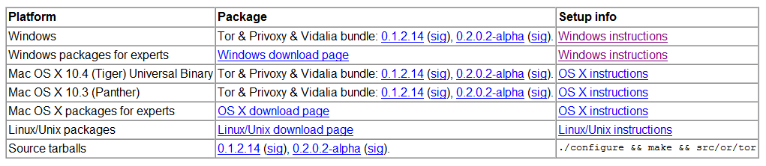
Tor Installation (Task 1)
Tor is available from tor.eff.org.
Development, experimental, alpha used interchangeably.
Wizard-style installation. It is however scarce on information (for example, there is no indication what Vidalia is).
Last dialogue: “Please see http://tor.eff.org/docs/tor-doc-win32.html to learn how to configure your applications to use Tor.”
Notes:
Solution -> put version at top. Solution -> add info to webpage and to installation wizard.

Slide 17
Manual Configuration (Task 2)
Manually configuring Tor requires a guide with inter-application documentation.
The documentation informs the user what Vidalia and Privoxy are, however this would be more useful before installation.
The documentation offers, “to Torify ... applications that support HTTP proxies, just point them at Privoxy (that is, localhost port 8118)” and also links to a second document: “How To Torify.”
The second document uses unfamiliar language and offers two methods of configuring Firefox. Its unclear to the novice user which method should be pursued (and the intended method is listed second).
Notes:
First method-> about:config... Second uses menu options...

Slide 18
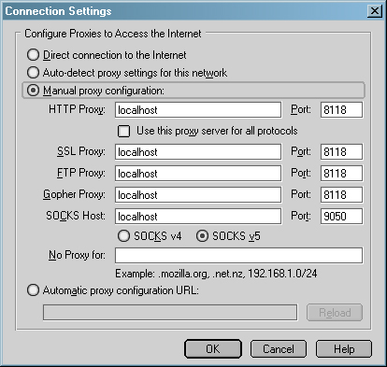
Configuring Firefox
Two options:
Set HTTP and use this proxy for all protocols.
Specify each individually.
Both are suggested but not distinguished.
Notes:
Which one? Not equivalent (see SOCKS Host).

Slide 19
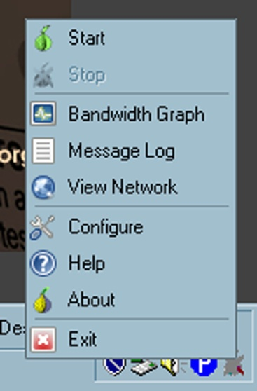
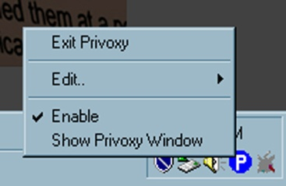
Running Applications
By default, Vidalia and Privoxy auto-start at boot time. If they did not, it would be unclear what applications a user needs to run.
Privoxy is enabled by default.
Vidalia is stopped by default.
Notes:
Tor.exe is not needed but is installed, in the start menu, and is the one app you would think you would need to run...

Slide 20
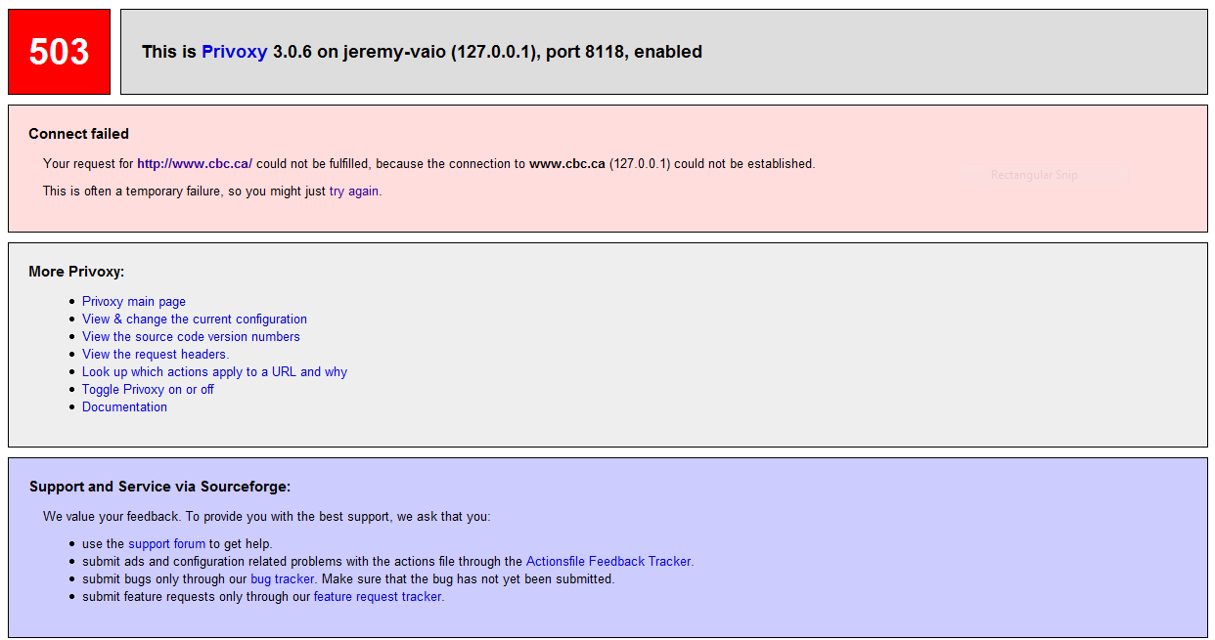
Errors
Privoxy enabled, Tor stopped.

Slide 21
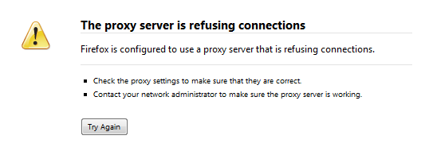
Errors
Tor started, Privoxy disabled.

Slide 22



Manual Configuration (Task 2)
Vidalia visual cues:
Two-factor cue. Color changes, consistent with traffic lights. A visual X appears when stopped.
Privoxy does not change from enabled to disabled. However it spins when traffic is being accessed through it.

Slide 23
Manual Configuration
Task 3 (Determining correct configuration): Document links to a Tor detector website.
Task 4 (Disabling Tor): Correct method is to change Firefox settings back. However there is no documentation on how to do this on either configuration page.
Disabling Vidalia or Privoxy or both will result in an error rendering Firefox unusable.

Slide 24

Torbutton (w/ Tor, Vidalia, & Privoxy)
Task 1: Installation of Tor, Privoxy, and Vidalia is the same. Torbutton installs as a Firefox extension.
Task 2&4: Does not require the Firefox configuration step. Torbutton enables and disables Tor with a click on the cue. The cue is dual factor: text-based (“Tor Disabled/Enabled”) and color-based (red and green).
Users may still try and disable Vidalia or Privoxy.
Notes:
Too easy to disable?

Slide 25
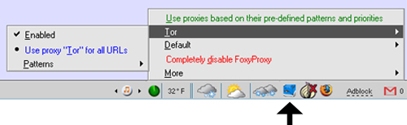
FoxyProxy (w/ Tor and Vidalia)
Task 1,3,4: Same as Torbutton
except slight harder toggling.
Task 2: FoxyProxy includes
a setup dialogue:
Configure FoxyProxy for use with Tor?
Use Tor with or without Privoxy?
Asks for Tor's local port number and states, “if you don't know, use the default,” which is port 9050.
“Would you like the DNS requests to go through the Tor network? If you don't understand this question, click yes.”
Alerts user to ensure Tor is running.
Notes:
4. When wouldn’t you? Communicates information

Slide 26
XeroBank
Task 1: Has one clearly marked version for installation and is a stand-alone application.
Task 2: Upon running, the following message is displayed:
Torpark secures the anonymity of your connection, but not the data you send. DO NOT use identity compromising information such as your name, login, password, etc. unless you see a closed padlock icon at the bottom status bar of the browser. Torpark should not be run on untrusted computers, as they may have malware or keystroke logging software secretly installed.
Notes:
Intended purpose, bundled together, usb stick,

Slide 27
XeroBank
Task 3: XeroBank comes with NoScript, Torbutton, and an IP display enabled by default.
XeroBank is the only application that attempts to prevent the dangerous errors associated with Java and scripting. However it does so by introducing new usability problems.
Task 4: Tor can be disabled with Torbutton or by simply returning to a standard browser.

Slide 28
Comparison and Summary
 | Installation | Configuration | Verification | Disabling
Manual Config | Difficult | Very Difficult | Easy | Very Difficult
Torbutton | Difficult | Easy | Easy | Very Easy
FoxyProxy | Difficult | Very Easy | Easy | Easy
XeroBank | Very Easy | Very Easy | Very Difficult | Very Easy

Slide 29
Concluding Remarks
Set-up dialogues are useful for communicating information for complex configurations.
Common language should be arrived upon through user interaction.
Default actions should be carefully considered and promote the completion of core-tasks.
Notes:
Extensions work better than manual config…

Slide 30
Concluding Remarks
Documentation should be collected in one place, and be as task-oriented as possible.
Java and client-side scripting exploits do not have a usable solution. Disabling applets and/or scripts can make webpages non-functional, while leaving them enabled is dangerous.
Inter-application configuration is difficult in terms of usability, and in terms of security while maintaining compatibility.

Slide 31
Questions?

