Slide 1
On the Security of Ballot Receipts in E2E Voting Systems
Jeremy Clark, Aleks Essex, and Carlisle Adams
Presented by Jeremy Clark

Slide 2
Introduction
A comparison of useful information leaked by ballot receipts in three E2E systems:
ThreeBallot
Prêt à Voter
Punchscan
Full Disclosure: First and second authors are members of the Punchscan team. Attach due scepticism.
On the Security of Ballot Receipts in E2E Voting Systems

Slide 3
No Information
A ballot receipt should satisfy the following two properties:
Privacy Property: The ballot receipt should provide no information that would increase an adversary’s ability to determine how the ballot was cast.
Integrity Property: The ballot receipt should provide no information that would increase an adversary’s ability to add, delete, or modify ballots without detection.
On the Security of Ballot Receipts in E2E Voting Systems

Slide 4
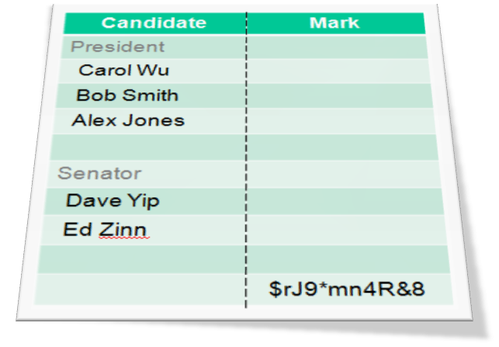
Prêt à Voter
Chosen: a random permutation.
Choose a candidate.
Does 1 reveal information about 2?
On the Security of Ballot Receipts in E2E Voting Systems

Slide 5
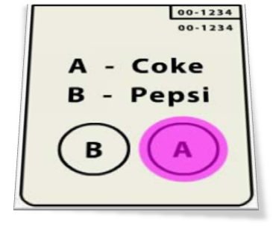
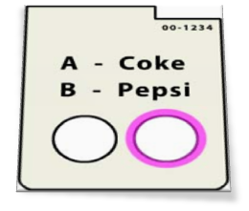
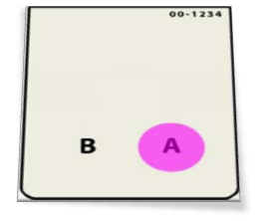
Punchscan
Chosen: a random permutation on top sheet.
Chosen: a random permutation on bottom sheet.
Choose a candidate.
Does 1&2 reveal information about 3?
On the Security of Ballot Receipts in E2E Voting Systems

Slide 6
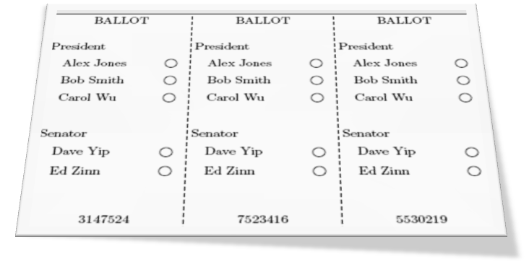
ThreeBallot
Choose a candidate.
Choose a marking pattern to vote for that candidate.
Choose a ballot to keep as a receipt.
Do 2&3 reveal information about 1?
R. Rivest. Public Domain
On the Security of Ballot Receipts in E2E Voting Systems

Slide 7
“No” Information
Privacy Property: The ballot receipt should provide no information that would increase an adversary’s ability to determine how the ballot was cast.
What does “no information” mean?
Insufficient information – receipt cannot be used in any manner to prove with certainty the cast vote of its respective ballot.
Negligible information – receipt cannot be used in any manner to guess with better than random probability the cast vote of its respective ballot.
On the Security of Ballot Receipts in E2E Voting Systems

Slide 8
Attack Game
To test for ‘guess with better than random probability’ information, we implement an attack game.
Random Voting Oracle – randomly selects a candidate to vote for and produces a ballot receipt based on random choices for each of the dynamic elements of a ballot.
On the Security of Ballot Receipts in E2E Voting Systems

Slide 9
Prêt à Voter
Chosen: a random permutation.
Choose a candidate.
Does 1 reveal information about 2?
On the Security of Ballot Receipts in E2E Voting Systems

Slide 10
Punchscan
Chosen: a random permutation on top sheet.
Chosen: a random permutation on bottom sheet.
Choose a candidate.
Does 1&2 reveal information about 3?
On the Security of Ballot Receipts in E2E Voting Systems

Slide 11
ThreeBallot
Choose a candidate.
Choose a marking pattern to vote for that candidate.
Choose a ballot to keep as a receipt.
Do 2&3 reveal information about 1?
R. Rivest. Public Domain
On the Security of Ballot Receipts in E2E Voting Systems

Slide 12
Attack Game
To test for ‘guess with better than random probability’ information, we implement an attack game.
Random Voting Oracle – randomly selects a candidate to vote for and produces a ballot receipt based on random choices for each of the dynamic elements of a ballot.
Adversary – guesses which candidate was voted for based on the ballot receipt alone. Assumed to be PPT-bounded.
Advantage – if the adversary can guess with better probability than a random choice, this is the adversary’s advantage.
On the Security of Ballot Receipts in E2E Voting Systems

Slide 13
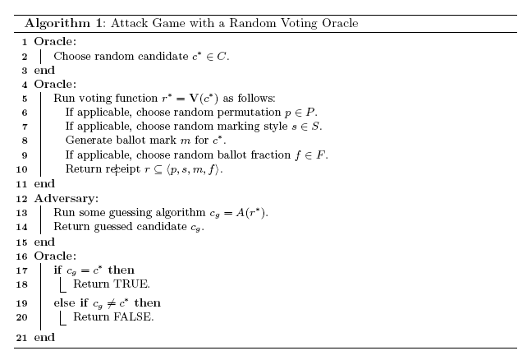
Attack Game (2)
On the Security of Ballot Receipts in E2E Voting Systems

Slide 14

Advantage
This is the weakest adversary possible. She only has access to the marks themselves. This is necessary but not sufficient for provable security.
The way to a provably secure voting system:
Psuedorandom Permutations
Serial Numbers or Cryptographic Onions
Bulletin Board
Election Results
Other Audit Information
On the Security of Ballot Receipts in E2E Voting Systems

Slide 15
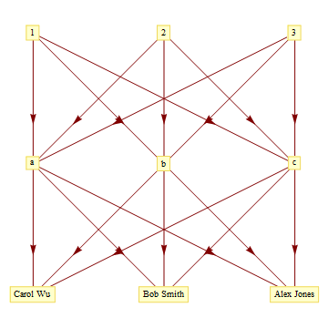
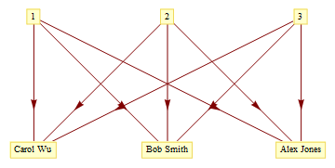


Prêt à Voter and Punchscan
Prêt à Voter
Punchscan
On the Security of Ballot Receipts in E2E Voting Systems

Slide 16
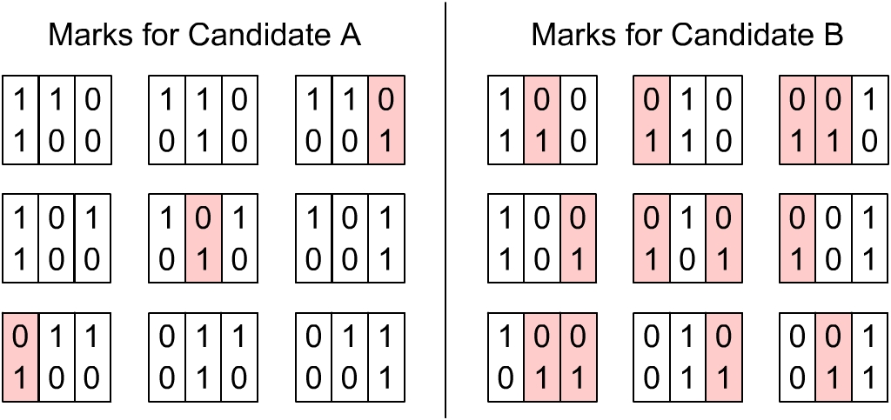
ThreeBallot
On the Security of Ballot Receipts in E2E Voting Systems
Notes:
No subset

Slide 17
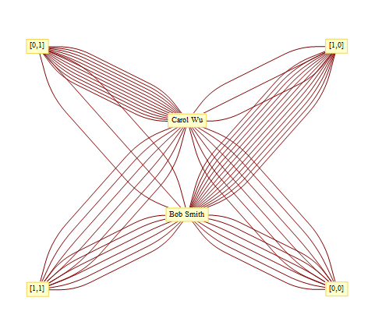
ThreeBallot (2)
On the Security of Ballot Receipts in E2E Voting Systems
Notes:
Greedy Search -> Adversary’s algorithm

Slide 18
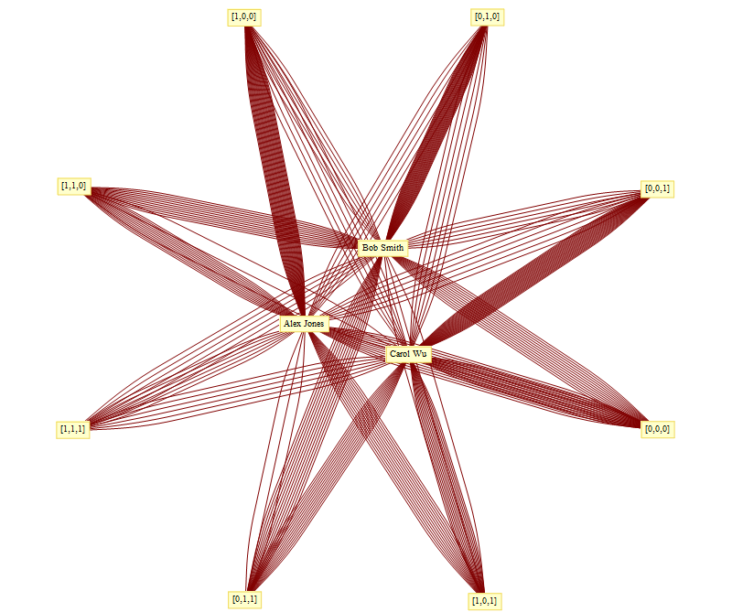
On the Security of Ballot Receipts in E2E Voting Systems
Notes:
Greedy Search -> Adversary’s algorithm

Slide 19
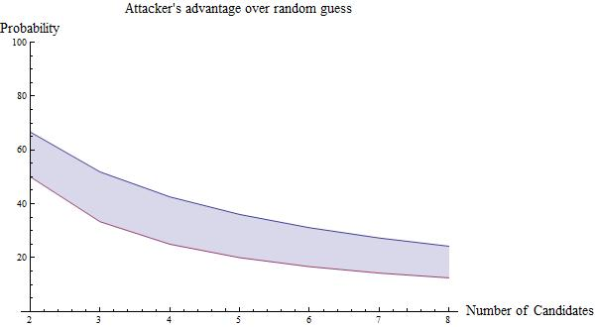
Advantage
On the Security of Ballot Receipts in E2E Voting Systems

Slide 20
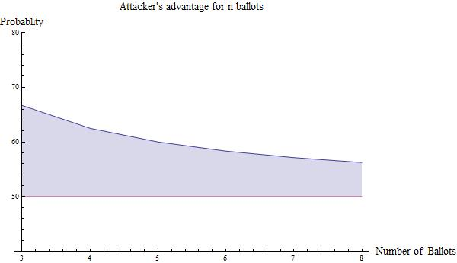
Advantage (2)
On the Security of Ballot Receipts in E2E Voting Systems

Slide 21
Integrity
Integrity Property: The ballot receipt should provide no information that would increase an adversary’s ability to add, delete, or modify ballots without detection.
Cost-Benefit Analysis: The probability of getting caught tampering with election results can be thought of as a cost to the adversary. What tampering with an election achieves can be thought of as a benefit.
On the Security of Ballot Receipts in E2E Voting Systems

Slide 22
Cost
In ThreeBallot, each receipt has a serial number. If the adversary sees a receipt or copy of one, she will not modify the corresponding ballot on the bulletin board when choosing a ballot to tamper with. This decreases her probability of getting caught, thus receipts leak partial information useful to the attacker.
If the adversary she’s all the receipts, her probability of getting caught is zero. ThreeBallot’s integrity checking is an improper cut-and-choose protocol.
This problem does not arise in Prêt à Voter or Punchscan because all the inputs to the tallying function are receipts.
On the Security of Ballot Receipts in E2E Voting Systems
Notes:
Traditional view -> Can’t keep, can see.

Slide 23
Benefit
In Prêt à Voter and Punchscan, the best an adversary can hope to achieve is apply a random mapping between which candidate was voted for and which candidate gets the vote.
In ThreeBallot, an adversary can explicitly take a vote away from one candidate and give it to another candidate.
So ThreeBallot has both a lower cost and a greater benefit to an adversary mounting an integrity attack. In the special case, where the adversary sees every receipt, the cost is zero.
On the Security of Ballot Receipts in E2E Voting Systems

Slide 24
Conclusions
Privacy Property: The ballot receipt should provide no information that would increase an adversary’s ability to determine how the ballot was cast.
Integrity Property: The ballot receipt should provide no information that would increase an adversary’s ability to add, delete, or modify ballots without detection.
ThreeBallot receipts fail to meet both criterion.
On the Security of Ballot Receipts in E2E Voting Systems

Slide 25
Future Work
The way to a provably secure voting system:
Marks Only
Psuedorandom Permutations
Serial Numbers or Cryptographic Onions
Bulletin Board
Election Results
Other Audit Information
On the Security of Ballot Receipts in E2E Voting Systems

Slide 26
Future Work
The way to a provably secure voting system:
Marks Only
Psuedorandom Permutations
Serial Numbers or Cryptographic Onions
Bulletin Board
Election Results
Other Audit Information
Punchscan
On the Security of Ballot Receipts in E2E Voting Systems

Slide 27
Future Work
The way to a provably secure voting system:
Marks Only
Psuedorandom Permutations
Serial Numbers or Cryptographic Onions
Bulletin Board
Election Results
Other Audit Information
Prêt à Voter, Punchscan, & ThreeBallot
On the Security of Ballot Receipts in E2E Voting Systems

Slide 28
Future Work
The way to a provably secure voting system:
Marks Only
Psuedorandom Permutations
Serial Numbers or Cryptographic Onions
Bulletin Board
Election Results
Other Audit Information
Combine partial information from ballot receipts to the Strauss attack on ThreeBallot. Also loosen the Strauss attack to be probabilistic.
Prêt à Voter, Punchscan, & ThreeBallot
On the Security of Ballot Receipts in E2E Voting Systems

Slide 29
Future Work
The way to a provably secure voting system:
Marks Only
Psuedorandom Permutations
Serial Numbers or Cryptographic Onions
Bulletin Board
Election Results
Other Audit Information
Prêt à Voter, Punchscan, & ThreeBallot
On the Security of Ballot Receipts in E2E Voting Systems

Slide 30
Future Work
The way to a provably secure voting system:
Marks Only
Psuedorandom Permutations
Serial Numbers or Cryptographic Onions
Bulletin Board
Election Results
Other Audit Information
Prêt à Voter & Punchscan
On the Security of Ballot Receipts in E2E Voting Systems
Notes:
Provable Security -> does not implied side-channel (i.e., active) attacks.

Slide 31
Questions?
On the Security of Ballot Receipts in E2E Voting Systems

