Slide 1

On Combating Adverse Selection in Anonymity Networks.
Jeremy Clark
CACR Seminar
October 17, 2007

Slide 2
On Combating Adverse Selection in Anonymity Networks.

Slide 3
On Combating Adverse Selection in Anonymity Networks.

Slide 4
Anonymity Networks.
Adverse Selection.
Three Methods to Combat It:
  Exit Node Repudiation,
  Revocable Access,
  Usability.

Slide 5
Anonymity Online
A few kinds of online identifiers:
Self-volunteered – pseudonym, screen-name, avatar, or email address.
Server-assigned – identifier inside a cookie or spyware.
Protocol-based - IP address.
Primary Function of Anonymity Networks: 3.

Slide 6
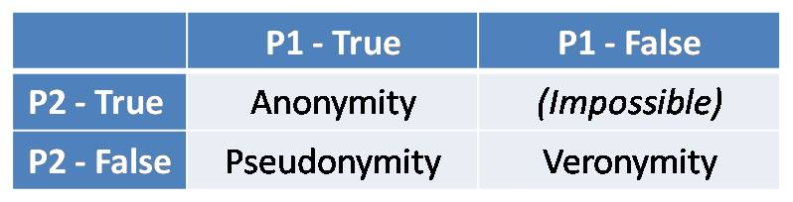
Anonymity
P1: an action is not linkable to the identity of the actor.
P2: two actions performed by the same actor are not linkable to each other.

Slide 7
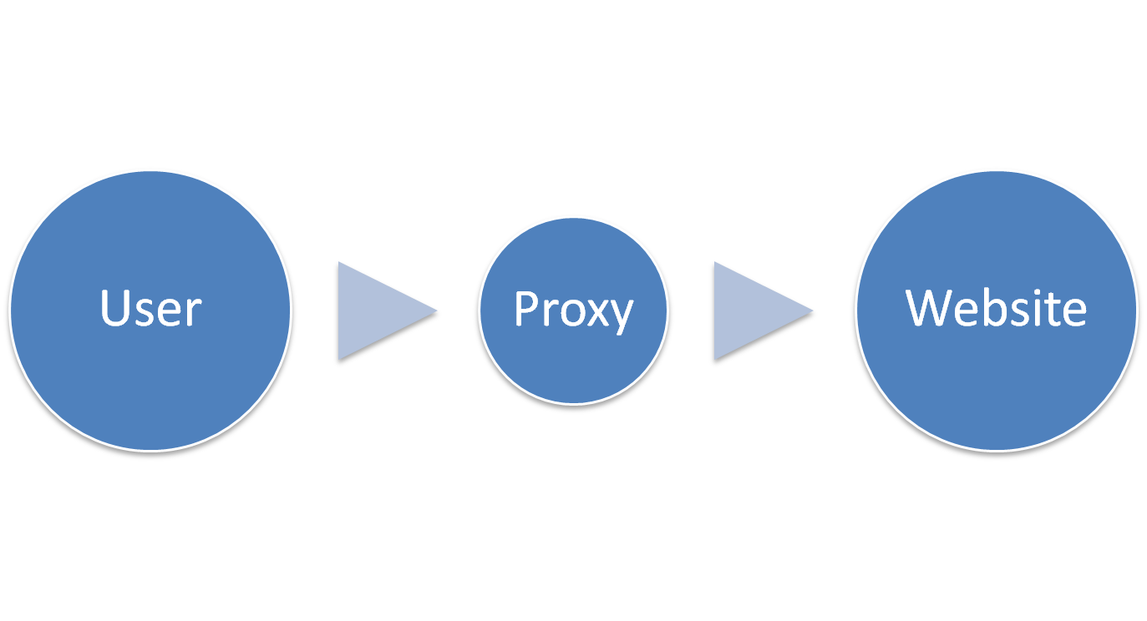
Proxy Model

Slide 8
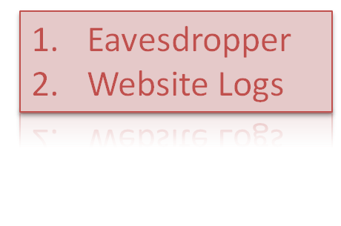

Slide 9
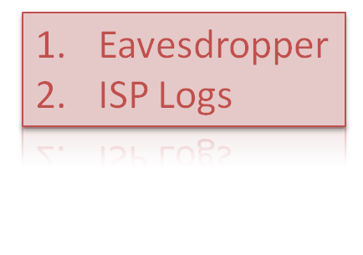

Slide 10
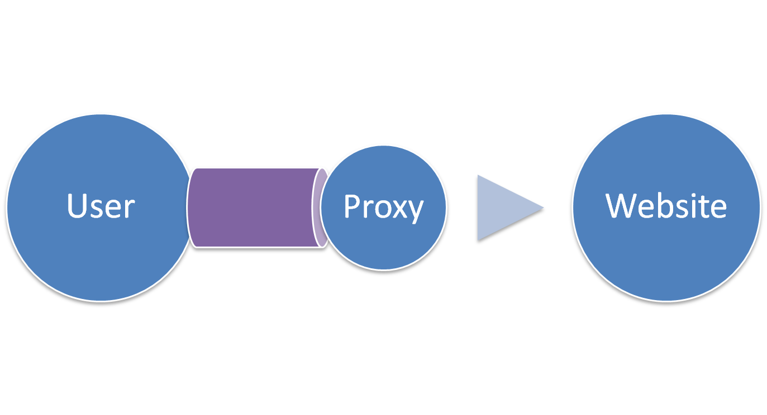

Slide 11
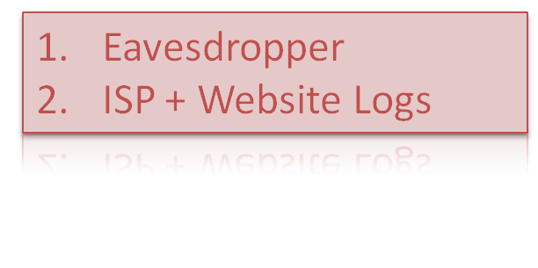

Slide 12
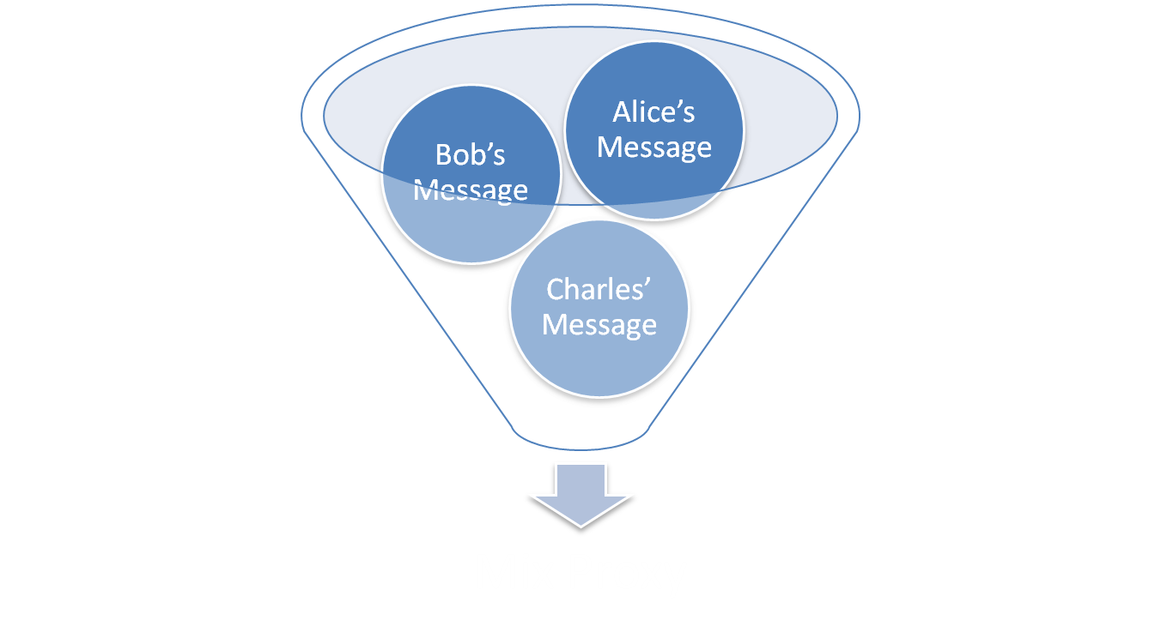

Slide 13
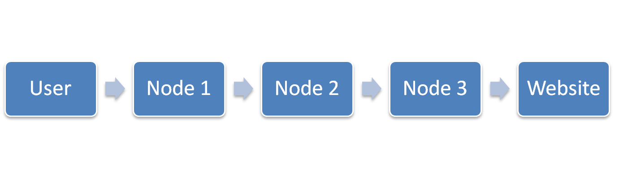
Node 4
Node 7
Node 5
Node 6

Slide 15
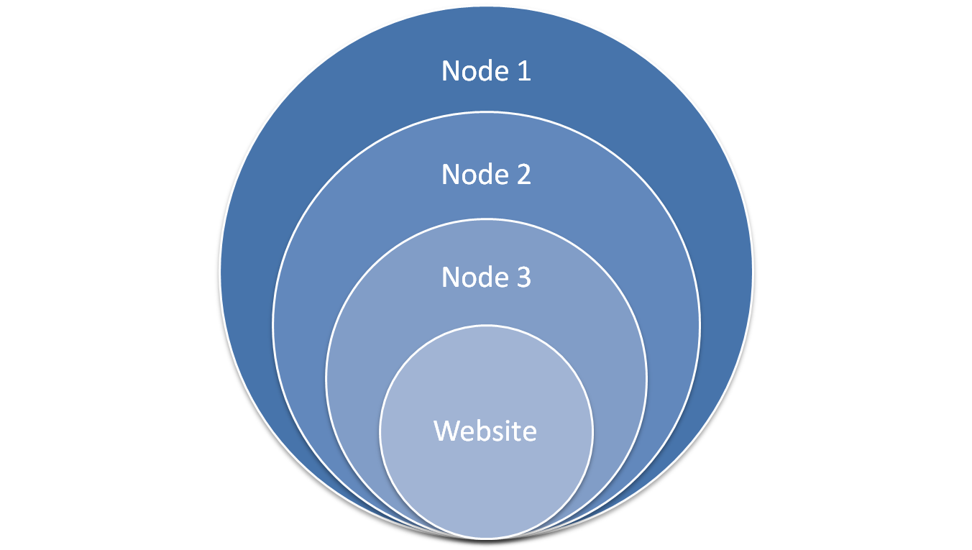
An “Onion”

Slide 16
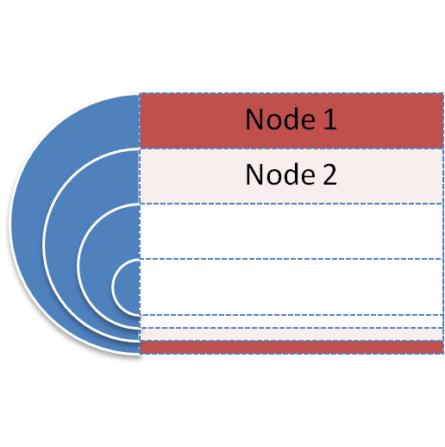
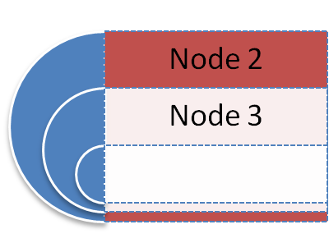
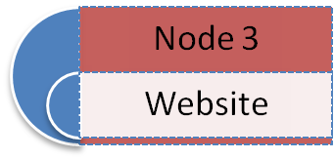

Node 1
Node 2
Node 3

Slide 17

Onion Routing in 30 seconds
© CBS 2006. Used under the fair dealings clause in the Canada Copyright Act .

Slide 18
The Legal Horizon
Criminal Liability
Regulation (Key escrow)
Civil Liability
Server Seizure (“Will afford evidence” clause)

Slide 19
Economics of Information Security
Economic premise: Humans are rational agents who respond to incentives.
A market need not involve money, just agents who respond to incentives.
Hypothesis: An anonymity network is a market with asymmetrical information.

Slide 20
Asymmetrical Information
Problems:
Adverse Selection [George Akerlof]
Moral Hazard [George Akerlof]
Prevention:
Signalling [Michael Spence]
Screening [Joseph Stiglitz]

Slide 21
Asymmetrical Information is an example of a market failure.
As an example, consider the market for life insurance.

Slide 22
Selection: high risk individuals are more likely to buy life insurance.
Adverse Selection: these individuals are more likely to cost the insurance company money.
Moral Hazard: once insured, individuals may increase their own risk.
Market Failure: raise prices, and the lower risk individuals will be the first to leave.

Slide 23
Economics of Anonymity Networks
The transaction: A service is provided by the operators in the anonymity network to the user.
Cost/Benefit: An operator gets certain benefits from running a node (altruism, research, spying, etc) but may incur a cost in the case of an unlawful message.
Asymmetry: The sender knows whether they will impose this cost as a result of the transaction; the operator does not.

Slide 24
Anonymity networks: unlawful users have a high incentive for anonymity, and users tend to behave differently when anonymous.

Slide 25
Elasticity: no insurance is easily substituted for overpriced insurance. Consider lowering prices.
The “price” of anonymity can be lowered by increasing usability and increasing speed.

Slide 26
Screening/Signalling: insurance companies can try and differentiate between high and low risk consumers.
Reputation is a good signal for anonymity networks. Users who misbehave could be banned (but how would we know who they are if they are anonymous?).

Slide 27
Causalities of Adverse Selection: exit nodes get wrongfully blamed for unlawful messages. We need a legally sound protocol for exit nodes to repudiate originating the message (but how could they do that if the originator is anonymous?).

Slide 28
Contributions
Exit Node Repudiation,
Revocable Access,
Usability.

Slide 29
Previous Work
Selective Traceability: Users join a group with an identity, and use an anonymous group signature to sign their messages. The anonymity can be revoked by a trustee or threshold of trustees. [Von Ahn, Bortz, Hopper, O’Neill 06]

Slide 30
Previous Work
Robust Mix Network: Prove the output set is a perfect permutation of the input set without revealing the permutation. [Jakobsson, Juels, Rivest 02]
Drawbacks: Slow and requires re-encryption.

Slide 31
Previous Work
Reputable Mix Network: Users get a blind signature on their message before sending it, to prove the message came ‘in the front door.’ [Golle 04]
Drawbacks: Operators should be able to mix in their own traffic; Requires a signature per message; If blind signature is valid, we have repudiation but if it is not valid we do not have non-repudiation.

Slide 32
Exit Node Repudiation
Alice
IP Address
N1
Anonymous and Signed Credential
Alice
Credential
N3
Proof IP_{A} ≠ IP_{EN}

Slide 33
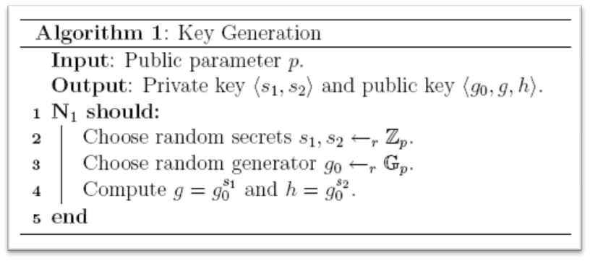
Key Generation

Slide 34
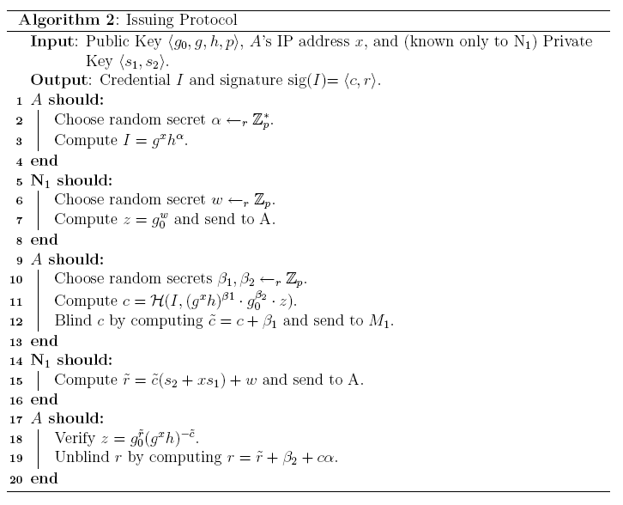
Issuing Protocol

Slide 35
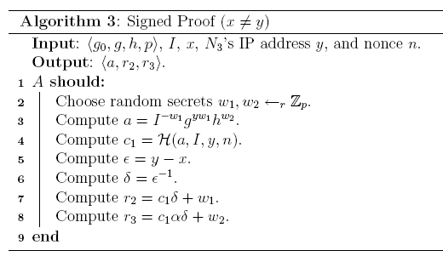
Signed Proof

Slide 36
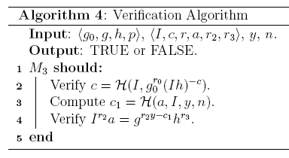
Verification

Slide 37
Exit Node Repudiation
Alice
IP Address
Entrance Node
Anonymous and Signed Credential
Alice
Credential
Exit Node
Proof IP_{A} ≠ IP_{EN}

Slide 38
Exit Node Repudiation
Alice
IP Address
Law Enforcement
Anonymous and Signed Credential
Alice
Credential
Exit Node
Proof IP_{A} ≠ IP_{EN}

Slide 39
Contributions
Exit Node Repudiation,
Revocable Access,
Usability.

Slide 40
Trust in Reputation Systems
Reputation Systems: Trust is dual factor.
Users trust the servers to not break anonymity.
Interested party trust the server to actually revoke access.

Slide 41
Previous Work
Reputation Systems: Trust is dual factor.
Users trust the servers to not break anonymity.
Interested party trust the server to actually revoke access.

Slide 42
NYMBLE Revisted
In NYMBLE, the revocable process preserves privacy but it does not provide integrity.
Note that integrity is likely outside the intention of NYMBLE, but for our slightly different application we require integrity.

Slide 43
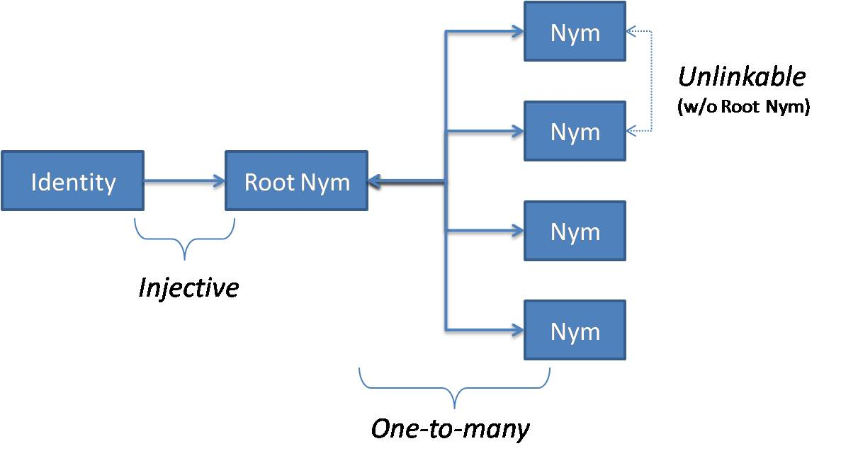
A Modified Architecture
Authentication Server (AS) – Injective
Access Control Server (ACS) – One to Many

Slide 44
Revocable Access
Alice
IP Address
AS - Law Enforcement
<MAC(IP)> in a Credential
<MAC(IP)>
Alice
<MAC(IP)>
ACS - Network Server

Slide 45
Revocable Access
Alice
IP Address
AS - Law Enforcement
<MAC(IP)> in a Credential
<MAC(IP)>
Cred Batch
Alice
<MAC(IP)>
ACS - Network Server
Credentials

Slide 46
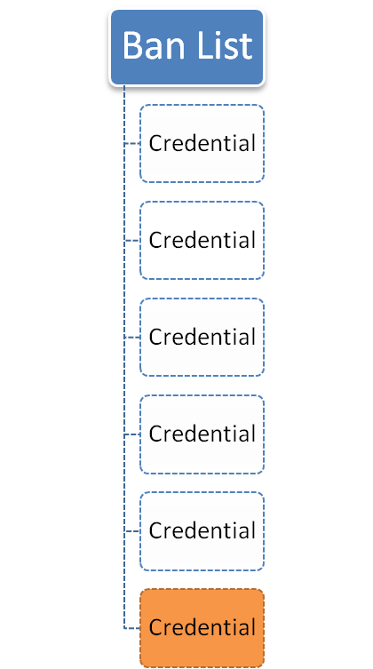
Adding to Ban List
Same IP
Credential

Slide 47
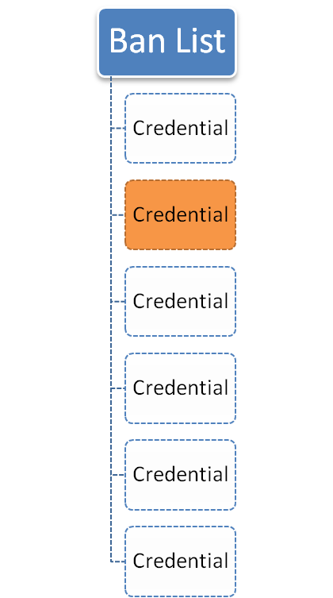
Challenging the Ban List
Different IP
Credential

Slide 48
Combining Credentials
Multiply together both I’s (both parties):
Calculate new alpha:

Slide 49
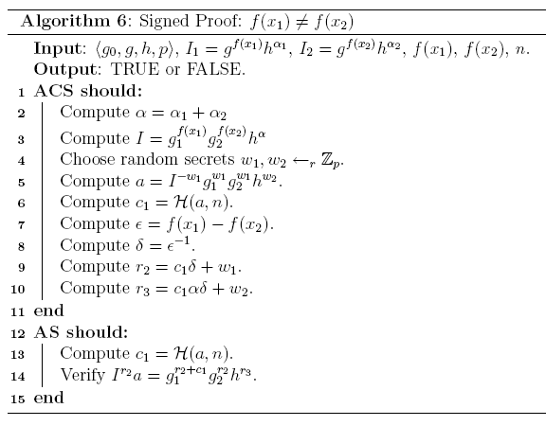
Signed Proof

Slide 50
Contributions
Exit Node Repudiation,
Revocable Access,
Usability.

Slide 51
Deployability
We conducted a usability study of Tor, the largest anonymity network.
We examined the task of configuring Firefox to use Tor through:
Manual Configuration,
Torbutton – an extension,
FoxyProxy – an extension,
XeroBank (nee Torpark) – a standalone browser.

Slide 52




A Mental Model
Firefox
http, https, ftp, etc
Privoxy
SOCKS
Tor
Vidalia
Internet

Slide 53

A Mental Model
Firefox
Torbutton/FoxyProxy
http, https, ftp, etc
Privoxy
SOCKS
Tor
Vidalia
Internet

Slide 54
A Mental Model
XeroBank
Tor
Internet

Slide 55
Core Tasks
We used four core tasks:
Successfully install Tor and the components in question.
Successfully configure the Firefox browser to work with Tor and the components.
Confirm that the web-traffic is being anonymised.
Successfully disable Tor and return to a direct connection.

Slide 56
Usability Guidelines for Tor
Users should be aware of the steps they have to perform to complete a core task.
Users should be able to determine how to perform these tasks.
Users should know when they have successfully completed a core task.
Users should be able to recognize, diagnose, and recover from non-critical errors.
Users should not make dangerous errors from which they cannot recover.
Users should be sufficiently comfortable with the interface to continue using it.
Users should be aware the application’s status at all times.
Notes:
Make clear borrowed and contribution…

Slide 57
Dangerous Errors
Users should not make dangerous errors from which they cannot recover:
  False sense of completion.
  DNS leaks.
  Applets, Flash, and client-side scripting can be exploited.

Slide 58
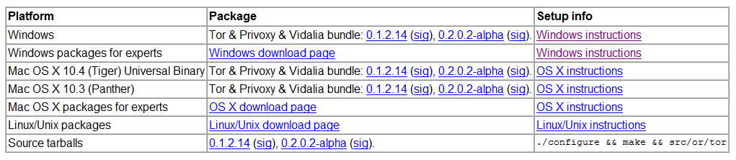
Tor Installation (Task 1)
Tor is available from tor.eff.org.
Development, experimental, alpha used interchangeably.
Wizard-style installation. It is however scarce on information (for example, there is no indication what Vidalia is).
Last dialogue: “Please see http://tor.eff.org/docs/tor-doc-win32.html to learn how to configure your applications to use Tor.”
Notes:
Solution -> put version at top. Solution -> add info to webpage and to installation wizard.

Slide 59
Manual Configuration (Task 2)
Manually configuring Tor requires a guide with inter-application documentation.
The documentation informs the user what Vidalia and Privoxy are, however this would be more useful before installation.
The documentation offers, “to Torify ... applications that support HTTP proxies, just point them at Privoxy (that is, localhost port 8118)” and also links to a second document: “How To Torify.”
The second document uses unfamiliar language and offers two methods of configuring Firefox. Its unclear to the novice user which method should be pursued (and the intended method is listed second).
Notes:
First method-> about:config... Second uses menu options...

Slide 60
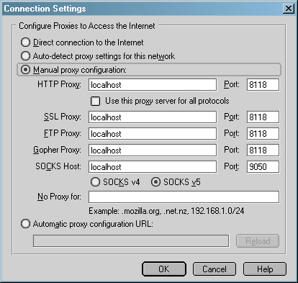
Configuring Firefox
Two options:
Set HTTP and use this proxy for all protocols.
Specify each individually.
Both are suggested but not distinguished.
Notes:
Which one? Not equivalent (see SOCKS Host).

Slide 61
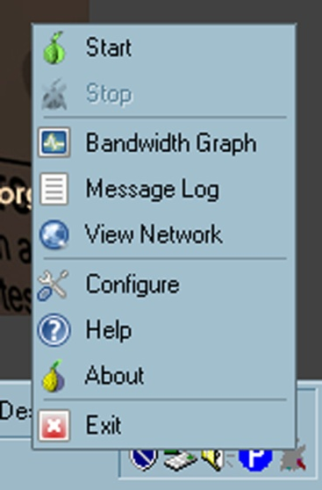
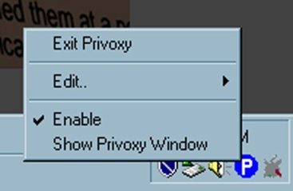
Running Applications
By default, Vidalia and Privoxy auto-start at boot time. If they did not, it would be unclear what applications a user needs to run.
Privoxy is enabled by default.
Vidalia is stopped by default.
Notes:
Tor.exe is not needed but is installed, in the start menu, and is the one app you would think you would need to run...

Slide 62
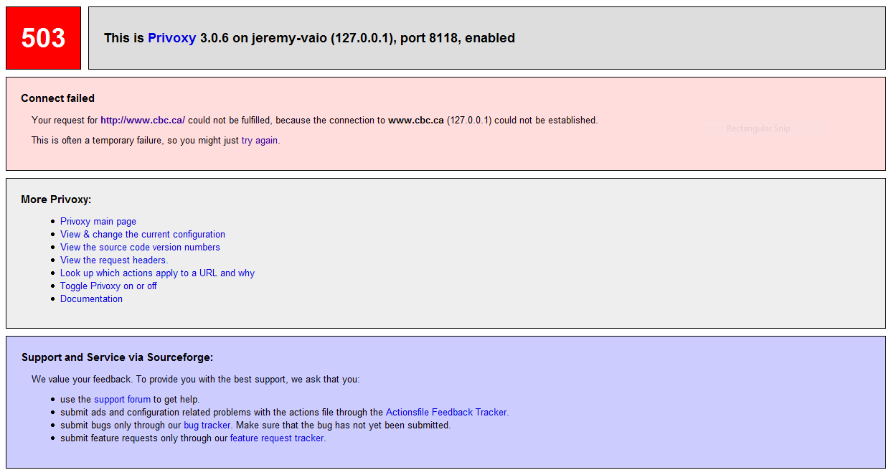
Errors
Privoxy enabled, Tor stopped.

Slide 63
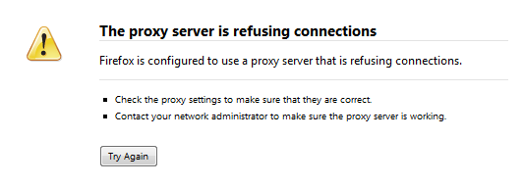
Errors
Tor started, Privoxy disabled.

Slide 64



Manual Configuration (Task 2)
Vidalia visual cues:
Two-factor cue. Color changes, consistent with traffic lights. A visual X appears when stopped.
Privoxy does not change from enabled to disabled. However it spins when traffic is being accessed through it.

Slide 65
Manual Configuration
Task 3 (Determining correct configuration): Document links to a Tor detector website.
Task 4 (Disabling Tor): Correct method is to change Firefox settings back. However there is no documentation on how to do this on either configuration page.
Disabling Vidalia or Privoxy or both will result in an error rendering Firefox unusable.

Slide 66

Torbutton (w/ Tor, Vidalia, & Privoxy)
Task 1: Installation of Tor, Privoxy, and Vidalia is the same. Torbutton installs as a Firefox extension.
Task 2&4: Does not require the Firefox configuration step. Torbutton enables and disables Tor with a click on the cue. The cue is dual factor: text-based (“Tor Disabled/Enabled”) and color-based (red and green).
Users may still try and disable Vidalia or Privoxy.
Notes:
Too easy to disable?

Slide 67
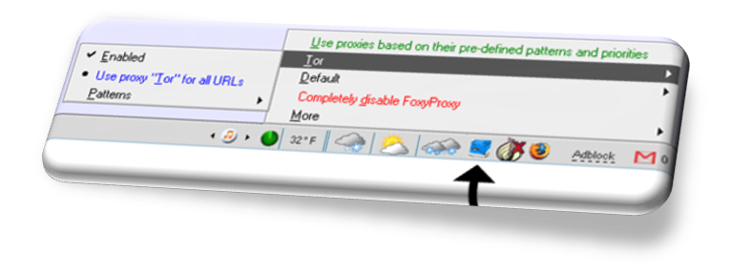
FoxyProxy (w/ Tor and Vidalia)
Task 1,3,4: Same as Torbutton
except slight harder toggling.
Task 2: FoxyProxy includes
a setup dialogue:
Configure FoxyProxy for use with Tor?
Use Tor with or without Privoxy?
Asks for Tor's local port number and states, “if you don't know, use the default,” which is port 9050.
“Would you like the DNS requests to go through the Tor network? If you don't understand this question, click yes.”
Alerts user to ensure Tor is running.
Notes:
4. When wouldn’t you? Communicates information

Slide 68
XeroBank
Task 1: Has one clearly marked version for installation and is a stand-alone application.
Task 2: Upon running, the following message is displayed:
  Torpark secures the anonymity of your connection, but not the data you send. DO NOT use identity compromising information such as your name, login, password, etc. unless you see a closed padlock icon at the bottom status bar of the browser. Torpark should not be run on untrusted computers, as they may have malware or keystroke logging software secretly installed.
Notes:
Intended purpose, bundled together, usb stick,

Slide 69
XeroBank
Task 3: XeroBank comes with NoScript, Torbutton, and an IP display enabled by default.
XeroBank is the only application that attempts to prevent the dangerous errors associated with Java and scripting. However it does so by introducing new usability problems.
Task 4: Tor can be disabled with Torbutton or by simply returning to a standard browser.

Slide 70
Comparison and Summary
 | Installation | Configuration | Verification | Disabling
Manual Config | Difficult | Very Difficult | Easy | Very Difficult
Torbutton | Difficult | Easy | Easy | Very Easy
FoxyProxy | Difficult | Very Easy | Easy | Easy
XeroBank | Very Easy | Very Easy | Very Difficult | Very Easy

Slide 71
Deployability Results
Set-up dialogues are useful for communicating information for complex configurations.
Familiar language should be arrived upon through user interaction.
Default actions should be carefully considered and promote the completion of core-tasks.
Notes:
Extensions work better than manual config…

Slide 72
Deployability Results
Documentation should be collected in one place, and be as task-oriented as possible.
Java and client-side scripting exploits do not have a usable solution. Disabling applets and/or scripts can make webpages non-functional, while leaving them enabled is dangerous.
Inter-application configuration is difficult in terms of usability, and in terms of security while maintaining compatibility.

Slide 73
Concluding Remarks
Complex problems can be aided by an interdisciplinary approach:
  Economics – model the problem,
  Law – resolve liability,
  Psychology – how users behave,
  Computer Science – actuate the solutions.

Slide 74
Concluding Remarks
The problem of adverse selection in anonymity networks is not solved.
We need to think about how incentives are structured to promote a good selection of users, and make proactive design decisions.

Slide 75
Related Publications
Exit Node Repudiation:
Jeremy Clark, Philippe Gauvin, Carlisle Adams. On Controlling IP Address Dissemination using Digital Credentials within Mix Networks. On the Identity Trail Internal Workshop on Anonymity, 2007.
Jeremy Clark, Philippe Gauvin, Carlisle Adams. Exit Node Repudiation for Anonymity Networks. Forthcoming book chapter, On the Identity Trail, 2008.
Usability:
Jeremy Clark, P.C. van Oorschot, Carlisle Adams. Usability of Anonymous Web Browsing: An Examination of Tor Interfaces and Deployability. Proceedings of the Third Symposium On Usable Privacy and Security (SOUPS 2007). ACM Press, ACM International Conference Proceedings Series, Volume 229, 2007, pages 41-51.

