Slide 1
Salesforce – SFDX
HCMC, October 2017

Slide 2
Outline
1.Overview of SFDX
- What is it used for?
2. Dev-Hub & Scratch Orgs
- What is Dev-Hub & Scratch Org
- Continuous with SFDX
-
3. Demo Case

Slide 3
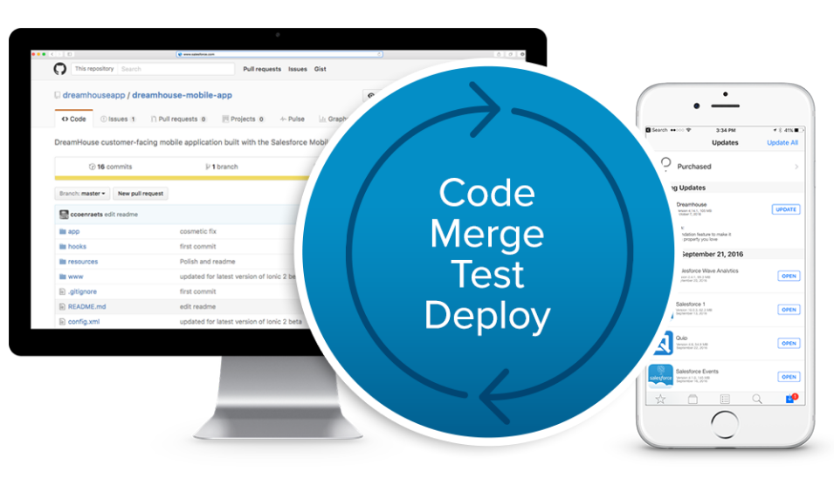
Overview
What is it used for?
Streamlines the entire development life cycle.
Improves team development and collaboration.
Facilitates automated testing and continuous integration.
Makes the release cycle more efficient and agile.

Slide 4
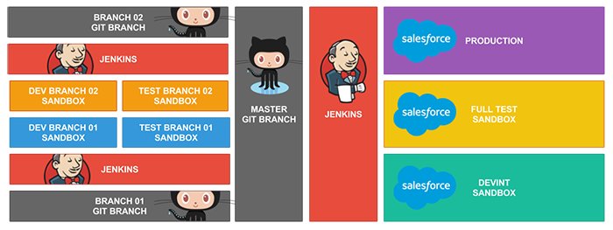
Overview
Simple Model Interation Migration using without SFDX

Slide 5
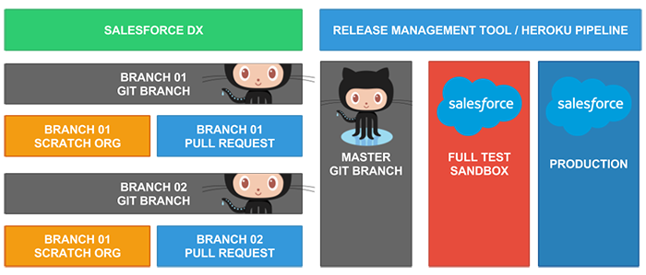
Overview
SFDX Model Interation Migration

Slide 6
Dev-Hub – Scratch Org
What is Dev-Hub (Base Trial)
The Developer Hub (Dev Hub) lets you create and manage scratch orgs.
The Dev Hub trial org expires after 30 days.
Your Dev Hub org gets 10 user licenses.
Salesforce deletes scratch orgs and their associated scratch org objects when a scratch org is older than 7 days.
The scratch org is a source-driven and disposable deployment of Salesforce code and metadata
A scratch org is fully configurable, allowing developers to emulate different Salesforce editions with different features and preferences.
You can create up to 40 scratch orgs per day per trial Dev Hub.
You can have up to 20 active scratch orgs.

Slide 7
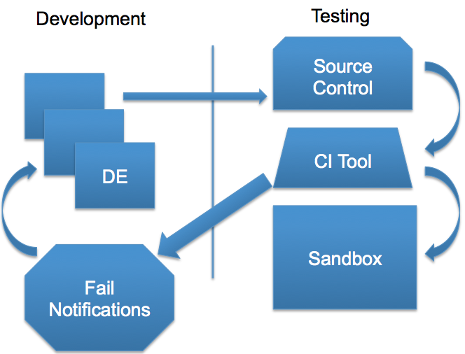
About Continuous integration (CI)
Many third-party CI tools are available for you to choose from. Salesforce DX easily integrates into these tools so that you can set up continuous integration for your Force.com applications.

Slide 8
Considerations for Salesforce DX
Until now the release contains a beta version of Salesforce DX, which means it’s a high-quality feature with known limitations. Salesforce DX isn’t generally available unless or until Salesforce announces its general availability in documentation or in press releases or public statements.
They can’t guarantee general availability within any particular time frame or at all. Make your purchase decisions only on the basis of generally available products and features.

Slide 9
Additional
Continuous integration (CI):
Developers practicing continuous integration merge their changes back to the main branch as often as possible. The developer's changes are validated by creating a build and running automated tests against the build.
Continuous delivery (CD):
Continuous delivery is an extension of continuous integration to make sure that you can release new changes to your customers quickly in a sustainable way. You also have automated your release process and you can deploy your application at any point of time
Continuous deployment (CD):
Every change that passes all stages of your production pipeline is released to your customers. There's no human intervention, and only a failed test will prevent a new change to be deployed to production.
It is an excellent way to accelerate the feedback loop with your customers and take pressure off the team as there isn't a Release Day anymore.

Slide 10
Thank You

