Slide 1
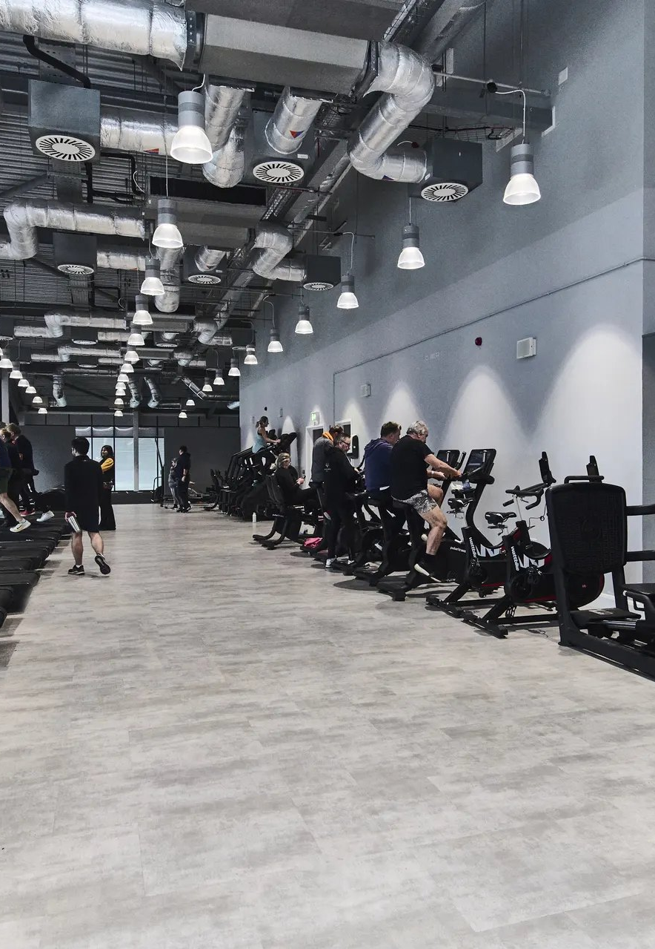

THE CONNECTED OPERATIONS PLATFORM
Your equipment,
faults and history —
in one clear portal.
Log faults, track equipment, request parts and see your whole estate at a glance — purpose-built for fitness facilities.
pulsefitness.ai Built by fitness equipment and service specialists

Slide 2
THE CHALLENGE
Too much runs through disconnected tools
Equipment, faults and history end up spread across inboxes, spreadsheets and messages — so nothing is truly visible.
When information lives in separate places, jobs get missed, response slips, and it's hard to prove what happened to a machine and when.
Email threads
Spreadsheets
→

WhatsApp
Phone calls


❑ No single record history scattered across people and systems
❑ Slow fault handling logged by phone or message, easily lost
❑ Weak reporting downtime and repeat faults hard to evidence
❑ No audit trail limited visibility for managers and owners
Paper notes
Local files


pulsefitness.ai
1

Slide 3
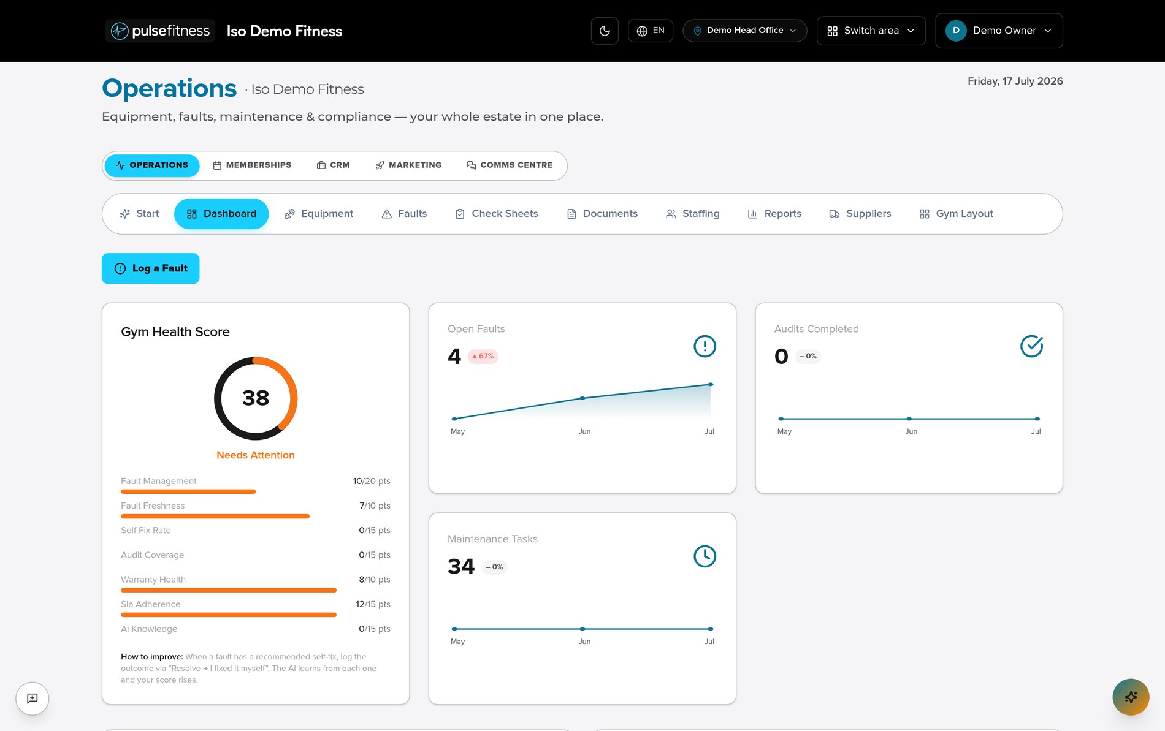
THE PLATFORM
One connected portal for your facility
Pulsefitness.ai brings equipment, faults, parts, compliance and reporting into a single place your team actually uses.
 A live health score see how your estate is performing at a glance
 Everything linked faults and parts sit against the right machine
 One or many sites switch between locations in a click
 Full history every action recorded and easy to retrieve
Operations dashboard
pulsefitness.ai
2

Slide 4
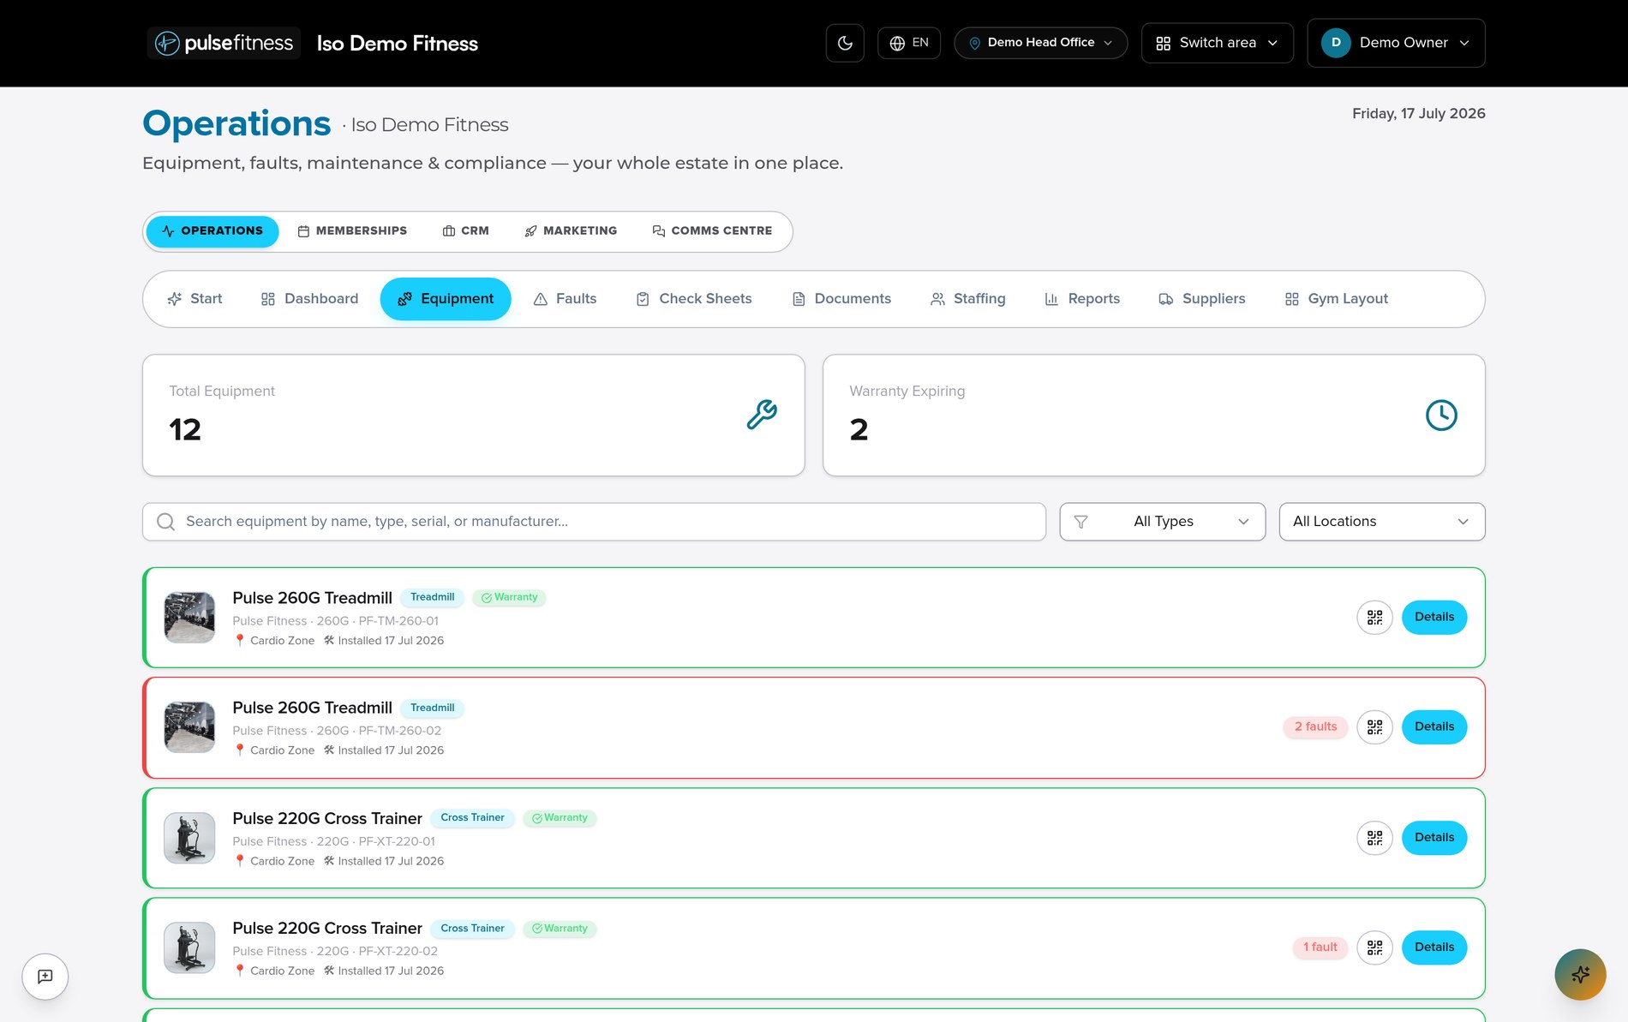
ASSET MANAGEMENT
Every machine has a complete record
A reliable source of truth for each item of Pulse Fitness equipment across all of your sites.
 Make, model & serial each machine identified precisely
 Warranty at a glance cover status shown on every item
 Photos & location know exactly what it is and where
 Service history faults, visits and parts on the record
Equipment register
pulsefitness.ai
3

Slide 5
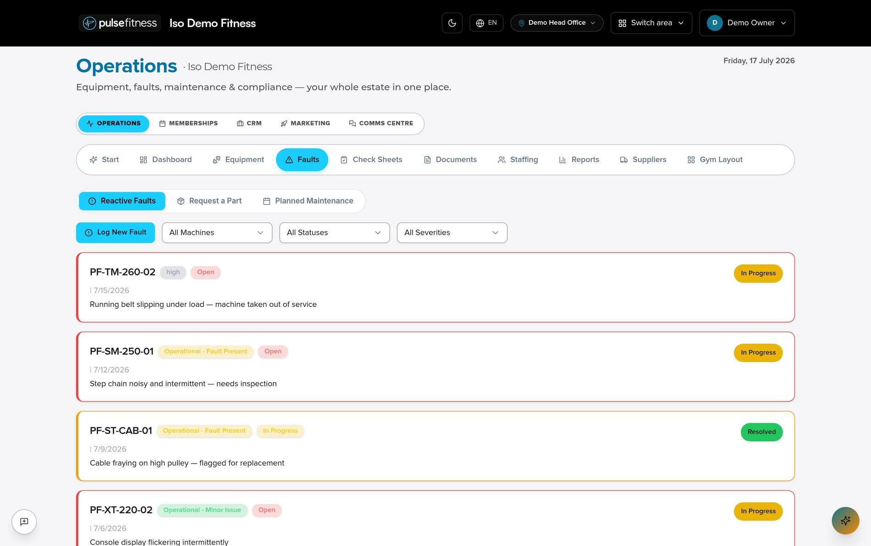
FAULT LOGGING
Report faults against the right machine
Structured fault capture means issues are clear, tracked and never lost in a message thread.
 Linked to equipment every fault against the correct asset
 Priority & status flag out-of-service machines and urgency
 Photos & notes evidence so the fix arrives prepared
 Tracked to resolution a clear trail from reported to resolved
Reactive faults
pulsefitness.ai
4

Slide 6
REQUEST PARTS
Order the right part, first time
Part requests are tied to the exact machine, with drawings and photos to remove the guesswork.
 Against the machine requests tied to the exact asset & serial
 Exploded drawings pick the correct part from a diagram
 Warranty visibility see cover before you request
 Straight to Pulse submitted directly to our team
portal.pulsefitness.ai/request-a-part
Request a part — Pulse 260G Treadmill
Exploded drawing
Drive belt
#3 · in warranty
6
2
1
Console board
3
#5 · chargeable
5
4
Roller kit
#2 · in warranty
Submit to Pulse Fitness
pulsefitness.ai
5

Slide 7
CONTRACTS & WARRANTY
Know what's covered before work begins
Warranty, contract cover, exclusions and chargeable status — all visible against the equipment.
 Warranty active cover and expiry dates at a glance
 Contract cover the agreement in place for each site
 Exclusions what falls outside cover, clearly shown
 Chargeable decisions confident, evidenced calls on billing
portal.pulsefitness.ai/equipment/PF-TM-260-01/cover
Cover summary — Pulse 260G Treadmill
Contract
Active
Comprehensive · Riverside estate
Warranty
Active
Parts & labour · exp 03/2027
Exclusions
Noted
Consumables · accidental damage
This request
Covered
Drive belt — within cover
pulsefitness.ai
6

Slide 8
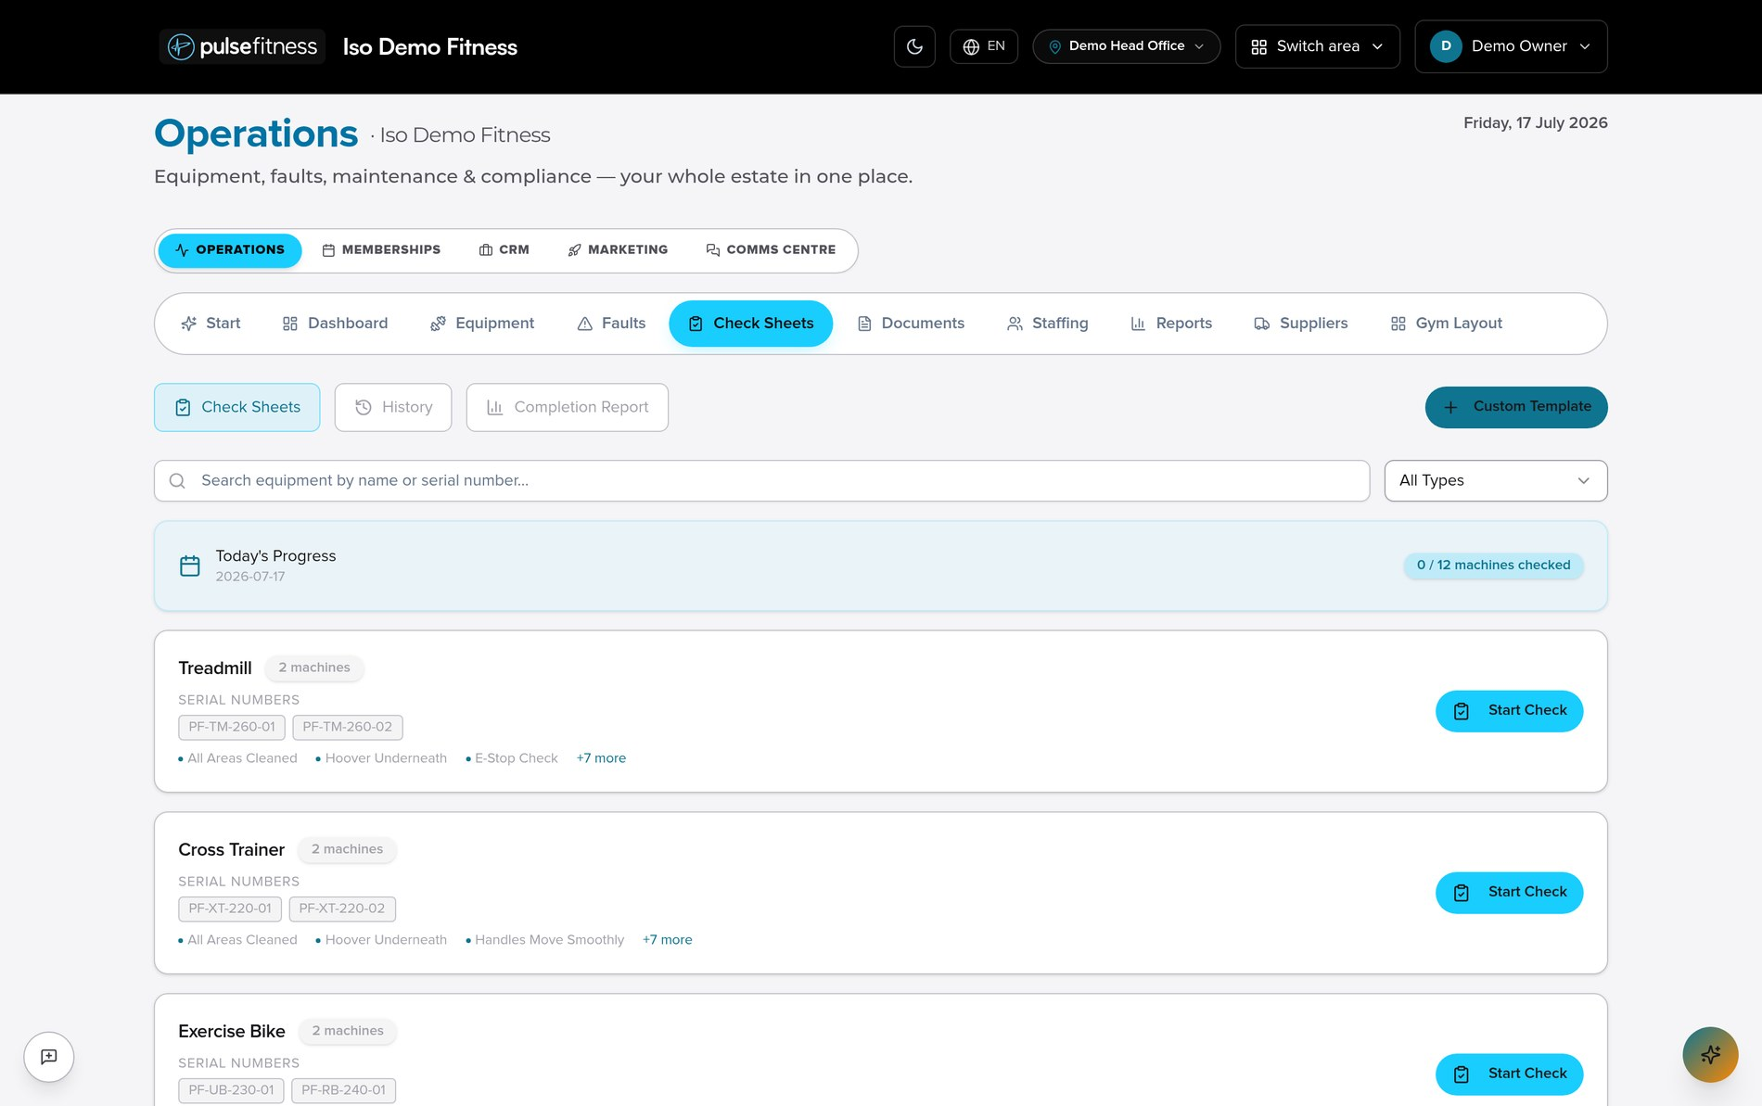
SAFETY & COMPLIANCE
Routine checks and records, done properly
Daily check sheets, risk assessments and incident records — with a complete, time-stamped trail.
 Daily check sheets per-machine safety checks, quick to complete
 Accident & RIDDOR incident records captured and stored
 Risk assessments documented against sites and tasks
 Audit trail every entry logged and easy to evidence
Check sheets
pulsefitness.ai
7

Slide 9
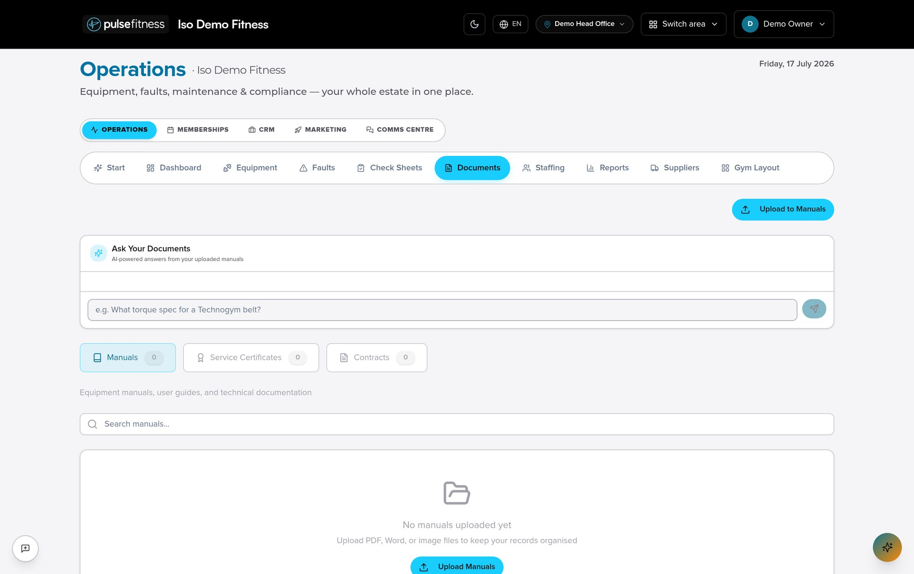
DOCUMENTS & MANUALS
Every manual, certificate and contract in reach
Keep equipment documentation together — and ask questions of it in plain English.
 Manuals & guides technical docs stored against the estate
 Certificates & contracts organised and quick to find
 Ask your documents get answers from your manuals instantly
 Always to hand the right document at the machine
Documents
pulsefitness.ai
8

Slide 10
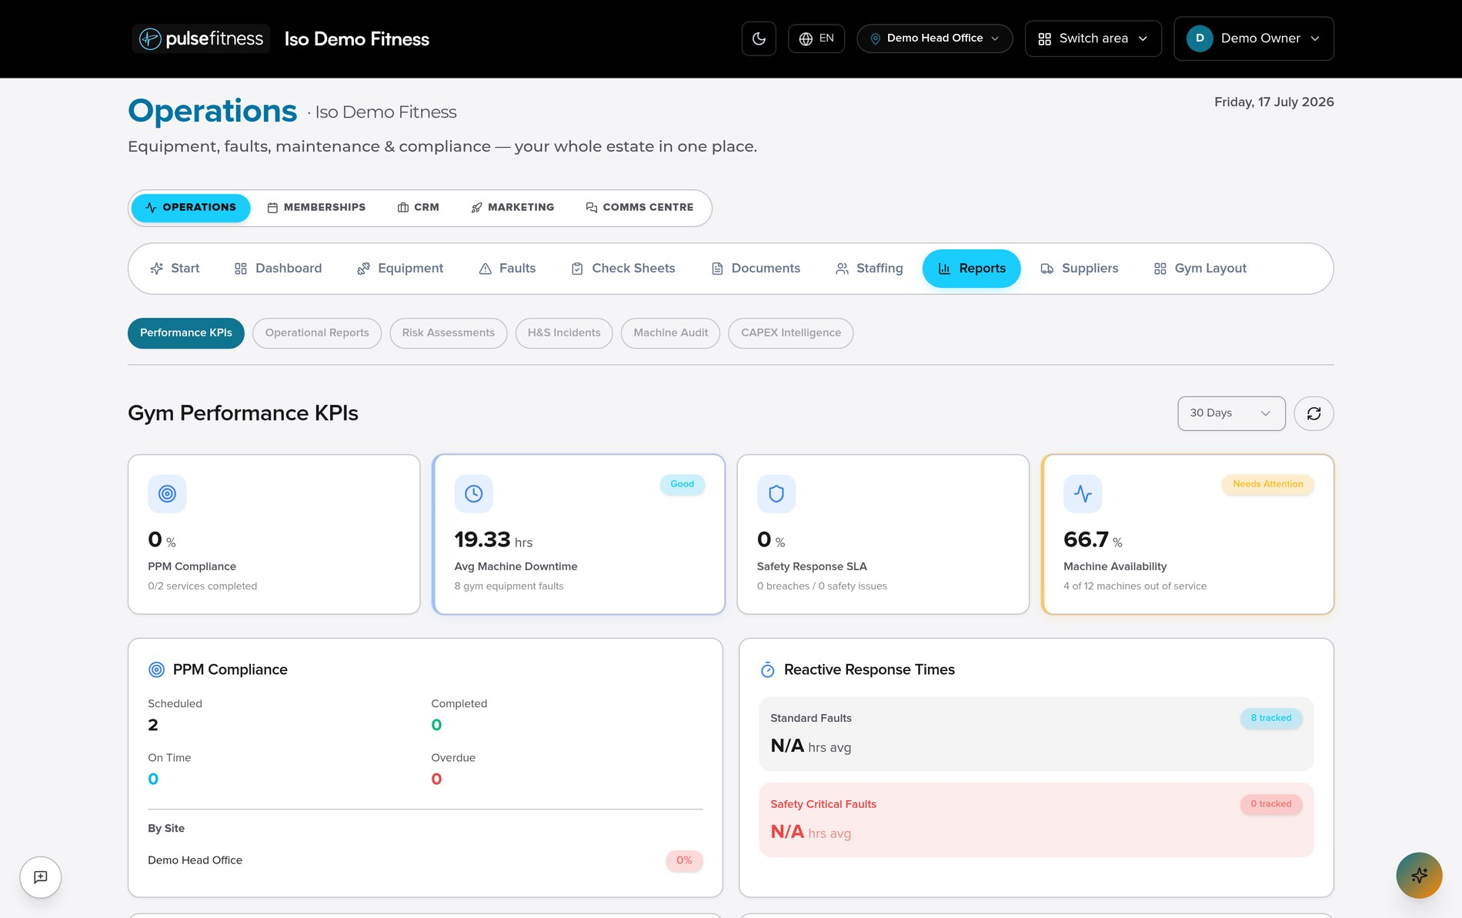
REPORTS & DASHBOARDS
The numbers that run your operation
Clear reporting across faults, response times, downtime, availability and safety performance.
 Availability & downtime see equipment uptime across the estate
 Response times how quickly faults are actioned
 Repeat issues surface the machines that keep breaking
 Safety performance SLA and incident visibility
Performance KPIs
pulsefitness.ai
9

Slide 11
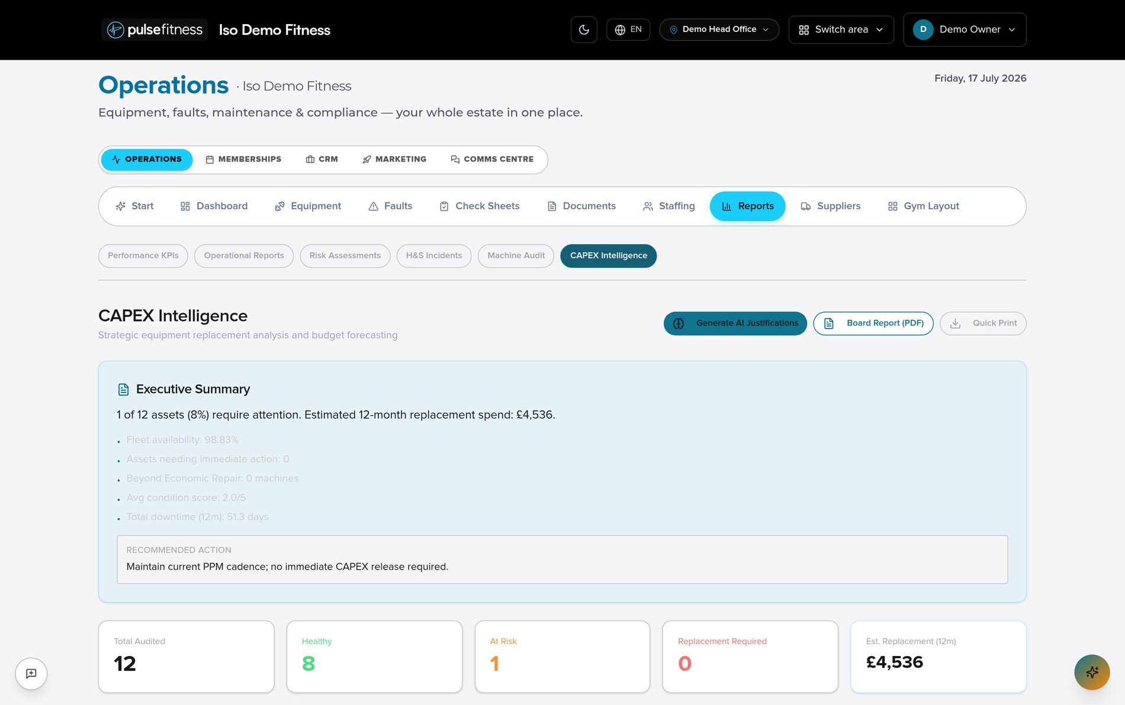
CAPEX REPORTING
Build the evidence for replacement
Turn service history into a clear, defensible case for repairing or replacing ageing equipment.
 Age & condition identify equipment nearing end of life
 Faults & downtime quantify unreliability and its impact
 Replacement spend forecast the year ahead with confidence
 Board-ready report a clear case for capital investment
CAPEX intelligence
pulsefitness.ai
10

Slide 12
ONBOARDING
Add your equipment quickly — two ways
Import by spreadsheet, or photograph a machine and let Pulse draft the record for your review.
01

02

03

Upload

Extract

Review & confirm
Add equipment by spreadsheet, or photograph the machine and data plate.
Pulse reads make, model and serial and drafts the asset record.
Your team checks the detail and approves it into the register.
Nothing is added automatically. AI drafts the record; your team always reviews and confirms first.
pulsefitness.ai
11

Slide 13
AI SUPPORT
Practical help, with people in control
AI assists your team with the routine — from reading manuals to building replacement cases — but never decides on its own.



Ask your documents
Fault triage
CAPEX evidence
Plain-English answers pulled from your manuals.
Likely causes and next steps suggested for a fault.
Assembles the case for repair or replacement.

→

Onboarding checks
Summaries
Report drafting
Reads data plates and pre-fills records for review.
Condenses long histories into a clear picture.
Helps produce clear, consistent reports.
pulsefitness.ai
12

Slide 14
WHY PULSEFITNESS.AI
Built for real operational problems
Not another disconnected tool — a platform shaped by people who service fitness equipment for a living.

✴

One connected platform
Built by specialists
Designed for the day-to-day
Equipment, faults, parts, compliance and reporting in one joined-up system.
Designed by fitness equipment and service experts who know the work.
Focused on the practical problems facilities face, every single day.
pulsefitness.ai
13

Slide 15
WHO IT'S FOR
Built for the whole sector
From a single independent gym to national multi-site operators.




Commercial gyms
Multi-site operators
Leisure trusts
Councils




Universities
Hotels
Studios
Colleges
pulsefitness.ai
14

Slide 16
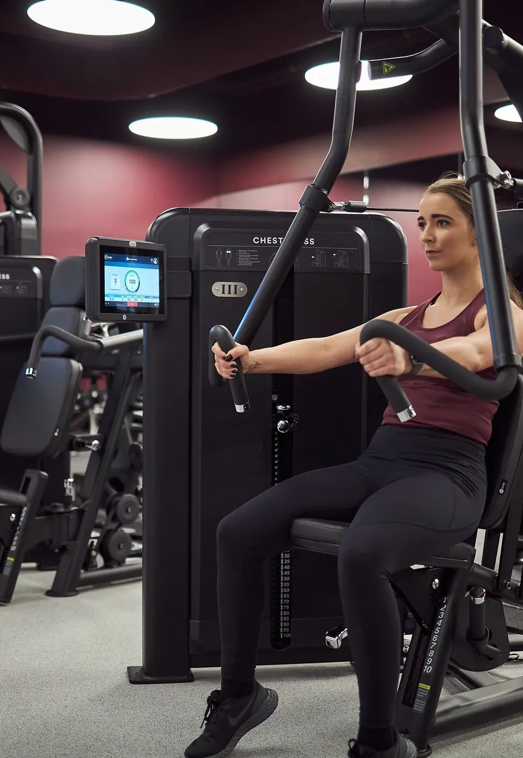
See it working
for your facility.
Arrange a walkthrough and we'll show you the platform against your own equipment, sites and service setup.
⬧
Book a demo
✶
pulsefitness.ai
→
Talk to our team

