Slide 1

Accelerating Access to Life-Saving
Treatments to Patients
Notes:
Good afternoon – on behalf of Pumas-AI team we would like to thank you for the opportunity to meet with you to discuss our bid.
Let me briefly introduce the company. Pumas-AI envisions to accelerate access to life-saving treatments to patients. Our vision aligns with your own vision of “(At Vertex), we invest in scientific innovation to create transformative medicines for people with serious diseases”.
We aspire to achieve our vision through….(cue to hit next slide).

Slide 2
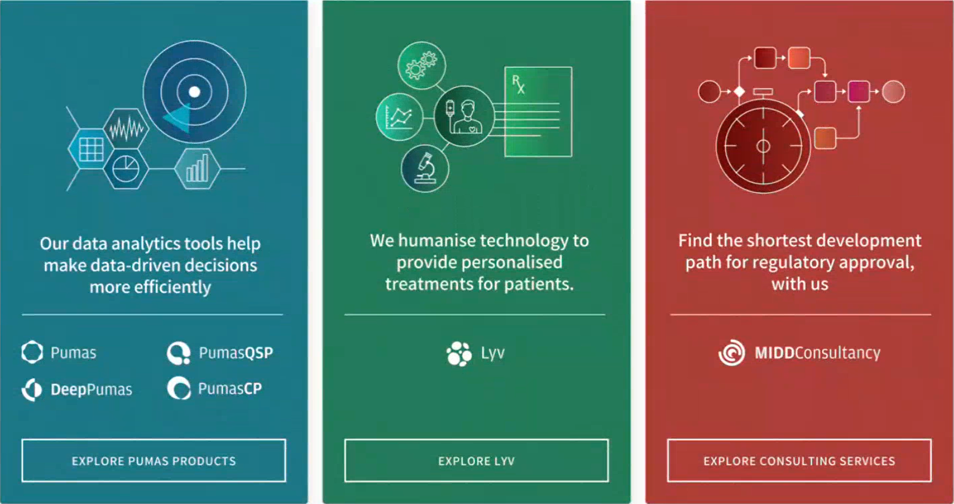

Augmenting healthcare intelligence with predictive analytics that turn data into life-saving decisions
Our data-analytical tools help make data-driven decisions more efficiently
We humanize technology to provide personalized treatments for patients
Find the shortest development path for regulatory approval, with us
PumasCP
DeepPumas
Scientific &
Strategic Consulting
Lyv
Pumas
PumasQSP
Notes:
..Three offerings.
We commercialize data analytics software Pumas that enable scientists to perform all quantitative analysis to support drug development and regulatory submissions. Pumas is a suite of products which offers an integrated set of tools to double efficiency and reduce technical overhead.
The second offering is Lyv – which is a Clinical Decision Support system software that is used to manage patient treatments in a hospital setting. Lyv can also be used during drug development for titration-, enrichment- and adaptive-trial designs allowing bedside guidance to investigators. Lyv ensure more patients respond well to medicines and minimize the toxicity.
Finally, we work with pharma companies on Scientific & Strategic Consulting projects to find the shortest development path for regulatory approval. We bring unparalleled drug development and regulatory experience across a wide range of areas. Let me introduce you to Dhanu, who Heads our Business Development (cue for next slide)

Slide 3
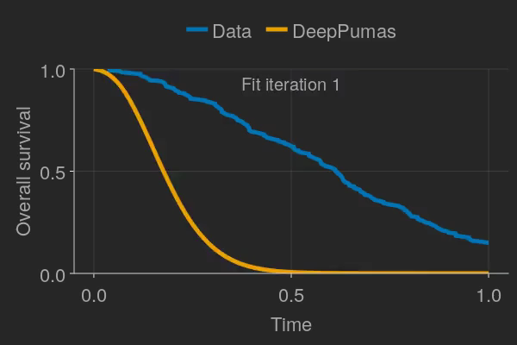

PAGANZ 2024 Pumas
Introduction
Mohamed Tarek

Slide 4
Instructor’s background
I am a senior product engineer at PumasAI Inc. (3 years)
My background is in engineering (BSc and MSc) and computer science (PhD)
Core strength in math and programming of statistical software:
Bayesian inference,
Optimal design of experiments, and
(Scientific) machine learning.
Contact: mohamed@pumas.ai

Slide 5
Rough timeline
Time | Activity
08:30 | Registration and coffee
09:00 | Setting up and introduction to Pumas cloud
09:30 | Basic introduction to Julia
10:00 | Morning tea
10:30 | Pumas model building, data reading and estimation workflow
12:00 | Lunch
13:00 | Uncertainty quantification, simulation and dose selection
15:00 | Afternoon tea
15:30 | Joint time to event and tumor size model
17:00 | Close

Slide 6
Announcements
Pre-conference workshops at Population Approach Group in Europe (PAGE) in June 2024
Workshop 1: Scientific Modeling Augmented by Machine Learning with DeepPumas
Workshop 2: A Practical Bayesian Analysis Workflow in Pumas
Pumas-Labs: https://pumas.ai/pumas-labs
Remote internship program: https://pumasai.com/careers/pumasai-remote-internship-program
We are hiring: https://pumasai.com/careers
Sales contact: sales@pumas.ai
Consulting contact: consulting@pumas.ai

Slide 7
JuliaHub setup
Create an account on juliahub.com
Go to the following URL to get credit added to your account
https://shorturl.at/uRU03
Launch a custom instance (8 vCPUs and 32 GB of memory)

Slide 8
Download the workshop material
Download https://github.com/PumasAI-Labs/PAGANZ_2024_NLME_Workshop as a zip file
Upload the zip file to JuliaHub by dragging and dropping
Go to the terminal and type `unzip PAGANZ_2024_NLME_Workshop.zip`

