Slide 1

Accelerating Access to Life-Saving
Treatments to Patients
Notes:
Good afternoon – on behalf of Pumas-AI team we would like to thank you for the opportunity to meet with you to discuss our bid.
Let me briefly introduce the company. Pumas-AI envisions to accelerate access to life-saving treatments to patients. Our vision aligns with your own vision of “(At Vertex), we invest in scientific innovation to create transformative medicines for people with serious diseases”.
We aspire to achieve our vision through….(cue to hit next slide).

Slide 2
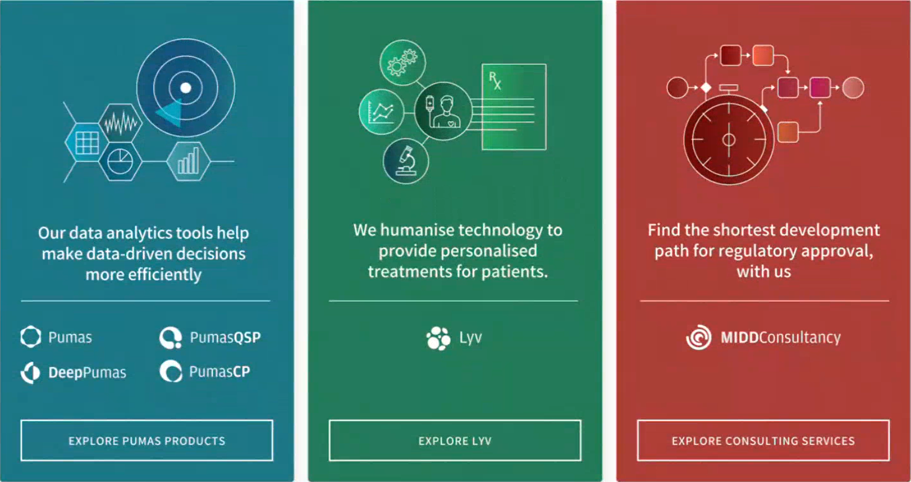

Augmenting healthcare intelligence with predictive analytics that turn data into life-saving decisions
Our data-analytical tools help make data-driven decisions more efficiently
We humanize technology to provide personalized treatments for patients
Find the shortest development path for regulatory approval, with us
PumasCP
DeepPumas
Scientific &
Strategic Consulting
Lyv
Pumas
PumasQSP
Notes:
..Three offerings.
We commercialize data analytics software Pumas that enable scientists to perform all quantitative analysis to support drug development and regulatory submissions. Pumas is a suite of products which offers an integrated set of tools to double efficiency and reduce technical overhead.
The second offering is Lyv – which is a Clinical Decision Support system software that is used to manage patient treatments in a hospital setting. Lyv can also be used during drug development for titration-, enrichment- and adaptive-trial designs allowing bedside guidance to investigators. Lyv ensure more patients respond well to medicines and minimize the toxicity.
Finally, we work with pharma companies on Scientific & Strategic Consulting projects to find the shortest development path for regulatory approval. We bring unparalleled drug development and regulatory experience across a wide range of areas. Let me introduce you to Dhanu, who Heads our Business Development (cue for next slide)

Slide 3
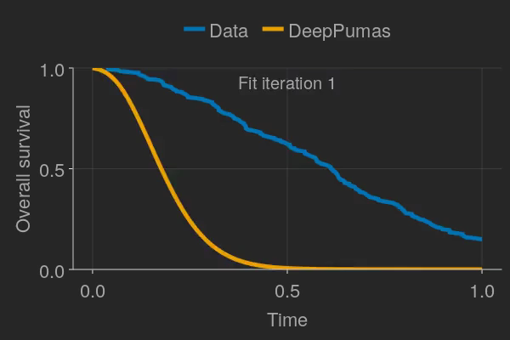

Pumas Berlin Virtual Workshop 2025
Mohamed Tarek

Slide 4
Instructor’s background
Senior product engineer at PumasAI Inc. (4 years)
Background in engineering (BSc and MSc) and computer science (PhD)
Main expertise in math and programming (not pharmacometrics)
Contact: mohamed@pumas.ai

Slide 5
Announcements
Events: https://pumas.ai/events
Resources: https://pumas.ai/resources
Sales contact: sales@pumas.ai
Consulting contact: consulting@pumas.ai

Slide 6
JuliaHub setup
Cloud
Launch a custom instance (8 vCPUs and 32 GB of memory)
Desktop installation
https://pumas.ai/our-products/pumas/windows
https://pumas.ai/our-products/pumas/mac

Slide 7
Download the workshop material
Download https://github.com/PumasAI-Labs/Pumas_Berlin_Virtual_Workshop_2025 as a zip file
Upload the zip file to JuliaHub / VSCode by dragging and dropping
Go to the terminal and type `unzip Pumas_Berlin_Virtual_Workshop_2025.zip`

