Slide 1
TheAnalytics Team
SPROCKET CENTRAL PTY LTD
Data Analytics Approach
A report by Pummy Jha

Slide 2
Agenda
Introduction
Data Exploration
Model Development
Interpretation

Slide 3

Introduction
Identifying And Providing The Best To The Customers
Outline Of Problems
Sprocket Central is a company that specializes in high quality bike and accessories.
The marketing team is looking to boost the sales.
To target 1000 customers that will bring most value to the company.
Approach For Data Analysis
Bike related purchases for the last 3 years based on gender.
Top Industries contributing the maximum profit and bike related sales.
Wealth Segment by Age Category.
Number of cars owned in each state.
Customer Classification

Slide 4
Data Exploration
Data Quality Assessment
Customer Demographic- DOB is inaccurate, Age is missing, removed blanks from Job Title, Replaced Genders
Customer Address-Replaced and Filtered States
Transactions-Made a profit column, Removed blanks from online order and brands,Changed the date format.

Slide 5


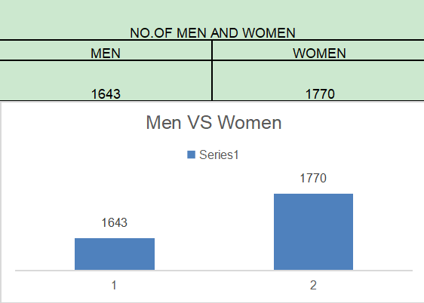
Data Exploration
Bikes Related Purchase Over The Last 3 Years Based On Gender
Data Shows, on average females have made more bike
related purchases to males in the last 3 years.

Slide 6
Data Exploration
Top Job Industry Contributing to the Maxing Profit & Bike Related Purchases
The Top 3 Sector Bringing in the Highest Profit are Financial Services, Health and Manufacturing.
Customers prefer bikes mostly because industries are located within the city and in local.

Slide 7
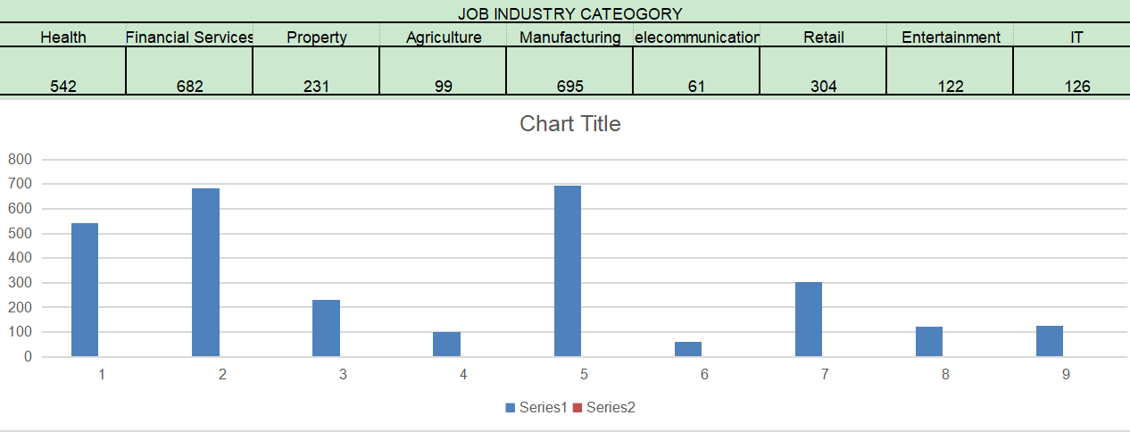
Data Exploration

Slide 8
Data Exploration
Profit of Wealth Segment by Age Cluster
Overall, the Mass customer segmentation makes the highest profit across the different age clusters.
People aged 38 - 47 are likely to bring more profit for the company.
This shows that middle aged people are enthusiastic buyers and contribute mostly in the profit.

Slide 9
Data Exploration
Number of Cars Owned in Each State
New South Wales, QLD & Victoria could be the potential market for the company.
New South Wales has the highest number of people that own car is almost equal to the people who don’t own cars which shows there is opportunity to find value customers there.

Slide 10
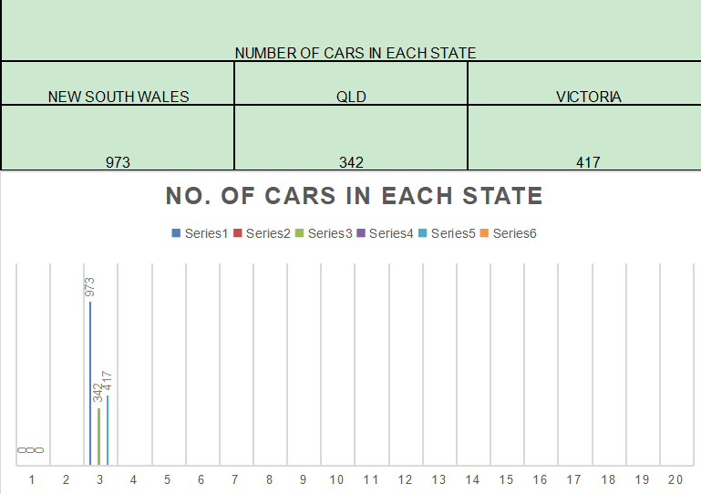

Slide 11
Thank You !

