Slide 1
MongoDB

Slide 2
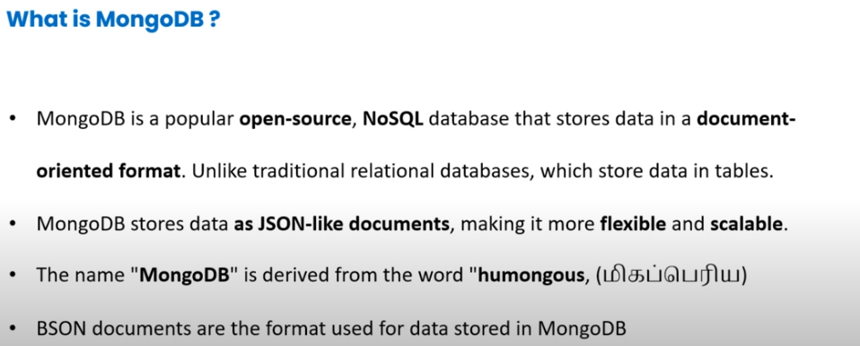

Slide 3
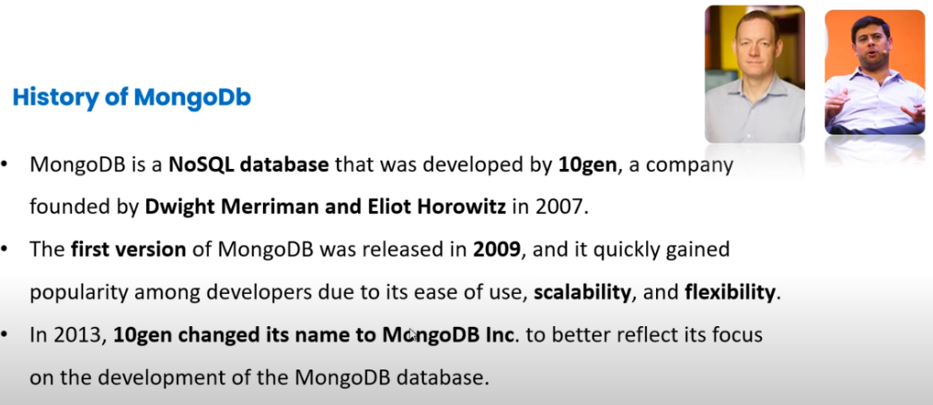

Slide 4
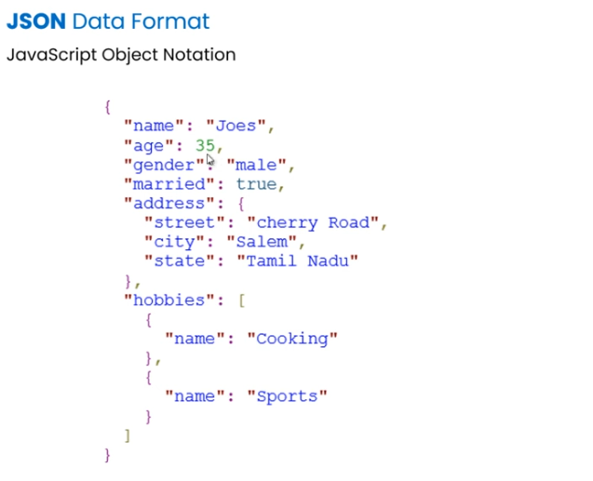

Slide 5
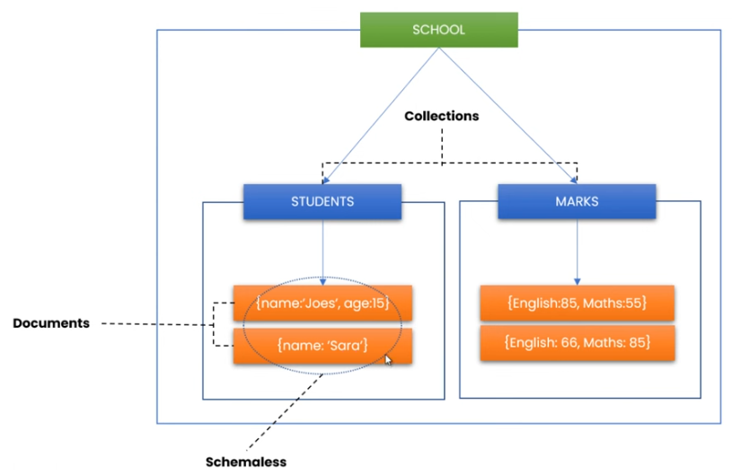
How MongoDB Works

Slide 6
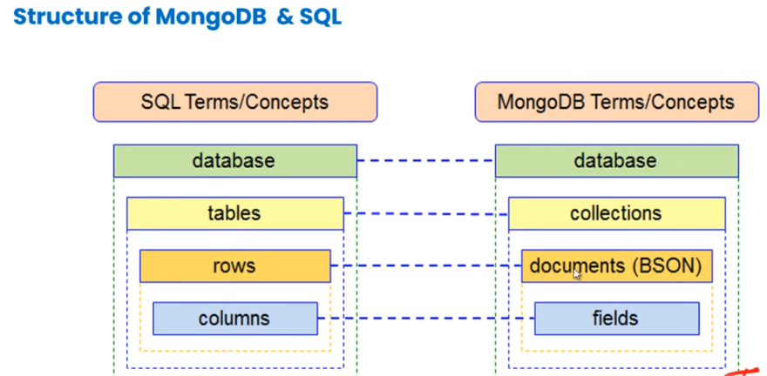

Slide 7
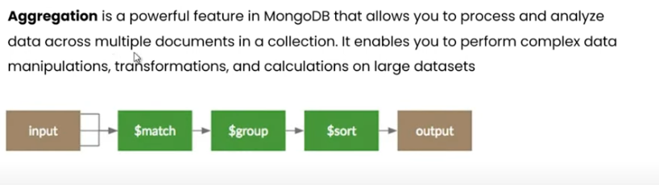
MongoDB Features

Slide 8
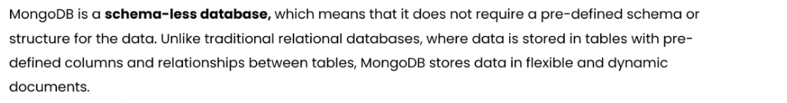
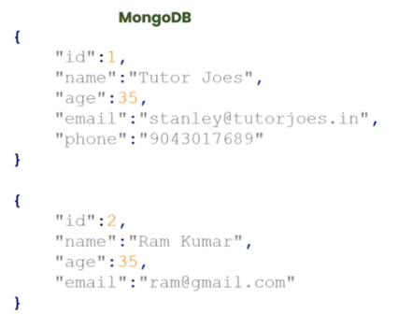
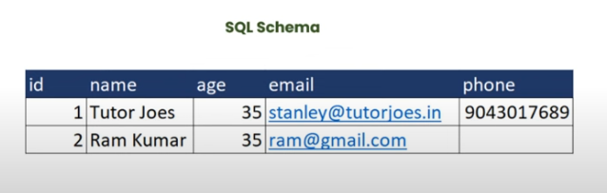

Slide 9
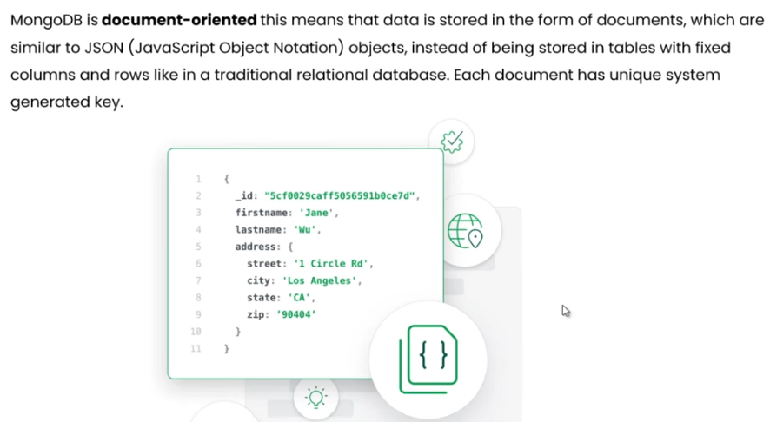

Slide 10
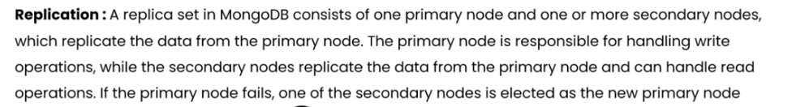
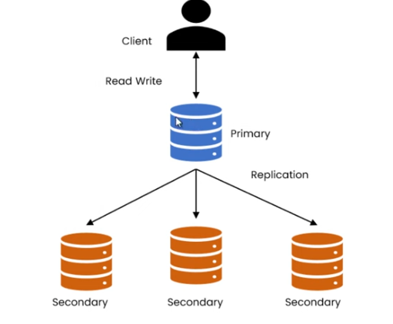

Slide 11
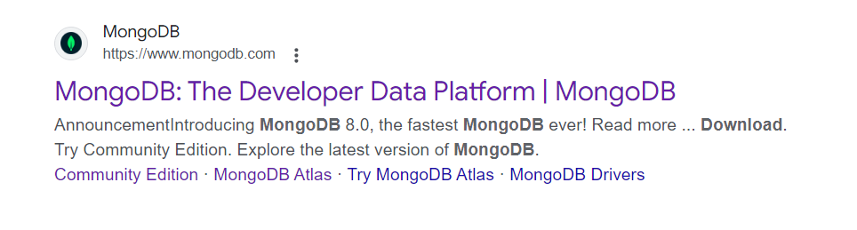
Mongodb download

Slide 12
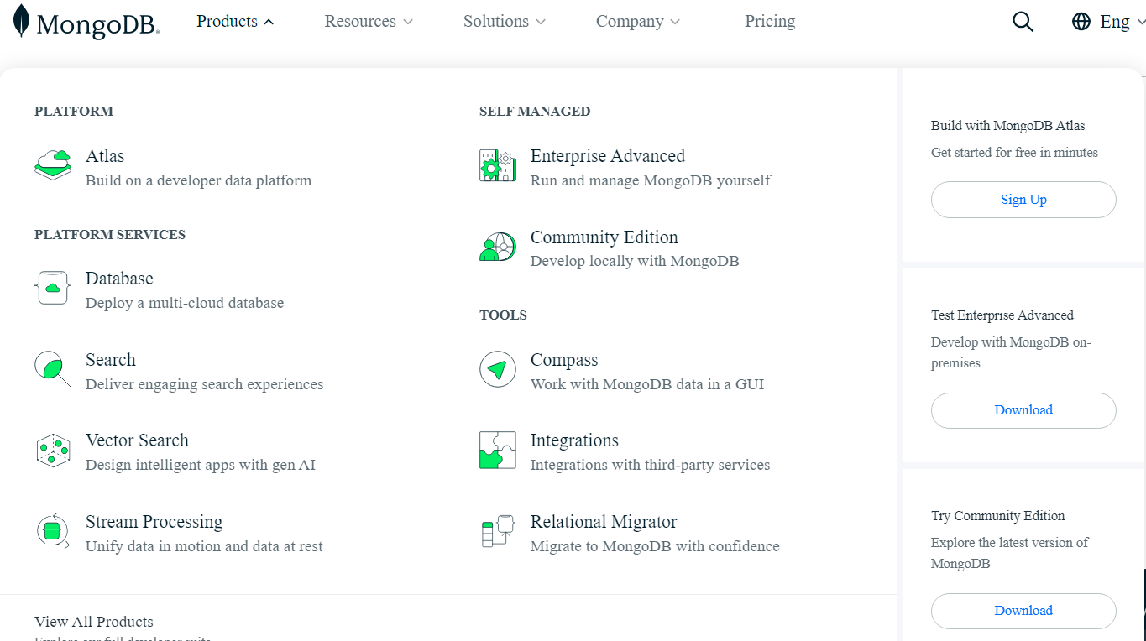

Slide 13
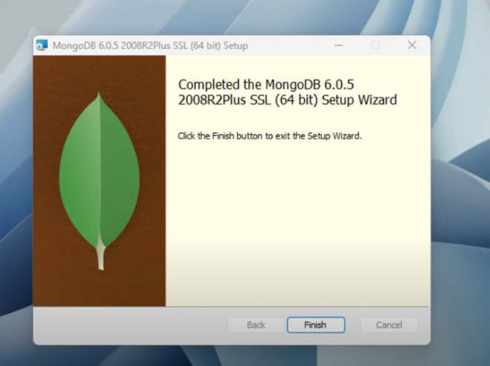

Slide 14
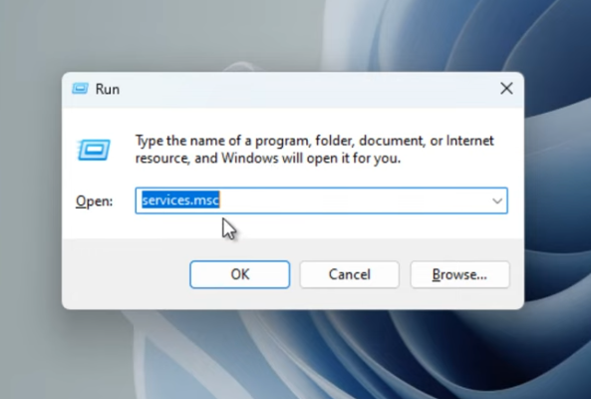

Slide 15
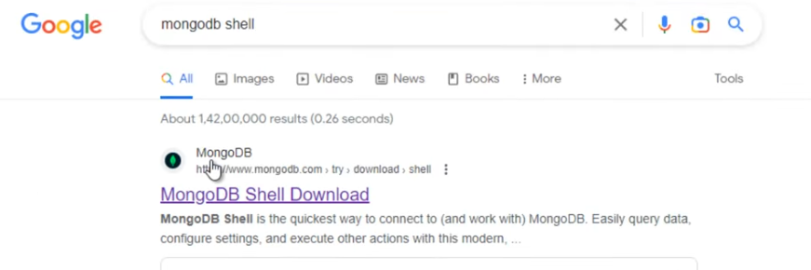

Slide 16
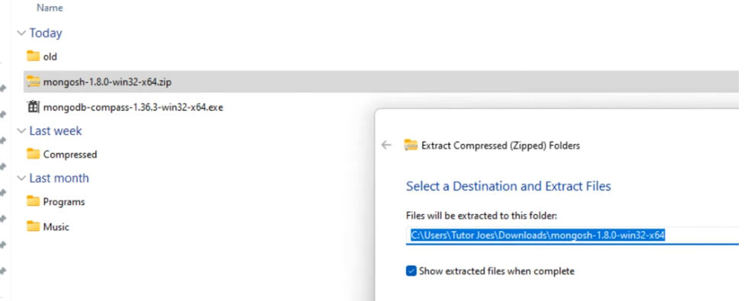

Slide 17
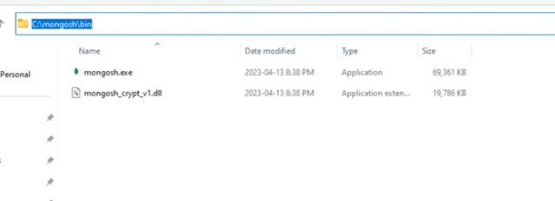
Change your folder name
Just copy the folder and paste in c drive

Slide 18
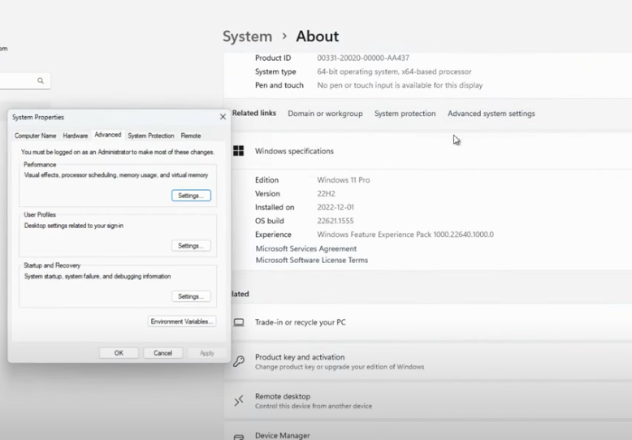

Slide 19
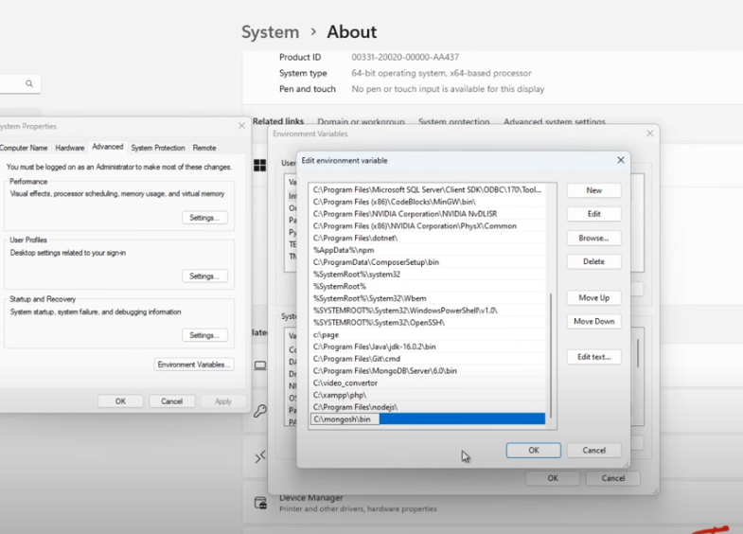

Slide 20
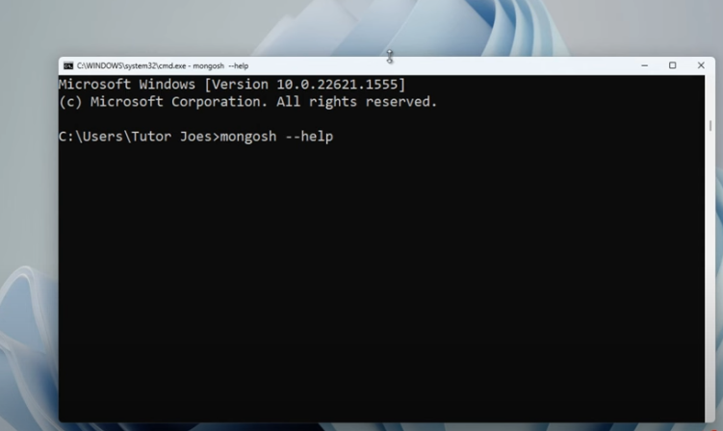

Slide 21
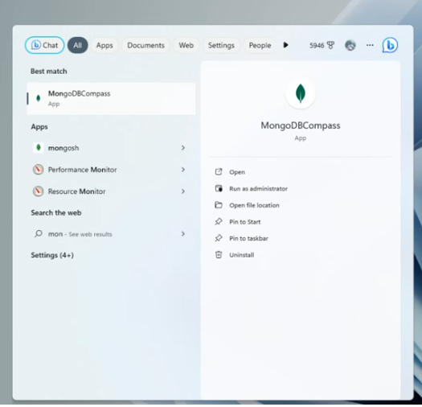

Slide 22
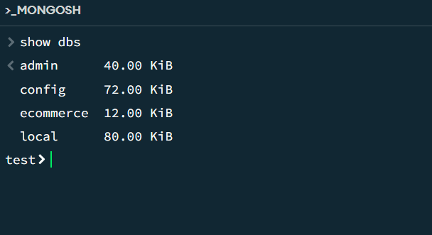
MongoDB mongosh Create Database:
Show all databases
To see all available databases, in your terminal type show dbs.

Slide 23
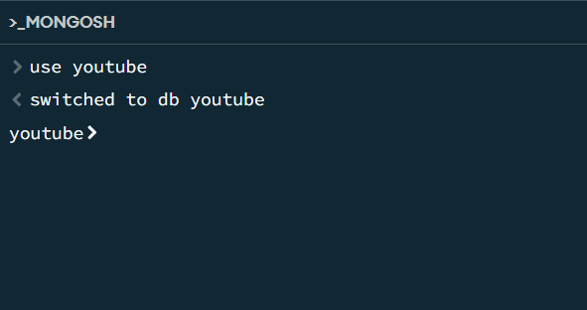
Change or Create a Database
You can change or create a new database by typing use then the name of the database.
Example:

Slide 24
MongoDB mongosh Create Collection(table)
Create Collection using mongosh
2 ways to create a collection.
Method 1
You can also create a collection during the insert process.
Example
db.posts.insertOne(object)
Method 2
You can create a collection using the createCollection() database method.
Example
db.createCollection("posts")

Slide 25
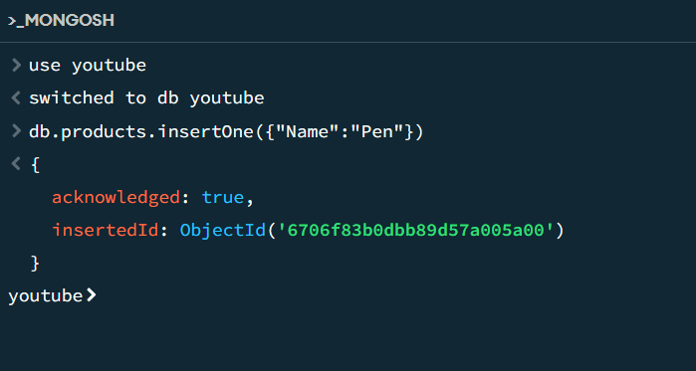
In MongoDB, a collection is not actually created until it gets content!
Method 1

Slide 26
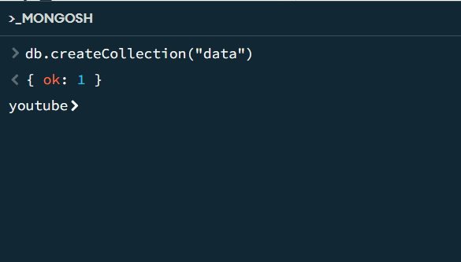
Method 2

Slide 27
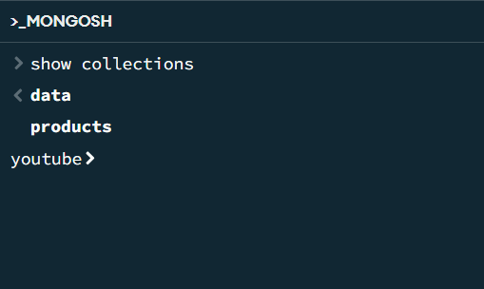
Show all collections
To see all available collections, in your terminal type show collections or show tables.

Slide 28
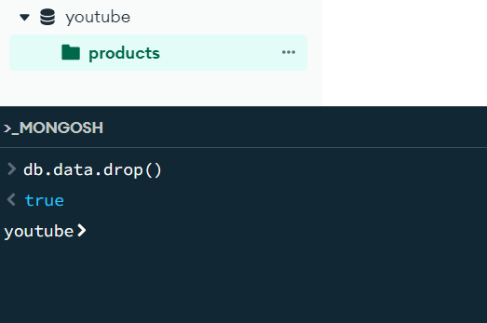
Drop collections
In your terminal type db.collectionname.drop()

Slide 29
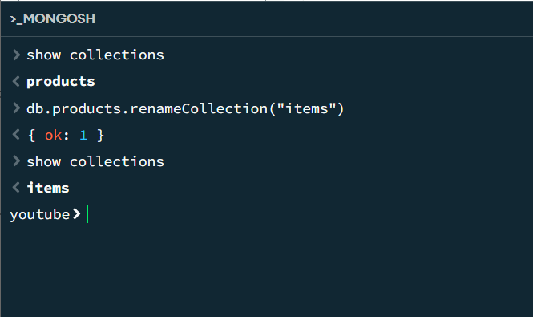
Rename collections
In your terminal type db.oldcollectionname.renameCollection("newcollectionname")

Slide 30
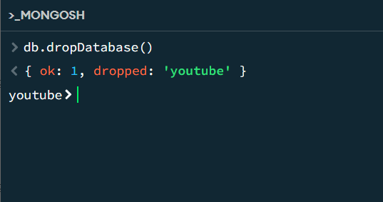
Drop database
In your terminal type db.dropDatabase()

Slide 31
MongoDB mongosh Insert
Insert Documents
There are 2 methods to insert documents into a MongoDB database.
insertOne()
insertMany()

Slide 32
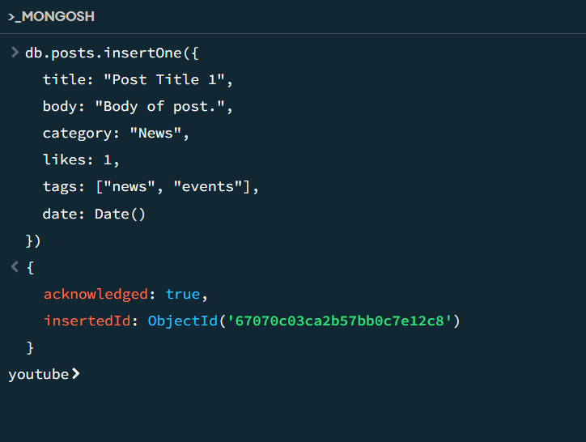
insertOne()
To insert a single document, use the insertOne() method.
This method inserts a single object into the database.

Slide 33
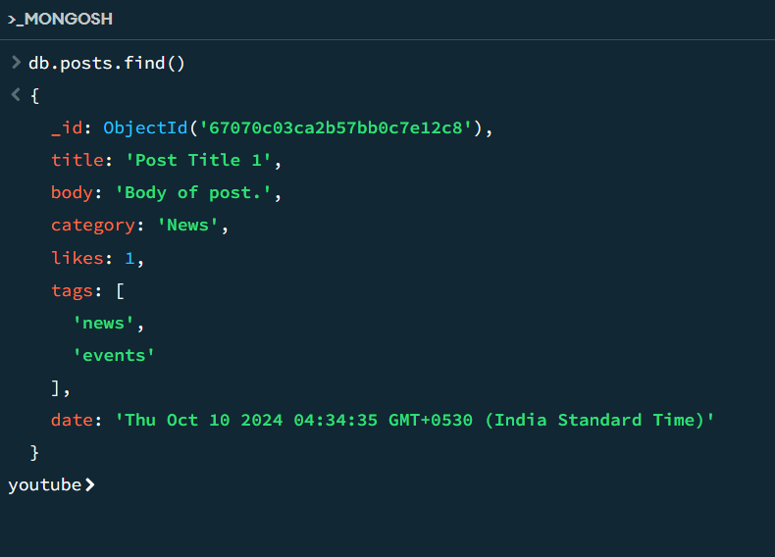
Show the inserted data in your terminal type db.collectionname.find()

Slide 34
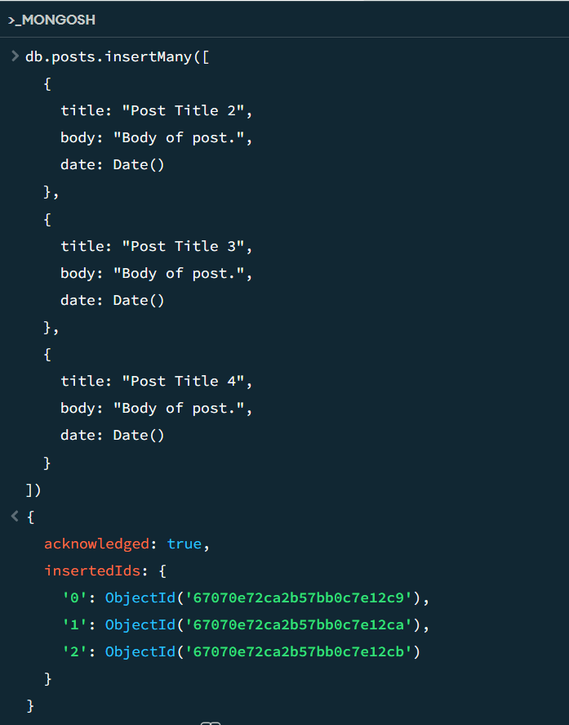
insertMany()
To insert multiple documents at once, use the insertMany() method.
This method inserts an array of objects into the database.

Slide 35
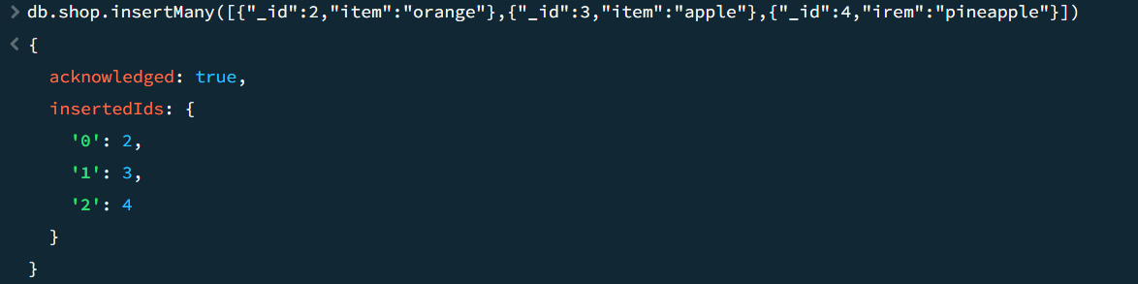
Insert data with own id value:

Slide 36
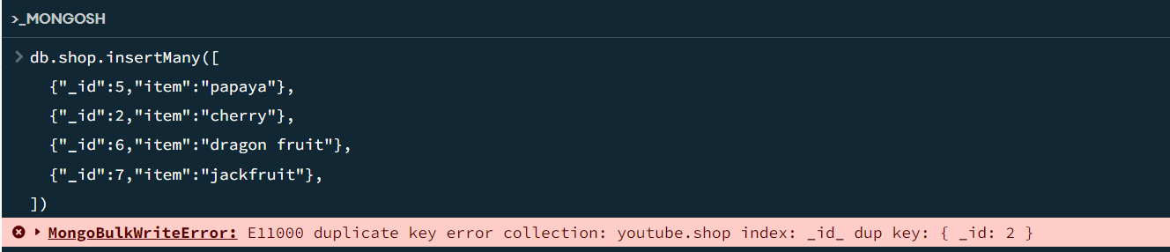
Unordered Insert In MongoDB

Slide 37
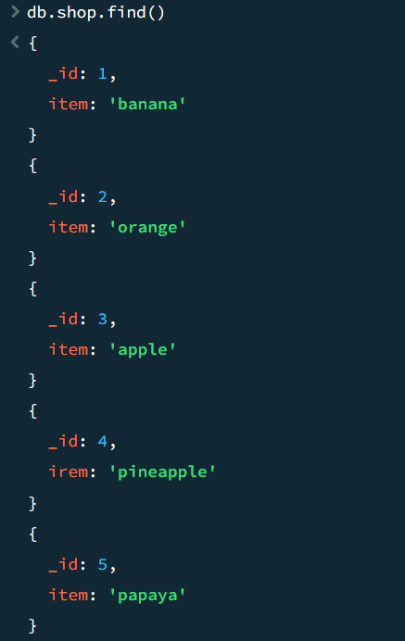
We get the output :

Slide 38
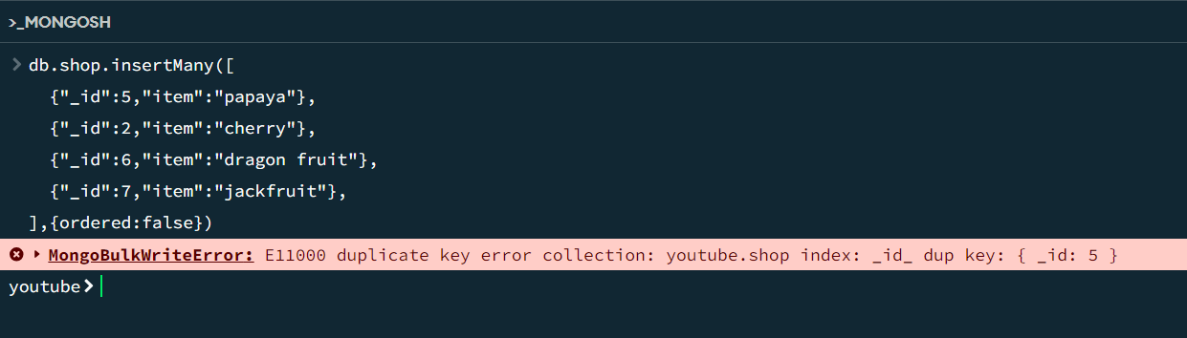
To avoid this error:
Again we get error but our data inserted successfully. check the data use find method.

Slide 39
Mongodb Mongosh Find (select)
Find Data
There are 2 methods to find and select data from a MongoDB collection, find() and findOne().
find()
To select data from a collection in MongoDB, we can use the find() method.
This method accepts a query object. If left empty, all documents will be returned.
db.collectionname.find()
findOne()
To select only one document, we can use the findOne() method.
This method accepts a query object. If left empty, it will return the first document it finds.
db.collectionname.findOne()

Slide 40
Querying Data
To query, or filter, data we can include a query in our find() or findOne() methods.
db.collectionname.find( {key: "value"} )
Specify Conditions Using Query Operator
If you want to display the one or more brand details means use this query operator way.
db.collectionname.find( {key: {$in:["value", "value"]}} )
Example:
db.products.find( {"brand": {$in:["Oneplus", "vivo"]}} )

Slide 41
Specify AND Conditions
A compound query can specify conditions for more than one field in the collection's documents. Implicitly, a logical AND conjunction connects the clauses of a compound query so that the query selects the documents in the collection that match all the conditions.
Retrieves all documents in the items collection where the category "mobile" and qty is less than ($lt) 20.
Query :
db.items.find({
"category " : "mobile" ,
qty: { $lt: 20 }
});

Slide 42
Specify OR Conditions
Using the $or operator, you can specify a compound query that joins each clause with a logical OR conjunction so that the query selects the documents in the collection that match at least one condition.
retrieves all documents in the items collection where the category "mobile" or qty is less than ($lt) 20.
Query:
db.items.find({
$or: [{"category " : "mobile" }, { qty: { $lt: 20 } }]
});

Slide 43
Specify AND as well as OR Conditions
In the following example, the compound query document selects all documents in the collection where the category "mobile" and either qty is less than ($lt) 20 or title starts with the character s.
Query:
db.items.find({
"category " : "mobile" ,
$or: [{ qty: { $lt: 20 } }, {"title":/^s/}]
});
Query:
db.items.find({
"category " : "mobile" ,
$or: [{ qty: { $lt: 20 } }, {"title": {"$regex":'^s'}]
});

Slide 44
MongoDB mongosh Update
Update Document
To update an existing document we can use the updateOne() or updateMany() methods.
The first parameter is a query object to define which document or documents should be updated.
The second parameter is an object defining the updated data.
updateOne()
The updateOne() method will update the first document that is found matching the provided query.
db.collectionname.updateOne( { key: "value" }, { $set: { key: new value } } )

Slide 45
Insert if not found
If you would like to insert the document if it is not found, you can use the upsert option.
Query: Update the document, but if not found insert it:
db.posts.updateOne(
{ title: "Canon EOS 90D" },
{
$set:
{
brand: 'Canon',category: 'camera',price: 119999,
qty: 10,display: 3.0,storage: null,
color: ['black','silver']
}
},
{ upsert: true }
)

Slide 46
Sample Dataset
db.students.insertMany([
{
"name": "Alice Johnson",
"age": 15,
"grade": 10,
"status": "active"
},
{
"name": "Bob Smith",
"age": 16,
"grade": 11,
"status": "active"
},
{
"name": "Charlie Davis",
"age": 15,
"grade": 10,
"status": "active"
},
{
"name": "Diana Evans",
"age": 17,
"grade": 12,
"status": "graduated"
}
])

Slide 47
updateMany() Query
To promote all students in grade 10 to grade 11 and update their status to "promoted",
Query
db.students.updateMany(
{ grade: 10 }, // Filter: Select students in grade 10
{
$set: {
grade: 11,
status: "promoted"
}
}
)

Slide 48
MongoDB mongosh Delete
In MongoDB, you can use the deleteMany() or deleteOne() method to delete documents from a collection based on a filter. Here's how each method works:
deleteOne(): Deletes only the first document that matches the filter.
deleteMany(): Deletes all documents that match the filter.

Slide 49
deleteOne()
If you only want to delete a single document, you can use deleteOne(). For example, suppose you want to delete the first student who is "active".
Query:
db.students.deleteOne({ status: "active" })
deleteMany()
Suppose you have a students collection, and you want to delete all students who have graduated (status: "graduated").
Query:
db.students.deleteMany({ status: "graduated" })

Slide 50
Deleting All Documents in a Collection
If you want to delete all documents in a collection, you can pass an empty filter {} to deleteMany().
Query:
db.students.deleteMany({})

Slide 51
MongoDB Query Operators
MongoDB Query Operators
There are many query operators that can be used to compare and reference document fields.
Comparison
The following operators can be used in queries to compare values:
$eq: Values are equal
$ne: Values are not equal
$gt: Value is greater than another value
$gte: Value is greater than or equal to another value
$lt: Value is less than another value
$lte: Value is less than or equal to another value
$in: Value is matched within an array

Slide 52
Logical
The following operators can logically compare multiple queries.
$and: Returns documents where both queries match
$or: Returns documents where either query matches
$nor: Returns documents where both queries fail to match
$not: Returns documents where the query does not match
Evaluation
The following operators assist in evaluating documents.
$regex: Allows the use of regular expressions when evaluating field values
$text: Performs a text search
$where: Uses a JavaScript expression to match documents

Slide 53
Fields
$currentDate: Sets the field value to the current date
$inc: Increments the field value
$rename: Renames the field
$set: Sets the value of a field
$unset: Removes the field from the document
Array
$addToSet: Adds distinct elements to an array
$pop: Removes the first or last element of an array
$pull: Removes all elements from an array that match the query
$push: Adds an element to an array

Slide 54
Sample Dataset
users Collection
db.users.insertMany([
{
"_id": ObjectId("64b1f4c2e1d3f8b7c8e4a1b1"),
"username": "john_doe",
"email": "john@example.com",
"age": 28,
"status": "active",
"roles": ["customer"],
"address": {
"street": "123 Maple Street",
"city": "Springfield",
"zip": "12345"
},
"signupDate": ISODate }, ("2022-01-15T08:00:00Z")
{
"_id": ObjectId("64b1f4c2e1d3f8b7c8e4a1b2"),
"username": "jane_smith",
"email": "jane@example.com",
"age": 34,
"status": "inactive",
"roles": ["admin"],
"address": {
"street": "456 Oak Avenue",
"city": "Metropolis",
"zip": "67890"
},
"signupDate": ISODate("2021-06-20T10:30:00Z")
},
{
"_id": ObjectId("64b1f4c2e1d3f8b7c8e4a1b3"),
"username": "alice_wonder",
"email": "alice@example.com",
"age": 22,
"status": "active",
"roles": ["customer", "subscriber"],
"address": {
"street": "789 Pine Road",
"city": "Gotham",
"zip": "54321"
},
"signupDate": ISODate("2023-03-10T14:45:00Z")
}
])

Slide 55
Sample Dataset
{
"_id": ObjectId("64b1f4c2e1d3f8b7c8e4a2b2"),
"title": "Advanced JavaScript",
"author": "Emily Clark",
"category": "Programming",
"price": 39.99,
"tags": ["javascript", "programming", "web"],
"publishedDate": ISODate("2019-11-15T00:00:00Z"),
"ratings": 4.7,
"stock": 80
},
{
"_id": ObjectId("64b1f4c2e1d3f8b7c8e4a2b3"),
"title": "Learning Python",
"author": "Michael Brown",
"category": "Programming",
"price": 24.99,
"tags": ["python", "programming", "coding"],
"publishedDate": ISODate("2021-05-20T00:00:00Z"),
"ratings": 4.3,
"stock": 200
}
])
products Collection
db.products.insertMany([
{
"_id": ObjectId("64b1f4c2e1d3f8b7c8e4a2b1"),
"title": "MongoDB Basics",
"author": "Mark Spencer",
"category": "Database",
"price": 29.99,
"tags": ["mongodb", "database", "nosql"],
"publishedDate": ISODate("2020-07-01T00:00:00Z"),
"ratings": 4.5,
"stock": 120
},

Slide 56
Sample Dataset
orders Collection
db.orders.insertMany([
{
"_id": ObjectId("64b1f4c2e1d3f8b7c8e4c3b1"),
"userId": ObjectId("64b1f4c2e1d3f8b7c8e4a1b1"),
"products": [
{ "productId": ObjectId("64b1f4c2e1d3f8b7c8e4a2b1"), "quantity": 2 },
{ "productId": ObjectId("64b1f4c2e1d3f8b7c8e4a2b3"), "quantity": 1 }
],
"orderDate": ISODate("2023-04-12T09:30:00Z"),
"status": "shipped",
"totalAmount": 84.97
},
{
"_id": ObjectId("64b1f4c2e1d3f8b7c8e4c3b2"),
"userId": ObjectId("64b1f4c2e1d3f8b7c8e4a1b3"),
"products": [
{ "productId": ObjectId("64b1f4c2e1d3f8b7c8e4a2b2"), "quantity": 1 }
],
"orderDate": ISODate("2023-07-22T16:15:00Z"),
"status": "processing",
"totalAmount": 39.99
}
])

Slide 57
Sample Dataset
reviews Collection
db.reviews.insertMany([
{
"_id": ObjectId("64b1f4c2e1d3f8b7c8e4d4b1"),
"productId": ObjectId("64b1f4c2e1d3f8b7c8e4a2b1"),
"userId": ObjectId("64b1f4c2e1d3f8b7c8e4a1b1"),
"rating": 5,
"comment": "Great introduction to MongoDB!",
"reviewDate": ISODate("2023-04-15T12:00:00Z")
},
{
"_id": ObjectId("64b1f4c2e1d3f8b7c8e4d4b2"),
"productId": ObjectId("64b1f4c2e1d3f8b7c8e4a2b2"),
"userId": ObjectId("64b1f4c2e1d3f8b7c8e4a1b3"),
"rating": 4,
"comment": "Very detailed and well-explained.",
"reviewDate": ISODate("2023-07-25T14:30:00Z")
}
])

Slide 58
Sample Dataset
inventory Collection
db.inventory.insertMany([
{
"_id": ObjectId("64b1f4c2e1d3f8b7c8e4e5b1"),
"productId": ObjectId("64b1f4c2e1d3f8b7c8e4a2b1"),
"warehouse": "A1",
"quantity": 50
},
{
"_id": ObjectId("64b1f4c2e1d3f8b7c8e4e5b2"),
"productId": ObjectId("64b1f4c2e1d3f8b7c8e4a2b2"),
"warehouse": "B1",
"quantity": 30
},
{
"_id": ObjectId("64b1f4c2e1d3f8b7c8e4e5b3"),
"productId": ObjectId("64b1f4c2e1d3f8b7c8e4a2b3"),
"warehouse": "A1",
"quantity": 150
}
])

Slide 59
1. Comparison Operators
Example 1: Find users older than 25
db.users.find({ age: { $gt: 25 } })
Example 2: Find products priced between $25 and $35
db.products.find({ price: { $gte: 25, $lte: 35 } })
Example 3: Find orders with a total amount greater than $50
db.orders.find({ totalAmount: { $gt: 50 } })

Slide 60
2. Logical Operators
Example 1: Find active users older than 25
db.users.find({
$and: [ { status: "active" },{ age: { $gt: 25 } }]
})
Example 2: Find users who are admins or have the role of 'subscriber'
db.users.find({
$or: [{ roles: "admin" },{ roles: "subscriber" }]
})
Example 3: Find users who are not inactive
db.users.find({
status: { $ne: "inactive" }
})
Alternatively, using $not operator:
db.users.find({
status: { $not: { $eq: "inactive" } }
})

Slide 61
3. Element Operators
Example 1: Find users who have an email address
db.users.find({ email: { $exists: true } })
Example 2: Find products where the 'ratings' field is of type double
db.products.find({ ratings: { $type: "double" } })
4. Evaluation Operators
Example 1: Find products with titles starting with 'L' (case-insensitive)
db.products.find({ title: { $regex: /^L/, $options: 'i' } })

Slide 62
Sample Dataset (employees collection):
db.employees.insertMany([
{
"_id": 1,
"name": "Alice",
"age": 28,
"position": "Developer",
"skills": ["JavaScript", "React"],
"join_date": "2020-01-15",
"projects_completed": 5
}
{
"_id": 2,
"name": "Bob",
"age": 35,
"position": "Manager",
"skills": ["Management", "Communication"],
"join_date": "2018-07-23",
"projects_completed": 12
}
])

Slide 63
Fields
1. $currentDate: Sets the field value to the current date
db.employees.updateOne(
{ _id: 1 },
{ $currentDate: { "lastUpdated": true } }
);
2. $inc: Increment a numeric field
db.employees.updateOne(
{ _id: 1 },
{ $inc: { "projects_completed": 1 } }
);
3.$rename: Rename a field
db.employees.updateOne(
{ _id: 1 },
{ $rename: { "join_date": "start_date" } }
);

Slide 64
4. $set: Set the value of a field
db.employees.updateOne(
{ _id: 2 },
{ $set: { "position": "Senior Manager" } }
);
5. $unset: Remove a field
db.employees.updateOne(
{ _id: 1 },
{ $unset: { "skills": "" } }
);
Array Modifiers:
1. $addToSet: Add an element to an array, ensuring no duplicates
db.employees.updateOne(
{ _id: 1 },
{ $addToSet: { "skills": "Node.js" } }
);

Slide 65
2.$pop: Remove the first or last element of an array
db.employees.updateOne(
{ _id: 1 },
{ $pop: { "skills": -1 } }
);
3. $pull: Remove specific elements from an array
db.employees.updateOne(
{ _id: 1 },
{ $pull: { "skills": "React" } }
);
4. $push: Add an element to an array
db.employees.updateOne(
{ _id: 2 },
{ $push: { "skills": "Leadership" } }
);

Slide 66
Relational concepts
MongoDB is a NoSQL document-oriented database that differs fundamentally from traditional relational databases in how it handles data and relationships.
While relational databases use structured tables with defined schemas and relationships, MongoDB offers a more flexible, schema-less approach.
However, understanding relational concepts within MongoDB is crucial for designing efficient and scalable applications. Below, we'll explore how relational concepts translate to MongoDB, including modeling relationships, best practices, and tools available within MongoDB to manage these relationships.

Slide 67
1. Understanding Relationships in MongoDB
In relational databases, relationships are typically defined using foreign keys and join operations. MongoDB, being a document store, handles relationships differently, primarily through embedding and referencing.
Embedding (Denormalization)
Embedding involves nesting related data within a single document. This approach is suitable for scenarios where related data is frequently accessed together and doesn't grow unbounded.
Advantages:
Performance: Faster read operations since all related data is retrieved in a single query.
Atomicity: Updates to the document are atomic.

Slide 68
One to One Relation
Step 1: use company
Step 2: create collection
db.employees.insertOne({_id:'EMP001',name:'John Doe',
postion:'Software Enginner'})
db.profiles.insertOne({employee_id:'EMP001',age:26,address:'123 Main St',
phone:'555-555-5555'})
Step 3: Query For One to One Relation
db.employees.aggregate([{$lookup:{from:'profiles',localField:'_id',
foreignField:'employee_id',as:"personalDetails"}}])

Slide 69
One to Many Relation
Step 1: Creating Companies collection
db.companies.insertMany([
{_id:'CMP001',name:'Nule Soft',isMNC:true},
{_id:'CMP002',name:'JexiTech',isMNC:false},
{_id:'CMP003',name:'DSA Softwares',isMNC:true}])
Step 2: Updating old employee to assign company
db.employees.updateOne({_id:'EMP001'},{$set:{company_id:'CMP001'}})

Slide 70
Step 3: Adding More Employee with different companies
db.employees.insertMany([
{_id:'EMP002',name:'Alice Smith',postion:'Product Manager',company_id:'CMP001'},
{_id:'EMP003',name:'Bob Brown',postion:'UI/UX Designer',company_id:'CMP002'},
{_id:'EMP004',name:'Charlie Davis',postion:'Backend Developer',company_id:'CMP001'},
{_id:'EMP005',name:'Diana Evans',postion:'Frontend Developer',company_id:'CMP001'}])

Slide 71
db.profiles.insertMany([
{employee_id:'EMP002',age:36,address:'123 Main St',phone:'444-555-5555'},
{employee_id:'EMP003',age:28,address:'123 Main St',phone:'222-333-5555'},
{employee_id:'EMP004',age:37,address:'567 Main St',phone:'111-333-4444'},
{employee_id:'EMP005',age:32,address:'987 Main St',phone:'111-222-8888'}])
Step 4:Query For One to Many Relation
db.companies.aggregate([
{$lookup:{from:'employees',localField:'_id',foreignField:'company_id',as:'Employees'}}])

Slide 72
Thank You

