Slide 1

R project
Prepared by:
Natalya Gaponenko

Slide 2

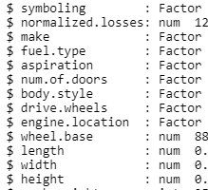
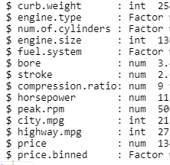

Slide 3


Missing values

Slide 4
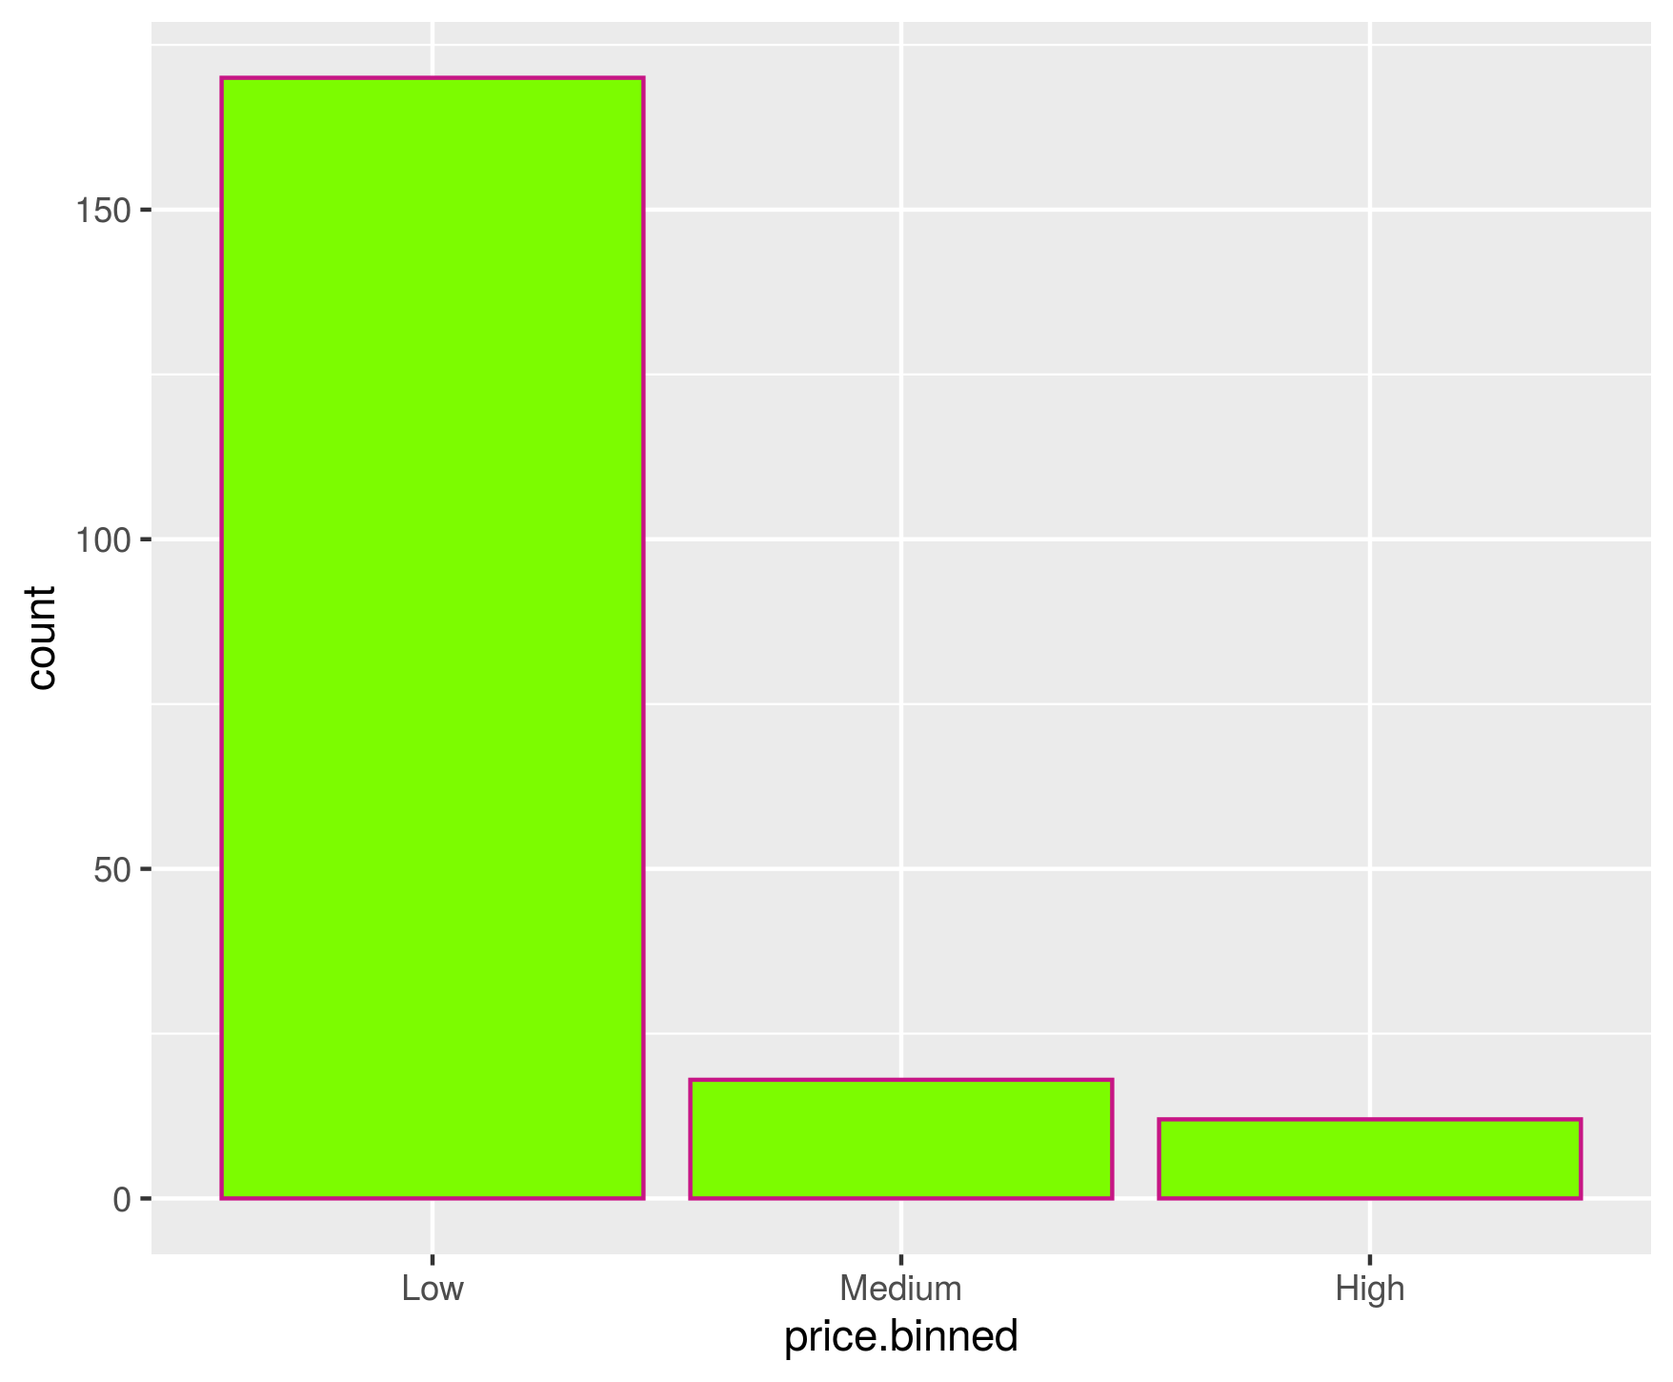
Distribution of price

Slide 5
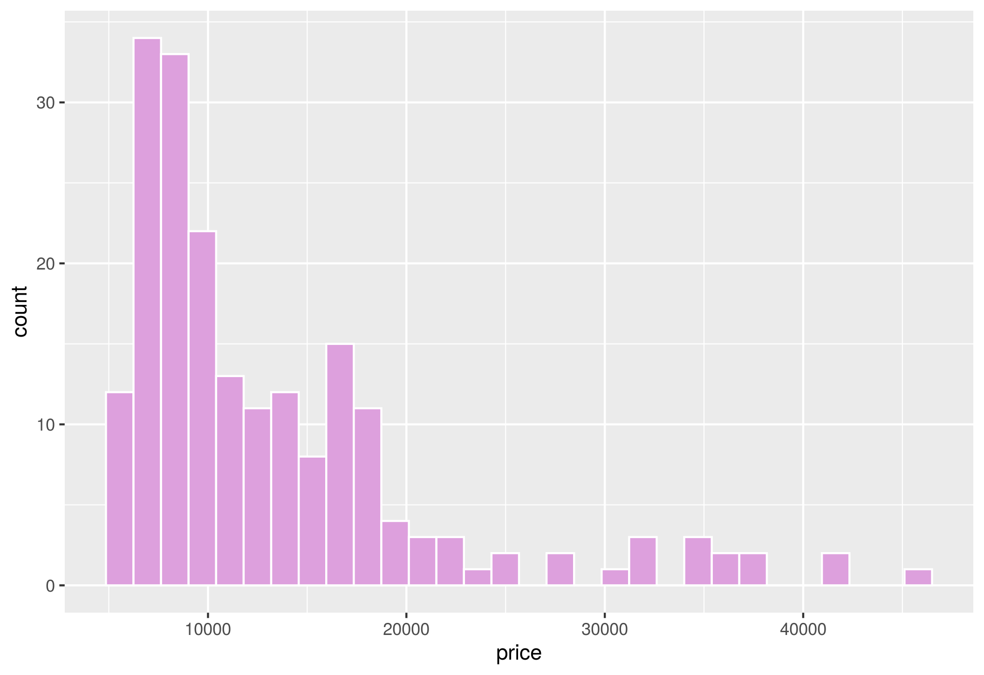
Distribution of price

Slide 6
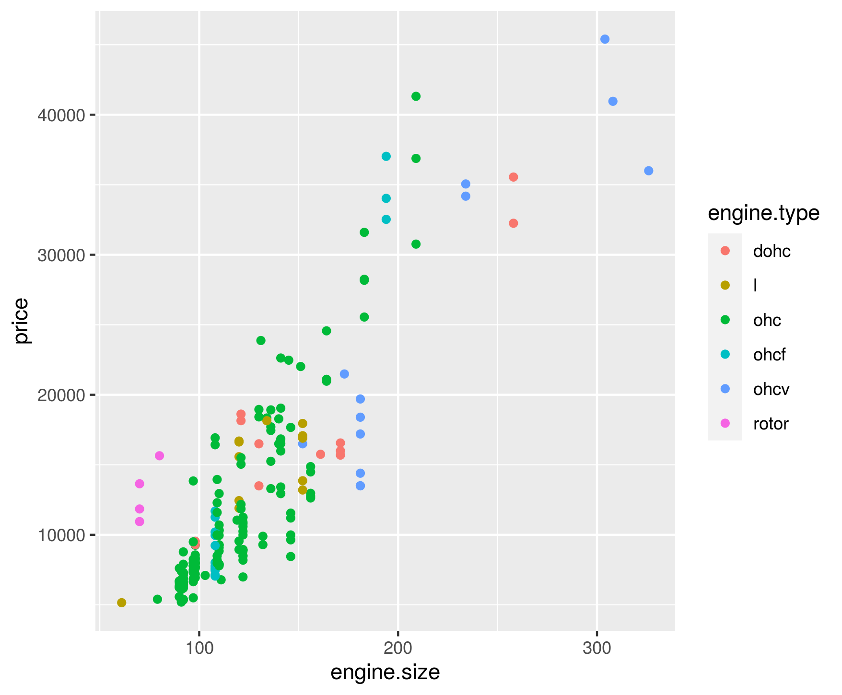
Engine.size vs price

Slide 7
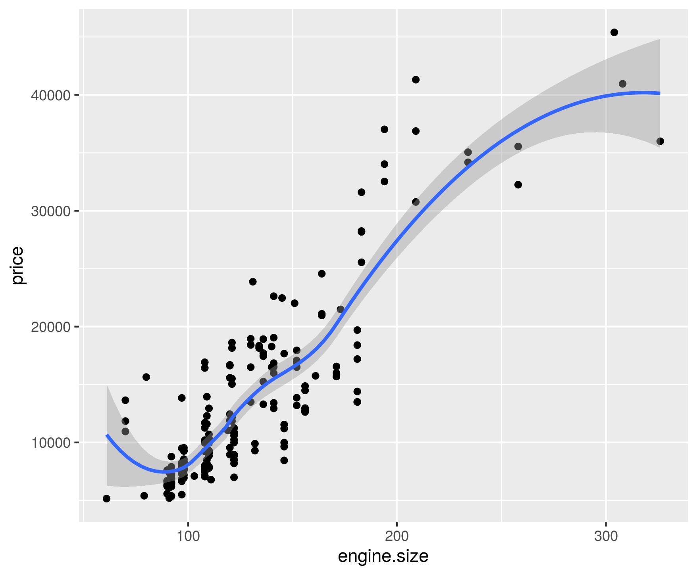
Engine.size vs price

Slide 8
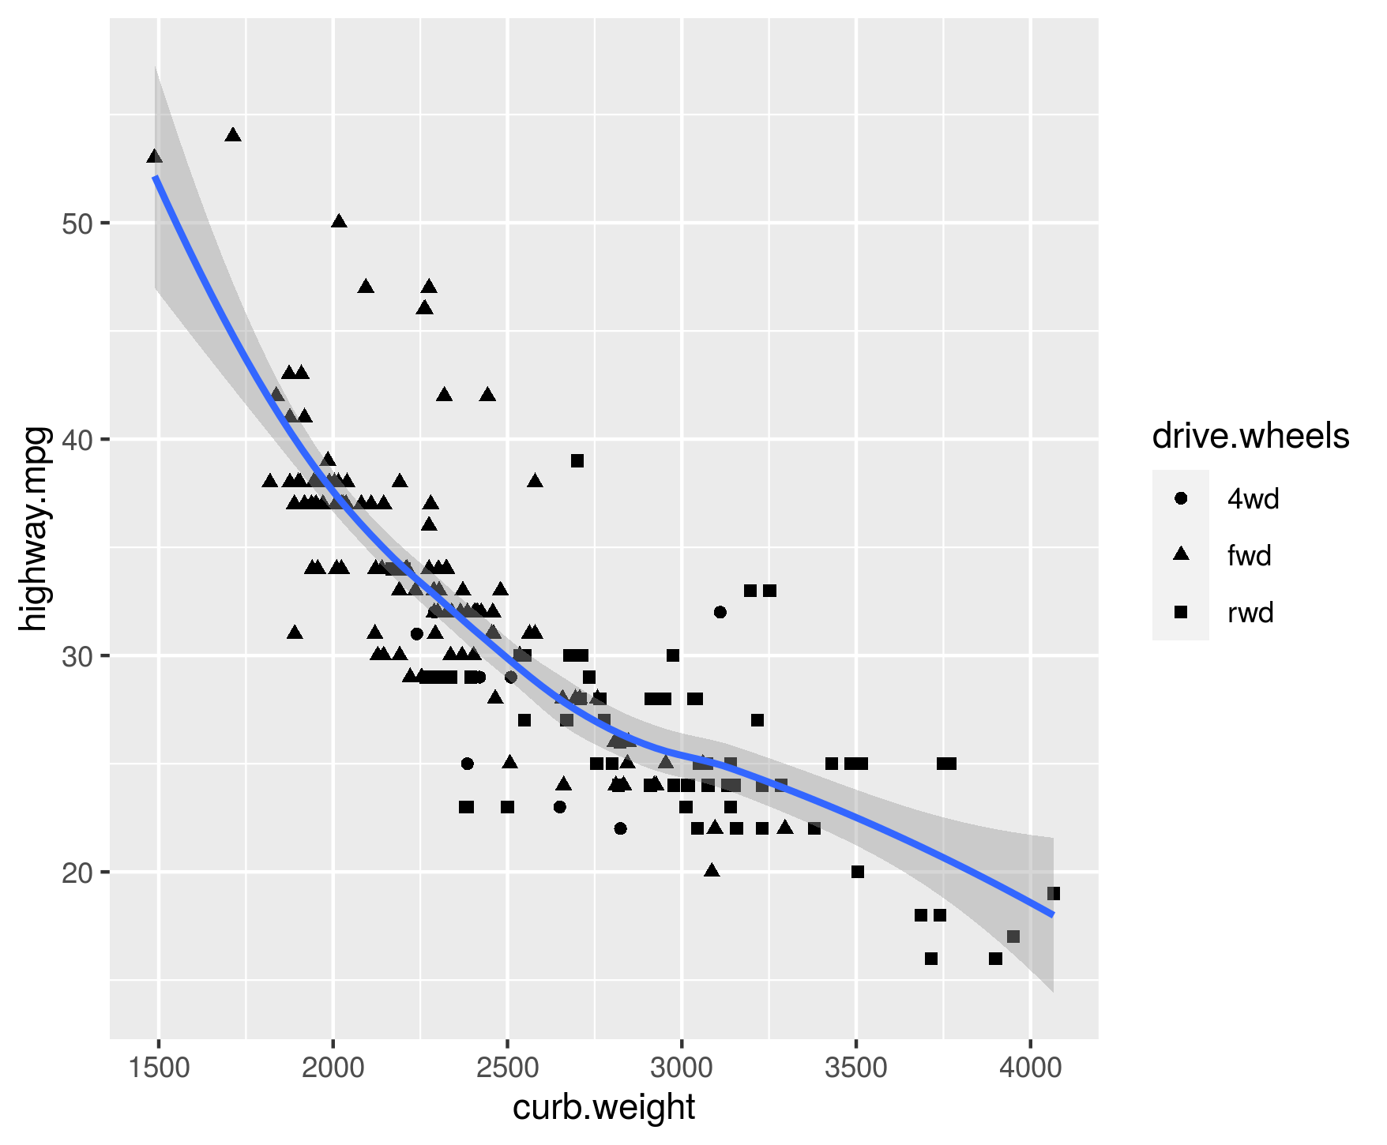
Curb.weight vs highway.mpg

Slide 9
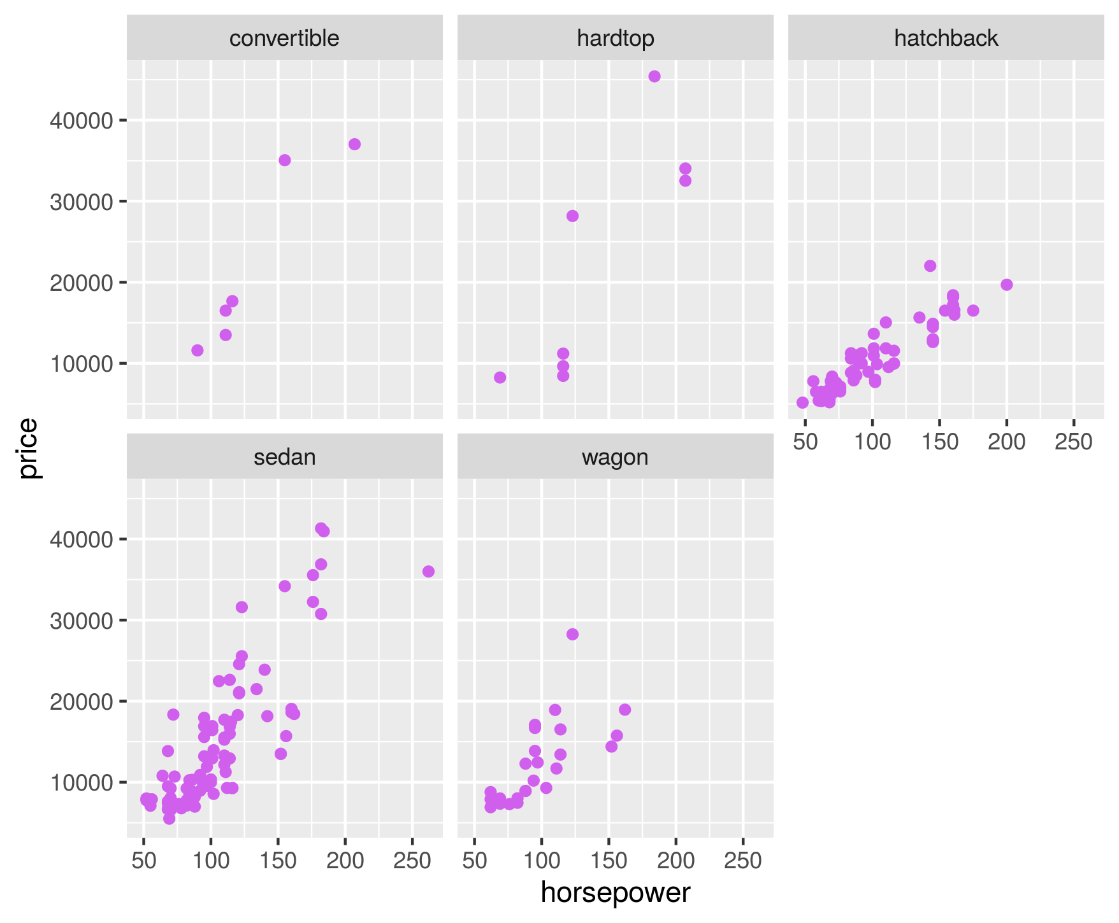
Horsepower and price

Slide 10
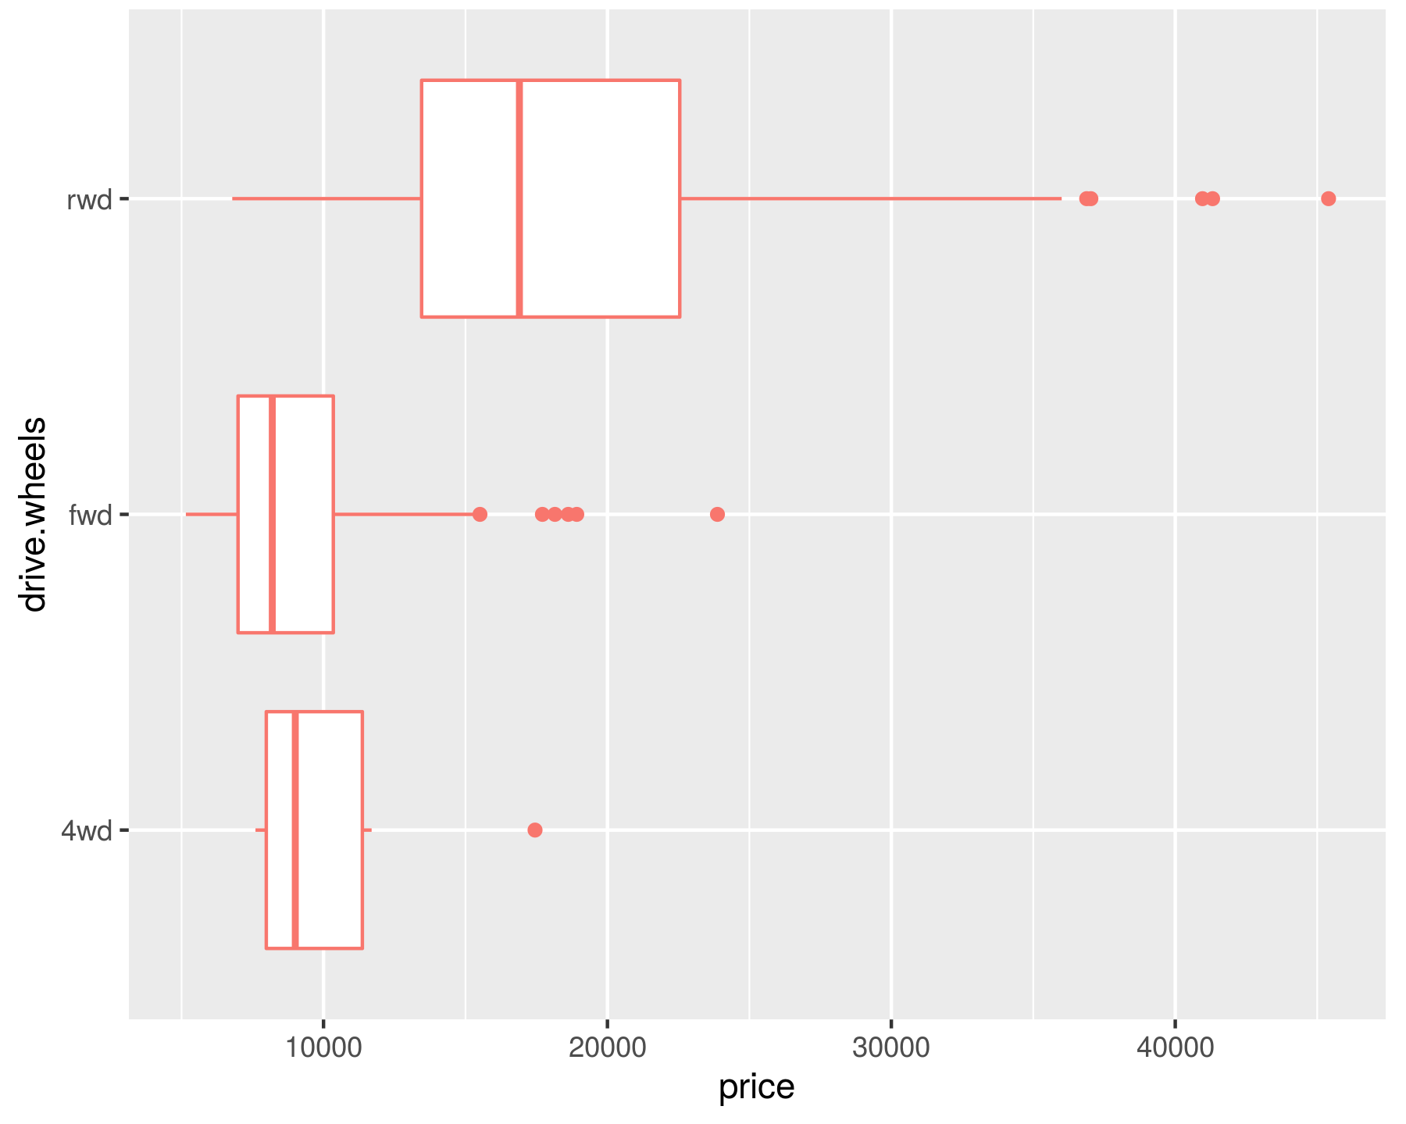
Boxplot of price based on drive.wheels

Slide 11
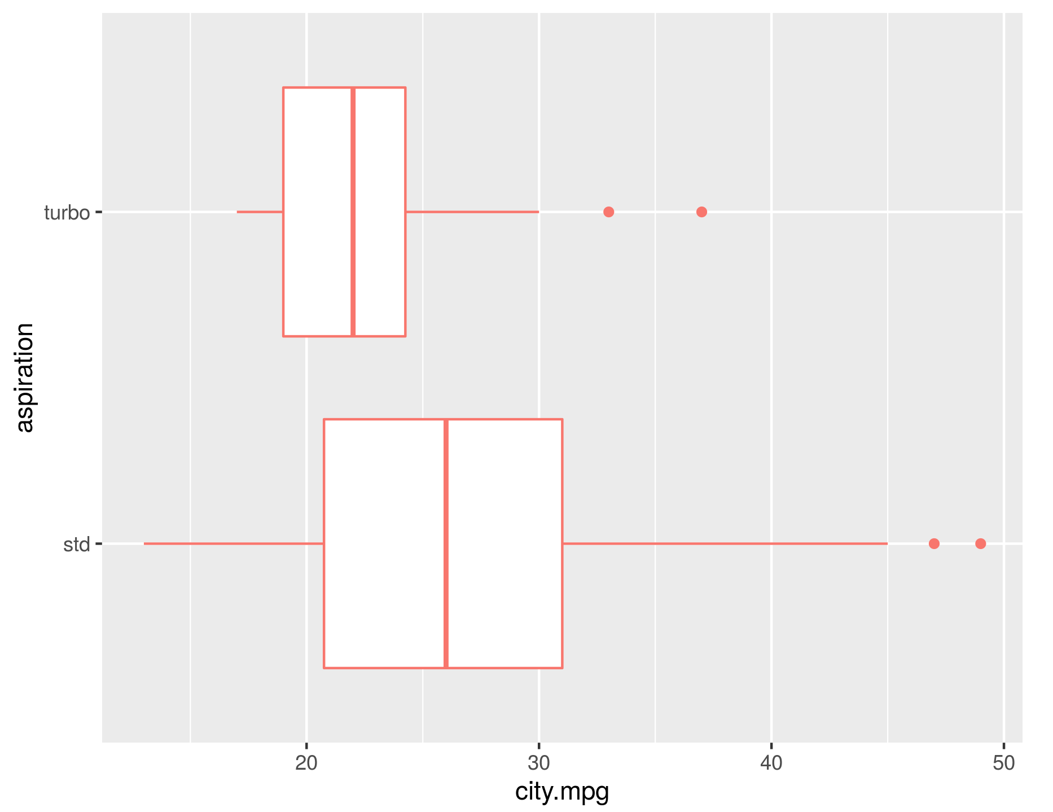
Boxplot of city.mpg based on aspiration

Slide 12
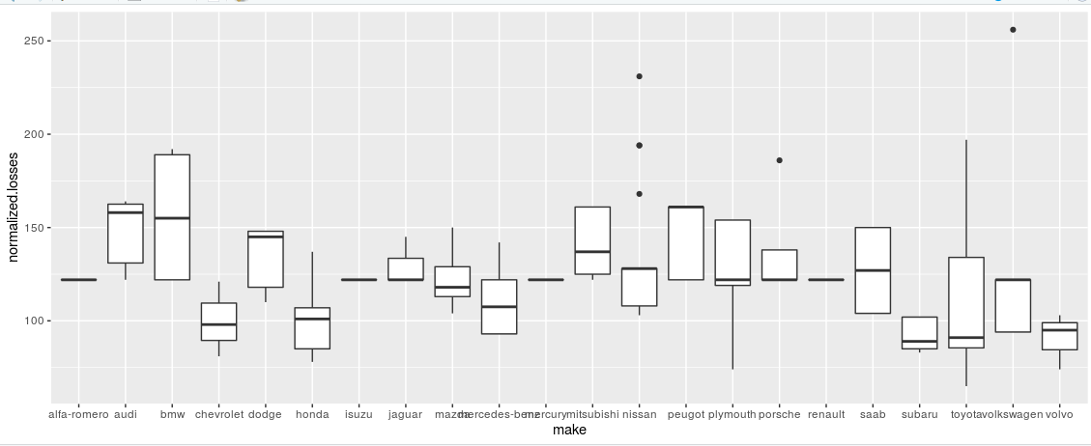
Boxplot between normalized losses and manufacturing company

Slide 13
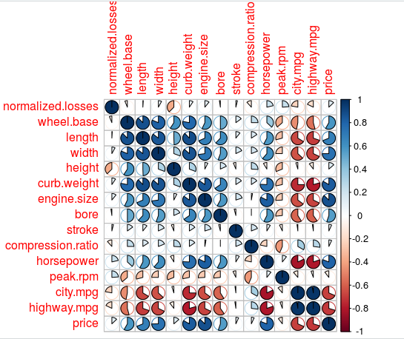
Correlation between variables

Slide 14
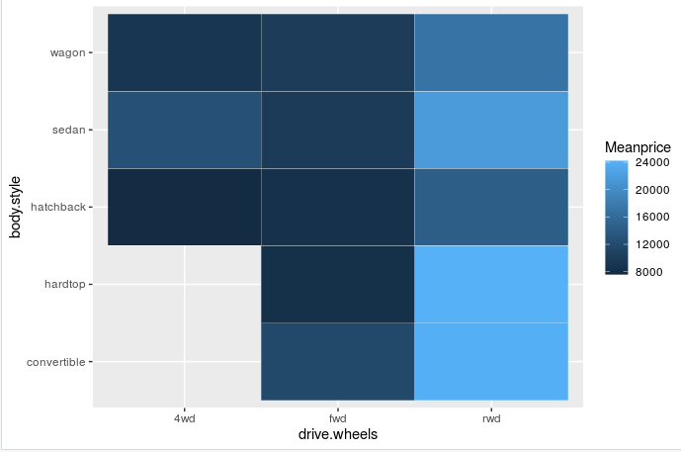
Heatmap

Slide 15
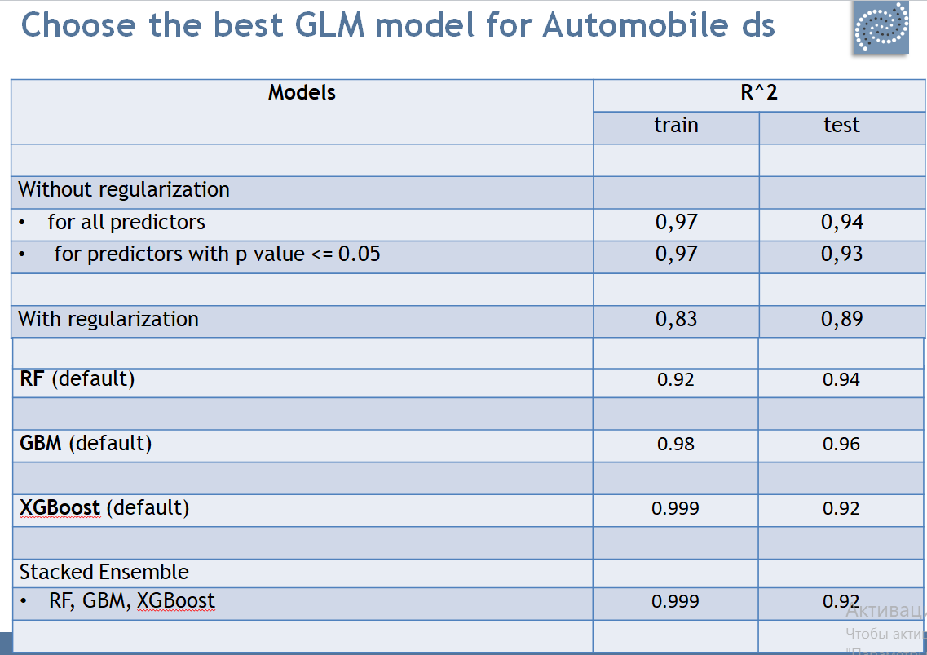

Slide 16
