Slide 1
SECURE DIGITAL STUDENT VOTING SYSTEM
A Modern MERN-Stack Election Platform
Presented by: ASLAM (2301112345)
Guided by: MS. REMITHA N V

Slide 2
THE CHALLENGE
• Traditional Voting Issues
- Long physical queues and high administrative cost
- Paper waste and manual counting errors
- Potential for vote duplication and fraud
• Our Solution
- Modern web-based portal with instant results
- Zero physical infrastructure requirements
- End-to-end encryption for tamper-proof counting

Slide 3
PROJECT OBJECTIVES
SECURITY | Ensuring one-student-one-vote through atomic database operations.
USABILITY | Modern, intuitive UI using glassmorphism and smooth animations.
TRANSPARENCY | Live visualization of results for administrators.
EFFICIENCY | Automated calculations with zero manual overhead.

Slide 4
TECHNOLOGY STACK (MERN)
FRONTEND
BACKEND
DATABASE
React.js, Vite,
Framer Motion,
Axios, Lucide React
Node.js, Express,
Mongoose ODM,
Bcrypt, JWT
MongoDB Atlas,
Cloud Document Storage,
NoSQL Architecture

Slide 5
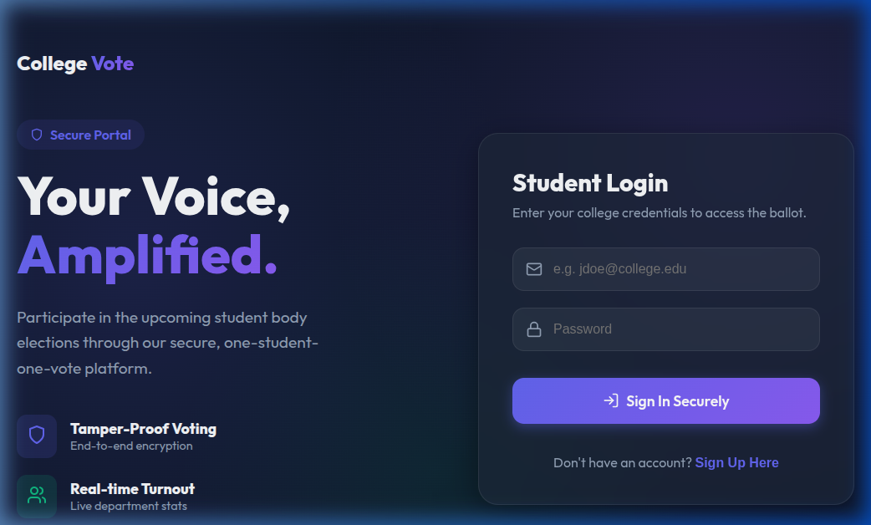
SECURE ACCESS
Custom email validation for student authentication.

Slide 6
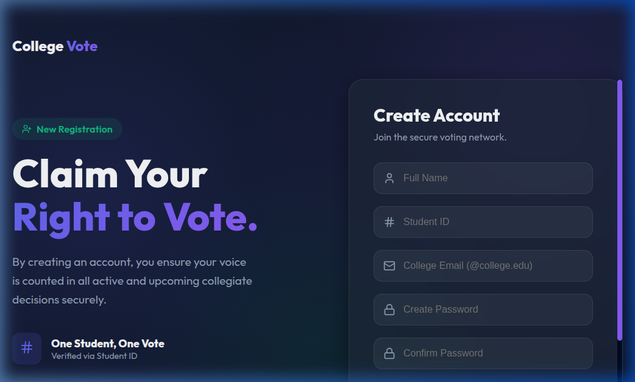
VOTER ONBOARDING
Registration portal for first-time student users.

Slide 7
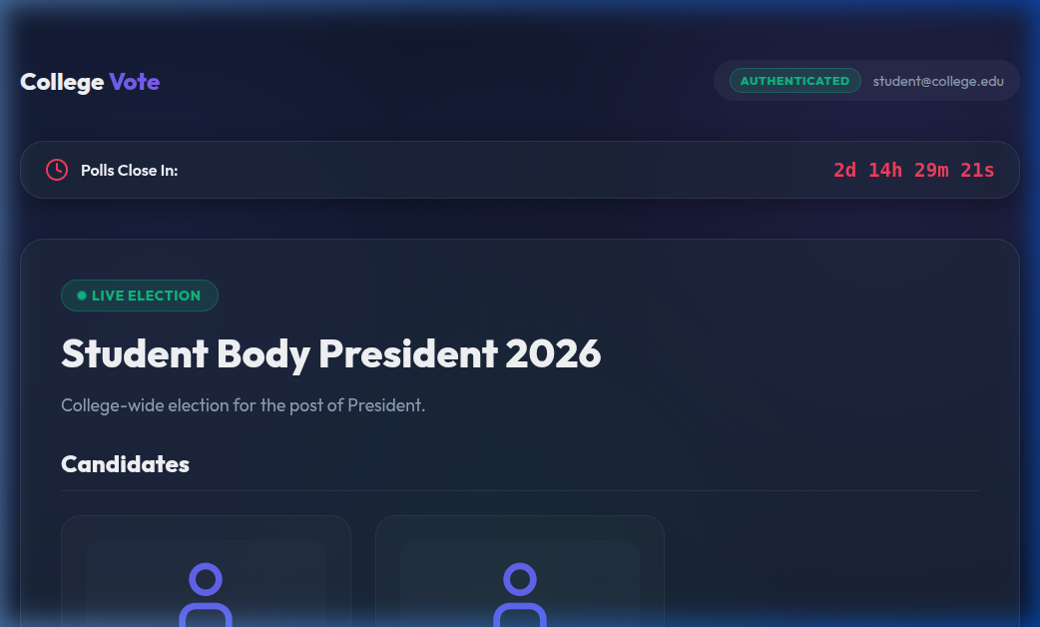
VOTER DASHBOARD
Unified interface for monitoring active elections.

Slide 8
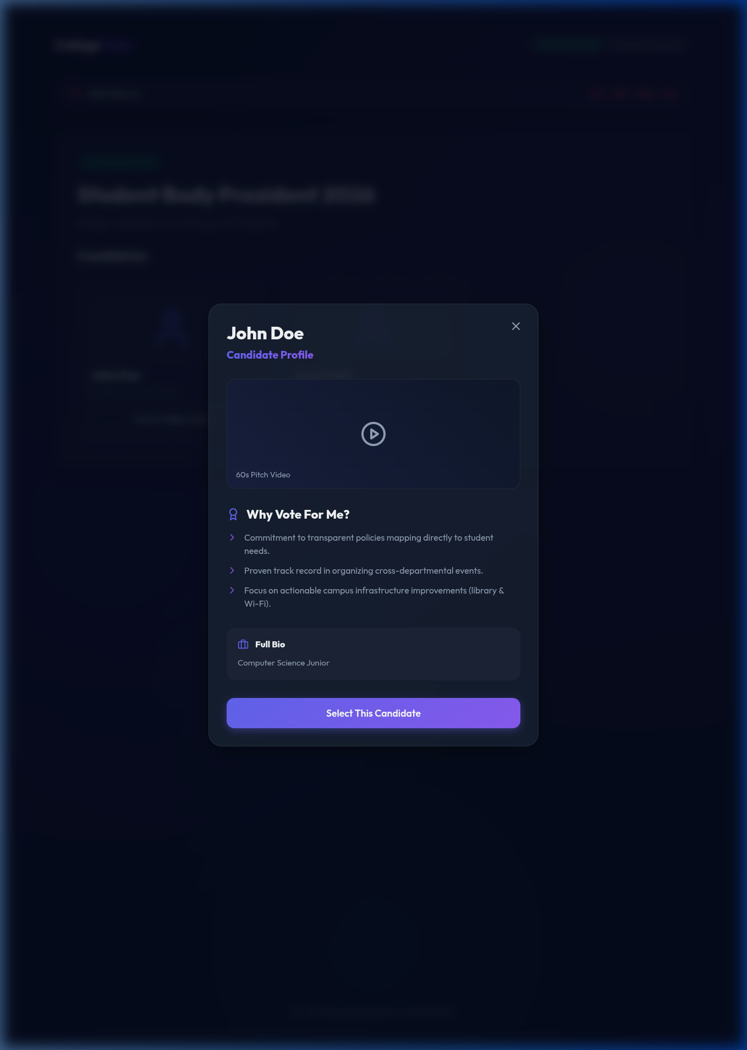
CANDIDATE INSIGHTS
Detailed profiles and campaign bios.

Slide 9
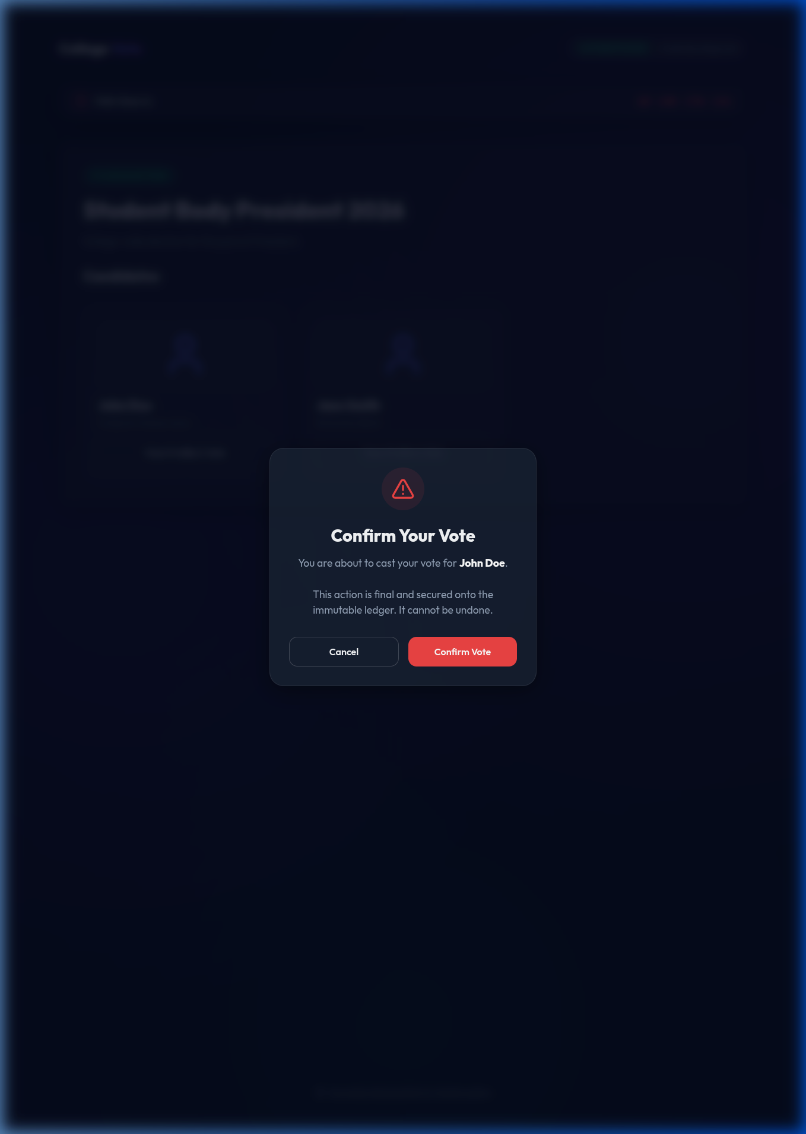
THE VOTING PROCESS
Multi-step confirmation to eliminate errors.

Slide 10
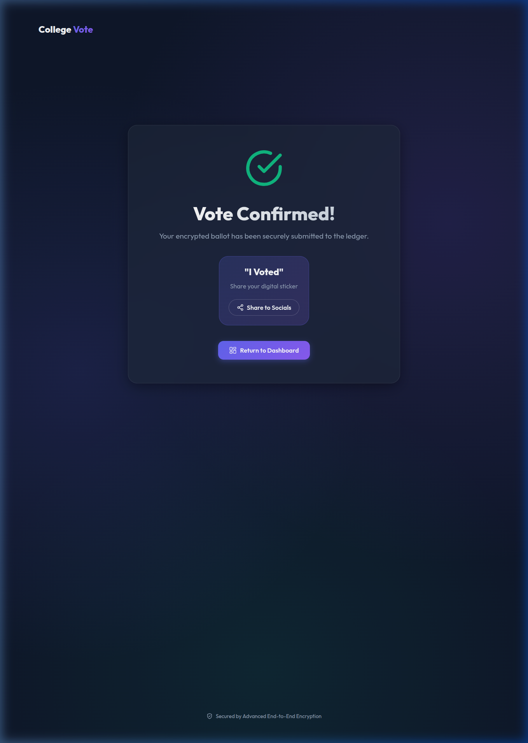
VOTE CONFIRMATION
Instant feedback upon successful vote casting.

Slide 11
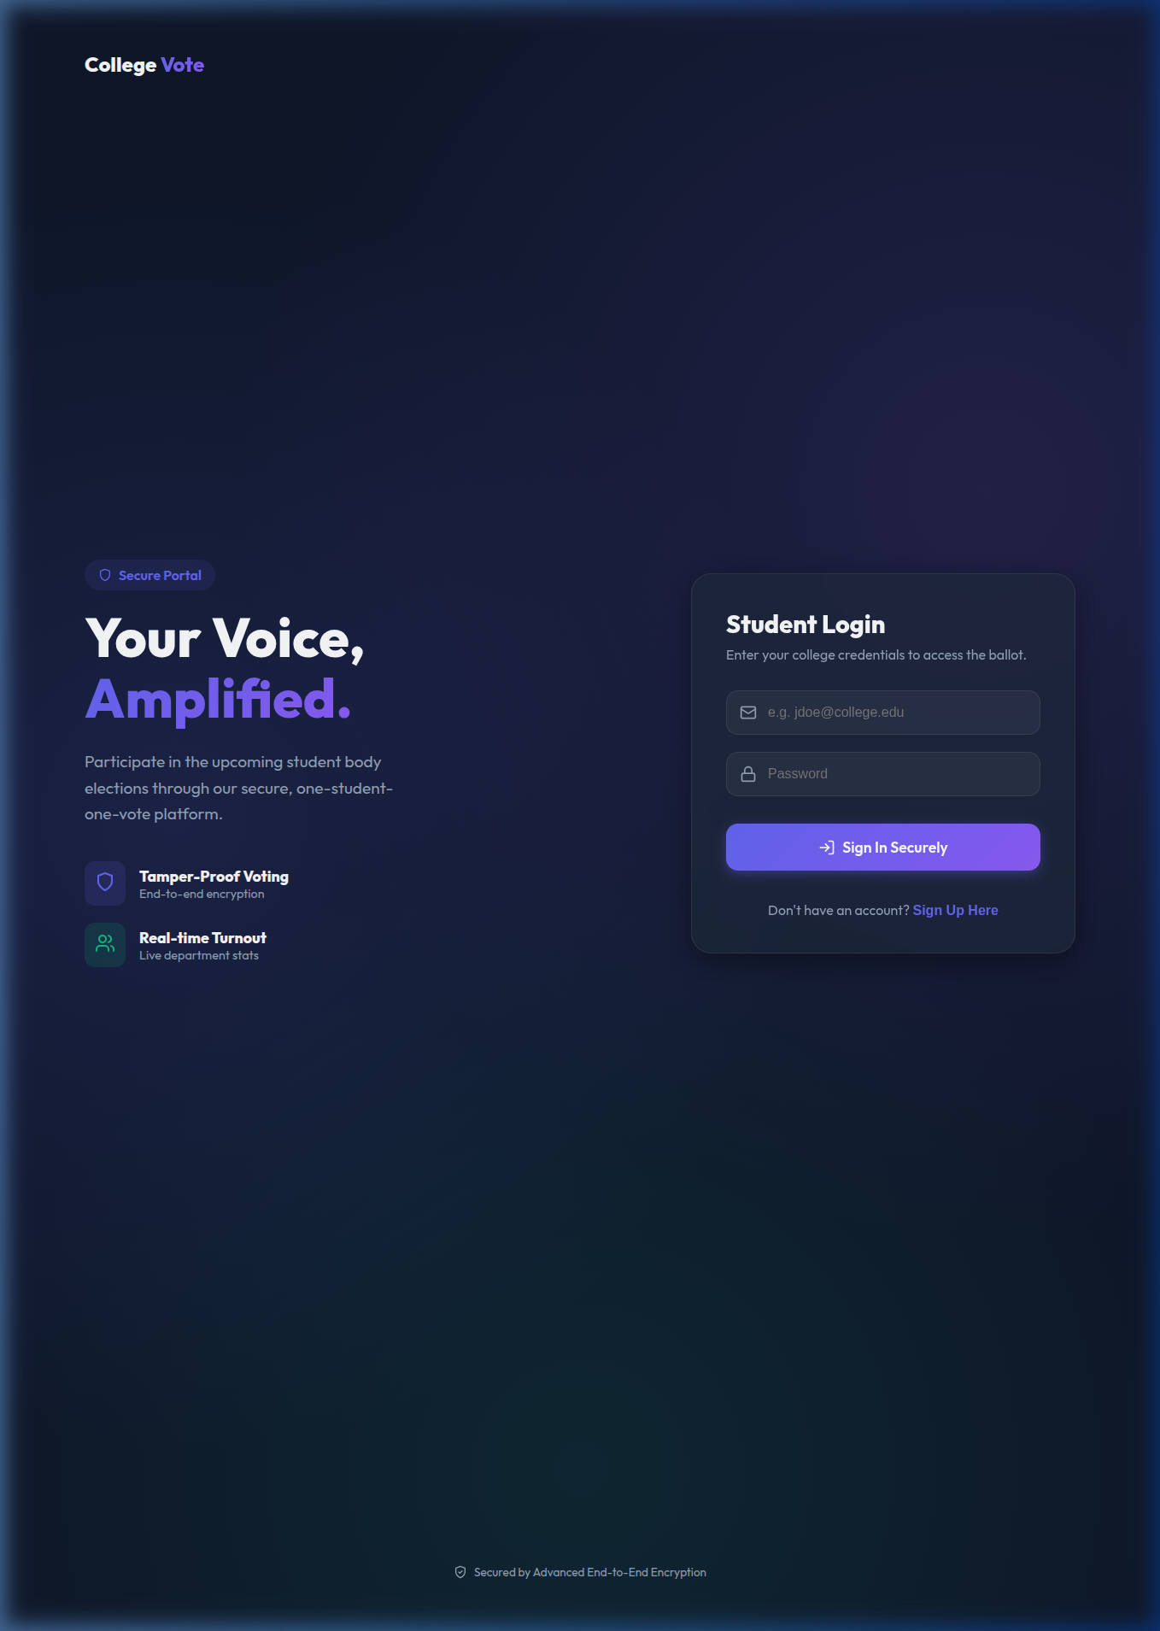
ADMIN ANALYTICS
Real-time results dashboard and visualization.

Slide 12
FUTURE HORIZONS
• Blockchain Integration Ensuring immutable audit trails for every vote. • Biometric Authentication Adding face/fingerprint recognition for identity proof. • Mobile App Release
Native mobile support for seamless voting on-the-go.

Slide 13
THANK YOU!
Questions & Discussion

