Slide 1

Larry cai <larry.caiyu@gmail.com>

Slide 2
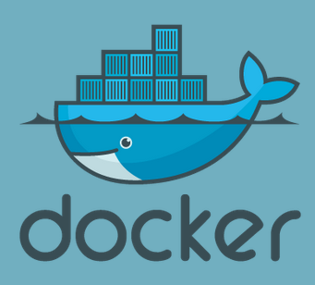
Agenda
Introduction
Exercise 1: First docker container
Exercise 2: Add package and create own docker image
Exercise 3: Understand layer
Exercise 4: Expose the service
Exercise 5: Dockerfile to build
Exercise 6: Publish your image in docker.io index registry
Reference
Online for ex1/ex2: https://www.docker.io/gettingstarted/
Online for ex5: https://www.docker.io/learn/dockerfile/
Learn docker in 90 minutes

Slide 3

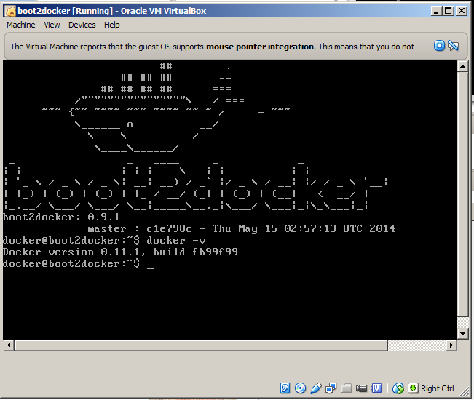
Environment Preparation
Boot2docker Installer (127M)
  Contains latest docker already, fast
  Container persistence via disk automount on /var/lib/docker
  Add proxy /var/lib/boot2docker/profile if needed
    $ sudo vi /var/lib/boot2docker/profile
    export http_proxy=<your proxy>
    $ sudo /etc/init.d/docker restart
  $ docker -v
  User/Passwd: docker/tcuser
http://boot2docker.io/
Learn docker in 90 minutes

Slide 4
Issues
Boot2docker is excellent to start with, But
  Boot2docker 1.1.0 windows has problem, see issue https://github.com/boot2docker/windows-installer/issues/23
  (choose other distribution or check inside)
  Inside container, DNS could be set to google default, see issue
  https://github.com/boot2docker/boot2docker/issues/357
  Workaround (welcome PR)
  $ sudo udhcpc
  $ sudo /etc/init.d/docker restart
Share folder using guest addition (not officially used, but popular)
https://medium.com/boot2docker-lightweight-linux-for-docker/boot2docker-together-with-virtualbox-guest-additions-da1e3ab2465c
Learn docker in 90 minutes

Slide 5

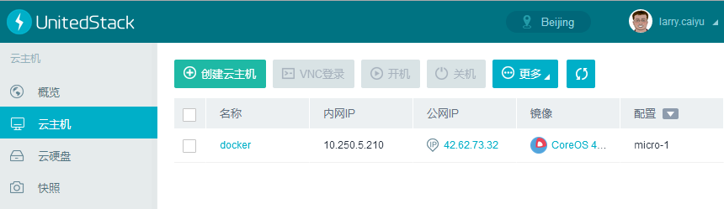
Or Ustack online environment
Register in https://www.ustack.com/cloudservice/public-cloud/
Select CoreOs VirtualMachine with key pair
Arrange Public IP for it to access
$ ssh -i id_rsa core@42.64.x.x
Reference: https://www.ustack.com/blog/running-coreos-on-uos/ (Chinese)
Learn docker in 90 minutes

Slide 6
Or Ubuntu 14.04 Environment
Ubuntu 14.04 (recommend to use virtualbox if windows)
  $ sudo apt-get install docker.io
  $ sudo ln -sf /usr/bin/docker.io /usr/local/bin/docker
  $ sudo usermod -a -G docker <user>
  # <user> is the normal user name
if need proxy
  $ sudo vi /etc/default/docker.io
  $ sudo service docker.io restart
  $ docker -v
  Docker version 0.9.1, build 3600720
Upgrade to latest docker: http://askubuntu.com/questions/472412/how-do-i-upgrade-docker
Learn docker in 90 minutes

Slide 7
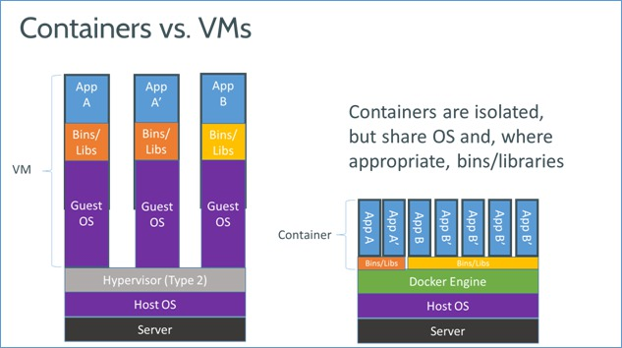
Introduction
Docker is an open-source engine that automates the deployment of any application as a lightweight, portable, self-sufficient container that will run virtually anywhere.
Based on LXC (Linux Container), easy to use.
Similar to VM as end-user with different features
Learn docker in 90 minutes

Slide 8
Exercise 1: First docker container
Download central place for ubuntu
Execute command inside container
Interactive with container
$ docker search ubuntu # from lots of release
$ docker pull ubuntu:latest # may take minutes
Pulling repository ubuntu
ad892dd21d60: Pulling dependent layers
511136ea3c5a: Pulling fs layer
..
$ docker images # list local images
REPOSITORY TAG IMAGE ID CREATED VIRTUAL SIZE
ubuntu latest ad892dd21d60 6 days ago 275.5 MB
$ docker run ubuntu echo “Hello World”
$ docker run -i -t ubuntu /bin/bash
Learn docker in 90 minutes

Slide 9
`docker` - the command line tool
Some common commands:
  $ docker search # search hub.docker.com for an image
  $ docker pull # download image
  $ docker images # list all existing local images
  $ docker run # initiates a container from an image
  $ docker ps # list running containers
  $ docker build # build images from Dockerfile
$ docker start/stop/kill # commands
$ docker rm/rmi to remove a container or image
Learn docker in 90 minutes

Slide 10
Exercise 2: Add own package and image
Try to install apache2 inside (could update /etc/apt/sources.list)
  $ docker run -i -t ubuntu /bin/bash
  # apt-get update && apt-get install –y apache2
  # exit
$ docker ps –l # -l means –latest
CONTAINER ID IMAGE COMMAND CREATED STATUS
c4bd63cc87f1 ubuntu:latest bash 2 minutes ago Exited 2 sec
$ docker commit <container id> apache2
66db661d9ad8681b082bb62b21b6ef5f2ddb4799e3df5dbd8fb23aed16616b1d
Check and run it again to see the apache is there
$ docker images
REPOSITORY TAG IMAGE ID CREATED VIRTUAL SIZE
apache2 latest 66db661d9ad8 28 seconds ago 298.5 MB
ubuntu latest ad892dd21d60 6 days ago 275.5 MB
$ docker run –i –t apache2 bash
Learn docker in 90 minutes

Slide 11
Docker image & layer
Docker images are saved in layered !!
  Differed binary for apache2 image
$ docker images –tree
Warning: '--tree' is deprecated, it will be removed soon. See usage.
└─511136ea3c5a Virtual Size: 0 B
└─e465fff03bce Virtual Size: 192.5 MB
└─23f361102fae Virtual Size: 192.7 MB
└─9db365ecbcbb Virtual Size: 192.7 MB
└─ad892dd21d60 Virtual Size: 275.5 MB Tags: ubuntu:latest
└─66db661d9ad8 Virtual Size: 298.5 MB Tags: apache2:latest
http://docs.docker.io/terms/layer/
Learn docker in 90 minutes

Slide 12
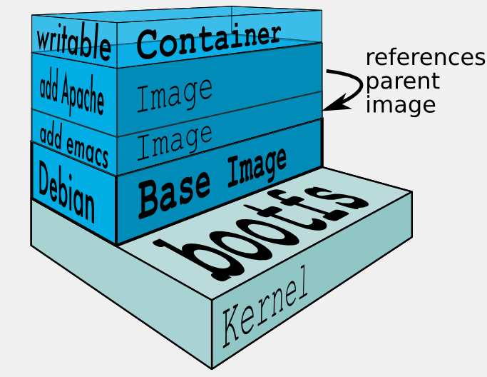
Docker image & layer
When Docker mounts the rootfs, it starts read-only, it takes advantage of a union mount (aufs) to add a read-write file system over the read-only file system.
There may be multiple read-only file systems stacked on top of each other. We think of each one of these file systems as a layer.
http://docs.docker.io/terms/layer/
Learn docker in 90 minutes

Slide 13
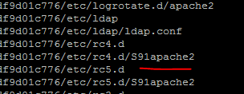
Exercise 3: Understand the layer
Data are stored under /var/lib/docker (root permission)
  aufs is used in boot2docker, could be others like devicemapper/btrfs …
$ ls –al /var/lib/docker
$ ls -1 /var/lib/docker/aufs/diff/
..
66db661d9ad8681b082bb62b21b6ef5f2ddb4799e3df5dbd8fb23aed16616b1d/
9db365ecbcbbb20e063eac70842c53e27fcad0e213f9d4ddb78152339cedd3b1/
See what is diff inside /var/lib/docker/aufs/diff/<image id> !!
$ find /var/lib/docker/aufs/diff/66* | grep apache2
See more http://blog.thoward37.me/articles/where-are-docker-images-stored/
Learn docker in 90 minutes

Slide 14
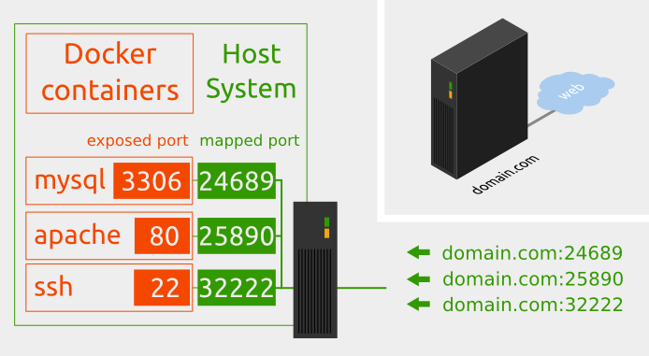
Docker service
Network in container is not visible outside (using NAT)
The service is exposed by Port !!
Run –p host:guest # assign port to host
    $ docker run –p 25890:80 –i –t apache2 bash
    # apache2ctl start
source from : http://pierre-jean.baraud.fr/blog/2014/06/02/host-docker-containers/
Learn docker in 90 minutes

Slide 15
Docker service
Interactive mode vs. Daemon (Deattach) mode
(docker run)
  -d : run in daemon mode
  -i : run in interactive mode
  (CTRL-P-Q to quit from shell to enter daemon mode, exit will stop the container)
  $ docker attach <container> : connect to existing container
Other parameters for docker run
--name : define container name
Learn docker in 90 minutes

Slide 16
Exercise 4: Expose the service
Export the port to host as 25890 and start the service manually
$ docker run -p 25890:80 –i -t apache2 bash
root@35ac981a49e5:/# service apache2 start (CTRL-P-Q)
$ docker ps
CONTAINER ID IMAGE …. STATUS PORTS NAMES
e020aa2c02a5 apache2:latest ….. Up 14 seconds 0.0.0.0:25890->80/tcp web
$ curl http://localhost:25890
Attach the container again to check ..
$ docker attach e020aa2c02a5
Run contain in daemon mode
$ docker run –p 25891:80 –d –t apache2 apache2ctl –D FOREGROUND
Learn docker in 90 minutes

Slide 17

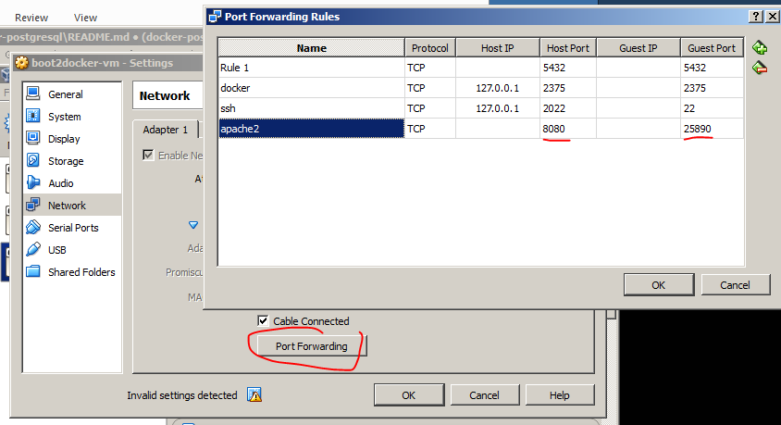
Port forward to Windows
Use boot2docker VM IP to access
$ boot2docker ip
  http://192.168.59.104:25890
Use Virtualbox (may cause network issues, not recommend)
  25890 is visible in VM
  8080 is visible in Host (Windows)
  http://localhost:8080
Learn docker in 90 minutes

Slide 18
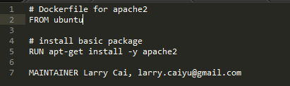
Dockerfile
Dockerfile instructs on how to build the image automatically
Dockerfile Syntax (INSTRUCTION arguments)
  FROM – defines base image
  RUN - executes arbitrary command
  ENV – sets environment
  EXPOSE – expose a port
  ADD – add local file
  CMD – default command to execute
  MAINTAIN – author information
Used by docker build
Learn docker in 90 minutes

Slide 19

Exercise 5: Dockerfile apache2/wget
Write the Dockerfile
$ vi /tmp/Dockerfile
$ cd /tmp
$ docker build –t wget .
$ docker images --tree
(may need ENV http_proxy <proxy>)
Start the wget image and verify !!
Learn docker in 90 minutes

Slide 20
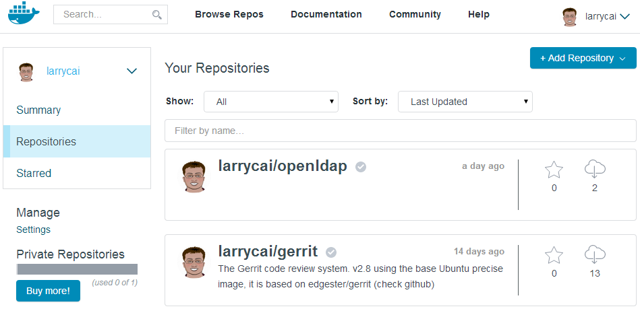
Share images in docker repository
Docker is also a tool for sharing. A repository is a shareable collection of tagged images that together create the file systems for containers.
Public repo. <username>/<repo_name>
$ docker search/pull/login/push
http://docs.docker.com/docker-hub/repos/
Learn docker in 90 minutes

Slide 21
(Bonus) Exercise 6: Share your image
Register in https://hub.docker.com/
Connect it with your github and build
Learn docker in 90 minutes

Slide 22
Bonus: more for docker
Run container in daemon
Use supervisor to control process
Several docker container as a complete service
Share disk between containers
Share disks with host
Network …
See next CodingWithMe for “Learn Docker in Depth”
Learn docker in 90 minutes

Slide 23
Summary
This is getting started training slides, door is open to you.
Benefit and use case will be added with your growing competence
Docker grows very fast, follow it.
Docker vs. openstack ? Friends/Competition …
Learn docker in 90 minutes

Slide 24
Reference
https://www.docker.io
http://prezi.com/d2vm7h0mmze5/containerize-it/
Blog: http://blog.thoward37.me/articles/where-are-docker-images-stored/
http://stackoverflow.com/questions/17252356/run-a-service-automatically-in-a-docker-container
Cool service, v5!
  http://drone.io open source CI system
  https://quay.io another register service
  http://www.tutum.co/ PaaS, AWS+Heroku
  http://ustack.com coreos image provider
Learn docker in 90 minutes

