Slide 1
Microservices
Fundamentals of microservice based architectures

Slide 2
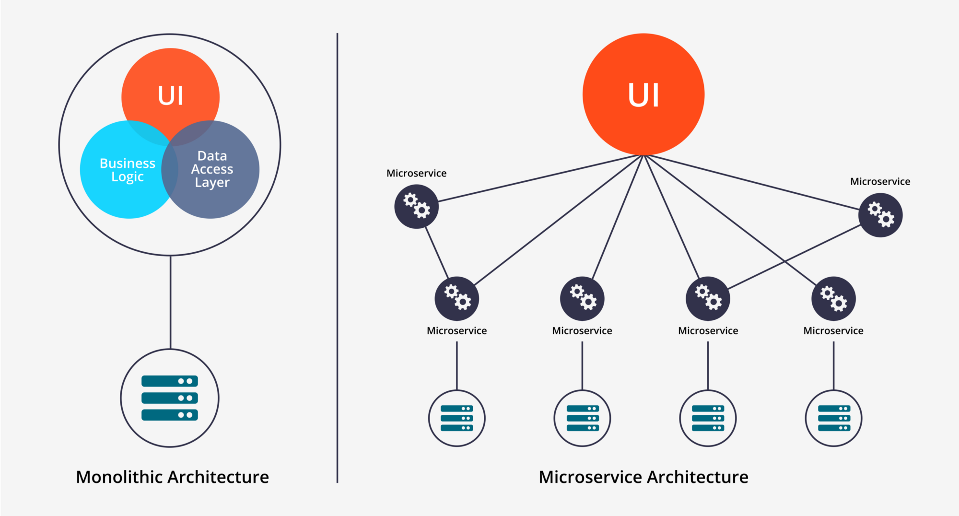
Microservice based architecture

Slide 3
Communication between services
Restful API calls
Too slow
Supported between different languages
RPC
Speed depends on what we use (JSON, protobuf)
Unsupported between different languages (or hard to implement it)
gRPC
Fast because of the protobuf
Supported between different languages (limited)

Slide 4
Communication between front - back - end
Restful API
GraphQL
gRPC-web (Improbable) - only HTTP2
Websockets (depends on)

Slide 5
Communication between front - back - end
Services have own communication protocols, but they don’t communicate directly with the client-side. There is another layer called API Gateway or Proxy layer

Slide 6
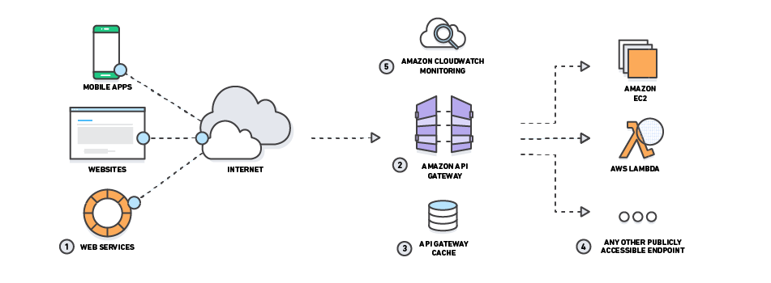
API Gateway

Slide 7
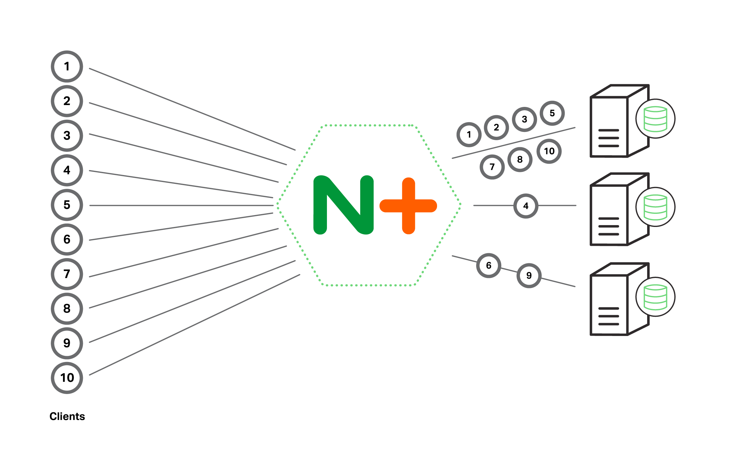
Proxy layer

Slide 8
Message queue systems
These systems purpose storing the data in memory or on the disk until they won’t have processed.
There is two different service, sender - receiver or producer - consumer
Popular message queue systems
RabbitMQ
NSQ

Slide 9
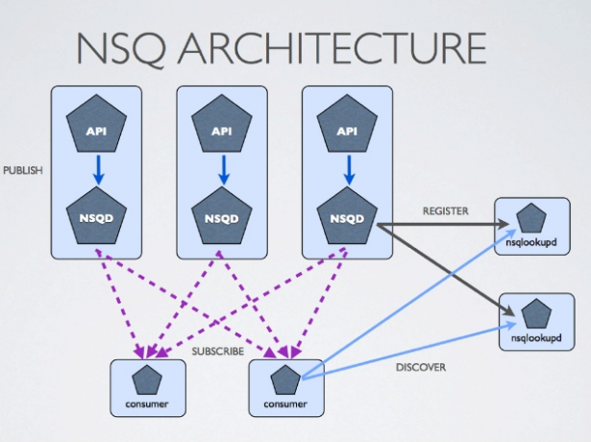
NSQ

Slide 10
Service discovery
Service discovery is a huge topic in microservice architectures.
Why? Because the services instances have dynamically assigned network locations, because of auto-scaling, failures, and upgrades.
The client makes a request to a service via load balancer. The load balancer checks the state of the service registry and attach the request to the closest service.
Popular service discovery tools
Consul
etcd
Nginx+

Slide 11
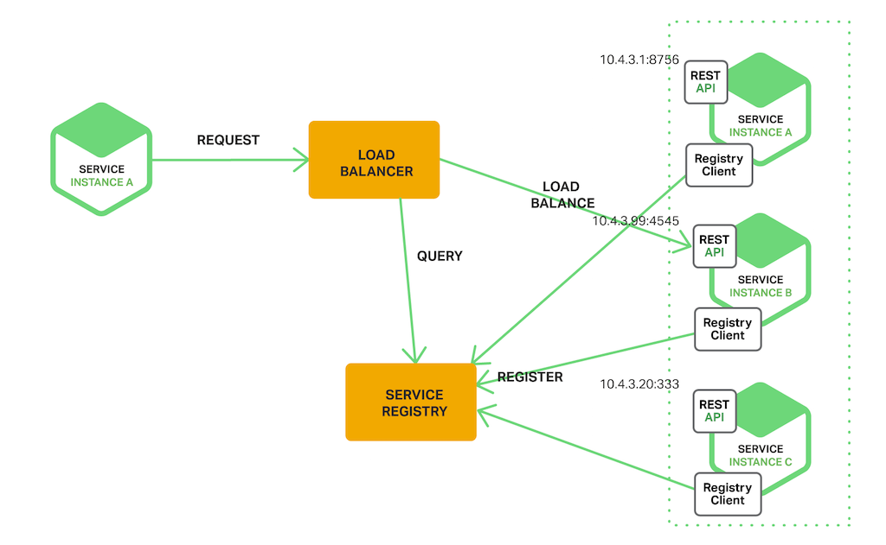
Server-side service discovery

Slide 12
Orchestration
Automated arrangement, coordination and management of complex computer systems
When everything ready pick an orchestration tool and deploy the services
Popular orchestration tools
Kubernetes
Docker-compose (lightweight)
Apache Marathon
Nomad (Hashicorp)

