Slide 1


LioCinema
Jotstar
OTT Merger : Future of Streaming

Slide 2
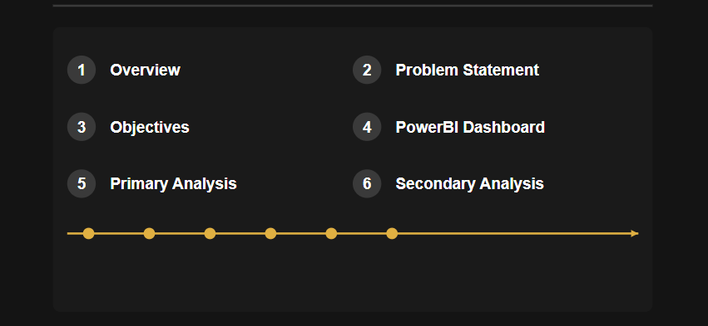
AGENDA :

Slide 3
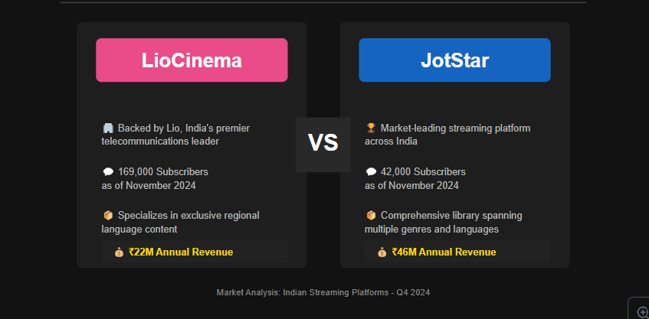
1. Overview : Platforms Key Strengths Before Merger
183,000 Subscribers
45,000 Subscribers

Slide 4

2. Problem Statement:
Lio, a leading telecom provider, and Jotstar, a prominent streaming platform, are merging to revolutionize digital streaming in India.
As part of the merger preparation, Lio management requires a detailed analysis of both platforms (LioCinema and Jotstar) over the past year (Jan-Nov 2024)
Analysis Focus Areas
Individual Platform Performance
Subscriber Insights
Inactivity Analysis
Upgrade Patterns
Downgrade Patterns
Content Consumption Behaviour

Slide 5
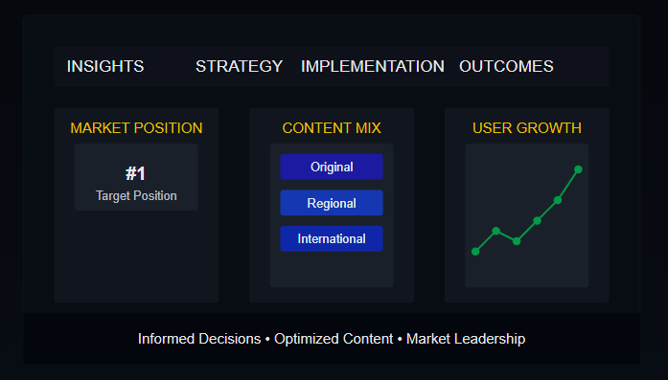
3. Objective
My role, as a Data Analyst at Lio, is to provide actionable insights to the management team. Specifically, I aim to:
Conduct a comprehensive Content Library Analysis, detailed subscribers' behavior and revenue analysis.
The insights derived from this study will help the management make informed decisions and optimize content strategies post-merger, with the ultimate goal of establishing Lio-Jotstar as the leading OTT platform in India.

Slide 6

4. POWER BI DASHBOARD:

Slide 7
5. PRIMARY ANALYSIS:
Tool Used : Python
Check complete analysis here :

Slide 8

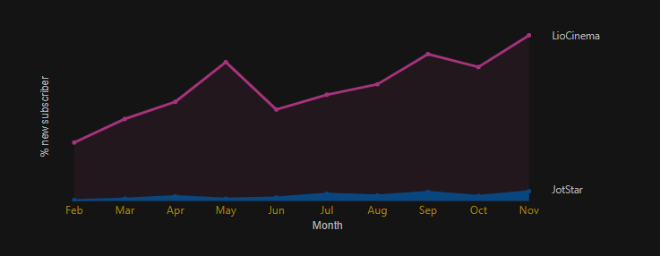
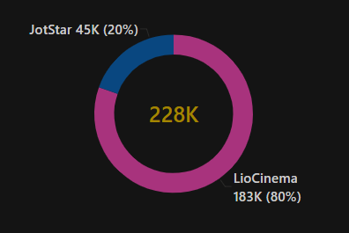
Q1. Total Users & Growth Trends
● What is the total number of users for LioCinema and Jotstar, and how do they compare in terms of growth trends (January–November 2024)?
Subscriber’s Growth Rate (MOM)
Subscriber’s Market Share
LioCinema shows exponential increase in users, with CMGR of 39%.
Jotstar shows a linear growth, with CMGR of 27.5%.
LioCinema has 4x larger user base than Jotstar

Slide 9
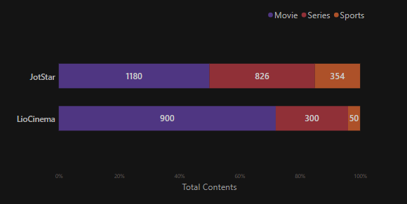
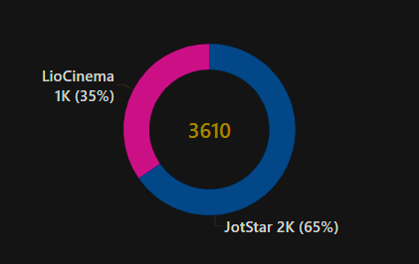
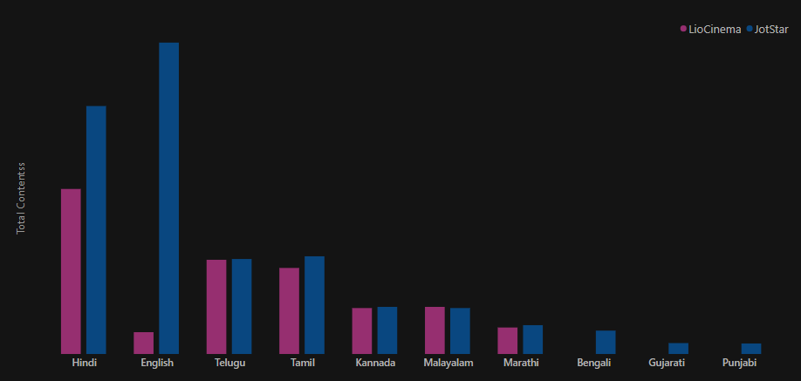
Q2. Total Content Library Comparison
● What is the total number of contents available on LioCinema vs. Jotstar? How do they differ in terms of language and content type?
Content-Type Distribution
Content Distribution
Jotstar - Diverse distribution.
LioCinema – Movie Centric
Jotstar offers 30% more content than LioCinema
Language Distribution
LioCinema – Regional language focused
Jotstar – Diverse regional languages and International language.

Slide 10


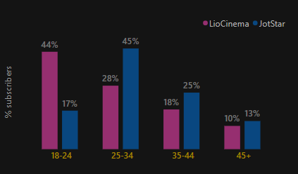
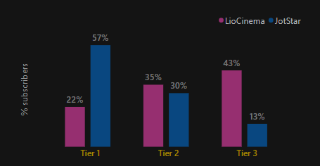
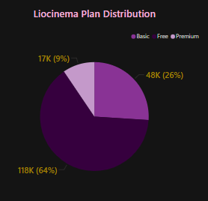

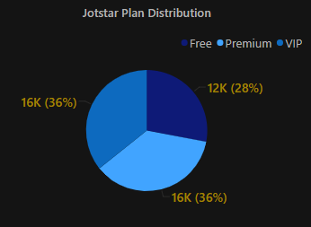
Q3. User Demographics
● What is the distribution of users by age group, city tier, and subscription plan for each platform?
Age-Group
City tier
LioCinema popular among Youth (18-24)
Jotstar among Young Adults (25-34)
LioCinema popular in Tier-3
Jotstar popular in Tier-1.
Both platforms shows equal distribution in Tier-2.
Subscription Plan
LioCinema have 64% of Free users indicates users less willing to pay.
Jotstar has 72% of paid users indicates better monetization.
Jotstar have 27% more Premium users.

Slide 11
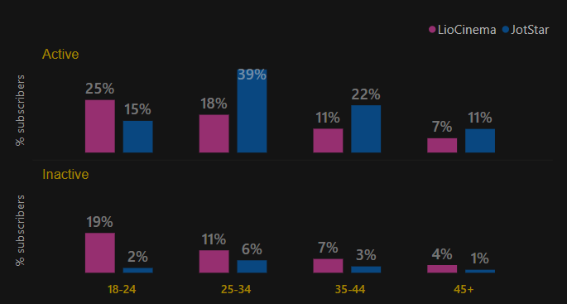
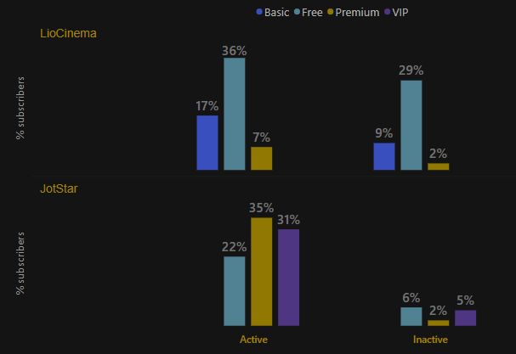
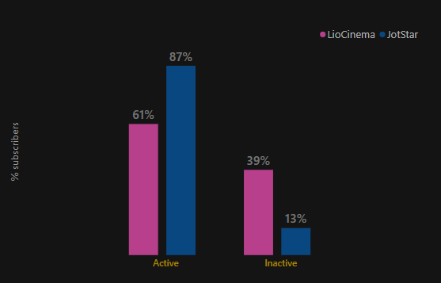
Q4. Active vs Inactive Users
● What percentage of LioCinema and Jotstar users are active vs. inactive? How do these rates vary by age group and subscription plan?
Age-Group
Platform comparison
Subscription Plan
LioCinema
Active
Inactive
Jotstar
Active
Inactive
LioCinema have highest amount of active and inactive users among the Youth (18-24)
Jotstar shows better retention in all age-groups not exceeding 6%.
Jotstar have 26% more active users than LioCinema.
LioCinema have 26% more inactive users.
Jotstar shows better retention of users.
Both platforms shows better retention for Premium Plan.
LioCinema have higher active and inactive for free plan.
Jotstar have high activity in all plans.

Slide 12

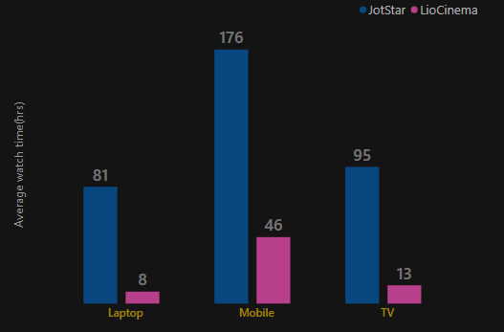
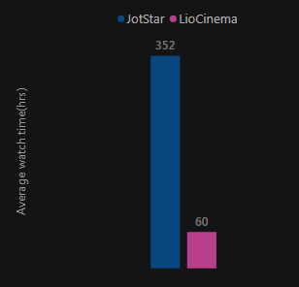
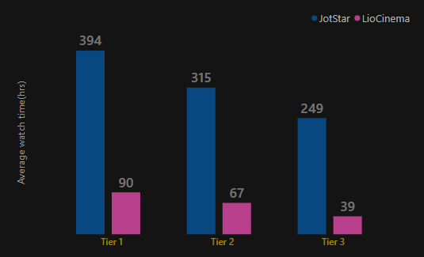
Q5. Watch Time Analysis
● What is the average watch time for LioCinema vs. Jotstar during the analysis period? How do these compare by city tier and device type?
Devices
Platform comparison
City-Tier
Mobile is the most popular device.
Jotstar shows high engagement in all the devices
LioCinema shows high engagement in Mobile and then declines sharply.
Jotstar maintained high engagement in all cities.
LioCinema engagement is weak in all tiers.
Jotstar users watch ~480% more content than LioCinema users, indicating higher engagement and a stronger content strategy.

Slide 13
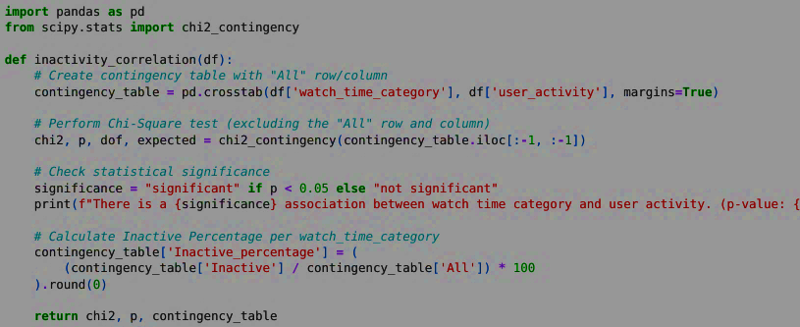
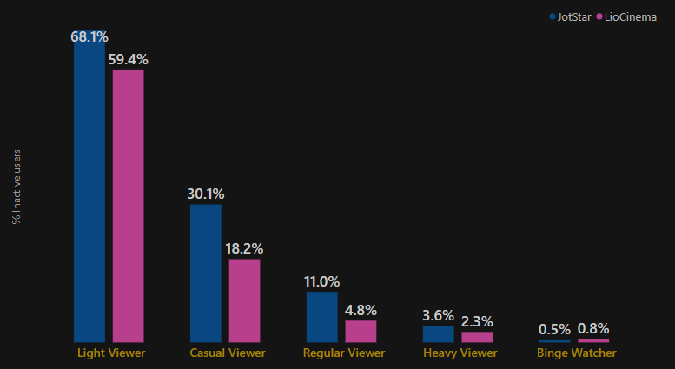


Q6. Inactivity Correlation
● How do inactivity patterns correlate with total watch time or average watch time? Are less engaged users more likely to become inactive?
Statistical Analysis: Watch Time vs. Inactivity
Inactivity Trends by Watch Category
Light viewers have the highest inactivity rate (over 60%), while binge watchers remain the most engaged.
There is a statistically significant correlation between watch time and inactivity, with p-value = 0.00000.
Casual and regular viewers show moderate inactivity rates, suggesting engagement levels impact retention.

Slide 14
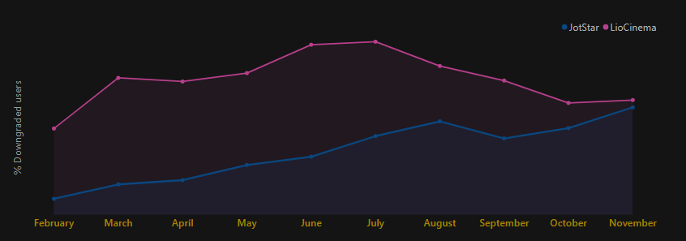
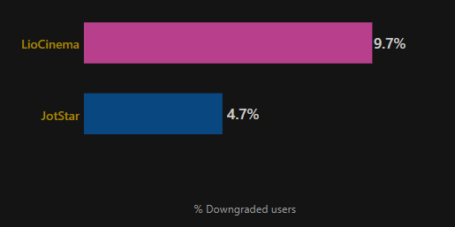
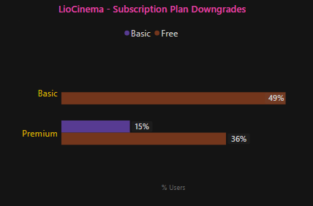
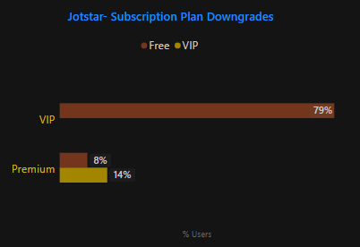
Q7. Plan Downgrade Trends
● How do downgrade trends differ between LioCinema and Jotstar? Are downgrades more prevalent on one platform compared to the other?
Downgrade rate Comparison
Downgrade Trend
Subscription Plan
LioCinema has 2.2 times higher downgrades than Jotstar, shows weak user retention.
LioCinema 36% of Premium downgrades go directly to Free, leading to a major revenue loss.
Jotstar only 7.9% of Premium users downgrade to Free—4.5x lower than LioCinema

Slide 15
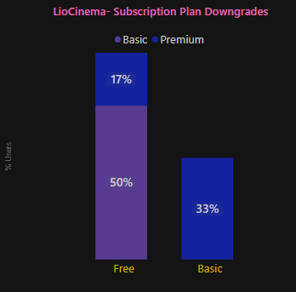
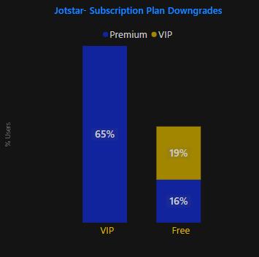
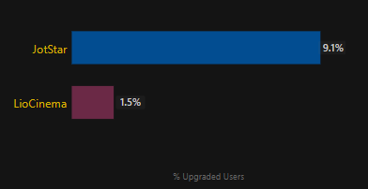
Q8. Plan Upgrade Patterns
● What are the most common upgrade transitions (e.g., Free to Basic, Free to VIP, Free to Premium) for LioCinema and Jotstar? How do these differ across platforms?
Upgrade rate Comparison
Subscription Plan
Jotstar has 6x times higher upgrades than Jotstar.
JotStar :Strong performance in direct-to-premium conversions
LioCinema : Multi-step upgrade journey is prevalent.
80% of JotStar users upgrade to Premium vs. 50% of LioCinema users

Slide 16
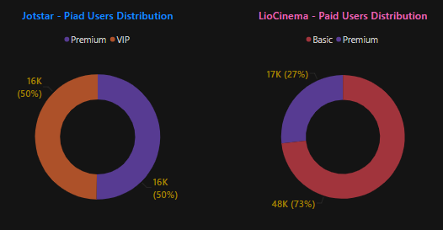
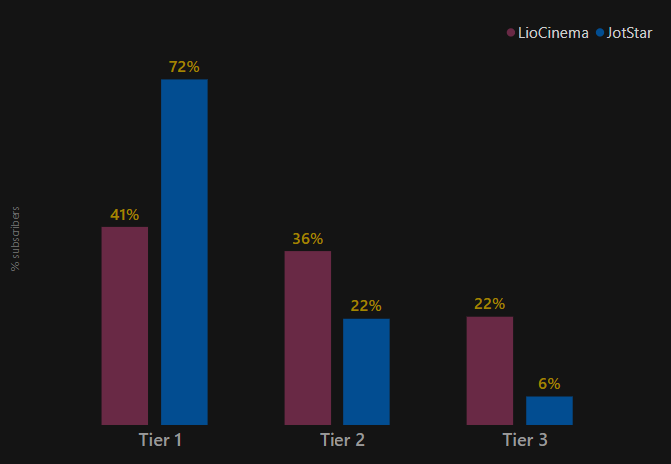
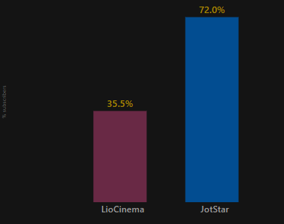
Q9. Paid Users Distribution
● How does the paid user percentage (e.g., Basic, Premium for LioCinema; VIP, Premium for Jotstar) vary across different platforms? Analyze the proportion of premium users in Tier 1, Tier 2, and Tier 3 cities and identify any notable trends or differences.
Subscription Plan
Paid Users Comparison
City Tier
LioCinema have more basic subscription plan, suggesting lower monetization.
Jotstar have equal distribution of paid subscription plan.
Premium plan is highest in Tier-1, with more user preference for Jotstar.
In lower tiers users prefer LioCinema, shows price sensitivity issue with Jotstar.
Jotstar have 36% more paid users than LioCinema, shows users willingness to pay for higher tier.

Slide 17
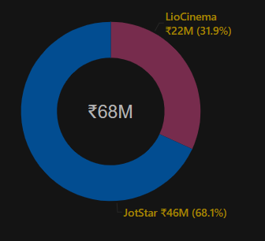
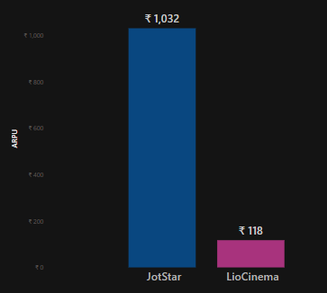
Q10. Revenue Analysis
● Calculate the total revenue generated by both platforms (LioCinema and Jotstar) for the analysis period (January to November 2024).
Total Revenue comparison
ARPU comparison
JotStar has generated 2.3x times higher revenue than LioCinema.
JotStar users are spending ~9x times higher amount than LioCinema.

Slide 18

4. SECONDARY ANALYSIS:

Slide 19







Re-engaging Inactive Users: Key Strategies
Q1. What strategies can the merged platform implement to increase engagement among inactive users and convert them into active users?
Smart Notifications
Personalized
recommendations
Targeted
Promotions
USER ACTIVATION STRATEGY
Inactive Users
Active Users
Increases users activity by 10-30 %
Loyalty Incentives
Discounts
Cross Platform
Experience

Slide 20







OTT Platform : Go-To-Brand Campaigns
Q2. What type of brand campaigns should the merged platform launch to establish itself as the go-to OTT platform in India?
AI Driven Targeting
Cross-Device Targeting
Personalized Content
Multi-Channel
Promotions
Brand
Campaigns
Cricket Engagement
Brand Exclusives

Slide 21



OTT Pricing Strategy : Finding The Right Balance
Q3. How should the merged platform price its subscription plans to compete effectively while maintaining profitability?
Competitive benchmarking
Tiered Pricing
Limited-time Discounts
Market Positioning
Sustainable Growth
Freemium Model
Bundle Discounts
Flexible Payments
Sustainable Growth
Content Investment
Reduce Churn
Ad-supported plans
Customer-Centric
Pricing
Revenue
Optimization

Slide 22




Strategic Telecom Partnership
Q4. How can the platform leverage partnerships with telecom companies to expand its subscriber base?
Bundled Packs
Telecom + OTT packages
Targeted Promotions
Cross-App Marketing
Device
Integration
Smart Tv’s & Set up boxes
Broadband
Synergy
Home Internet + OTT bundles

Slide 23





AI For User Experience
Q5. What role can AI and machine learning play in personalizing the user experience and improving content discovery?
Personalized Recommendations
AI Powered Content Curation
Behavior Analysis
Real Time Trends
Dynamic User Profiles.
Automated Playlists
Personalized Homepages
Tailored Carousels
Enhanced Content and Search
User Experience Optimization
Voice Search
Contextual Suggestions
Semantic Understanding
Churn Prediction
Personalized Remainders
Dynamic UI

Slide 24



Brand Ambassador For New Platform
Q6. Who should be the brand ambassador for the newly merged OTT platform (LioCinema - Jotstar) to effectively represent its identity and attract a diverse audience?
Alia Bhatt
Virat Kohli
Rana Daggubati
Broad Entertainment Appeal
Pan-India Reach
Strong fan base among youth
Most popular sports Icon
Mass appeal beyond cricket
High engagement on Social Media
Massive Regional popularity
Strong OTT Presence
Diverse Entertainment Portfolio

