Slide 1

Toxicity Detection using NLP
Sahil Fruitwala, B00844489
Abhijeet Singh, B00833813
Punarva Vyas, B00841566
Joel Joseph Thomas, B00843518

Slide 2
Introduction:
Cyberbullying have their roots from most of the online discussion forums which gives users the opportunity to express feeling of hate and direct personal attacks.
Users report any kind of online harassments manually.
In this project, we have automated the process of predicting whether the given input is toxic or not.
It is a binary classification problem.

Slide 3
Project Workflow:
Collection of Dataset
Data Preprocessing
Data Visualization
Feature Engineering
Run Machine Learning Algorithms

Slide 4
Dataset sources:
Obtained from Kaggle which was originally prepared by Jigsaw/Conversation AI team.
The dataset consist of 8 attribute fields such as id, comment_text, toxic, etc.

Slide 5
Data Preprocessing:
Data Cleaning:
Ignored the unnecessary attributes from the dataset
Removed the URLs from comment text.
Removed trailing whitespaces, tabs and new lines
Removed emoticons and special characters or non-ASCII characters
Converted the words to lowercase and removed contractions
Data Preprocessing using NLP techniques:
Stop words removal
Lemmatization

Slide 6
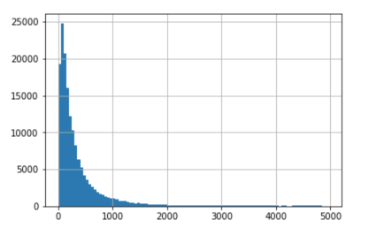
Data Visualization:
Implemented data visualization to have a clear insights of the dataset obtained.
Data visualization is performed before and after cleaning of the data.
Generated a histogram to identify how the length of comment text was distributed over whole corpus
Comment length Distribution over the corpus

Slide 7
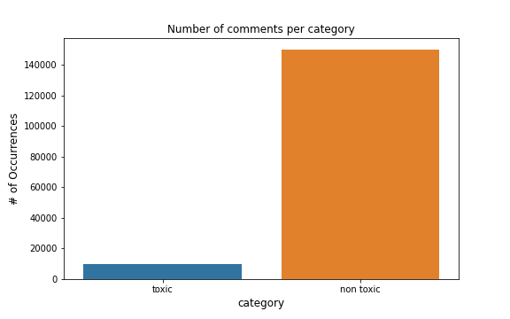
Dataset Information:
After cleaning and preprocessing of data, we have obtained the output as binary classified data
By visualizing the binary classified data, we have identified that the data is highly imbalanced with most of data belonging to the non-toxic class (94%) and very little belonging to the toxic class (6%).

Slide 8
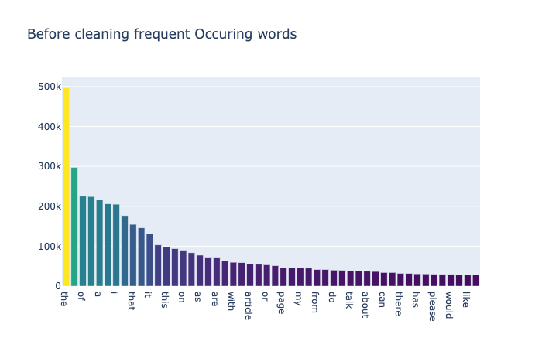
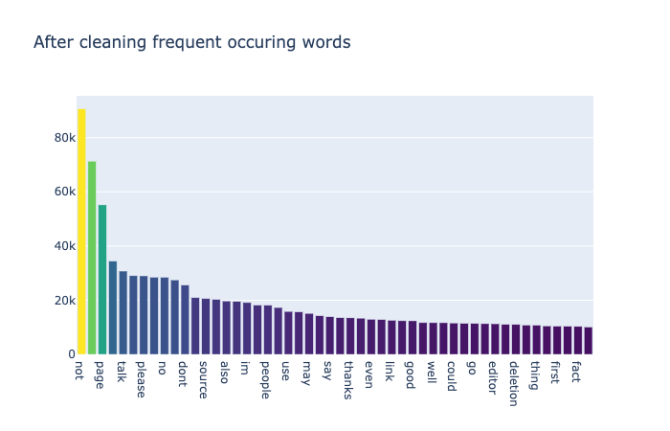
Comparison study using Bar chart
Visualization of top100 frequent occurring words before and after data preprocessing.

Slide 9
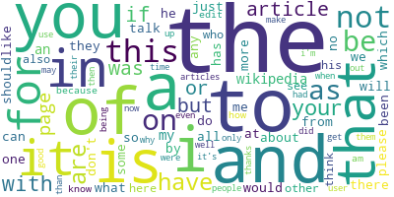
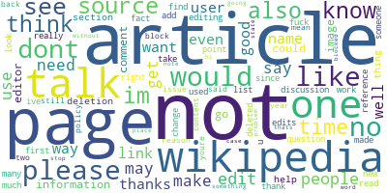
Comparison study using Word Cloud
Before Cleaning:
After Cleaning:

Slide 10
Feature Engineering:
Implemented feature engineering to create vector representation of words.
Feature engineering is performed with the help of various NLP Word Embedding Techniques
Word Embedding Techniques:
- BoW (Bag of Words)
- TF-IDF (Term Frequency – Inverse Document Frequency)
- SpaCy

Slide 11
Balancing the Data:
As mentioned earlier, the dataset obtained was highly imbalanced.
As a result, it would yield poor prediction of toxic comments with low precision and recall scores.
To overcome this, we have implemented sampling methods on the train data.
Sampling Method Used:
- Over-sampling

Slide 12
Hyperparameter Tuning:
While training the model we have used Hyper parameter tuning on train, test and CV data to get the best parameters for the machine learning algorithms in order to achieve accurate prediction.
Hyperparameter Tuning Technique used:
- RandomizedSearchCV

Slide 13
Implementation of Machine Learning algorithms
The created features are are given as inputs to various chosen Machine learning algorithms.
Machine learning algorithms used:
- Support Vector Machine (SVM)
- Random Forest
- Naïve Bayes
- AdaBoost

Slide 14
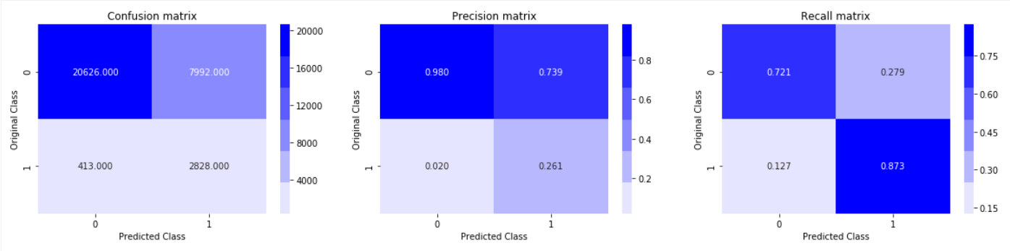
SVM with BoW:

Slide 15
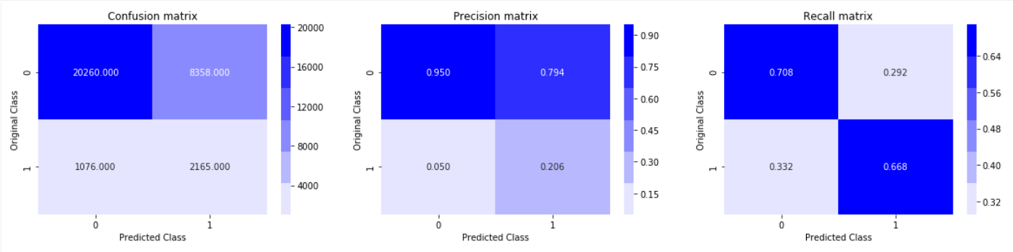
Random Forest with BoW:

Slide 16
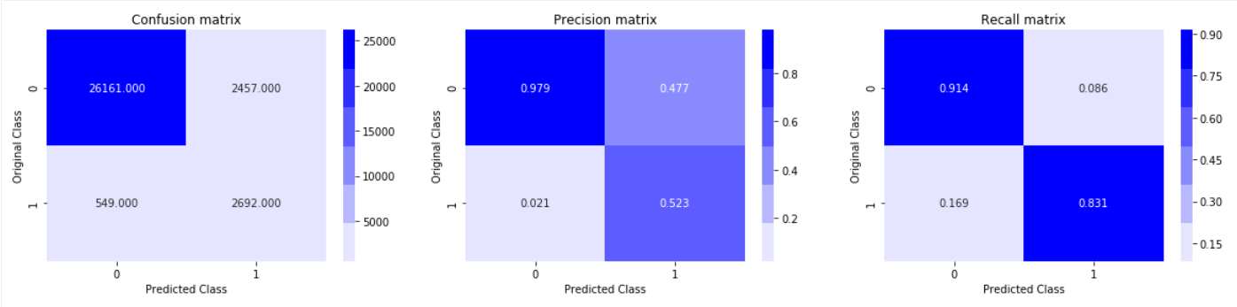
SVM with TF-IDF:

Slide 17
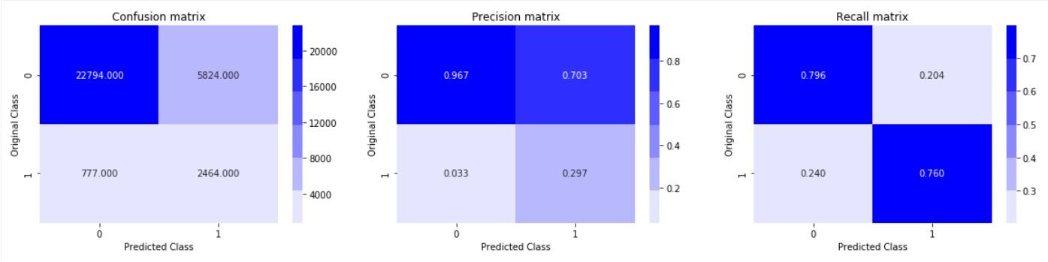
Random Forest with TF-IDF:

Slide 18
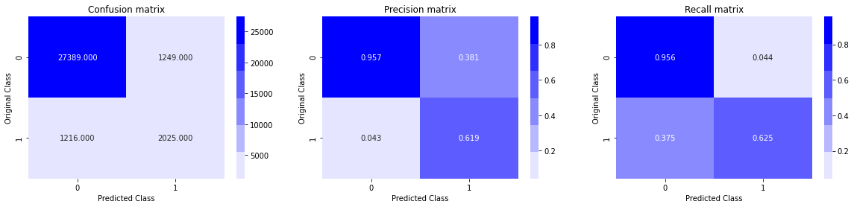
NaiveBayes with BoW

Slide 19
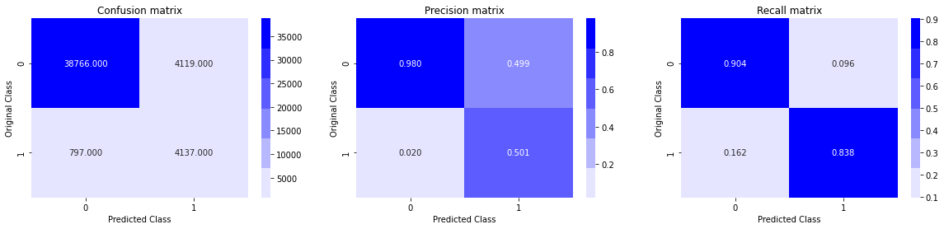
NaiveBayes with TF-IDF

Slide 20
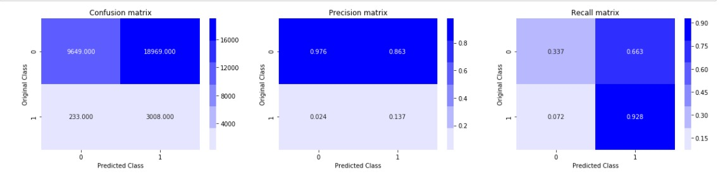
AdaBoost with BoW:

Slide 21
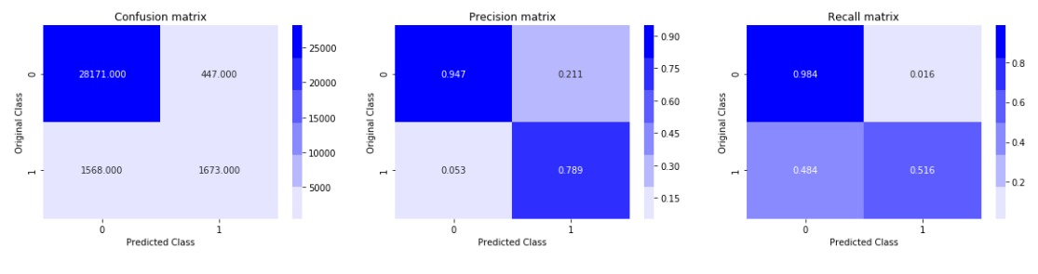
AdaBoost with TF-IDF:

Slide 22
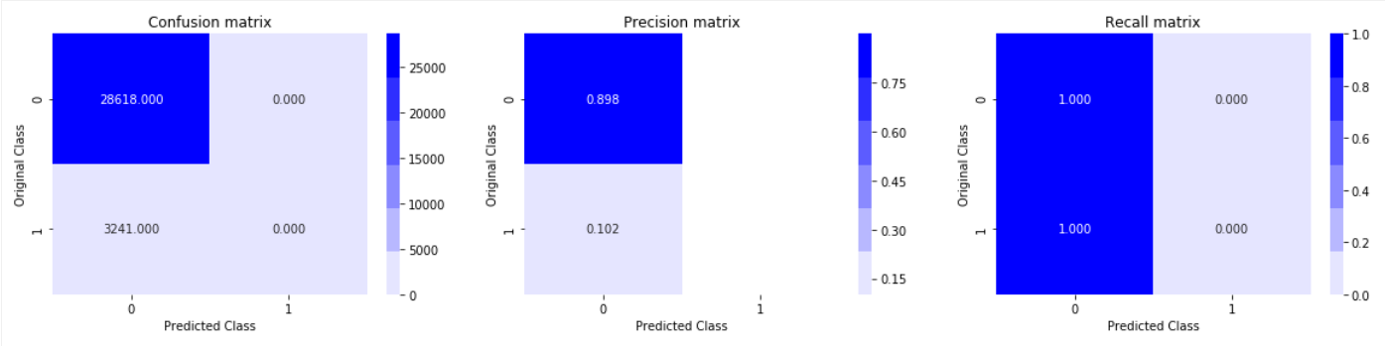
SVM with SpaCy:

Slide 23
Comparison of various ML algorithms:
Algorithms | Precision |  | Recall
 | 0 (Non-Toxic) | 1 (Toxic) | 0 (Non-Toxic) | 1 (Toxic)
SVM with BoW | 98% | 26% | 72% | 87%
SVM with TF-IDF | 98% | 52% | 91% | 83%
Random Forest with BoW | 95% | 21% | 71% | 67%
Random Forest with TF-IDF | 97% | 30% | 80% | 76%
Naïve Bayes with BoW | 96% | 62% | 96% | 63%
Naïve Bayes with TF-IDF | 98% | 50% | 90% | 84%
AdaBoost with BoW | 98% | 14% | 34% | 93%
AdaBoost with TF-IDF | 95% | 79% | 98% | 52%
SVM with SpaCy | 90% | - | 100% | 0%

Slide 24
Conclusion
From the various Machine learning algorithms used, we have identified the best performing algorithms as SVM and Naive Bayes with TF-IDF features obtaining the best prediction result.

Slide 25
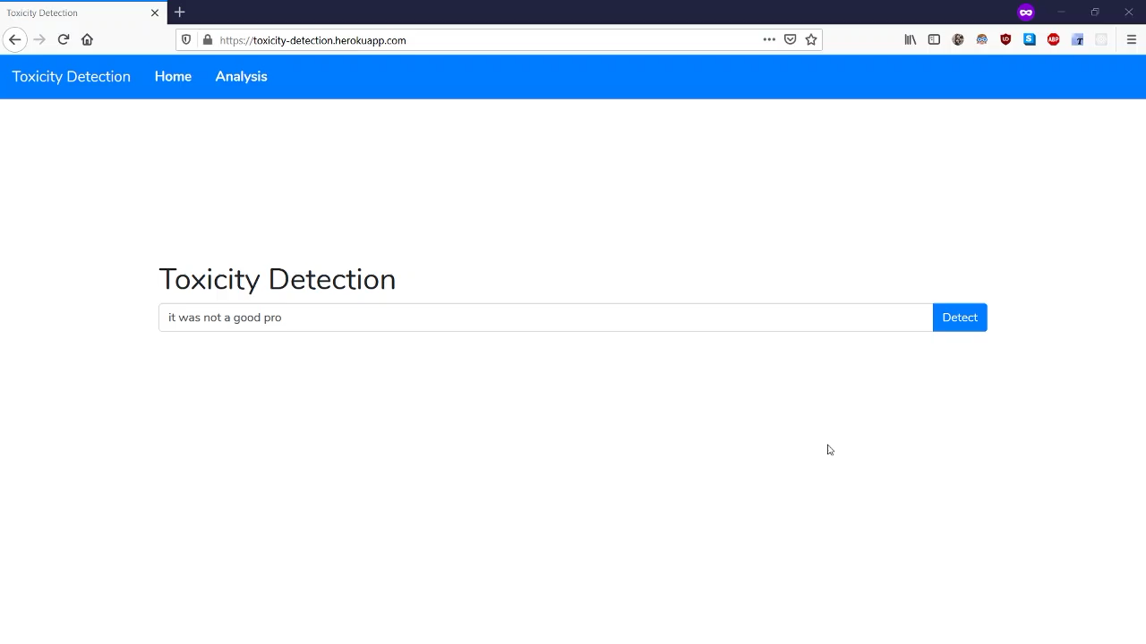
Working Demo:

Slide 26
Thank You

