Slide 1
Lecture 2
NLP&Visualization
Provilkov Ivan
iv.provilkov@gmail.com

Slide 2
Plan
Lecture: RNNs
Seminar: Visualization with Facebook Research Visdom and TNT

Slide 3
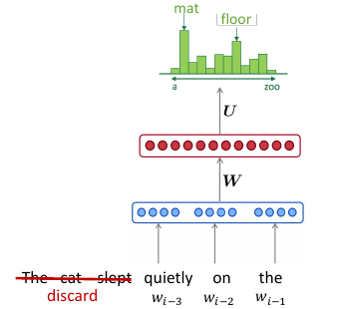
What’s the problem?
We want to have access to the information in different parts of sentences to solve many NLP tasks.
We can not do it via fixed-window algorithms.

Slide 4
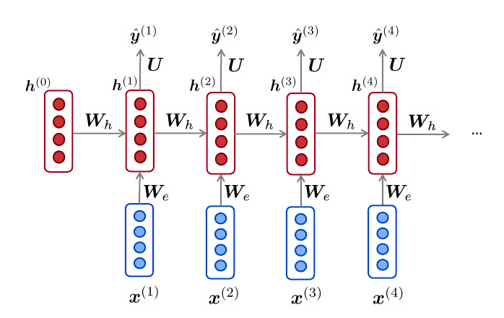
Recurrent Neural Networks
Simple RNN formulation
Multiply the same matrix at each time step during backprop

Slide 5
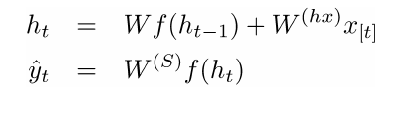
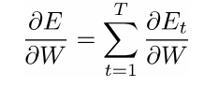

RNN formulation
E = error

Slide 6

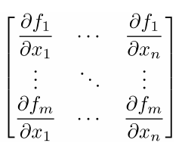
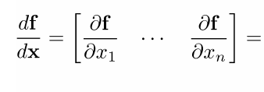
More chain rule
Each partial derivation is Jacobian

Slide 7
Problems with simple RNN
Vanishing gradients, Exploding gradients. Because of many steps, backprop norm goes to 0 and our network does not want to learn long-range dependencies.
It has only 1 vector of fixed size for ALL information.

Slide 8
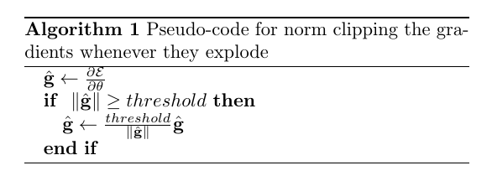
Solutions: clipping
Exploding gradients: clipping

Slide 9
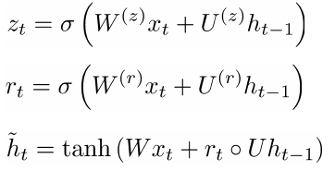

Solutions: GRU
GRU:
Update gate
Reset gate
New memory content
Sum with previous step

Slide 10
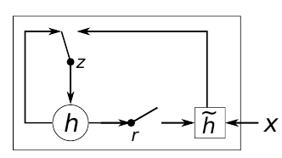
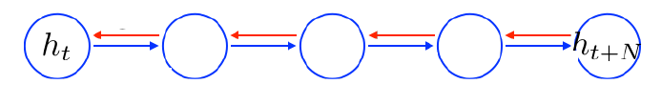
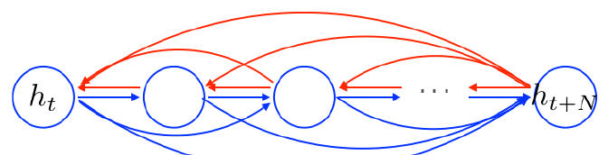
Solutions: GRU

Slide 11
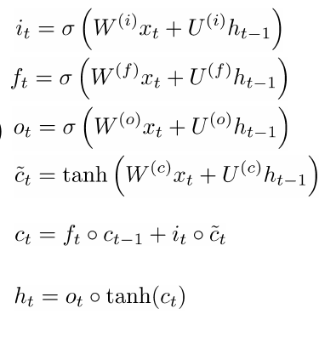
Solutions:LSTM
LSTM:
Input gate
Forget gate
Output
New memory cell
Sum with previous cell
Final hidden state

Slide 12
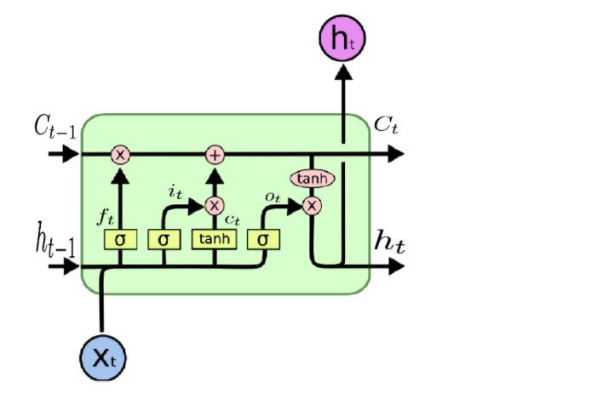
Solutions:LSTM

Slide 13
Thank you for your attention. Let’s go to the seminar.

