Slide 1
Lecture 3
NLP&Visualization
Provilkov Ivan
iv.provilkov@gmail.com

Slide 2
Plan
Text classification task
Convolutional neural networks in text
Kim (2014) pap

Slide 3

Text classification problem
Sentiment analysis
Spam filtering
Text structuring
Bot identification
Dialog systems

Slide 4
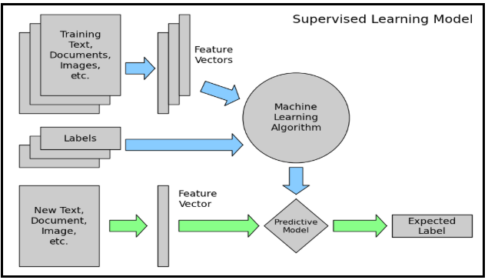
Text classification in general (let’s discuss)

Slide 5
CNNs in text
Main CNN in texts idea: what if we compute multiple vectors for every possible phrase in parallel.
Example: “She sat listening to the music.”
She sat, sat listening, listening to ,…, she sat listening, sat listening to, …, she sat listening to, …, she sat listening to the, …, she sat listening to the music

Slide 6
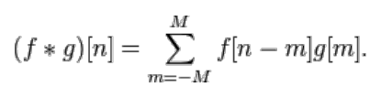
CNNs in text
Main benefit is that it works very fast.
More closely:

Slide 7
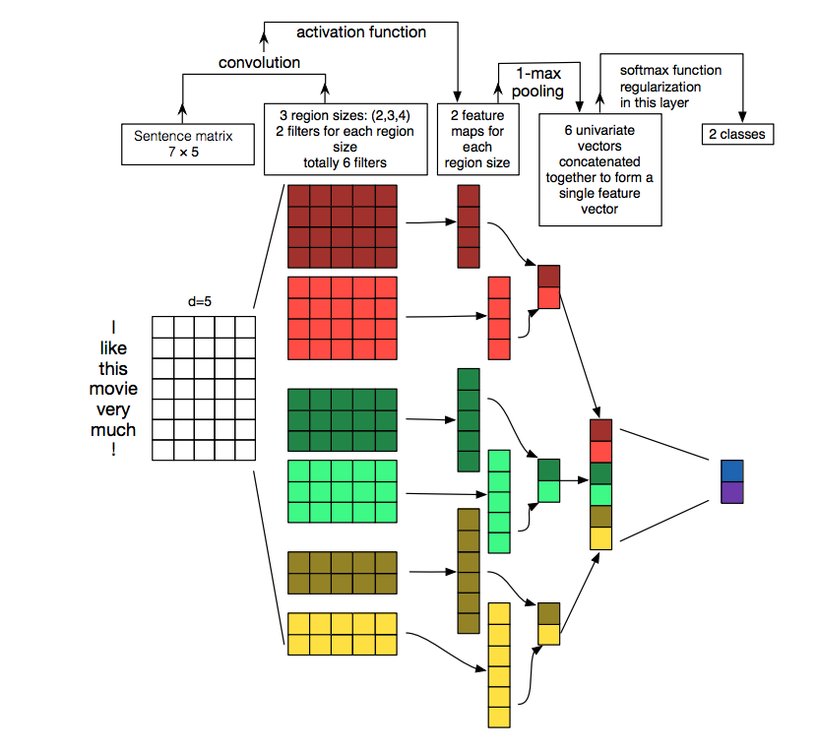

Slide 8
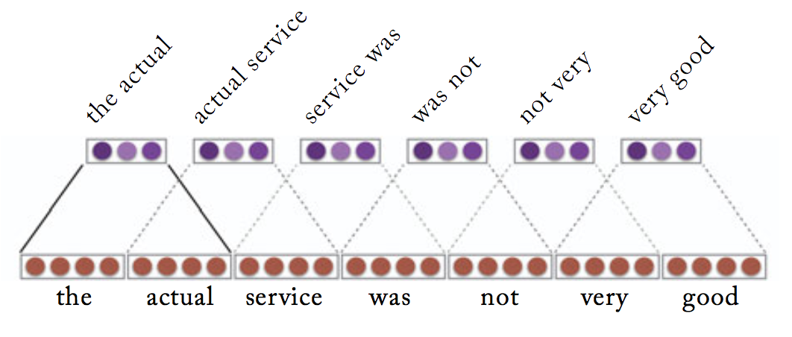

Slide 9
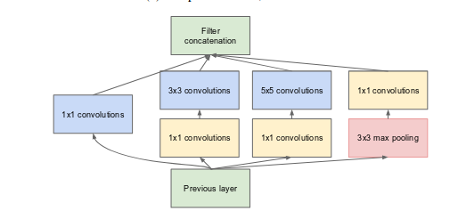

Slide 10


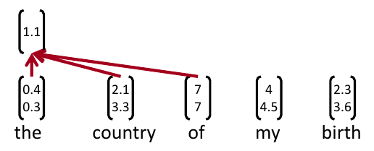
Simple variant
Word vectors
Concatenation of words in range
Convolutional filter(s) W
Question: why 1.1?

Slide 11
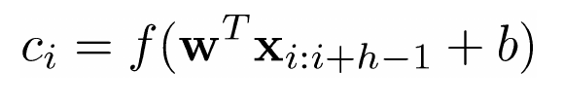
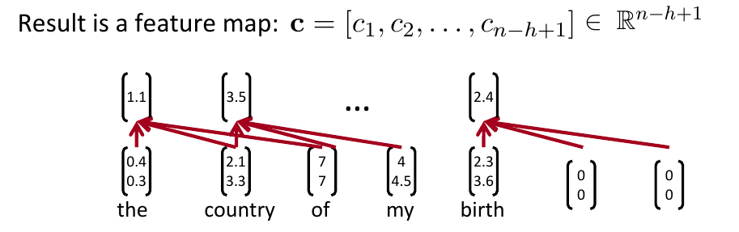
Simple variant

Slide 12

Pooling
In particular: max-over-time pooling.
Catch most important activations
We want to have many features, so we need to do many filters
We can make unigram, bigram, trigram and so on features

Slide 13

Dropout
Idea: randomly dropout some of the feature weights (or words)
Reasoning: prevents co-adaptation (overfiting to seeing specific feature constellations)
At training time gradient go only through features without mask
At test time their is no dropout, so we scale final vector by Bernoulli probability p.

Slide 14
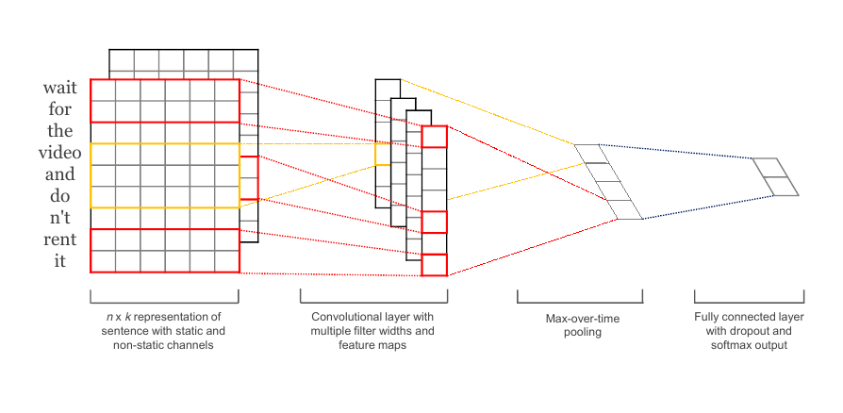
On seminar we are going to code Kims (2014) model
https://arxiv.org/pdf/1408.5882.pdf

Slide 15
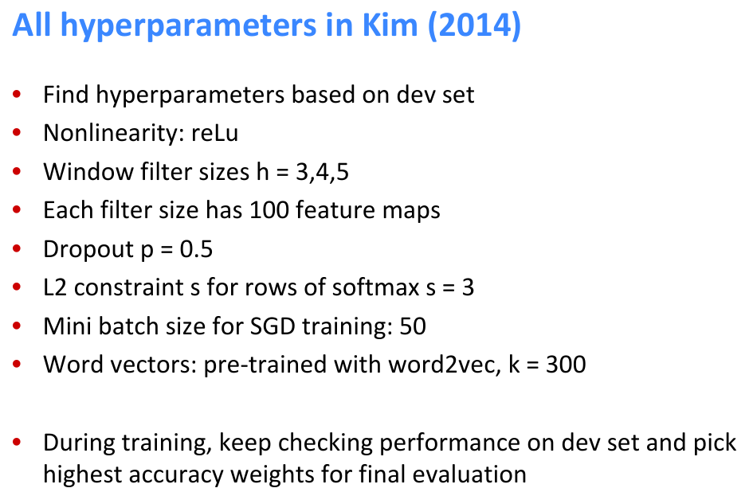

Slide 16
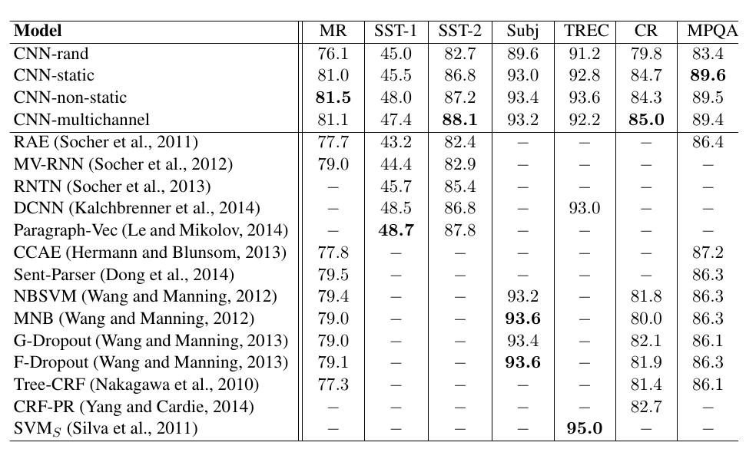
Results

Slide 17
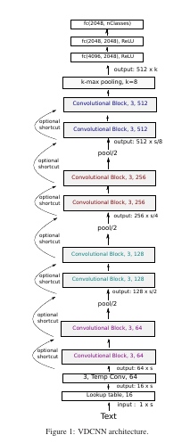
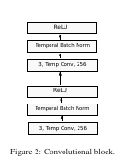
Convolutional architectures became much more deeper in texts
VDCNN (2016): ResNet like
https://arxiv.org/pdf/1606.01781.pdf

Slide 18
Thank you for your attention. Let’s go to the seminar.

