Slide 1

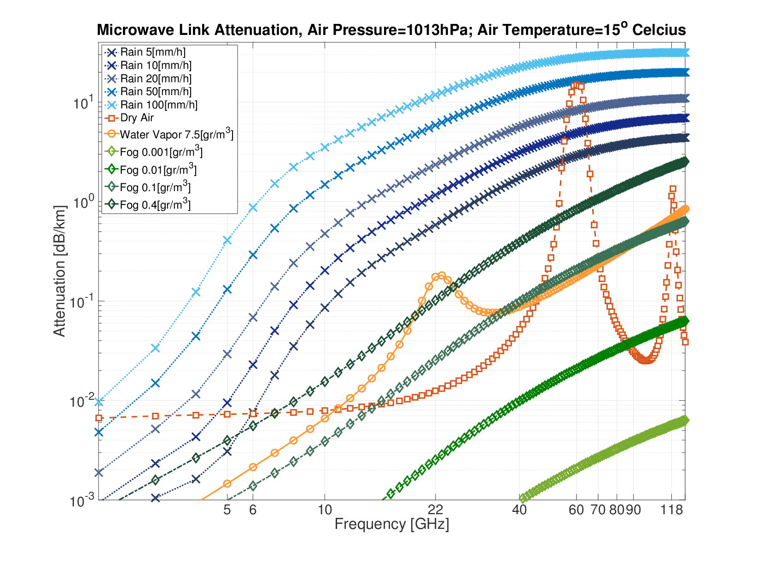

Insert The Project Name Here
Project Number: XX-X-X-XXXX
Names: Insert The Students Names Here
Advisor: Insert Advisors Names Here
DON’T FORGET TO DELETE THIS TEXT! This spot is a reserved spot for the company/lab logo, only if applicable!
Introduction As part of a team-based final project, each group designed a key block of a Digital Phase-Locked Loop (DPLL) system. Our team focused on the design and implementation of the Time-to-Digital Converter (TDC), a critical component responsible for measuring the time difference between reference and feedback signals with high resolution. The TDC was designed using 28nm CMOS technology. We used Cadence Virtuoso for schematic design, testbench creation, simulations, and full layout verification, including DRC and LVS checks. Motivation We start with a low-frequency accurate clock and a high-frequency signal that is an integer multiple of it. To keep them in sync, we need to measure the time difference between their edges. The TDC measures this difference so other DPLL blocks can adjust the high-frequency clock and keep it aligned with the reference. | Implementation Here we can see an example of text followed by an example block diagram that helps in presenting the project implementation. You may also include formulas, images, designs etc.. Make sure those are readable and with reasonable font sizes. Results Here we can see an example of text that can elaborate on the results followed by an example plots that helps in presenting the project results. You may also include graphs, plots, images, tables etc.. | Conclusions An example of text that elaborates on the conclusions followed by an example table that presents the project conclusions. You may also include graphs, plots, images, tables etc..
Initial
Conditions
Strapdown
Solution
Kalman
Filter
GPS
$$Δt?$$
IMU
Integrated
Solution

