Slide 1
Vim – We do hjkl ☺
Devchandra L
Github id : deleisha

Slide 2

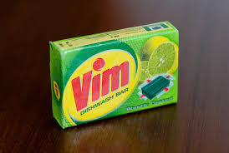



Slide 3
Table Of Content
Some vim trivialities
Starting vim
Modes and its magic
Being productive with vim
Navigating in vim
Effective vim for C++
Questions and Answers

Slide 4
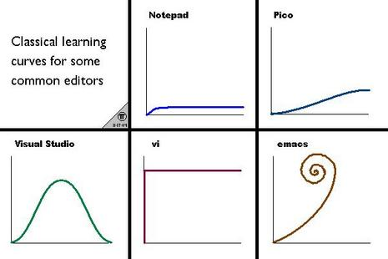
Triviality - Why Vim
Cons
Vim is odd(compared to other text editors)
Hostile to novices
Not popular on windows
Pros
ubiquitous( Except on windows)
flexible, configurable and powerful
fast
Plays well with other tools like terminal multiplexer

Slide 5
Vim - History
Vim – vi improved by Bram Moolenar and the community
Vi is derived from ed
Vi was written by Bill Joy
Neovim by Thiago de Arruda and the community

Slide 6
Vim Triviality Contd
vi/vim is modal editor
Has 4 modes
Normal mode(command mode)
Insert mode
Ex command
Visual mode
Vim buffer
Every open file will have a memory area called buffer.
A window can have many buffers associated with it. But only one is visible

Slide 7
Let us start
vi or vim ? vi file.cc – open file.cc
Opening a file from inside vim - :e file_new.cc
How do we open multiple files – buffers and tabs???
-- How do we navigate to files – args, :n, :rew, :last
Saving/Writing to file – :w, :w!,
What does :saveas file.cc does?
Closing file
:q/q! – quit/closes without saving
:what about :x and :wq
:qa or qa!
What ZZ do?

Slide 8
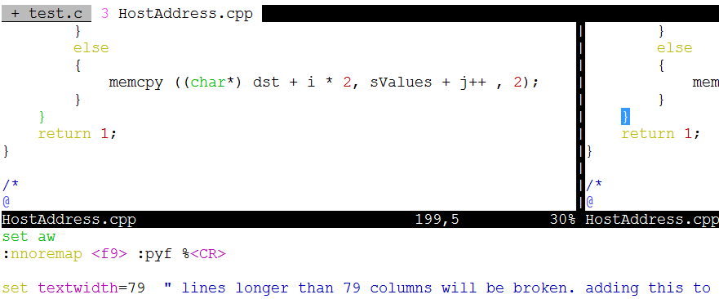
Splitting
: split – split file into two view,
: vsplit – vertical split with two view, left and right
:tabnew file – open file in new tab
:new file – open file and make two view
How do we navigate the files now?
How do we resize the files - :res
Closes all files except the current one -- :only, :tabonly
current window to a new tab page -Ctrl-W T
More at :h Ctrl-W

Slide 9

Gone with wind - motion
Use hjkl, instead of arrows
Use b/B, e/E, w/W, gg(:0), G( :$)
What about 0, $
CTRL-F Scroll down full page
CTRL-B Scroll up full page
CTRL-D Scroll down half page
CTRL-U Scroll up half page
Go to particular line number – 143gg, :143
More :help motions

Slide 10
Other Motions
Check matching (, {, [, # - using %
[ and it’s allies – [{, [(, [) – prev and ]{, ]) next matching {,(
:help various-motions
Home work – [m, [M
Let us try out ^, fchar

Slide 11
Edit with operators
c change
d delete
y yank into register (does not change the text)
! filter through an external program
= filter through 'equalprg' or C-indenting if empty
> shift right/indent
< shift left/dedent
zf define a fold
:help operators
Operators TAKE motions

Slide 12
Edit Continued – text object and registers
The power of -- a, i
:help text-object
OMG, I have deleted a line and I don’t exactly remember the word.
vim in rescue
Check using :reg
Select the reg which holds the texts and do “regp
Record in a reg named k – qk
Replay with @k

Slide 13
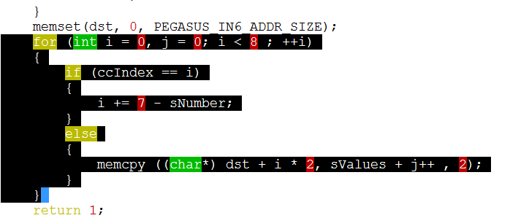
Visual Commands
Change to visual mode pressing v, V
Select using any positioning or navigational keys
Apply any operator
gv – go to visual mode again and reselecting last selection
Press escape to return to normal mode
What about the block edit – Ctrl-v

Slide 14
Edit with operators – Insert Mode
insert, append and replace – i, a, r
Insert a new line below/above current line – o, O
Undo and Redo – u, U, ctrl +r, :earlier 15m, :later
Indent in insert mode - ctrl-t/ctrl-d –indent/dedent
Auto completion commands – Ctrl - p and ctrl - n
Ctrl –x and ctrl –l – line completion
Ctrl-x and ctrl –f – completes file name
Ctrl-E –end the completion option
More details at :help ins-completion

Slide 15
Searching
/word – search forwards
press n – to go forwards
Press N – go backwards search directions
?word – search backwards
Sometimes we need to escape as in \\<John\>
Now it gives yellow yellow dirty fellows, How do we turn that off?
We don’t want to type variable name always, is there a short cut? –gd, gD
Not satisfied – What about * and #

Slide 16
Replace And Substitute
Search and substitute
:s/old/new/g – search and replaces all old by new
:s/old/new/g[w, c] – same as above but confirms before changes
But I don’t trust machines, How do I do that myself – gd, cw, escape, n and .(dot)
Block Edit – Select using shift + ctrl +v and navigations + I
Make changes and then escape

Slide 17
vimrc
Vim setting script, older systems call it .exrc
Has two vimrc
System wide at /etc/vimrc
and user specific ~user/.vimrc – Yea, we like this
vim executes it before opening a file
Confirm your vimrc locations using vim --version
Put all the settings that you want enable in vim like syntax highlighting
But before that

Slide 18
Let Us Be Lazy but beautiful - Epilogue
Autoclosing string
nnoremap <f9>:make<CR>copen
Looking up API
Navigating to header file – gf and path magic
Look up manpage - K
What does J command do
What does :r command do and !! Do?
:set paste !!!!!!
Use some commands and make it a habit

Slide 19

Thank You

