Slide 1

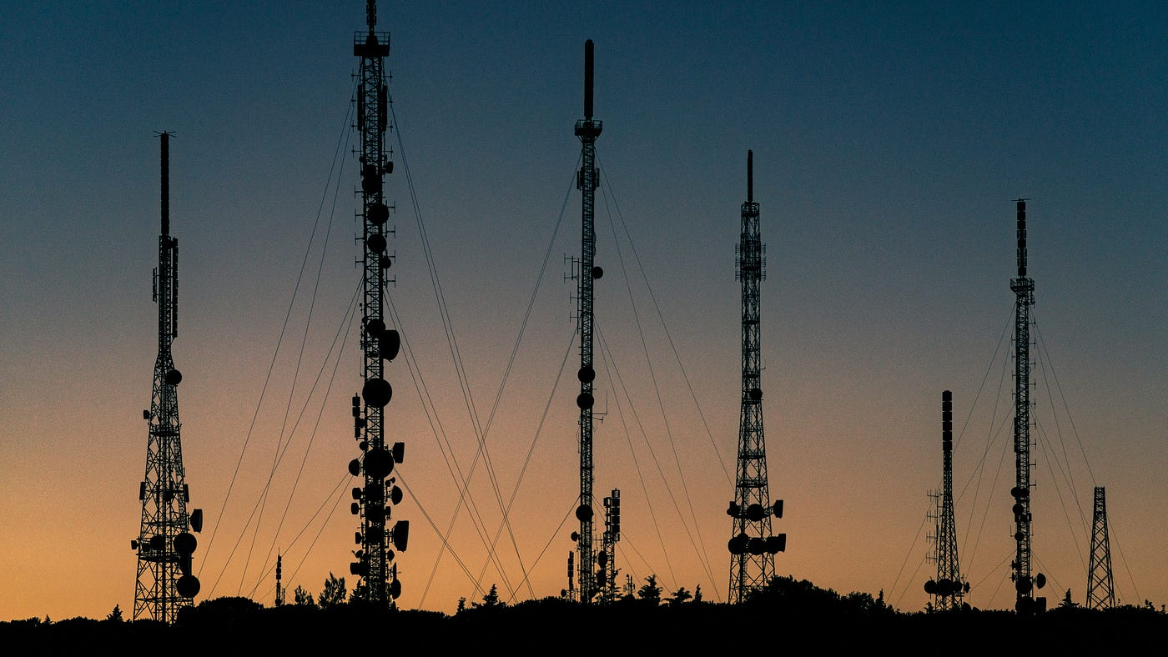

Slide 2

Agenda :
Data Cleaning & Pre-processing
Introduction
Mission & Vision
ML model Building
Our Goals
Hyperparameter Tuning
SVM & Confusion Matrix
Our Milestones
Key Challenges
Conclusion

Slide 3
Agenda :
Introduction
Vision
Mission
Data Cleaning & Pre-processing
Telecom churn prediction can drive significant improvements in customer satisfaction, business performance, and competitiveness within the telecommunications sector.
Mission & Vision
Telecom churn prediction contributes to the overall success and competitiveness of telecom companies in a rapidly evolving market landscape.
Our Goals
ML model Building
Hyperparameter Tuning
Our Milestones
SVM & Confusion Matrix
Key Challenges
Conclusion

Slide 4
Our Goals
Mission & Vision
Vision
Mission
Telecom churn prediction can drive significant improvements in customer satisfaction, business performance, and competitiveness within the telecommunications sector.
Telecom churn prediction contributes to the overall success and competitiveness of telecom companies in a rapidly evolving market landscape.

Slide 5

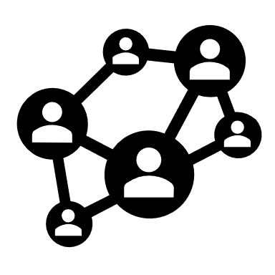

Our Goals
Maximize customer retention
Optimize business performance
Minimize churn rate
Mission
Vision
Telecom churn prediction contributes to the overall success and competitiveness of telecom companies in a rapidly evolving market landscape.
Telecom churn prediction can drive significant improvements in customer satisfaction, business performance, and competitiveness within the telecommunications sector.
Mission & Vision

Slide 6
Milestones
Our Goals
Maximize customer retention
Optimize business performance
Minimize churn rate
Mission
Vision
Telecom churn prediction contributes to the overall success and competitiveness of telecom companies in a rapidly evolving market landscape.
Telecom churn prediction can drive significant improvements in customer satisfaction, business performance, and competitiveness within the telecommunications sector.
Mission & Vision

Slide 7
Our Goals
Milestones
Maximize customer retention
Optimize business performance
Minimize churn rate

Slide 8
Key Challenges
Our Goals
Milestones
A
B
C
D
Data Gathering & Understanding the dataset
Data Cleaning & pre-processing
Machine Learning & Model Building
Hyperparameter Tuning, SVM & Confusion Matrix
Maximize customer retention
Optimize business performance
Minimize churn rate

Slide 9
Our Goals
Milestones
Key Challenges
A
B
D
C
• Dynamic Customer Behavior: Customer behavior and preferences evolve over time, making it challenging to build accurate predictive models that adapt to changing patterns and trends.
• Scalability: Telecom companies serve large customer bases, and churn prediction systems must be scalable to handle massive volumes of data and real-time predictions.
• Real-Time Prediction: Implementing real-time churn prediction systems that can provide timely interventions to prevent churn is challenging due to the need for fast data processing and decision-making.
• Data Quality and Integration: Telecom companies often have vast amounts of data stored across multiple systems, including customer demographics, call logs, usage patterns, and billing information. .Integrating and cleansing this data for analysis can be challenging, and poor data quality can lead to inaccurate predictions.
• Imbalanced Data: Telecom datasets are often imbalanced, with a small percentage of customers churning compared to those who remain. Imbalanced data can bias predictive models and lead to inaccurate churn predictions.
Data Gathering & Understanding the dataset
Data Cleaning & pre-processing
Hyperparameter Tuning, SVM & Confusion Matrix
Machine Learning & Model Building
Maximize customer retention
Optimize business performance
Minimize churn rate

Slide 10
Data Pre-Processing
Key Challenges
• Data Quality and Integration: Telecom companies often have vast amounts of data stored across multiple systems, including customer demographics, call logs, usage patterns, and billing information. .Integrating and cleansing this data for analysis can be challenging, and poor data quality can lead to inaccurate predictions.
• Imbalanced Data: Telecom datasets are often imbalanced, with a small percentage of customers churning compared to those who remain. Imbalanced data can bias predictive models and lead to inaccurate churn predictions.
• Dynamic Customer Behavior: Customer behavior and preferences evolve over time, making it challenging to build accurate predictive models that adapt to changing patterns and trends.
• Scalability: Telecom companies serve large customer bases, and churn prediction systems must be scalable to handle massive volumes of data and real-time predictions.
• Real-Time Prediction: Implementing real-time churn prediction systems that can provide timely interventions to prevent churn is challenging due to the need for fast data processing and decision-making.

Slide 11
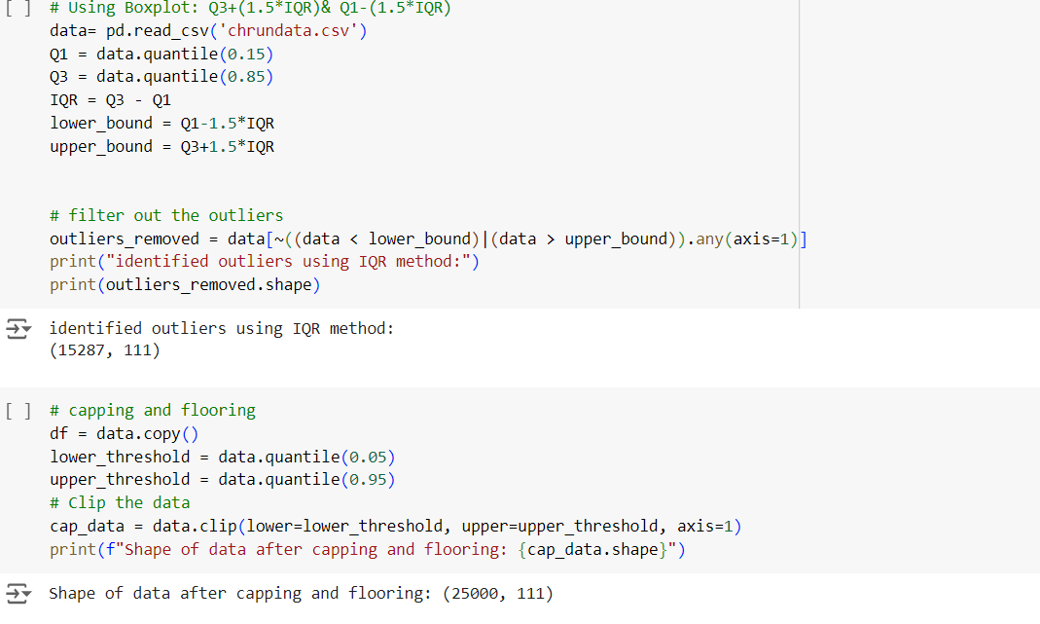
Key Challenges
Data Pre-Processing
• Dynamic Customer Behavior: Customer behavior and preferences evolve over time, making it challenging to build accurate predictive models that adapt to changing patterns and trends.
• Scalability: Telecom companies serve large customer bases, and churn prediction systems must be scalable to handle massive volumes of data and real-time predictions.
• Real-Time Prediction: Implementing real-time churn prediction systems that can provide timely interventions to prevent churn is challenging due to the need for fast data processing and decision-making.
Convert datatypes of variables which are misclassified:- ensures accurate analysis and efficient processing.
Removing duplicate records:- ensure accuracy, maintain integrity, and optimize efficiency in data management and analysis.
Removing unique value variables:- necessary to avoid redundancy, improve efficiency, and ensure meaningful analysis.
Removing Zero variance variables:- necessary to eliminate redundant information, improve model stability, and simplify interpretation.
Outlier Treatment:- necessary to maintain data integrity, improve model performance, and ensure robust and interpretable analyses.

Slide 12
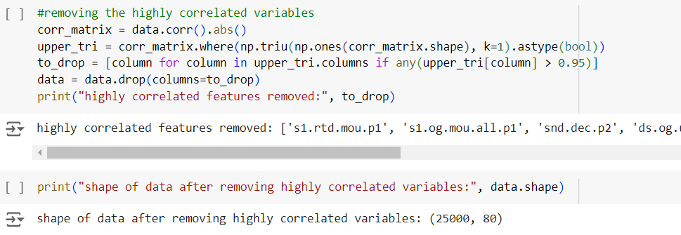
Missing value Treatment:- essential for maintaining data integrity, improving model performance, and ensuring accurate and statistically valid analyses.
Removing the highly correlated variables:- necessary to reduce redundancy, improve model stability, and enhance efficiency in model training and interpretation.
Data Pre-Processing
Convert datatypes of variables which are misclassified:- ensures accurate analysis and efficient processing.
Outlier Treatment:- necessary to maintain data integrity, improve model performance, and ensure robust and interpretable analyses.
Removing duplicate records:- ensure accuracy, maintain integrity, and optimize efficiency in data management and analysis.
Removing unique value variables:- necessary to avoid redundancy, improve efficiency, and ensure meaningful analysis.
Removing Zero variance variables:- necessary to eliminate redundant information, improve model stability, and simplify interpretation.

Slide 13
Outlier Treatment:- necessary to maintain data integrity, improve model performance, and ensure robust and interpretable analyses.
Missing value Treatment:- essential for maintaining data integrity, improving model performance, and ensuring accurate and statistically valid analyses.
Removing the highly correlated variables:- necessary to reduce redundancy, improve model stability, and enhance efficiency in model training and interpretation.

Slide 14
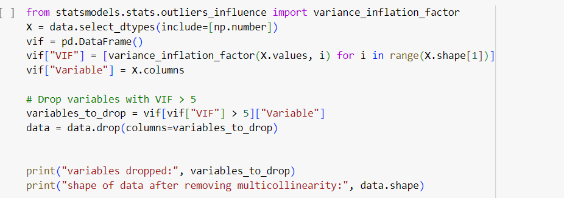
Outlier Treatment:- necessary to maintain data integrity, improve model performance, and ensure robust and interpretable analyses.
Missing value Treatment:- essential for maintaining data integrity, improving model performance, and ensuring accurate and statistically valid analyses.
Removing the highly correlated variables:- necessary to reduce redundancy, improve model stability, and enhance efficiency in model training and interpretation.
Code Snippet
Multicollinearity (VIF>5)

Slide 15
Model Building
Multicollinearity (VIF>5)
Code Snippet

Slide 16
Model Building
Code Snippet
Logistic Regression
Multicollinearity (VIF>5)
Random Forest
Decision Trees

Slide 17
Model Building
Logistic Regression
Random Forest
Decision Trees

Slide 18
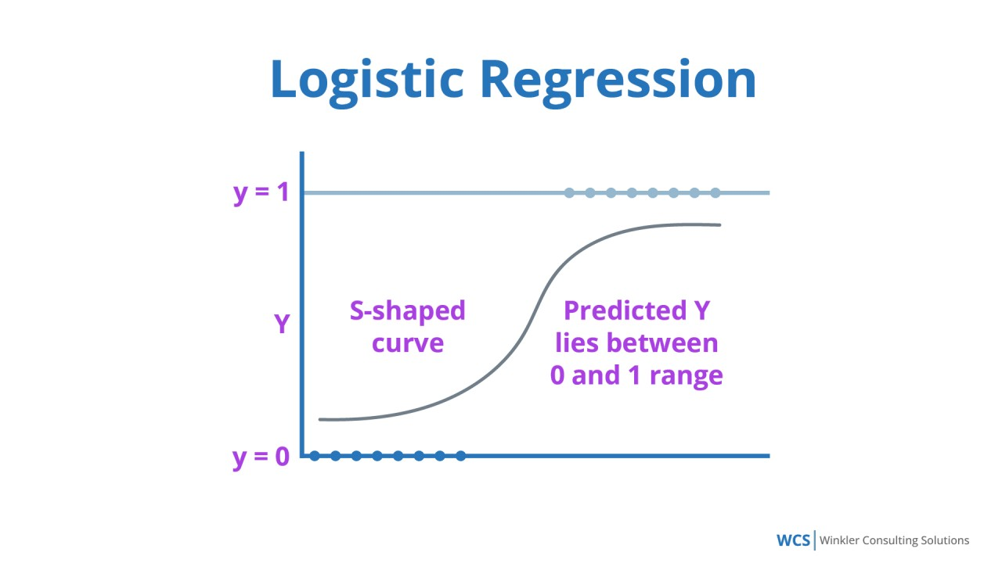
Model Building
Logistic Regression
Random Forest
Decision Trees

Slide 19
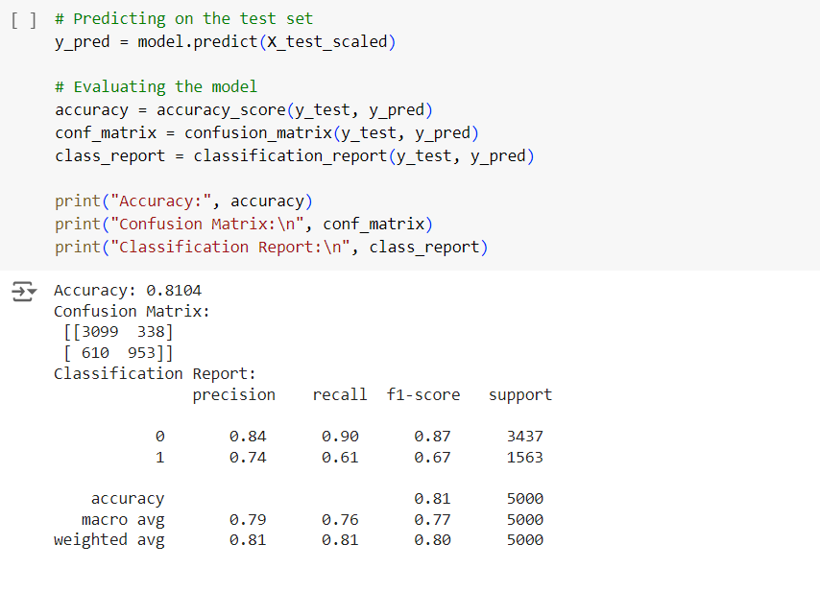
Model Building
Logistic Regression
Random Forest
Logistic regression is a type of supervised machine learning algorithm used for binary classification problems, where the target variable is a binary outcome (0 or 1). It's an extension of linear regression, but instead of predicting a continuous value, it predicts the probability of the binary outcome.
Decision Trees

Slide 20
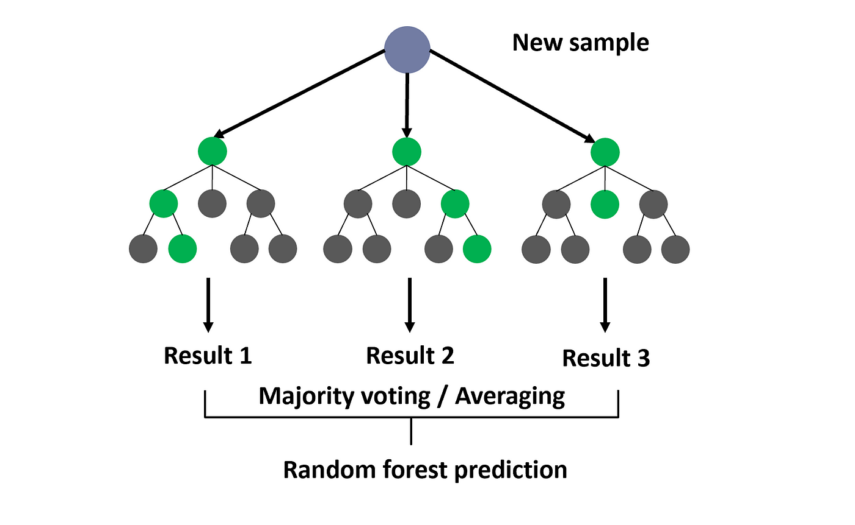
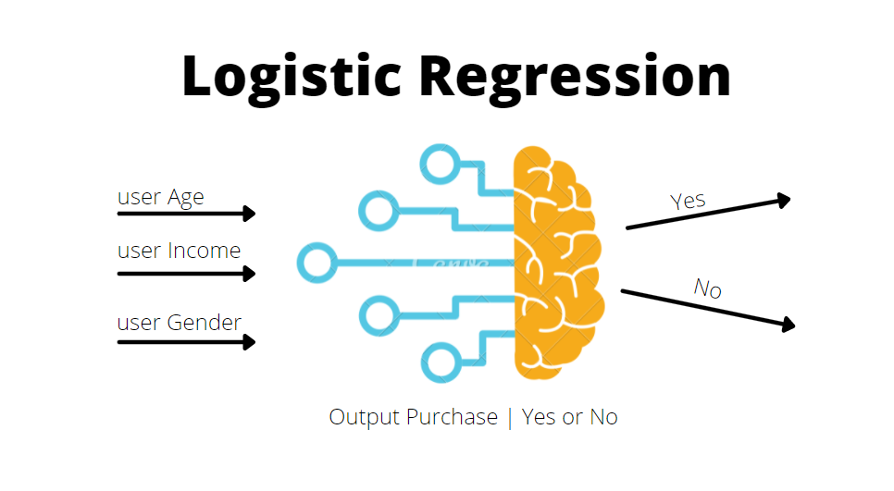
Random Forest
Model Building
Logistic regression is a type of supervised machine learning algorithm used for binary classification problems, where the target variable is a binary outcome (0 or 1). It's an extension of linear regression, but instead of predicting a continuous value, it predicts the probability of the binary outcome.
Logistic Regression
Code Snippet
Decision Trees

Slide 21
Code Snippet
Random Forest
Random Forest is a supervised learning algorithm that combines multiple decision trees to improve the accuracy and robustness of predictions. It is a popular ensemble learning method that is widely used in classification and regression tasks. Random Forests enhance accuracy and robustness through ensemble learning, resist overfitting, highlight feature importance, handle missing values, scale well with large datasets, and are versatile for both classification and regression.

Slide 22
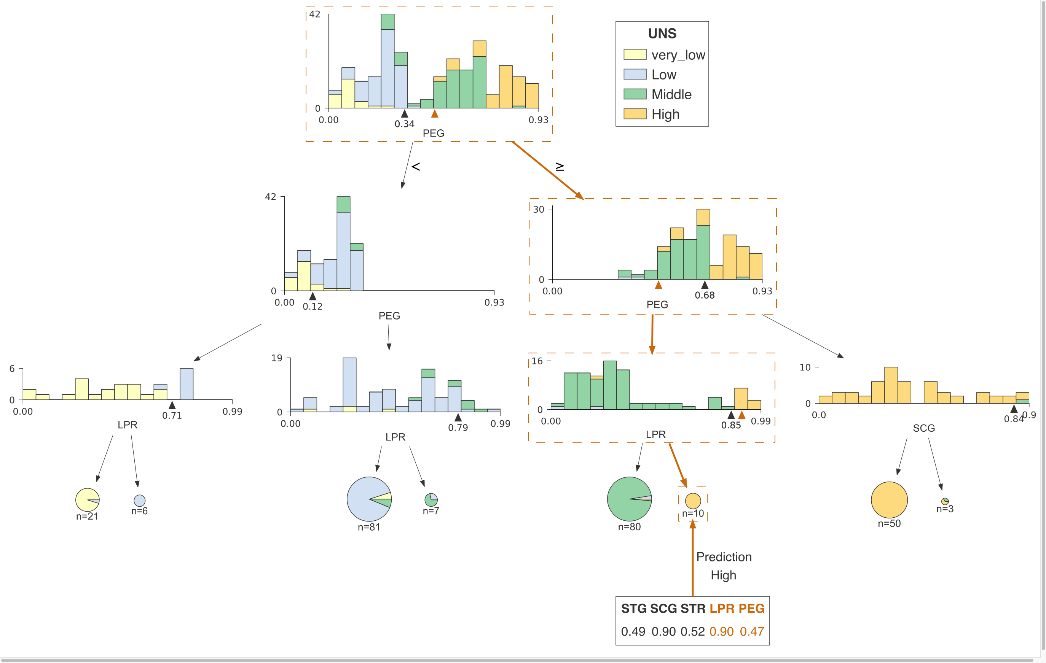
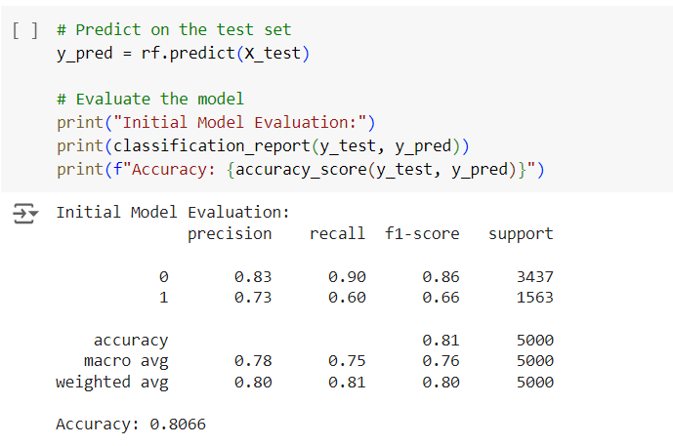
Random Forest is a supervised learning algorithm that combines multiple decision trees to improve the accuracy and robustness of predictions. It is a popular ensemble learning method that is widely used in classification and regression tasks. Random Forests enhance accuracy and robustness through ensemble learning, resist overfitting, highlight feature importance, handle missing values, scale well with large datasets, and are versatile for both classification and regression.
Decision Trees
Code Snippet

Slide 23
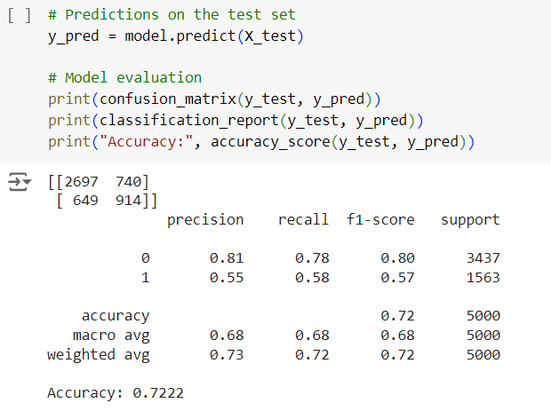
Code Snippet
Decision Trees

Slide 24
Key Differences
Decision Trees
Code Snippet

Slide 25
Code Snippet
Logistic regression is ideal for telecom churn prediction because it effectively models the probability of a customer churning (a binary outcome) based on various factors like contract length, usage patterns, and demographics. Its interpretability allows for understanding the impact of different variables on churn likelihood, aiding targeted retention strategies.
Decision Trees
Key Differences
Why Logistic Regression?
Parameters | Logistic Regression | Random Forest | Decision Trees
Accuracy | 81 | 80 | 72
Precision | (0) 84% (1) 74% | (0) 83% (1) 73% | (0) 81% (1) 55%
F-1 Score | (0) 87% (1) 67% | (0) 86% (1) 66% | (0) 80% (1) 57%
Recall | (0) 90% (1) 61% | (0) 90% (1) 60% | (0) 78% (1) 58%

Slide 26
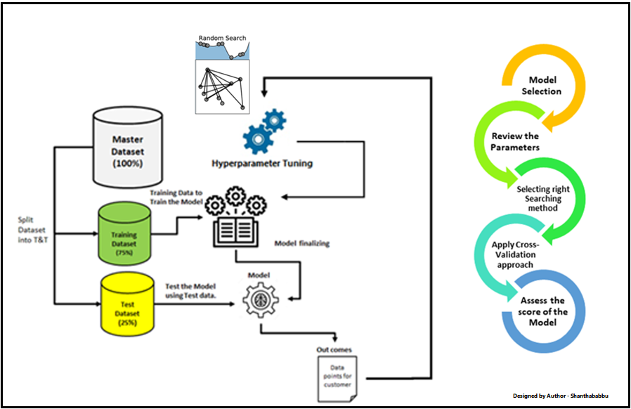
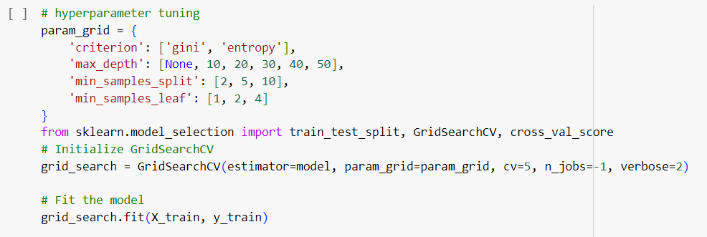
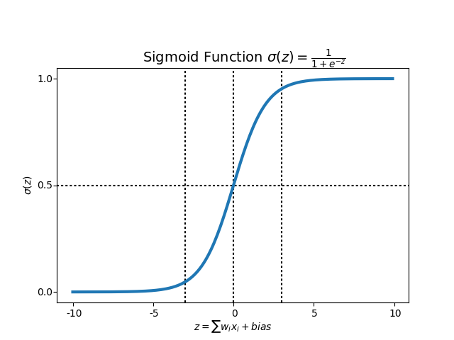
Why Logistic Regression?
Hyperparameter Tuning
Hyperparameter tuning is the process of optimizing a machine learning model's performance by adjusting its parameters that are set before the learning process begins, such as learning rate or kernel type.
Logistic regression is ideal for telecom churn prediction because it effectively models the probability of a customer churning (a binary outcome) based on various factors like contract length, usage patterns, and demographics. Its interpretability allows for understanding the impact of different variables on churn likelihood, aiding targeted retention strategies.

Slide 27
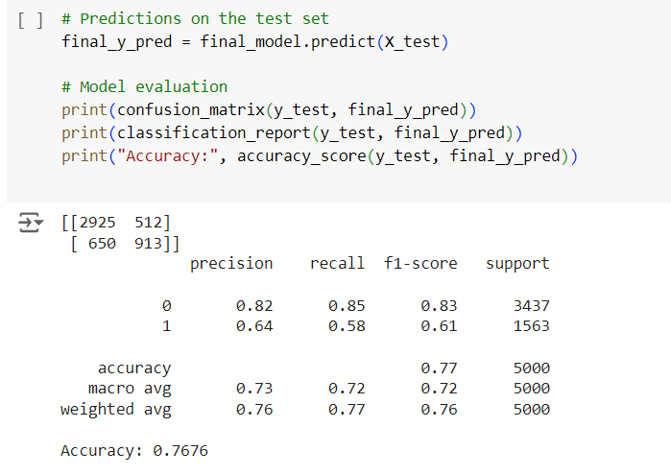
Hyperparameter tuning is the process of optimizing a machine learning model's performance by adjusting its parameters that are set before the learning process begins, such as learning rate or kernel type.
Hyperparameter Tuning
Code Snippet:

Slide 28
Conclusion
Hyperparameter tuning is the process of optimizing a machine learning model's performance by adjusting its parameters that are set before the learning process begins, such as learning rate or kernel type.
Hyperparameter Tuning
SVM & Confusion Matrix
A confusion matrix is a table that summarizes the performance of a classification model by comparing predicted and actual values, providing insights into accuracy, precision, recall, and F1-score.
SVM (Support Vector Machine) is a supervised machine learning algorithm that classifies data points by finding the optimal hyperplane that separates different classes, effectively handling complex patterns and outliers.
Code Snippet:

Slide 29
A confusion matrix is a table that summarizes the performance of a classification model by comparing predicted and actual values, providing insights into accuracy, precision, recall, and F1-score.
SVM (Support Vector Machine) is a supervised machine learning algorithm that classifies data points by finding the optimal hyperplane that separates different classes, effectively handling complex patterns and outliers.
Conclusion
Improved Customer Retention: By accurately predicting which customers are likely to churn, telecom companies can implement targeted strategies to retain valuable customers, ensuring their satisfaction and loyalty.
Enhanced Customer Experience: Understanding customer behaviour and preferences enables telecom providers to offer personalized experiences, address concerns proactively, and significantly improve overall satisfaction.
Increased Revenue: Retaining existing customers and maximizing their lifetime value leads to steady revenue streams and sustainable business growth.
Competitive Advantage: Effective churn prediction and management provide telecom companies with a competitive edge through superior service, tailored offers, and proactive retention initiatives.
SVM & Confusion Matrix

Slide 30
Improved Customer Retention: By accurately predicting which customers are likely to churn, telecom companies can implement targeted strategies to retain valuable customers, ensuring their satisfaction and loyalty.
Enhanced Customer Experience: Understanding customer behaviour and preferences enables telecom providers to offer personalized experiences, address concerns proactively, and significantly improve overall satisfaction.
Increased Revenue: Retaining existing customers and maximizing their lifetime value leads to steady revenue streams and sustainable business growth.
Competitive Advantage: Effective churn prediction and management provide telecom companies with a competitive edge through superior service, tailored offers, and proactive retention initiatives.
Conclusion
Thank YOU!

