Slide 1
Practical Data Science Assignment 3
Puneet Kaur Grewal
(s3900991)
I certify that this is all my own original work. If I took any parts from
elsewhere, then they were non-essential parts of the assignment, and they
are clearly attributed in our submission. I will show I agree to this honor
code by typing “Yes”: Yes

Slide 2
Union of Similar Items
HOW?
Finding items rated by either user ‘a’ or user ‘u’
Filling in missing values with the mean
WHY?
Allows the sample size to increase as there may not be a lot of movies rated by both users
Allows to better accuracy and therefore better model

Slide 3
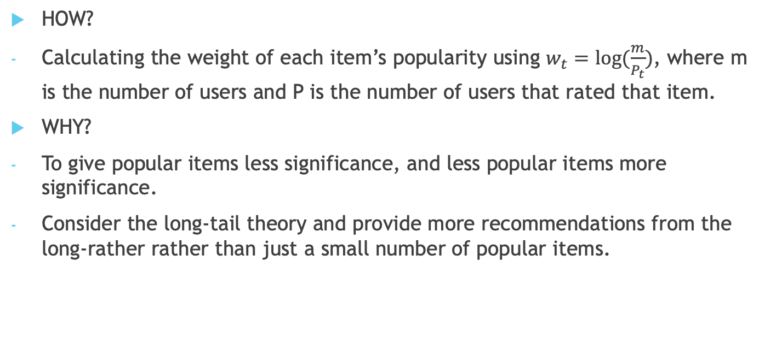
Weight of Item Popularity
HOW?
Calculating the weight of each item’s popularity using $w_{t}=\log{(\frac{m}{P_{t}})}$, where m is the number of users and P is the number of users that rated that item.
WHY?
To give popular items less significance, and less popular items more significance.
Consider the long-tail theory and provide more recommendations from the long-rather rather than just a small number of popular items.

Slide 4
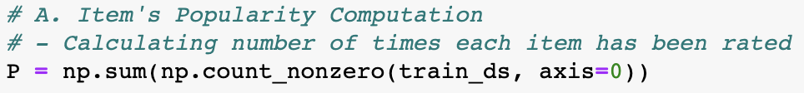
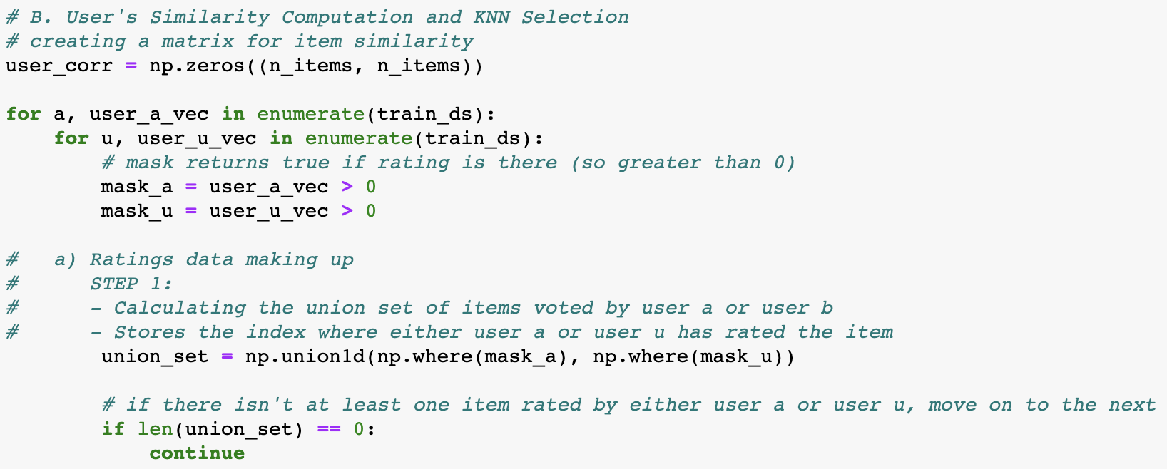
Implementation of the Code

Slide 5
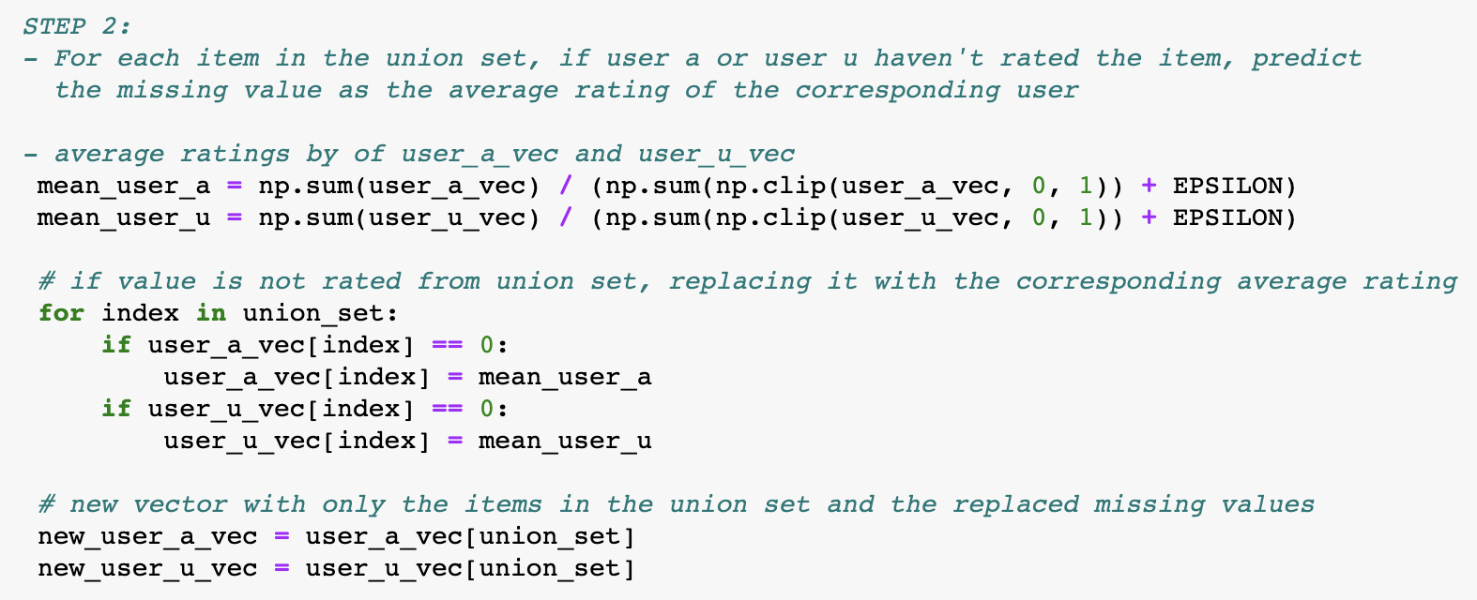
Implementation of the Code

Slide 6
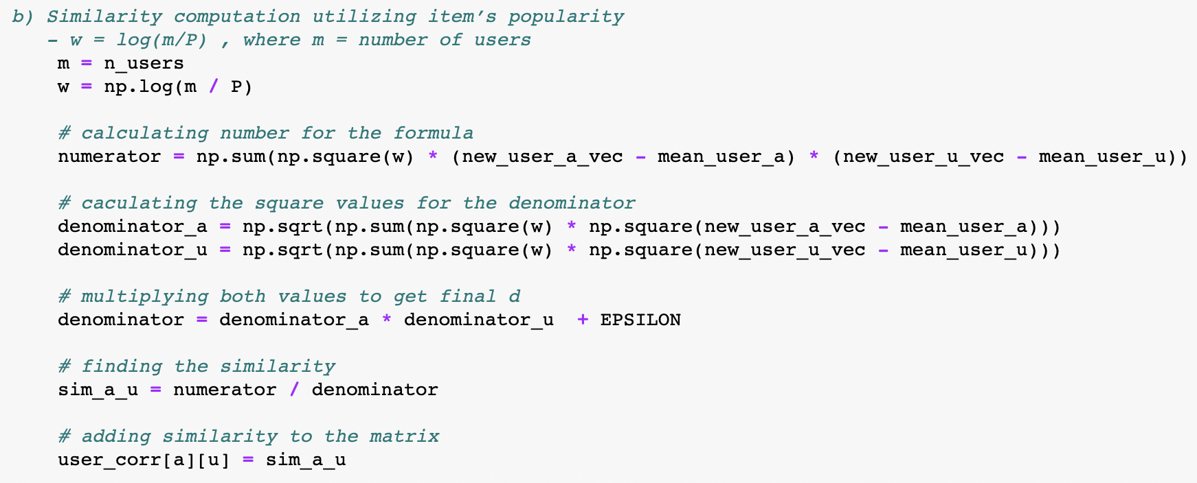
Implementation of the Code

Slide 7
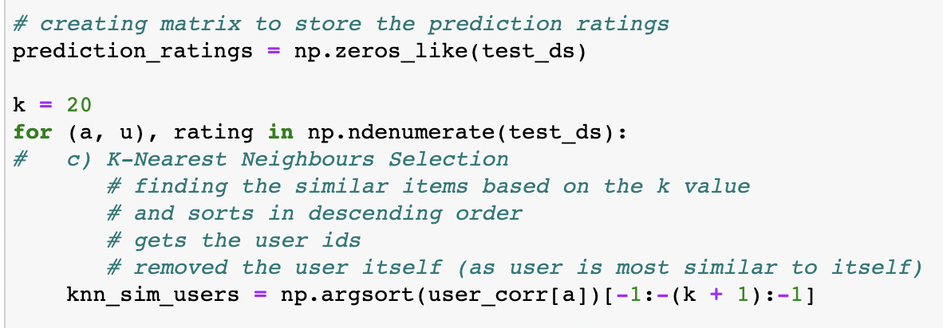
Implementation of the Code

Slide 8
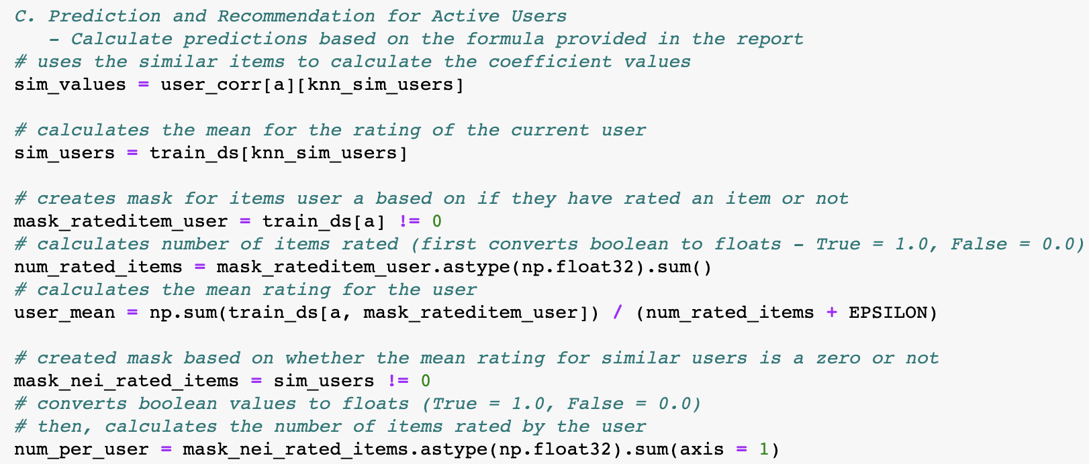
Implementation of the Code

Slide 9
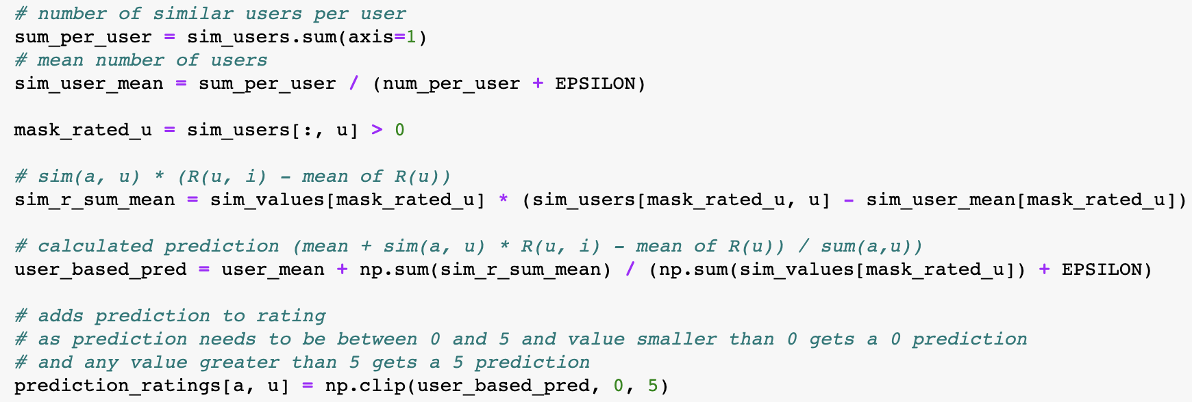
Implementation of the Code

Slide 10
Implementation of the Code

Slide 11
References
Could potentially reference the lecture slides for that basic knowledge and maybe I used some stuff when explaining that formula and all that stuff

