Slide 1
BASICS OF DATA ANALYTICS
USER_INTERFACE
by
Sreelekha.N

Slide 2
Python packages used
PysimpleGUI
For graphical Interface
TABULATE
To create table for Anova
MATPLOTLIB
For graphs
PYTHON VERSION:3.7

Slide 3
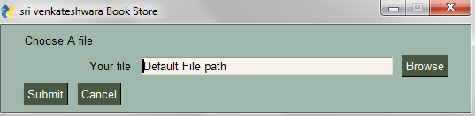
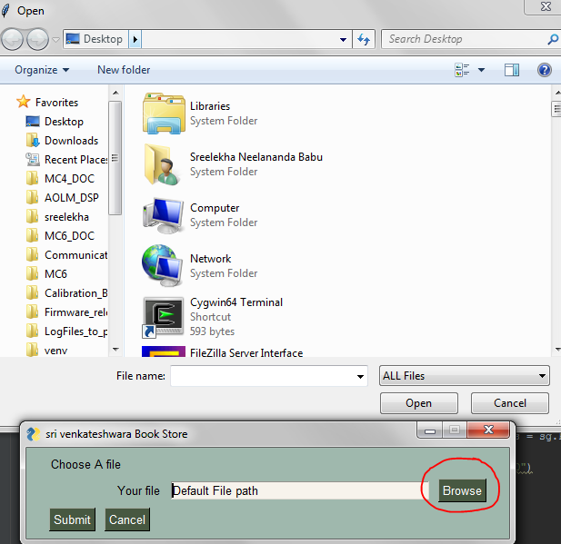
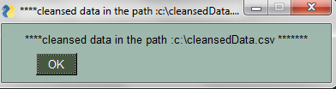
INPUT THE FILE

Slide 4

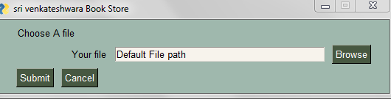
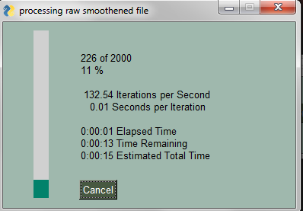
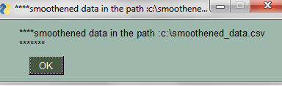
SMOOTHENING DATA is an option for user

Slide 5
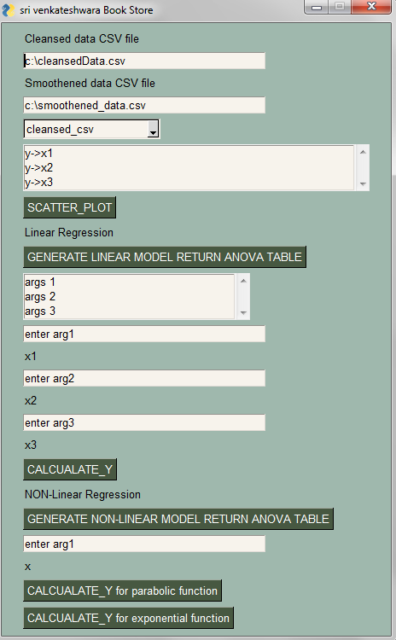
COMPUTATION

Slide 6
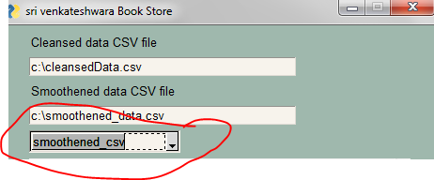
Select cleansed/smoothened CSV FILE in DropDown

Slide 7
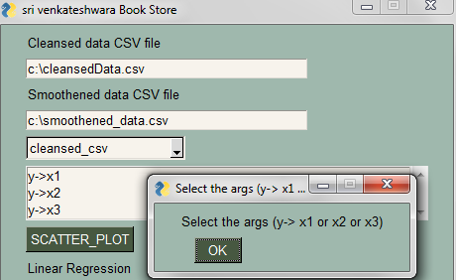
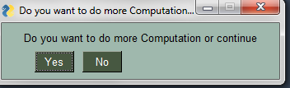
Generating plots
To generate scatter plot you need to select the args, If you don’t error is poped up & prompts for continuing

Slide 8
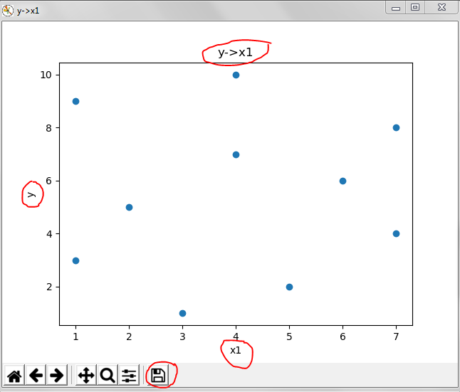
Cont’d
Scatter plot created for the appropriate arg selected and save as you wish to

Slide 9
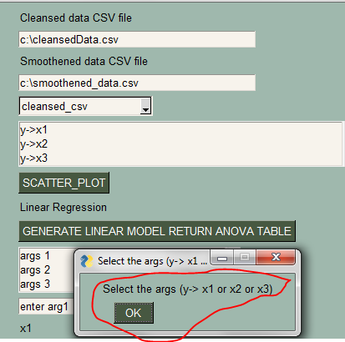
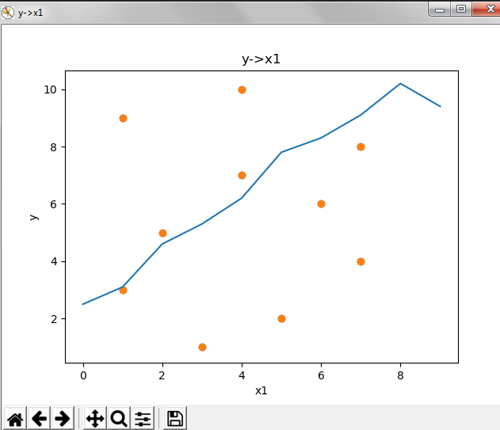
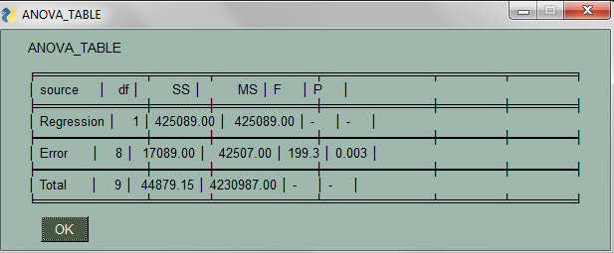
Generate linear model
ANOVA table returned & line plot is generated within the scatter plot
& do not forget the args y->x1 or x2 or x3

Slide 10
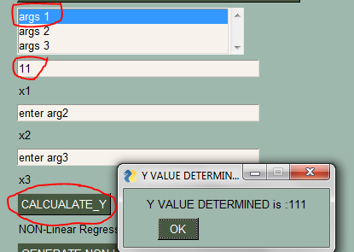
CALCULATE_Y
Enter appropriate values and select the args

Slide 11
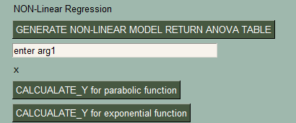
Non_linear model
Like Linear model , similarly generate non linear model
Calculate Y for parabolic function & Exponential function

Slide 12
THANK YOU

