Slide 1
EPICS · VIT BHOPAL · 2026
Metabolic
City AI
A working urban resilience platform for Bhopal, Indore and Sehore.
MERN operations console + H3 risk engine + Python spatiotemporal intelligence.
Built to show what is measured, what is modelled, and what is still missing.
MERN PLATFORM
H3 RISK ENGINE
PYTHON INTELLIGENCE
Working prototype, not a finished municipal deployment. Every limitation in this deck is intentional.
11 November 2026
Notes:
Open with the boundary: this is a working prototype. The deck is deliberately split into what is live, what is modelled, and what is still blocked on official data access. The project is MERN for operations and Python for spatial intelligence.

Slide 2
01 · THE PITCH
Cities do not lack data. They lack a shared picture of what is at risk right now.
Metabolic City turns fragmented municipal signals into one H3 cell view, then gives operators a traceable path from alert to resolution.
One cell. One score. One audit trail.
01
02
03
• Weather, roads, traffic, citizen reports and field updates are reconciled against the same H3 grid.
• The operator sees the evidence behind the score, not just a coloured polygon.
• Every decision, dispatch and closure is recorded, so the next shift inherits context.
OBSERVE
PRIORITISE
RESOLVE
Weather, roads, traffic,
citizen reports, field updates.
Deterministic 0–10 risk,
alerts, confidence, forecast.
Lock, decide, dispatch,
arrive, close, audit.
100 H3 CELLS
5,211 ROAD SEGMENTS
2 SERVICES HEALTHY
STATUS
Working local prototype. Live weather, roads and traffic; no live Bhopal transit feed; current incidents are workflow/test records.
METABOLIC CITY AI · EPICS · VIT BHOPAL
02 / 18
Notes:
This is the whole pitch in one slide. The product is the shared cell view and the audit trail, not the map. Say the status line out loud: live weather, roads and traffic; transit and municipal incidents are not live.

Slide 3
01 · THE PROBLEM
The problem is not another dashboard
The operational gap is integration and traceability. A prettier map does not fix either.
01
Fragmented signals
02
Slow triage
03
Weak accountability
Weather, traffic, complaints and field knowledge sit in separate systems.
Each source has a different location format, time window and owner.
Operators manually reconcile severity, location and ownership.
A road closure can disappear inside an averaged delay score.
Status changes are spread across calls, messages and memory.
The next shift cannot see who decided what, when, or why.
The community experiences the delay. The crew experiences the ambiguity.
Metabolic City is designed around the hand-off: source → cell → alert → decision → field status → audit.
Why now
Open data and low-cost APIs make a ward-level prototype possible without new hardware. The hard part is not ingestion; it is trust in the numbers.
METABOLIC CITY AI · EPICS · VIT BHOPAL
03 / 18
Notes:
Frame the problem in operational terms, not technology terms. The city already has data and maps. The missing layer is a shared, auditable cell view and a hand-off that survives shift changes.

Slide 4
02 · THE SYSTEM
What we built
Three layers, one spatial key. The Python service is deliberately separate from the operational core.
EXPERIENCE
ONE CELL,
THREE SCALES
React 18 + Vite
Operator console · field crew · admin · citizen QR
RES 8
street
OPERATIONS
stored risk cells
Node.js + Express
Auth · telemetry · H3 scoring · alerts · incidents · SSE
RES 6
neighbourhood
parent rollup
INTELLIGENCE
RES 4
city
Python 3.11 + FastAPI
Cell memory · multi-resolution · graph · RAG · LangGraph
parent rollup
MERN runs the workflow. Python explains the context. H3 is the shared spatial key.
METABOLIC CITY AI · EPICS · VIT BHOPAL
04 / 18
Notes:
Explain the separation of concerns. MERN is the operational system that owns auth, state and incident lifecycle. Python is an internal intelligence service that reads the same MongoDB and returns advisory output through the Node gateway.

Slide 5
02 · THE SYSTEM
End-to-end architecture
The browser never calls Python directly. Node owns identity, authorization and the public API.
EXPERIENCE
Operator console
Field crew
Admin
Citizen QR
OPERATIONAL CORE
Express REST
JWT / RBAC
SSE + Socket.IO
Alerts / incidents
STATE
INTELLIGENCE
MongoDB Atlas
Python FastAPI
telemetry · cells · alerts
incidents · audit · knowledge
cell memory · multi-resolution · graph
hybrid RAG · 8-node LangGraph workflow
SOURCES
Open-Meteo
TomTom
OSM + elevation
Citizen / field
Node gateway: /api/v1/intelligence · browser never reaches Python directly
METABOLIC CITY AI · EPICS · VIT BHOPAL
05 / 18
Notes:
Walk top to bottom. Experience calls the Node API. Node owns auth and writes to MongoDB. Python reads MongoDB and is proxied through the Node gateway. The bottom band is the only external input surface. Do not imply Python is public-facing.

Slide 6
03 · MERN PLATFORM
MERN: the operational system of record
MongoDB · Express · React · Node.js — one stack for the operator, field crew and admin workflow.
MONGODB
EXPRESS
REACT
NODE.JS
Identity & access
Telemetry ingestion
H3 risk engine
JWT access + refresh tokens
Operator / field crew / admin roles
Weather, traffic, citizen, transit
Stable event IDs for idempotency
Resolution-8 cells
0–10 composite, confidence, degradation
Alert & incident loop
Field operations
Admin & analytics
Locks, decisions, dispatch
Field status and audit trail
Task sync, GPS, photos
Arrival, resolution, notes
Weight changes with dry-run
1,053 audit entries in current DB
Engineering guardrails
7-layer security · rate limits · circuit breakers · dead-letter queue · idempotent ingestion · live SSE updates · audit logging
METABOLIC CITY AI · EPICS · VIT BHOPAL
06 / 18
Notes:
This is the MERN half. Emphasize that this is not a UI prototype: it has auth, RBAC, idempotent ingestion, incident state, field sync and audit. The 973 audit entries are from the current local database.

Slide 7
03 · MERN PLATFORM
How a cell gets its score
A deterministic, explainable screening score — not a black-box prediction.
R_c = 0.4 · S_m + 0.4 · S_c + 0.2 · S_v
WEIGHTS NORMALIZED
WHAT IT IS / IS NOT
threshold 7.0 · 1-hour window · 30-min half-life
IS
a deterministic screening score with visible inputs and guardrails.
IS NOT
a flood forecast, a dispatch decision, or a guarantee of outcomes.
S_m MOBILITY
S_c CLIMATE
S_v VULNERABILITY
TomTom speed and incidents
Transit adapter exists; no feed
Citizen mobility reports
Open-Meteo rain, visibility, wind
Inverse-distance interpolation
Per-cell reading, not one city number
OSM roads and watercourse distance
Elevation, slope and relief
Citizen distress reports
Guardrails
• Temporal decay
• Confidence / degradation flags
• Cascade risk from neighbours
• 3-hour forecast, kept separate
Current snapshot: 100 cells across 3 cities, zero critical cells.
Calm conditions are reported as calm. The system does not inflate risk to look impressive.
METABOLIC CITY AI · EPICS · VIT BHOPAL
07 / 18
Notes:
Explain the formula and the default weights. The most important line is the honesty line: peak is 2.25 out of 10. The score is a screening and triage aid, not a prediction guarantee. Do not claim flood prediction; the flood model is a separate screening layer and is not validated here.

Slide 8
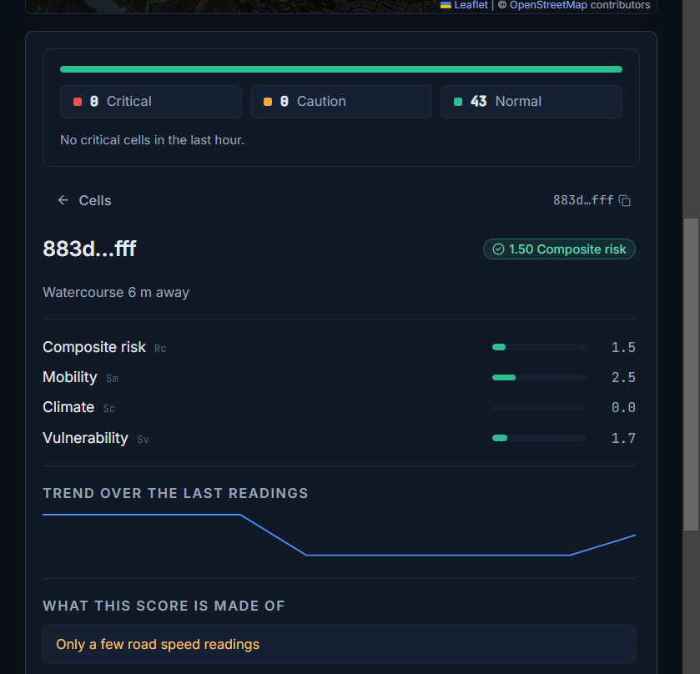
03 · MERN PLATFORM
From alert to resolution
The operator loop is the product. The map is only the entry point.
01
OBSERVE
Cell risk, alert score and the evidence behind it.
02
LOCK
A 60-second operator lock prevents duplicate decisions.
03
DECIDE
Approve or override, with a recorded reason.
04
DISPATCH
Crew, resources and dispatch text are attached to the incident.
05
RESOLVE
Acknowledge, arrive, close with note and photo.
STATUS MODEL
DETECTED → APPROVED → DISPATCHED → ACKNOWLEDGED → ARRIVED → RESOLVED
Current DB: 13 workflow/test incidents — not municipal history.
Live operator console · 43 Bhopal cells · 260 telemetry events
METABOLIC CITY AI · EPICS · VIT BHOPAL
08 / 18
Notes:
Walk the five-step loop. The 60-second lock matters because it prevents two operators from dispatching the same cell. Land on the amber caveat: the 13 incidents are workflow/test records, not real Bhopal history. That honesty is part of the pitch.

Slide 9
04 · PYTHON INTELLIGENCE
Python
intelligence layer
Five capabilities. One rule: advisory only.
Reads the same MongoDB as Node. Never dispatches a crew, sends SMS or changes incident status.
CELL MEMORY
MULTI-RESOLUTION
GRAPH ANALYTICS
HYBRID RAG
LANGGRAPH
Internal service · Node gateway · no browser exposure
09 / 18
Notes:
This is the transition to the Python half. Say the rule clearly: advisory only. The Python service is an internal decision-support layer. It does not own auth, incident state or dispatch.

Slide 10
04 · PYTHON INTELLIGENCE
Cell memory: a place with a history
Each H3 cell can carry risk, incidents, resources and neighbour correlations over time.
MULTI-RESOLUTION
RISK HISTORY
INCIDENTS
RES 8
street
trend, volatility,
seasonality
type, severity,
resolution time
100 stored cells
H3 CELL
neighbourhood
memory
RES 6
computed by parent membership
RESOURCES
NEIGHBOURS
assigned, efficiency,
outcome
correlation, cascade
direction
RES 4
city
computed by parent membership
recurrence · volatility · seasonality · personality profile
Built on request and persisted. Current DB: 100 materialized memory docs; 100 cells available.
METABOLIC CITY AI · EPICS · VIT BHOPAL
10 / 18
Notes:
Explain that memory is not a new database of fake history. It is computed from stored risk history, incidents and resources, then persisted. Only two cells have been materialized so far. Multi-resolution uses real parent membership, not string truncation.

Slide 11
04 · PYTHON INTELLIGENCE
Graph context + hybrid retrieval
The graph answers “what is connected?” The RAG layer answers “what has happened before?”
H3 ADJACENCY GRAPH
HYBRID RAG
critical hub
23 knowledge documents
13 historical incidents · 10 project playbooks
SPATIAL
neighbouring cells and same corridor
cascade direction
SEMANTIC
similar incident text and category
TEMPORAL
season, time of day, recurrence
• Degree / betweenness / closeness
• Critical hub + higher-risk neighbours
• Weighted response route
• Missing cells are not invented
RANKED CONTEXT → advisory brief
Cloudflare Workers AI embeddings and briefs when configured; deterministic local vectors and templates are the fallback. Playbooks are project-authored; isOfficial: false.
METABOLIC CITY AI · EPICS · VIT BHOPAL
11 / 18
Notes:
Graph analytics is NetworkX over real stored cells. RAG is hybrid retrieval over spatial, semantic and temporal signals. Be explicit: the default embedding is local hashed vectors, not a transformer. The 10 playbooks are project-authored templates, not official municipal SOPs.

Slide 12
04 · PYTHON INTELLIGENCE
LangGraph: eight advisory nodes
A traceable incident-resolution workflow, not an autonomous dispatcher.
01
DETECT
02
RISK
03
CONTEXT
04
RESOURCES
VERIFIED
LOCAL RUN
incident / cell
severity + urgency
RAG retrieval
skills + proximity
8
trace nodes
05
COMMUNICATE
06
EXECUTE
07
ESCALATE
08
LEARN
CRITICAL
dispatch text
progress check
threshold breach
outcome sample
immediate
7.8 / 10
effective risk
dry-run alerts
ADVISORY ONLY
No crew assignment, SMS or incident-status mutation. The operator remains the decision-maker.
5 runs recorded · learning stores outcome samples; retraining is deferred.
METABOLIC CITY AI · EPICS · VIT BHOPAL
12 / 18
Notes:
Walk the eight nodes. The verified run produced a trace with eight nodes, a CRITICAL/immediate recommendation, 7.8/10 effective risk and dry-run notifications. No crew, SMS or status changed. The learning node stores outcome samples; model retraining is a separate offline job.

Slide 13
05 · EVIDENCE & BOUNDARIES
The honest data ledger
If it is not in this table, we do not claim it.
LAYER
SOURCE
STATUS
WHAT IT MEANS
Weather
Open-Meteo
LIVE + IDW
100 events; interpolated per cell, not one city reading.
Roads & terrain
OSM + elevation
REAL STATIC
5,211 road segments; 100 terrain cells; real names and watercourses.
Traffic
TomTom
LIVE
60 events: 46 flow + 14 incidents; 60-minute polling; not bus data.
Transit
GTFS-RT
NO LIVE FEED
Zero GTFS rows; GTFS_RT_URL unset; simulation disabled.
Incidents
Operator workflow
DEMO / TEST
13 records created during development; not municipal history.
Citizen reports
QR / public API
AVAILABLE
Path exists; zero citizen rows in the current DB.
Intelligence
Python service
LIVE LOCAL
23 docs; 5 agent runs; advisory only; Cloudflare Workers AI + local fallback.
Performance
Not measured
NOT CLAIMED
No 40–60% response-time or resolution claim.
This ledger is the boundary of the project. It is also the answer to the first viva question: “what is actually real?”
METABOLIC CITY AI · EPICS · VIT BHOPAL
13 / 18
Notes:
This is the most important slide for credibility. Read the statuses. Weather and traffic are live but weather is interpolated. Transit is not live. The 13 incidents are test records. Citizen reports are supported but there are zero rows. The intelligence service is live locally but advisory. No performance improvement is claimed.

Slide 14
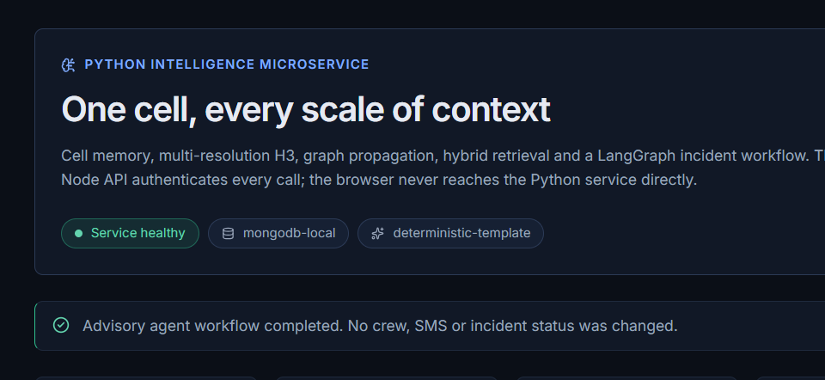
05 · EVIDENCE & BOUNDARIES
Verified system snapshot
Local development stack, 11 November 2026. Not a production SLA.
100
5,211
260
H3 CELLS
OSM ROAD SEGMENTS
TELEMETRY EVENTS
43 Bhopal · 32 Indore · 25 Sehore
Real road network + 100 terrain cells
100 weather · 100 GIS · 60 traffic
150
13
5
ALERTS
TEST INCIDENTS
AGENT RUNS
28 currently open
5 approved · 4 escalated · 2 detected · 2 resolved
23 knowledge docs · 8-node traces
Intelligence page · local dev · service healthy
2 live services healthy
Node API + Python FastAPI · frontend on Vite · 100 materialized memory docs · 1,053 audit entries
METABOLIC CITY AI · EPICS · VIT BHOPAL
14 / 18
Notes:
Use these numbers instead of adjectives. 100 cells, 5,211 road segments, 250 telemetry events, 126 alerts with 18 open, 13 test incidents, 4 agent runs. The 50 traffic readings are road measurements, not bus data. Two services are healthy. Note that this is a local dev measurement, not a production benchmark.

Slide 15
06 · EPICS & NEXT
EPICS fit: feasible, useful, honest
VIT Bhopal evaluates economic, societal, environmental, demographic feasibility and implementation. Here is the honest read.
ECONOMIC
SOCIETAL
ENVIRONMENTAL
DEMOGRAPHIC
IMPLEMENTATION
Open-source stack
Existing APIs + request budget
No new hardware
Citizen QR reporting
Transparent alerts
Field accountability
Flood / traffic resilience screening
No emissions claim
Climate data is measured
Bhopal, Indore, Sehore
English UI today
Local-language next
Working local stack
Tests + docs
Official access pending
The missing evidence is community validation — not another feature.
Next: 15–25 citizen and stakeholder interviews, 5 field observations, 3 review sessions, then a ward-level pilot.
What works today
Working software · real weather/roads/traffic · explainable risk · incident lifecycle · Python intelligence · documented limits
METABOLIC CITY AI · EPICS · VIT BHOPAL
15 / 18
Notes:
Map the project to the five EPICS criteria. The strongest columns are implementation and economic feasibility. The weakest is community validation. Say that directly: the next step is not more code, it is 15–25 real interviews and a ward-level pilot.

Slide 16
06 · EPICS & NEXT
What we do not claim — and what comes next
The engineering is ahead of the evidence. Close that gap before adding modules.
NOT CLAIMED
NEXT 90 DAYS
Live Bhopal transit
NOW
Mark demo data. Freeze features. Record a backup demo.
Real municipal incident history
2 WEEKS
Promote TomTom / corroborated citizen alerts to DETECTED; targeted cell recalculation.
Measured 40–60% response improvement
Production municipal deployment
4–6 WEEKS
Request GTFS / ICCC access; build a labelled replay fixture for the transit adapter.
Official municipal SOPs
8–12 WEEKS
15–25 citizen interviews; 3 stakeholder reviews; ward-level pilot plan.
These are boundaries, not failures. They keep the demo defensible.
Ship the honest boundary, then earn the next data source.
METABOLIC CITY AI · EPICS · VIT BHOPAL
16 / 18
Notes:
This is the roadmap slide. The left column is a pre-emptive answer to the toughest questions. The right column is what to do next. Emphasize that marking demo data and promoting real alerts are higher value than adding more Python features before the review.

Slide 17
06 · EPICS & NEXT
Seven-minute demo flow
Show the working loop, then show the boundary. Do not hide either.
0:00
LANDING / LOGIN
Role-based entry: operator, field crew, admin.
Q&A READY
OPERATOR MAP
100 cells across 3 cities; calm conditions shown honestly.
01
What is live today?
1:00
02
Why is there no Bhopal transit feed?
2:30
CELL DETAIL
Risk, evidence, alerts and data confidence.
03
How accurate is the score?
3:30
DECISION
Lock, approve/override, dispatch, audit.
04
What would you do with municipal access?
5:00
INTELLIGENCE
Memory, graph, RAG and agent trace.
Backup: recorded walkthrough + labelled demo data. Never present test incidents as live.
6:00
BOUNDARIES
Live vs demo vs missing; next steps.
Thank you.
Metabolic City AI · EPICS · VIT Bhopal
A city-scale prototype with the data boundaries written down.
METABOLIC CITY AI · EPICS · VIT BHOPAL
17 / 18
Notes:
Close on the demo flow. Six minutes is enough if you move quickly. The Q&A slide is a cue card for the four questions evaluators are most likely to ask. The final line is the thesis: a city-scale prototype with the data boundaries written down.

Slide 18
APPENDIX · TRANSIT STATUS
What “transit” means in this build
No live bus feed. Today’s mobility score is a road-traffic signal, not a transit-performance measurement.
LIVE
DORMANT
DISABLED
TomTom road traffic
GTFS-Realtime adapter
Simulated transit
46 flow readings + 14 incident readings at the last snapshot. This is the road data currently feeding mobility.
The adapter exists, but GTFS_RT_URL is unset, so the poller never starts. Current GTFS_TRANSIT rows: zero.
TRANSIT_SIMULATION_ENABLED=false. The static route/stop list is hand-maintained, not an official GTFS import.
WHAT THE SCORE ACTUALLY USES
TO TURN ON REAL TRANSIT
0 GTFS transit events
01
City supplies a GTFS-RT URL, directly or through an AVLS adapter.
60 road-traffic readings: 46 flow + 14 incidents
02
Feed provides vehicle positions and trip/stop identifiers.
100 weather + 100 terrain events
03
Set GTFS_RT_URL; the adapter polls and writes GTFS_TRANSIT events.
04
Validate stop attribution, delay maths and replay against known runs.
Mobility = road congestion and disruption, not bus punctuality
Pitch line: “We have a transit adapter ready; we do not have a live transit feed, so we do not claim bus performance.”
METABOLIC CITY AI · EPICS · VIT BHOPAL
18 / 18
Notes:
Use this appendix only if a judge asks why transit is missing. Be direct: there are zero GTFS_TRANSIT rows. The GTFS-Realtime adapter is code, not a data source, and GTFS_RT_URL is unset. The simulated transit generator is disabled because a modelled bus delay is not a measurement. Today's mobility score comes from TomTom road flow and incidents. If the city provides a feed, the adapter can be activated, but it needs stop-ID mapping and validation; the current code reads vehicle.trip.stopId, which is not a standard GTFS-RT field, so it must be tested against the real feed before it is trusted.

