Slide 1
E-commerce product showcase
CAPSTONE PROJECT
Presented By:
Jajula Puneeth Kumar
AVN Institute of Engineering Technology -
Cyber Security

Slide 2
OUTLINE
Problem Statement (Should not include solution)
System Development Approach (Technology Used)
Algorithm & Deployment (Step by Step Procedure)
Result
Conclusion
Future Scope(Optional)
References

Slide 3
Problem Statement
Small businesses often struggle to showcase their products online due to:
The complexity and cost of setting up full-scale e-commerce platforms.
Limited technical expertise to manage backends, databases, and servers.
Lack of simple, visually appealing tools to display products in a clear and engaging way.
As a result, many businesses fail to highlight their offerings effectively and miss opportunities to attract customers in the digital space.

Slide 4
System Approach
Frontend Technologies:
HTML5 – Structure of the webpage
CSS3 – Styling and responsive layouts
JavaScript – Dynamic interactivity (cart, filtering, total calculation)
Design Approach:
Clean and user-friendly interface
Mobile-responsive design
Modular separation of HTML, CSS, and JS files

Slide 5
Algorithm & Deployment
Product Catalog Creation
Define product categories and details (image, price, description).
Frontend Design
Layout using HTML and CSS (grid & cards).
Interactive Features
Add-to-Cart, Remove-from-Cart functions in JavaScript.
Real-time total price calculation.
Product filtering by category.
Modal views for product details.
Testing
Cross-browser compatibility
Mobile responsiveness
Test filtering and model interactions for smooth performance
Deployment
Host using GitHub Pages for free, reliable, and easy public access

Slide 6
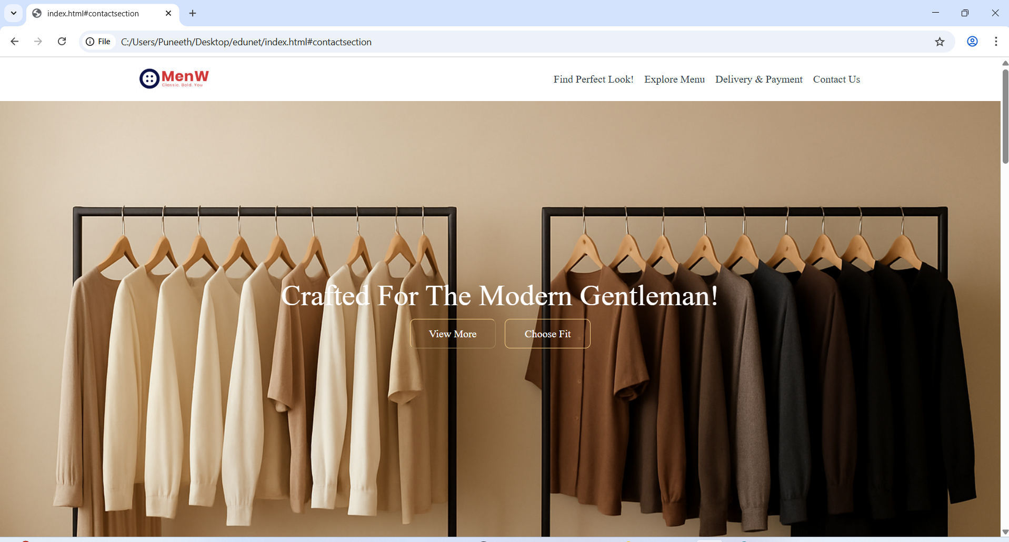
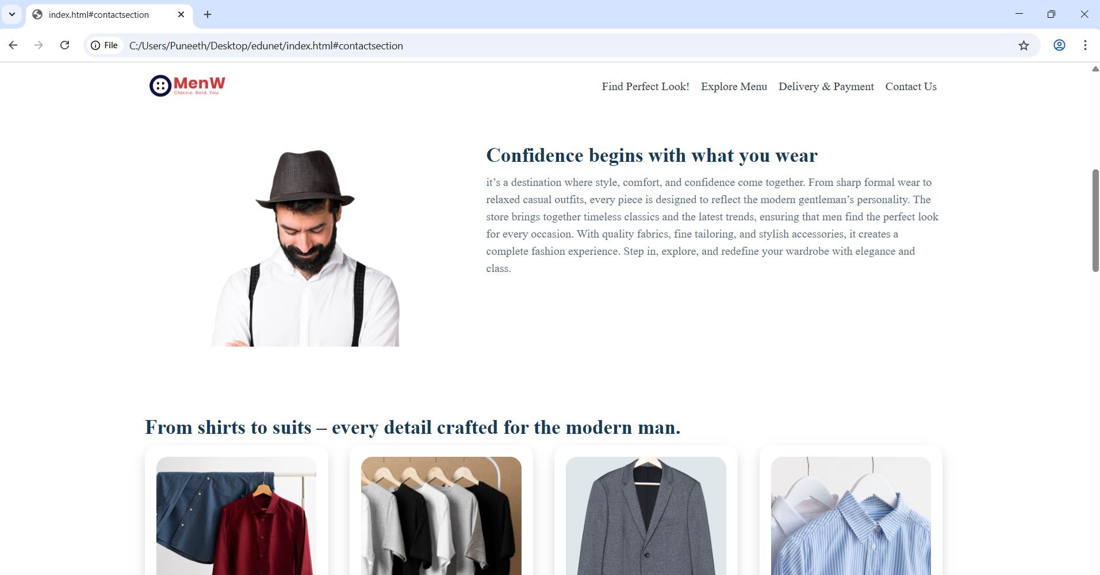
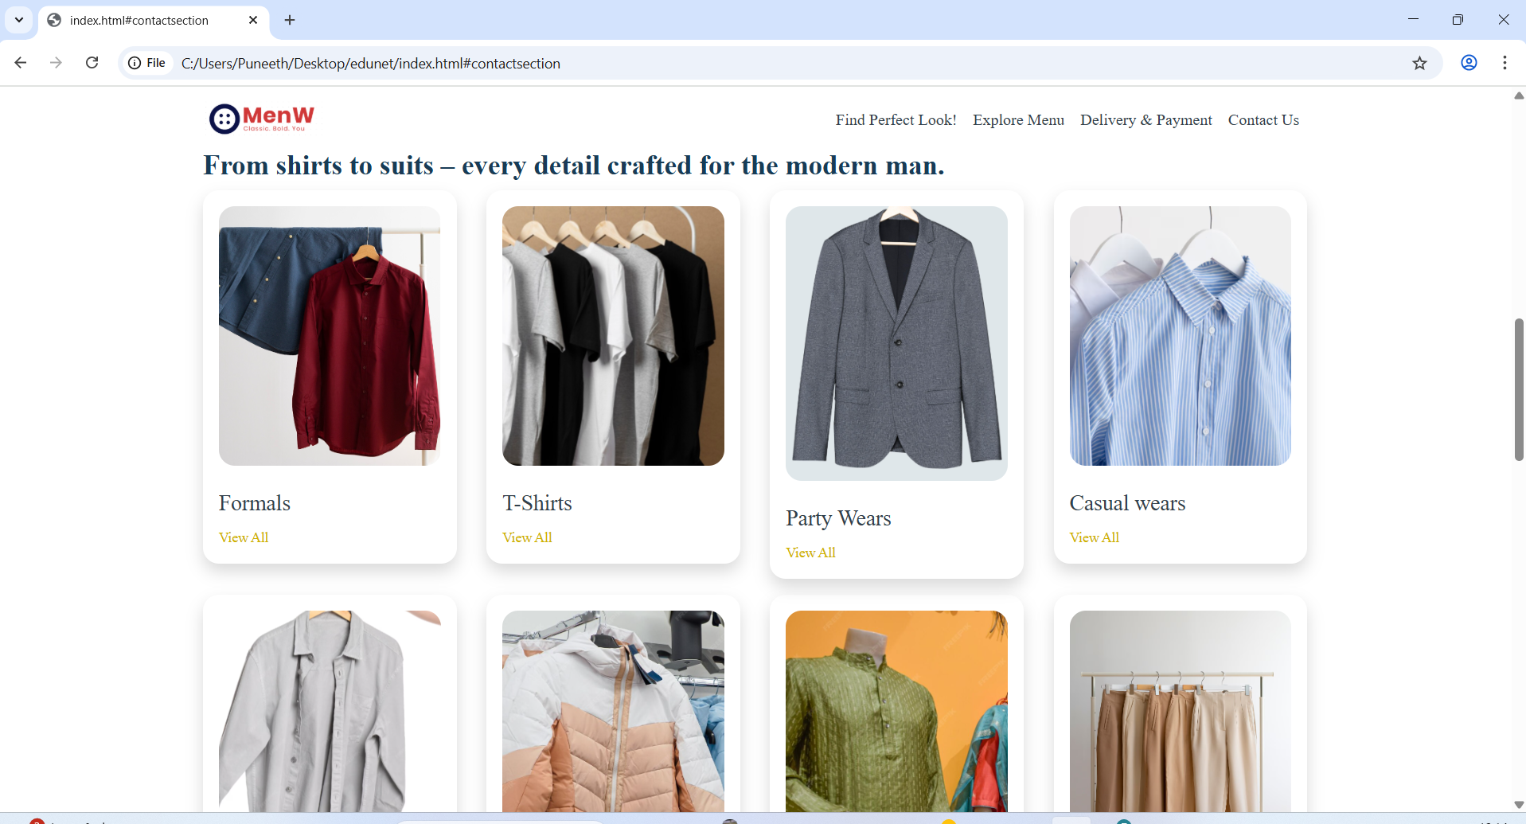
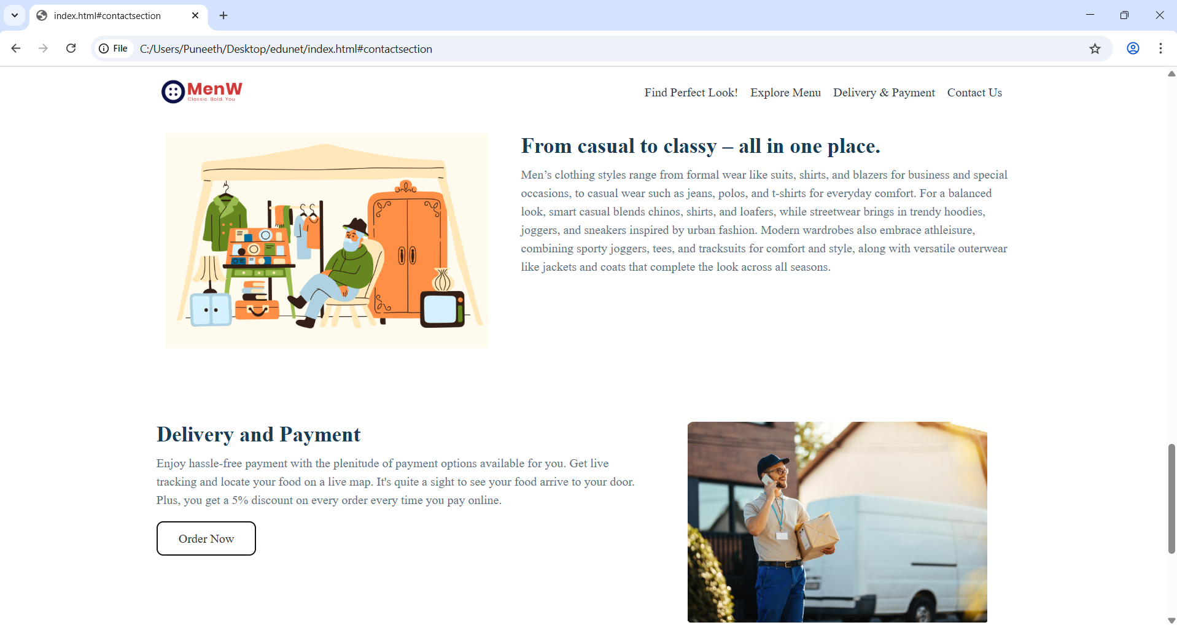
Result

Slide 7
Github & deployment Link
Attach your Github Link : https://github.com/Puneeth-255/MenW
Deployment link: https: https://puneeth-255.github.io/MenW/

Slide 8
Conclusion
This project provides a simple, cost-effective, and attractive online product display system tailored for small businesses. By eliminating the need for complex backends, it empowers business owners to showcase their products clearly, engage customers effectively, and establish an online presence with ease. The lightweight design, filtering options, and modal views ensure both usability and visual appeal, making it a practical solution for modern small-scale enterprises.

Slide 9
Future scope(Optional)
Search & Sorting: Add advanced search and sorting options for faster product discovery.
User Accounts: Enable login for customers and admins to personalize experiences.
Cart & Checkout: Extend into a lightweight e-commerce system with cart and payment options.
Analytics Integration: Track product views and customer interactions.
Multi-language Support: Expand reach by supporting regional languages.
Mobile App Version: Develop a companion app for wider accessibility.

Slide 10
References
W3Schools – https://www.w3schools.com (HTML, CSS, JavaScript tutorials)
MDN Web Docs – https://developer.mozilla.org (Web standards and best practices)
Bootstrap Documentation – https://getbootstrap.com (For responsive design inspiration)
GitHub Pages Documentation – https://pages.github.com (For project hosting)
FreeCodeCamp – https://www.freecodecamp.org (Frontend development resources)
Get started with Bootstrap · Bootstrap v5.3

Slide 11
THANK YOU

