Slide 1
Web Automation using Selenium with Python
Capstone Project Presentation
Presented by: Puneeth Kondlapudi
Course/Internship: Python Automation
Date: 11th March 2026

Slide 2
Contents
Problem Statement
Project Objective
Tools and Technologies Used
Automation Framework Architecture
Project Workflow
Project Test Output – Screenshots
Project Output
Challenges Faced
Future Enhancements
Conclusion

Slide 3
Problem Statement
Manual testing of web applications is time-consuming, repetitive, and error-prone.
Repeated testing across multiple browsers and user flows requires significant effort.
Human testers may miss edge cases or introduce inconsistencies between test runs.
Due to complex web applications, there is a need for an automated, reliable, and maintainable testing framework.
This project automates the end-to-end testing of BStackDemo (bstackdemo.com) an e-commerce web application.

Slide 4
Project Objectives
Build a Selenium-based automation framework using Python and the Page Object Model (POM).
Automate key user flows like Login, Product Search, Add to Cart, Checkout, Shipping, and Receipt Download.
Implement a BasePage class to centralise reusable Selenium methods to access locators easily.
Use data-driven testing by reading test data from Excel files (xlsx).
Generate detailed HTML test reports and capture screenshots on failure.
Implement structured logging for traceability and debugging.
Support parallel test execution using pytest-xdist.

Slide 5
Tools and Technologies Used
Language: Python 3.14.
Automation Tool: Selenium WebDriver (Chrome).
Test Framework: pytest with pytest-html for HTML reports.
Parallel Execution: pytest-xdist (-n flag for multi-worker runs).
Design Pattern: Page Object Model (POM) with BasePage inheritance.
Data Source: Excel (xlsx) using pandas and openpyxl.
Logging: Python logging module with file-based log output.
IDE: PyCharm.

Slide 6
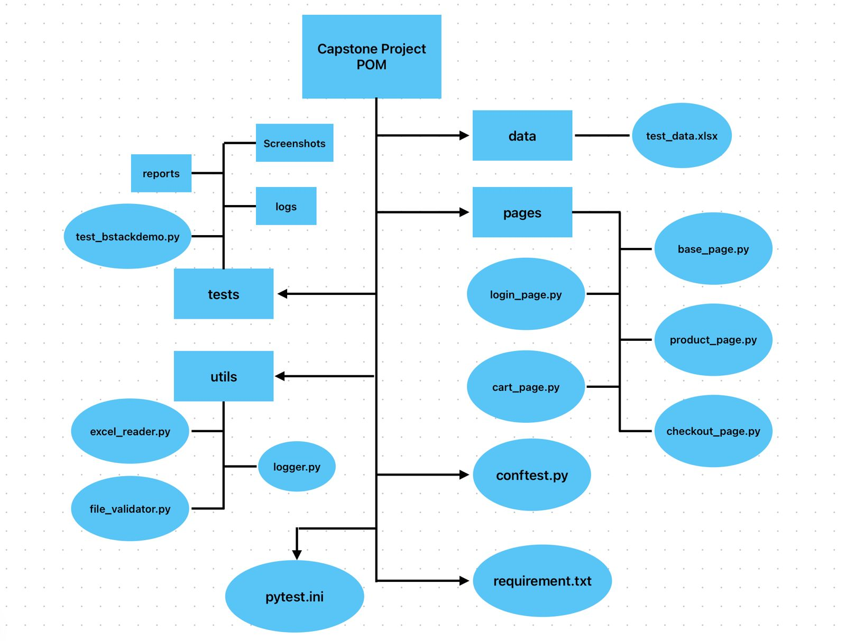
Automation Framework Architecture

Slide 7
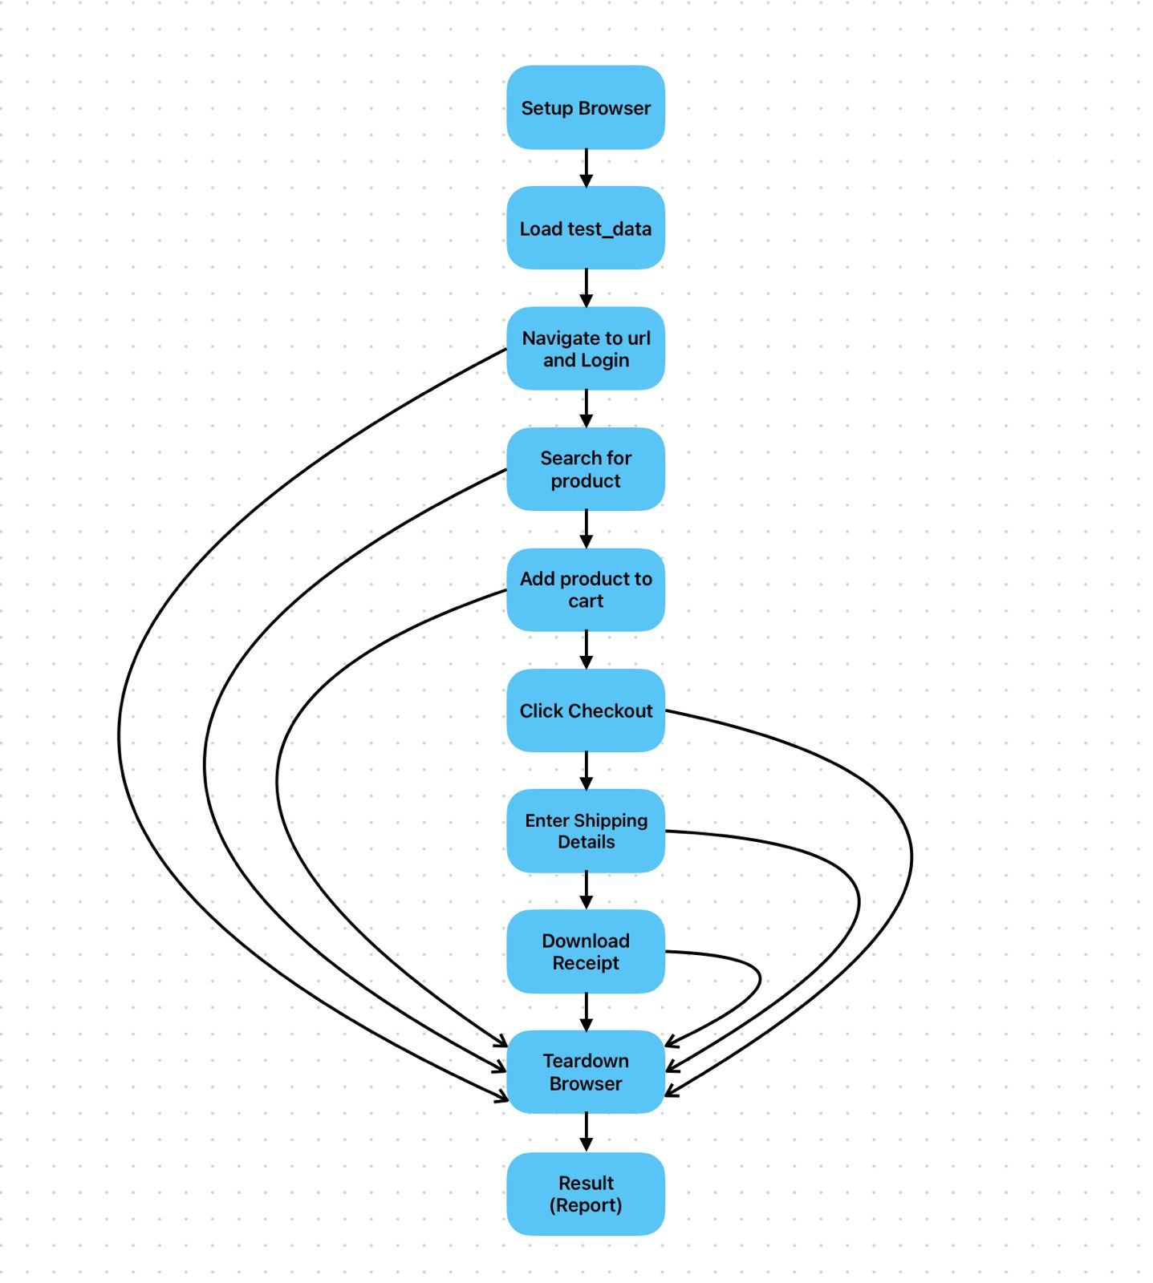
Project Workflow

Slide 8
Project Workflow
1. Browser launches via conftest.py fixture (Chrome, maximised window)
2. Test data is loaded from Excel (data/test_data.xlsx) using ExcelReader
3. Login: Navigate to bstackdemo.com → Select username/password → Click login
4. Product Search: Enter product name → Click search → Wait for results
5. Add to Cart: Click add-to-cart button → Wait for cart sidebar to appear
6. Checkout: Click checkout button in cart → Proceed to shipping page
7. Shipping Details: Fill first name, last name, address, province, postal code → Continue
8. Download Receipt: Click download → Validate receipt file exists in Downloads folder
9. Results: HTML report generated, logs saved, screenshots captured on failure

Slide 9
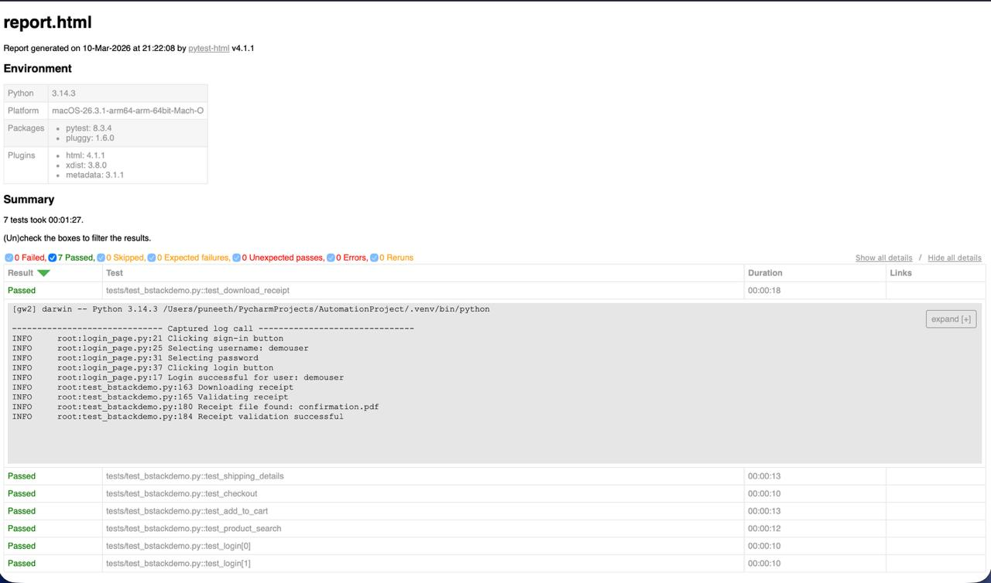
Project Test Output – Screenshots

Slide 10
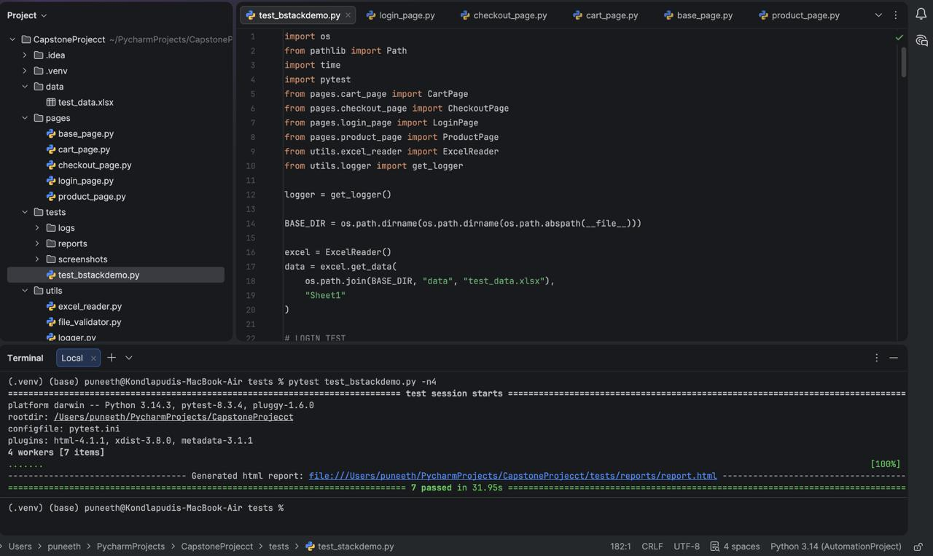
Project Test Output – Screenshots

Slide 11
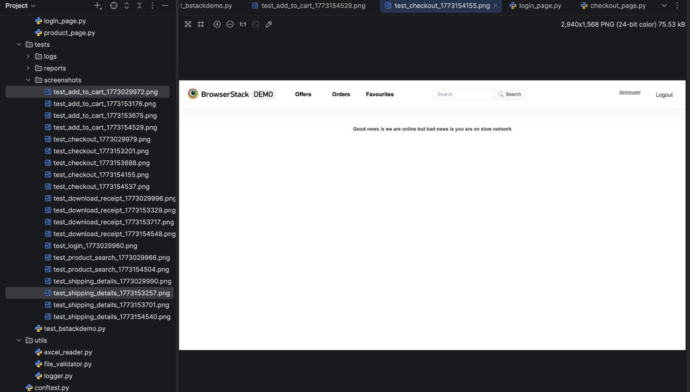
Project Test Output – Screenshots
Failed Screenshot

Slide 12
Project Output
Total Test Cases: 7
test_login (parameterized, 2 data sets) — Validates login with multiple users.
test_product_search — Verifies product search functionality.
test_add_to_cart — Validates adding a product to the cart.
test_checkout — Tests the checkout flow from cart.
test_shipping_details — Verifies entering complete shipping information.
test_download_receipt — Downloads and validates the order receipt.
Parallel execution supported via: pytest test_stackdemo.py -n2.
All tests pass with HTML report and log file generated.

Slide 13
Challenges Faced
Dynamic elements: Dropdown selections required explicit waits for options to render.
Timing issues: Replacing time.sleep() with explicit waits needed careful tuning.
Floating cart sidebar: The checkout button inside the cart was not immediately clickable after adding a product.
Parallel test flakiness: Running tests concurrently (-n2) caused occasional timeouts due to slow network speeds.
Solution: Implemented BasePage with robust wait helpers and increased timeouts for network-dependent operations

Slide 14
Future Enhancements
Cross-browser testing: Add support for Firefox, Edge, and Safari using WebDriver Manager
Detailed reporting: Replace pytest-html with Allure for richer, interactive test reports
Page load performance: Add performance metrics collection during test runs.
Increasing Testcases: Add additional testcases to go for deeper evaluation.
Using Marking : Adding Marking to run specific testcases for easy access.

Slide 15
Conclusion
Successfully built an end-to-end Selenium automation framework using Python.
Applied the Page Object Model with BasePage for clean, maintainable, and reusable code.
Automated 7 test cases covering the full e-commerce user journey on BStackDemo.
Implemented data-driven testing, structured logging, HTML reporting, and failure screenshots.
Framework supports parallel execution and uses explicit waits for reliability.

Slide 16


