Slide 1
FSA-Group-07
Group Members:
Sai Rohith Gorla
Puneeth Annam

Slide 2
Treasure Finder Game
This is a game application in which the player must follow a sequence of clues in order to locate the treasure.
The first color on the left side gives the user a correct location to locate the treasure.
While coming to the second color on the right side confirms whether the user is in a valid location and, if not, gives the user a hint to get into one.
If the treasure has been discovered, the user will be able to move on to the next level.

Slide 3
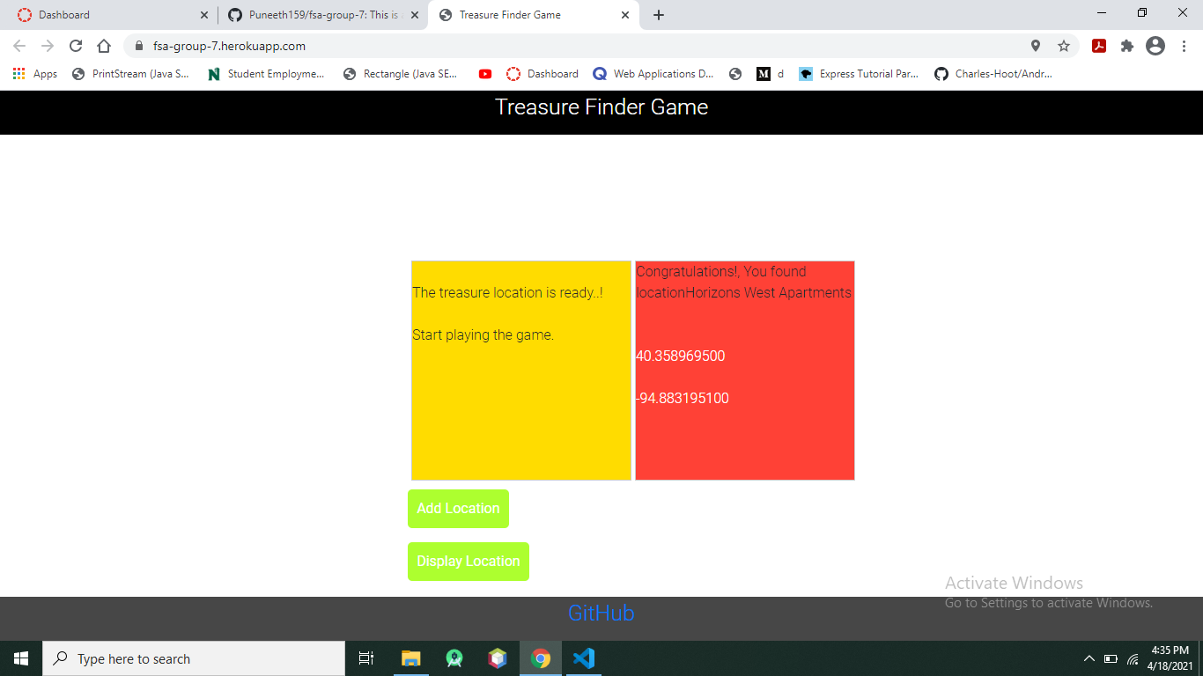
Treasure Finder Game

Slide 4
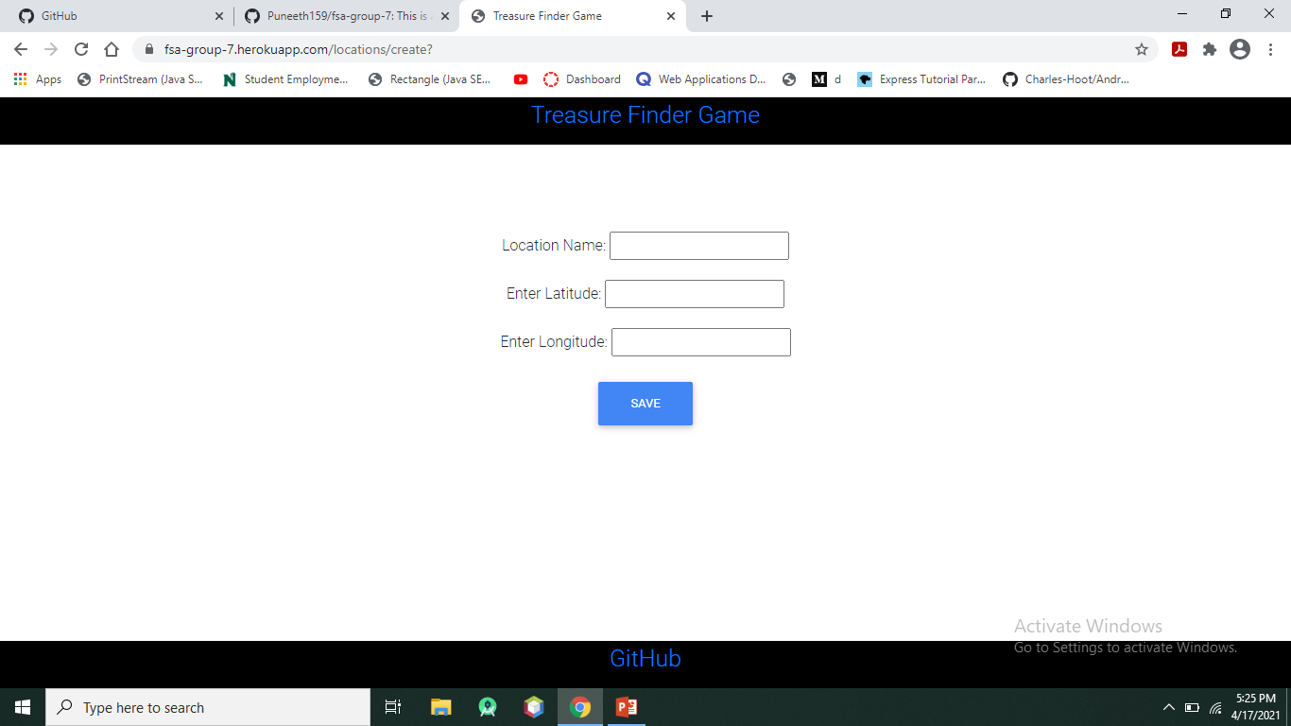
Treasure Finder Game
In this game app, we can add locations.

Slide 5
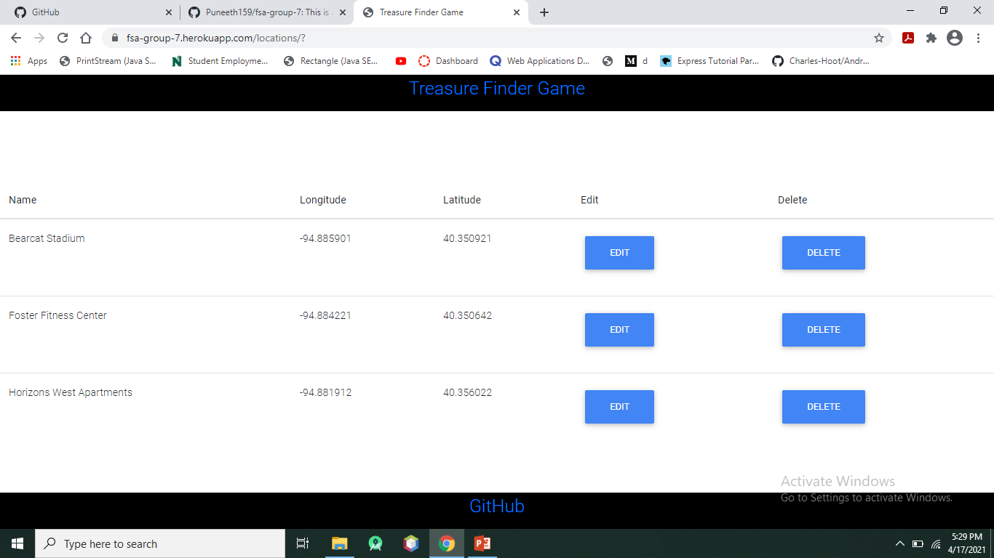
Treasure Finder Game
This app allows us to see the added locations.

Slide 6

Treasure Finder Game
In this game app, we can also edit location name, latitudes and longitudes.

Slide 7
Thank You

