Slide 1
Fire Fighting bot

Slide 2
Introduction :
This project aims to develop an autonomous fire fighting bot that can detect and extinguish fires in indoor environments. To protect the home and its occupants, the bot uses sensors to identify fire and obstructions.

Slide 3
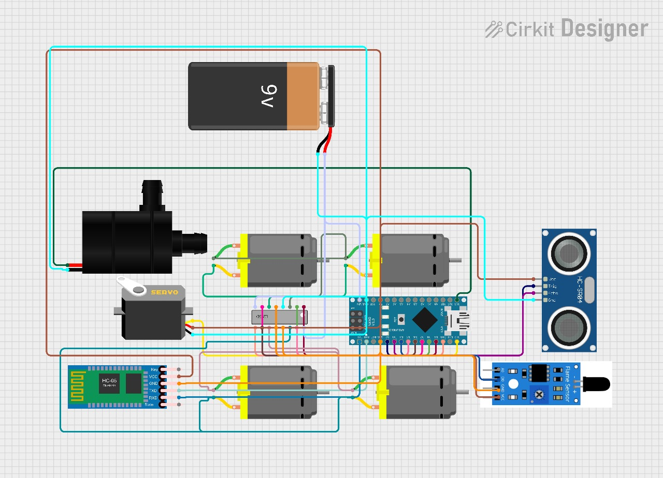
Block diagram

Slide 4
Components :
Arduino Nano : The Arduino Nano is a compact and versatile microcontroller board based on the ATmega328P microcontroller chip. It offers a wide range of functionalities in a small form factor, making it ideal for embedded projects with space constraints, such as robotics, IoT devices, and automation systems.
L293D IC : The L293D is a popular integrated circuit (IC) commonly used as a motor driver for controlling DC motors and stepper motors in various electronic projects. It is designed to drive inductive loads such as motors with high efficiency and reliability.
Li-ion Batteries (3.7V, 3000mAh) : Lithium-ion (Li-ion) batteries are rechargeable batteries known for their high energy density, lightweight design, and long cycle life. They are widely used in portable electronic devices, including smartphones, laptops, and various hobbyist projects like robotics and IoT devices.
DC Water Pump: A small DC water pump is a compact and efficient device designed for pumping water or other liquids in various applications, including hobbyist projects, aquariums, fountains, and small-scale irrigation systems.

Slide 5
Components :
HC-05 Bluetooth Module: The HC-05 is a widely used Bluetooth serial communication module that enables wireless communication between electronic devices over short distances. It is commonly employed in hobbyist projects, robotics, IoT applications, and various other electronic systems requiring wireless connectivity.
Servo Motor: A servo motor is a rotary actuator that allows for precise control of angular position, velocity, and acceleration. It is commonly used in robotics, automation, remote control systems, and various other applications requiring accurate motion control.
DC Motors: A DC (Direct Current) motor is an electrical machine that converts electrical energy into mechanical energy through the interaction of magnetic fields. It is commonly used in a wide range of applications requiring rotational motion, including robotics, automation, vehicles, and industrial machinery.

Slide 6
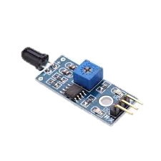
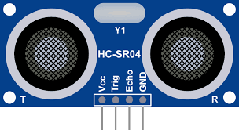
Sensors :
Ultrasonic Sensor: An ultrasonic sensor is a transducer that emits and receives ultrasonic sound waves to detect the distance between the sensor and an object. It operates on the principle of echolocation, similar to how bats navigate in the dark.
Flame Sensor: A flame sensor is a specialized electronic device designed to detect the presence of a flame or fire source. It operates by sensing the infrared radiation emitted by flames, allowing it to identify potential fire hazards and trigger appropriate responses.
Ultrasonic Sensor Flame Sensor

Slide 7
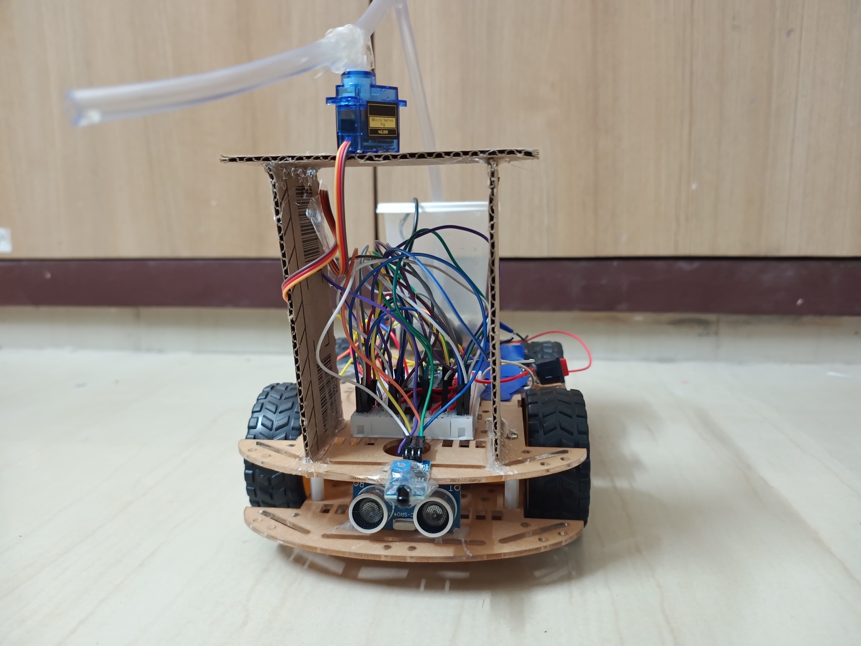
hardware

Slide 8
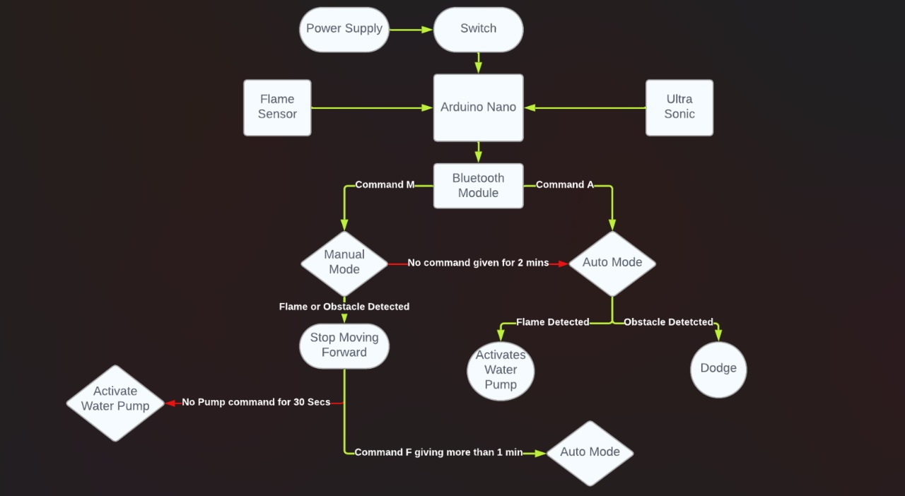
Block diagram

Slide 9
Advantages :
Autonomous Operation: The bot can operate autonomously without human intervention, thanks to its ability to detect obstacles, flames, and navigate its environment using ultrasonic sensors. This autonomy allows the bot to respond to fire emergencies quickly and effectively, even in remote or inaccessible areas.
Real-time Monitoring and Control: The integration of a Bluetooth module enables real-time monitoring and control of the bot using a smartphone or other Bluetooth-enabled devices. Users can switch between manual and automatic modes, send commands, and receive status updates from the bot, enhancing its usability and flexibility.
Fire Detection and Suppression: The inclusion of a flame sensor allows the bot to detect the presence of flames and activate the water pump for fire suppression automatically. This feature ensures rapid response to fire outbreaks, minimizing the risk of property damage and enhancing safety in fire-prone environments.
Obstacle Avoidance: The bot incorporates obstacle detection capabilities using ultrasonic sensors, enabling it to navigate through its environment safely and avoid collisions with objects or barriers. This capability enhances the reliability and efficiency of the bot's movement, particularly in cluttered or dynamic environments.
Efficient Motor Control: The use of a dual H-Bridge motor driver (L293D)IC and DC motors allows for precise control of the bot's movement, including forward, backward, left, and right turns. This efficient motor control system ensures smooth and accurate maneuverability, essential for effective firefighting operations.
Low-cost and Accessible Components: The project utilizes commonly available and affordable components such as Arduino Nano, servo motors, DC motors, and ultrasonic sensors, making it accessible to hobbyists, students, and DIY enthusiasts. This affordability ensures that the project can be replicated and adapted by individuals with limited resources or budget constraints.

Slide 10
Conclusion :
Our fire fighting bot project demonstrates an autonomous and efficient solution
for detecting and suppressing fires. By integrating advanced technologies like ultrasonic sensors and servo motors, we've created a versatile system capable of swift response and precise control. Its affordability and simplicity make it accessible for hobbyists and students, while its potential for widespread adoption underscores its significance in enhancing fire safety measures. Looking ahead, we aim to further refine and enhance its capabilities to ensure a safer and more resilient future.

Slide 11
Thank you
- Puneeth Peddeti
- Pasunath

