Slide 1
Smart Air Checking System

Slide 2
Smart Air Checker
Introduction
Real-time air quality is essential for health and safety.
Need for detecting harmful gases in homes and industries.
Proposed solution: Smart Air Checking System using Arduino.

Slide 3
Smart Air Checker
Objectives
Monitor air quality in real-time.
Detect harmful gases: CO, LPG, NOx, NH3, etc.
Send alerts via Bluetooth to smartphones.

Slide 4
Smart Air Checker
Platform used : Arduino IDE
Components used :
MQ2 Sensor : It is a gas sensor module widely used for detecting various gases in the atmosphere. In our project, we have used it for the detection of hazardous gases like CO, LPG and smoke. Connected to A0.
MQ135 Sensor : It is a gas sensor module particularly useful for monitoring air quality and detecting pollutants in indoor and outdoor environments. Connected to A2.
Temperature Probe : Used to measure atmospheric temperature. Connected to pin 2.
Bluetooth Module(HC-05) : It is a versatile and cost-effective module that enables serial communication between microcontrollers, such as Arduino or Raspberry Pi, and other devices like smartphones. Connected to digital pins 3 (TX) and 4 (RX).
Arduino Nano : It is a compact and versatile microcontroller board based on the ATmega328P microcontroller chip.

Slide 5
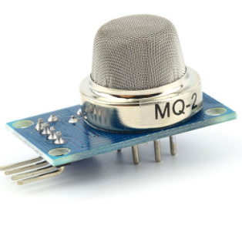
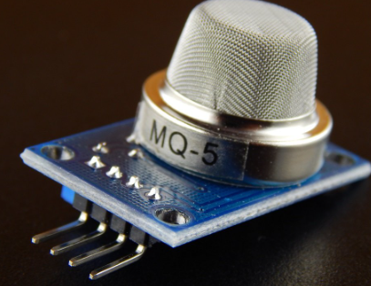
Sensors
MQ2 Sensor : It is a versatile and cost-effective solution for detecting
combustible gases in various environments. It can detect flammable
gases in a range of 300 - 10000ppm. Can be used to detect methane,
butane and smoke.
MQ5 Sensor : It is widely used in domestic gas leakage alarms,
industrial flammable gas alarms and in portable gas detectors. It can
detect gases in the range of 300 - 10000ppm. Can be used to detect
LPG and methane.

Slide 6
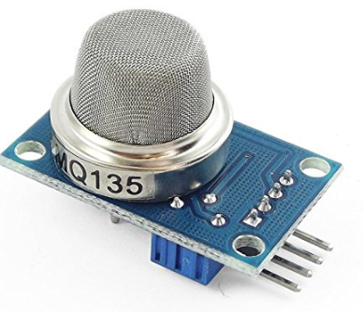
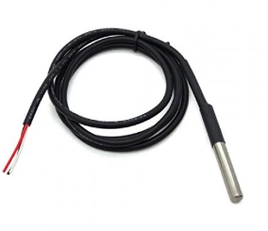
MQ135 Sensor : It is a popular gas sensor known for its ability to
detect a wide range of air pollutants, including ammonia (NH3),
nitrogen oxides (NOx), alcohol, carbon diode (CO2) and carbon
monoxide (CO). It can detect gases in the range of 10-1000ppm.
DS18B20 Temperature Sensor Probe: It is a digital temperature sensor known for its high accuracy and ease of use. It is commonly used in environmental
monitoring applications. It can measure temperatures ranging from
-55°C to +125°C with an accuracy of ±0.5°C within the range of
-10°C to +85°C.

Slide 7
Working
Our project is effectively a gas and air quality monitoring system using an MQ2 gas sensor, an MQ135 air quality sensor, and a Dallas Temperature sensor for measuring temperature.
The project also incorporates a Bluetooth module (HC-05) for wireless communication with a paired device, a smartphone in our case.
The main loop continuously reads MQ2 sensor values and checks if they exceed predefined thresholds.
It reads the MQ135 sensor for air quality and Dallas Temperature sensor for measuring temperature.
If any sensor value exceeds its threshold, it sends a warning message via Bluetooth.
It also listens for commands from the Bluetooth module. If it receives a command, it prints the readings in Bluetooth module interface as well as in Serial Monitor interface within Arduino, either reading the gas sensor values (CMD_GAS which is ‘R’) or checking air quality (CMD_AIR which is ‘A’).

Slide 8
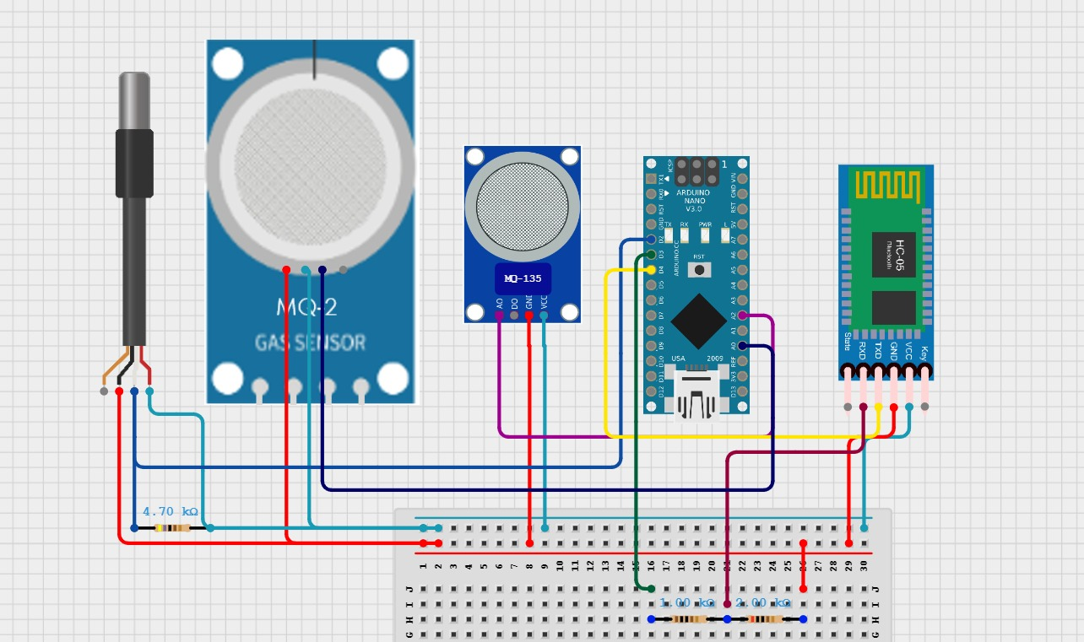
Circuit Diagram

Slide 9
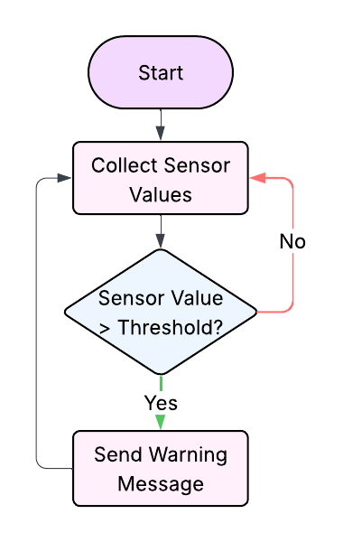
Code Flow / Logic Diagram

Slide 10
Smart Air Checker
Conclusion
Smart air checking system is efficient and responsive.
Portable and easy to integrate.
Ideal for homes, schools, and small industries.

