Slide 1
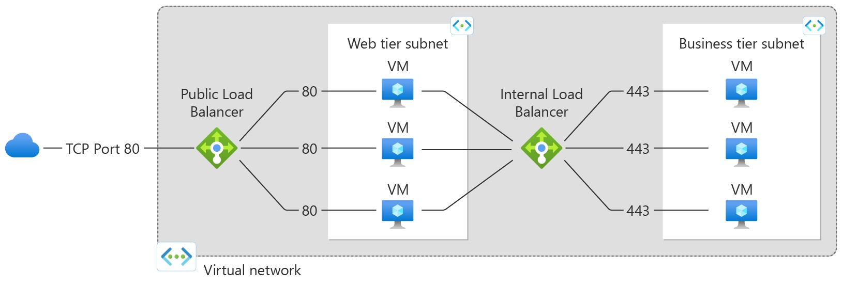
Load Balancer

Slide 2
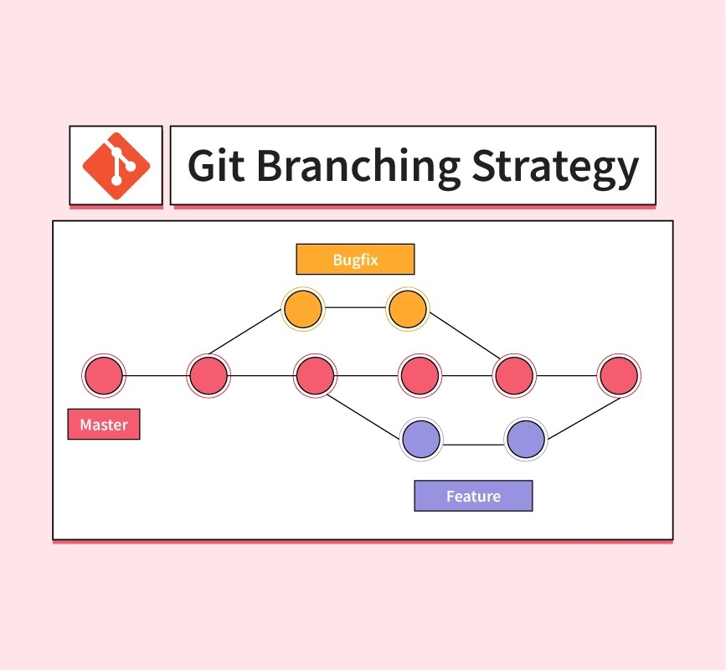

Slide 3
Terraform script

