Slide 1
Explainable Cyberbullying Detection Using Deep Learning and Transformer Models with LIME
A Binary Detector (RoBERTa) with Word-Level Explanations
• Presented by: Mohammad Asmual Hoque Yousha (0222210005101121)
• Md Mostafa Kamal Anna (0222210005101129)
• Supervised by: Ms. Tanni Dhoom, Assistant Professor
• Department of Computer Science and Engineering
• Premier University, Chattogram • October 2026
Explainable Cyberbullying Detection • RoBERTa + LIME
1
Notes:
[BOTH / Speaker 1 opens] Good morning. We are presenting our thesis on explainable cyberbullying detection. Our system detects whether an online comment is bullying or not, using a RoBERTa transformer, and — unlike most prior work — it also explains WHY, using LIME. ANIMATION: let the title bar fade in, then the names appear.

Slide 2
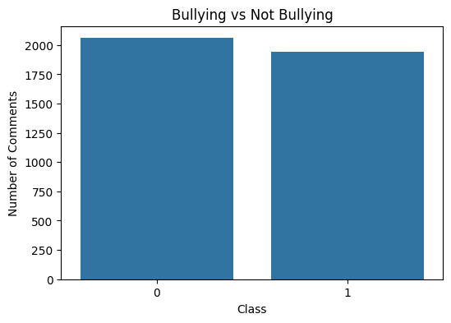
The Problem & Why It Matters
Speaker 1
• Millions of comments are posted daily on YouTube, Reddit, Facebook.
• A large share is hostile — and manual moderation cannot keep up.
• Most existing detectors give only a label, no reason.
• A black-box moderation decision is hard to trust or appeal.
• Our goal: high accuracy + a clear explanation for every decision.
Explainable Cyberbullying Detection • RoBERTa + LIME
2
Notes:
[Speaker 1] Social media produces a huge volume of comments and a lot of it is harmful. Humans cannot moderate it all. The bigger problem: existing detectors just output 'bullying' with no reason, so the decision cannot be trusted or challenged. Our aim is both accuracy AND transparency. ANIMATION: reveal the bullet points one by one; the chart appears last.

Slide 3
Objectives & Contributions
Speaker 1
• Build a binary detector (Bullying vs Not-Bullying) on multi-platform data.
• Compare four models: Logistic Regression, LSTM, GRU, RoBERTa.
• Beat the base paper (Esan et al., 77%) — on our data AND on their own data.
• Add LIME so every prediction can be explained word by word.
• Give an honest multi-dataset comparison against two reference studies.
Explainable Cyberbullying Detection • RoBERTa + LIME
3
Notes:
[Speaker 1] Our objectives: build the detector, compare four models from a simple baseline up to a transformer, beat the base paper's accuracy and verify it on more than one dataset, and — the key novelty — add LIME explanations. ANIMATION: each objective flies/fades in one at a time.

Slide 4
Related Work — Where We Fit
Speaker 1
Study | Best Model | Accuracy | Explainable
Esan et al. (2024) [base] | LSTM | 77.00% | No
Ogunleye & Dharmaraj (2023) | RoBERTa | 87.00% | No
Muneer et al. (2023) | BERT+biLSTM+CNN | 97.40% | No
Alrowais (2024) | RoBERTa + GloVe | 95.00% | No
Sihab-Us-Sakib (2024) | XLM-RoBERTa | 82.61% | No
Azhar & Runa (2025) | RoBERTa | 83.90% | No
Our Work | RoBERTa + LIME | 92.33% | Yes
We reviewed 12 studies — almost none explain their decisions. That gap is our contribution.
Explainable Cyberbullying Detection • RoBERTa + LIME
4
Notes:
[Speaker 1] We reviewed twelve studies. Some reach very high accuracy, but look at the last column — almost all say 'No' to explainability. Our work (highlighted) reaches 92.33% AND is explainable. ANIMATION: bring in the table, then highlight the last 'Our Work' row.

Slide 5
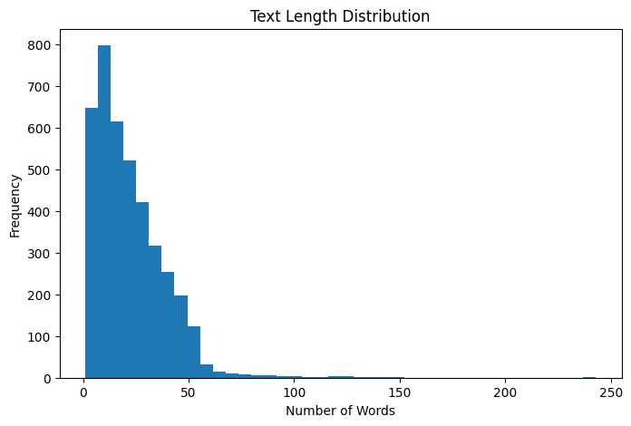
Dataset
Speaker 1
• ~4,000 English comments
• 1,000 self-collected: YouTube, Reddit, Facebook
• 3,000 from Jigsaw toxic-comment corpus
• Near-balanced: 2,059 Not-Bullying / 1,941 Bullying
• 0 = Not-Bullying, 1 = Bullying
• Avg length ~22.6 words
Left: class balance. Right: comment-length distribution.
Explainable Cyberbullying Detection • RoBERTa + LIME
5
Notes:
[Speaker 1] Our dataset has about 4,000 English comments — a thousand we collected ourselves from three platforms, and three thousand from the public Jigsaw corpus. The classes are almost evenly balanced, so accuracy is a fair measure. ANIMATION: bullets first, then the two charts slide in from the right.

Slide 6
Dataset Examples (6 Bully Types)
Speaker 1
Comment | Label | Type
Show this video and Ronaldo's stats to him. | Not-Bullying | --
Bolton is a clown | Bullying | Troll
Religion is primitive and a big waste of time. | Bullying | Religion
death to the infidel, whoever that may be | Bullying | Threat
This is what happens when you elect a moron. | Bullying | Political
Mass immigration is destroying the West. | Bullying | Racism
Strong wording alone is not bullying — the task needs context, not keywords.
Explainable Cyberbullying Detection • RoBERTa + LIME
6
Notes:
[Speaker 1] Here are real labelled examples covering all six bully types we recorded. Notice the task is not just keyword spotting — a strongly worded comment is not automatically bullying. ANIMATION: reveal rows top-to-bottom.

Slide 7
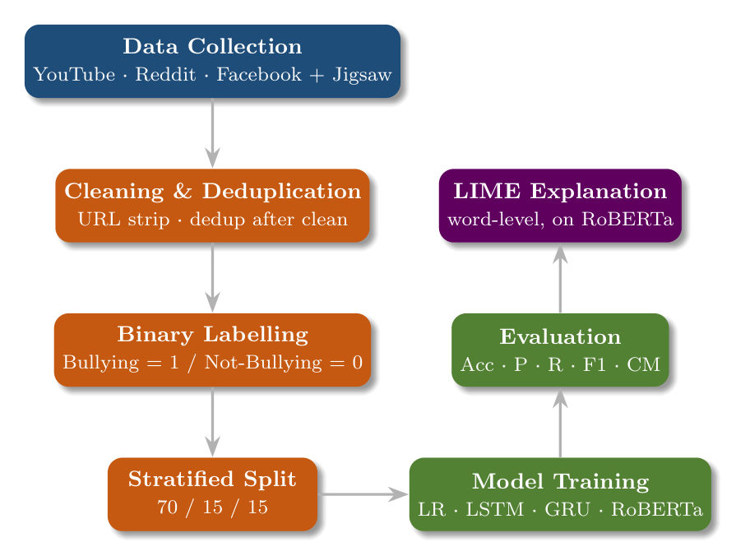
Methodology — The Pipeline
Speaker 1
Explainable Cyberbullying Detection • RoBERTa + LIME
7
Notes:
[Speaker 1 — hand over after this] This is our full pipeline: collect data, clean and de-duplicate (we de-duplicate AFTER cleaning, which improved every model), reduce to a binary label, split 70/15/15, train the four models, evaluate, and finally run LIME on the best model. My teammate will now take over with the models and results. ANIMATION: reveal the boxes step by step following the arrows.

Slide 8
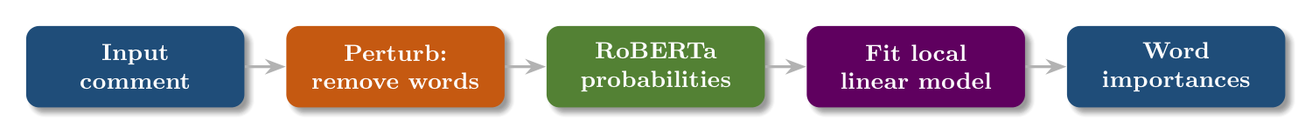
Models & Why LIME
Speaker 2
• Four models, simple → advanced:
  – TF-IDF + Logistic Regression (baseline)
  – LSTM and GRU (read word order)
  – RoBERTa (pretrained transformer)
• LIME = model-agnostic, local, word-level, lightweight
LIME perturbs the comment, watches RoBERTa's probability, and scores each word.
Explainable Cyberbullying Detection • RoBERTa + LIME
8
Notes:
[Speaker 2] Thank you. We trained four models from a simple baseline up to RoBERTa. For explanations we chose LIME because it is model-agnostic, explains one comment at a time, gives word-level reasons, and is lightweight. This diagram shows how LIME works. ANIMATION: bullets first, then the flow diagram.

Slide 9
Results — RoBERTa Wins
Speaker 2
Model | Accuracy | Precision | Recall | F1-Score
Logistic Regression | 83.33% | 83.62% | 83.33% | 83.27%
GRU | 85.33% | 85.36% | 85.33% | 85.34%
LSTM | 87.33% | 87.33% | 87.33% | 87.33%
RoBERTa (our model) | 92.33% | 92.36% | 92.33% | 92.33%
RoBERTa: 92.33% — 5 points above the best recurrent model, and far above the base paper's 77%.
Explainable Cyberbullying Detection • RoBERTa + LIME
9
Notes:
[Speaker 2] Here are the results on our test set. The pattern is clean: the linear baseline is solid, the recurrent models improve on it, and RoBERTa is the clear winner at 92.33% — five points ahead and well above the base paper's 77%. ANIMATION: reveal rows top-to-bottom, highlight the RoBERTa row.

Slide 10
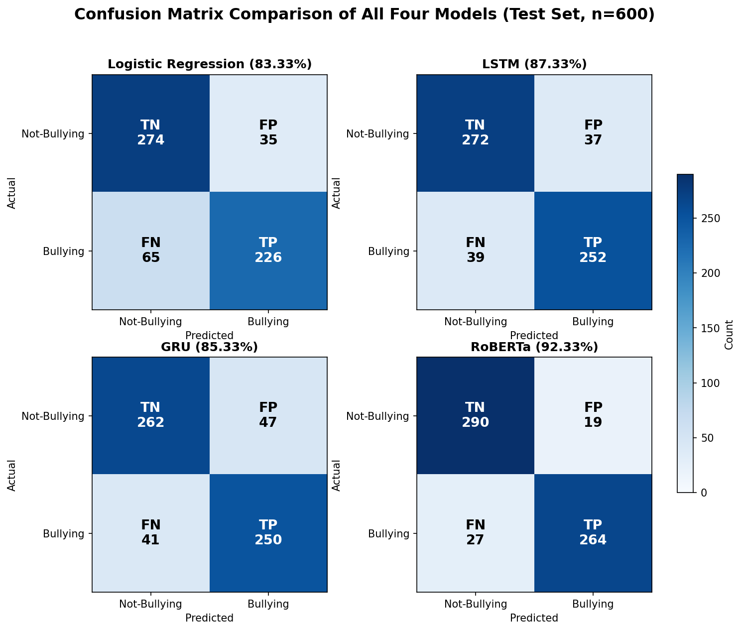
Confusion Matrices — All Four Models
Speaker 2
Explainable Cyberbullying Detection • RoBERTa + LIME
10
Notes:
[Speaker 2] All four confusion matrices on one scale. Every model gets most cases right (dark diagonal), but RoBERTa (bottom-right) has the fewest and most balanced errors — only 19 false positives and 27 missed. ANIMATION: zoom/fade the figure in; optionally point to the RoBERTa panel.

Slide 11
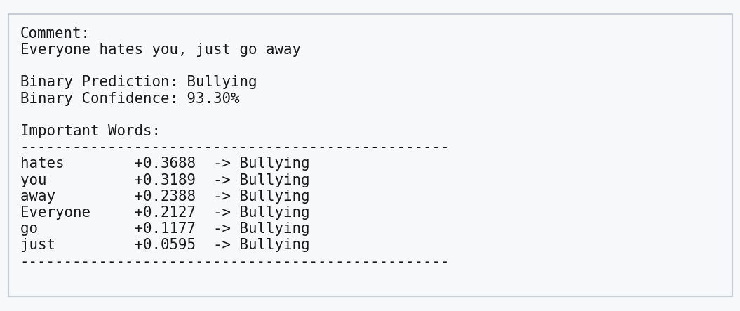
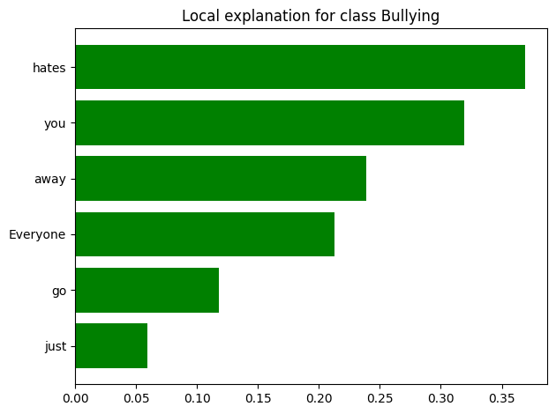
LIME — Explaining Correct Predictions
Speaker 2
“Everyone hates you, just go away” → Bullying (93.30%). LIME shows the words that drove it: hates, you, away. The decision is transparent and defensible.
Explainable Cyberbullying Detection • RoBERTa + LIME
11
Notes:
[Speaker 2] This is LIME in action on a correct case. The left is the actual program output; the right is the bar chart. The model flagged it as bullying because of 'hates', 'you', 'away' — exactly what a human would point to. ANIMATION: show the output screenshot first, then the bar chart, then the caption.

Slide 12
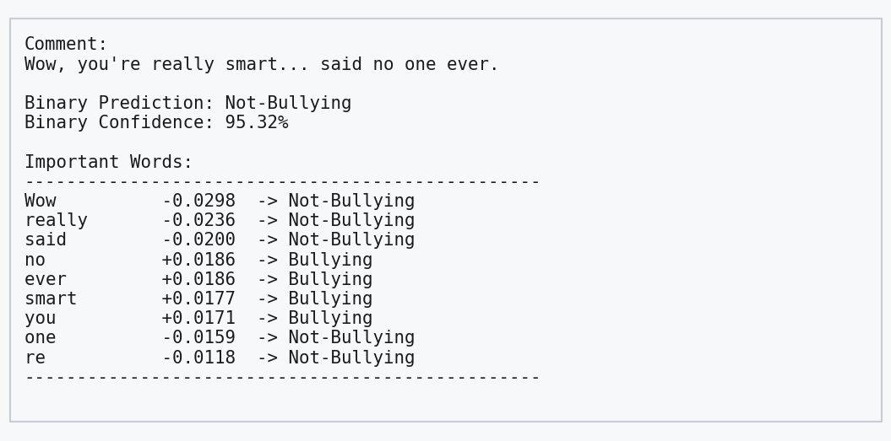
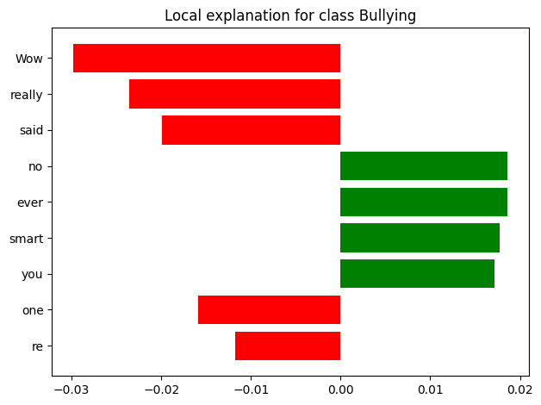
Honest Limitation — Sarcasm
Speaker 2
“Wow, you're really smart... said no one ever.” → predicted Not-Bullying (WRONG). Positive words (Wow, really, said) fool the model. LIME makes this failure visible — a strength of explainability.
Explainable Cyberbullying Detection • RoBERTa + LIME
12
Notes:
[Speaker 2] We are honest about weaknesses. This sarcastic comment is actually bullying, but the model said Not-Bullying with high confidence. LIME shows why: the positive-sounding words won. Sarcasm is a known hard problem — and note that WITHOUT explainability this error would be invisible. ANIMATION: output first, then chart, then caption.

Slide 13
Social Impact & Conclusion
Speaker 2
• Protects vulnerable users; reduces moderator burden.
• Explainable decisions → fairer, reviewable moderation.
• Best used human-in-the-loop (assist, not replace).
• Conclusion: RoBERTa best in every setting + LIME adds trust.
• Beats the base paper (77%) on our data (92.33%) and theirs (89.01%).
Explainable Cyberbullying Detection • RoBERTa + LIME
13
Notes:
[Speaker 2] Beyond the numbers: used responsibly, with a human in the loop, this system can protect users and make moderation fairer because every decision can be explained. In conclusion, RoBERTa was best in every setting and LIME adds the trust that prior work lacks. ANIMATION: reveal points one by one.

Slide 14
Future Work & Thank You
Speaker 2
• Close the training gap (reference code hit 95.25% on our data).
• Make the model sarcasm-aware.
• Bring back fine-grained bully types.
• Multilingual: Bangla + English + Hindi, with type.
Thank You — Questions?
Explainable Cyberbullying Detection • RoBERTa + LIME
14
Notes:
[Speaker 2] Future work: close the training gap, handle sarcasm, bring back the fine-grained types, and extend to Bangla, English and Hindi together. Thank you — we're happy to take questions. ANIMATION: bullets, then the Thank-You bar.

