Slide 1

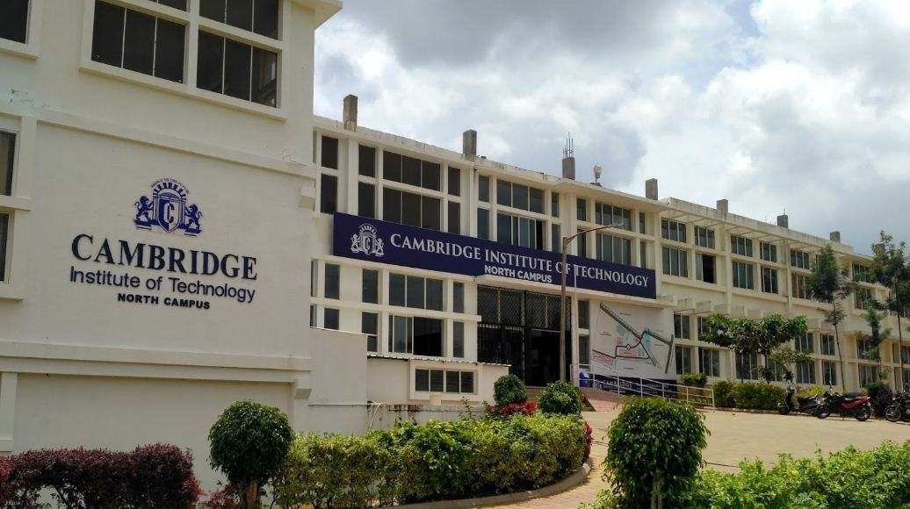

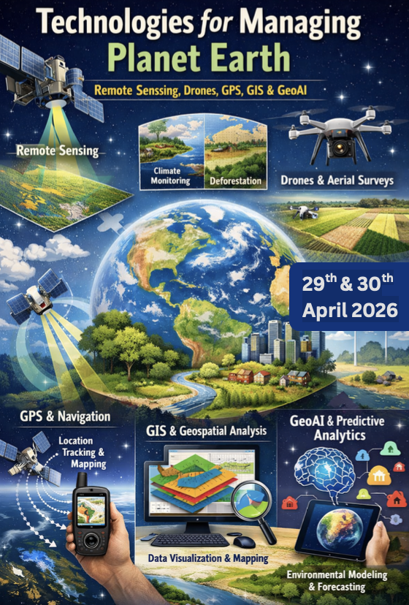
CAMBRIDGE INSTITUTE OF TECHNOLOGY NORTH CAMPUS, BENGALURU KARNATAKA
www.cambridge.edu.in
April 2nd 2026

Slide 2
Project Solution:
Urban Compass AI: Autonomous GeoAI Smart City Planning Platform
Urban planning today lacks an integrated, intelligent, and automated system to analyze land, optimize infrastructure, and generate sustainable city layouts, resulting in inefficient, costly, and poorly planned urban development.
Urban planning is manual, slow, and highly dependent on human judgment
Geospatial data (satellite, terrain, water, infrastructure) is fragmented and not integrated
Limited use of Artificial Intelligence and Geospatial Artificial Intelligence in planning processes
No system to automatically analyze land suitability and development potential
“Turn Any Land into a Ready-to-Build Smart City in Minutes.”
From raw terrain to a complete, optimized city plan using real data and intelligent algorithms.
“AI That Thinks Like an Urban Planner.”
Automatically analyzes, plans, and designs cities with logic, precision, and real-world constraints.
“From Empty Space to Fully Designed City — One Platform.”
Integrates analysis, planning, and building into a seamless, end-to-end system.

Slide 3

Team Details
Team Name – Urban Cruisers
Team :
Sowmya Sharma (Team Lead)
Spoorthi S Hiremath
Punit
Yashwanth Raj DJ
www.cambridge.edu.in
3

Slide 4
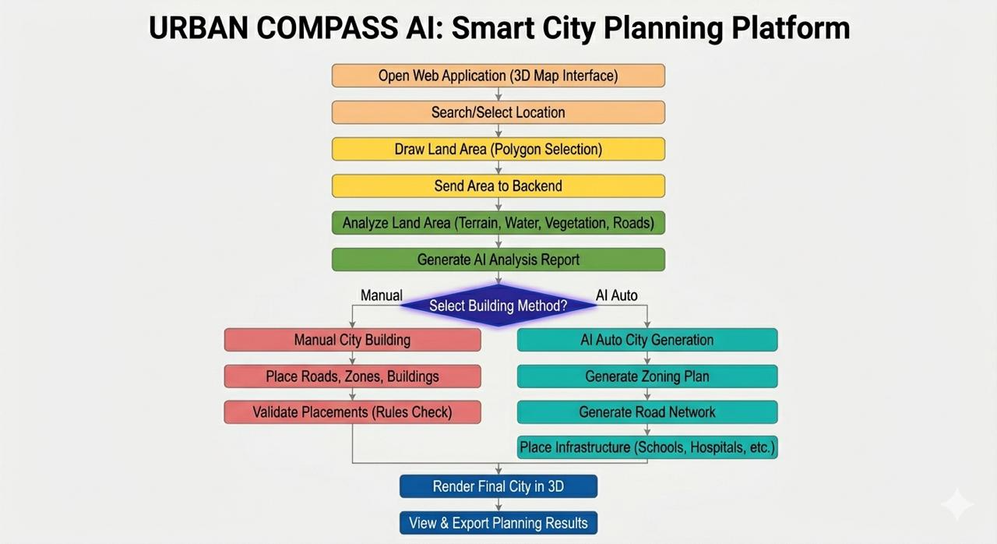
Proposed Solution
Solution : Urban Compass AI provides an integrated GeoAI platform that analyzes real-world land using geospatial data, then automatically generates optimized city layouts with zoning, roads, and infrastructure using rule-based and optimization algorithms. It enables fast, data-driven, and policy-aware urban planning within a single interactive 3D environment.
Addressing the problem Urban planning today is fragmented, relying on multiple tools, manual analysis, and human judgment, leading to delays and inefficient city designs.
Planners struggle to integrate land analysis, environmental factors, and infrastructure into a single workflow.
Existing tools provide only analysis or visualization, lacking intelligent decision-making.
Urban Compass AI offers a unified platform combining geospatial data, AI-driven analysis, and automated planning.
It enables fast, accurate, and data-driven city design, improving efficiency and sustainability..
Uniqueness of the solution : Urban Compass AI turns real-world land into a living design space where AI analyzes, plans, and builds alongside you combining real data, smart automation, and interactive city building to create practical, future-ready cities in one seamless experience.
Innovation
Real-World + AI City Building“Build intelligent cities on real land, not imaginary maps.”👉 Combines real satellite data with AI to design cities where they can actually be built.
2. Autonomous Planning Intelligence“AI that doesn’t just analyze land it designs the entire city.”Automatically generates zoning, roads, and infrastructure using smart algorithms.
3. From Data to Decision in One System “Turns raw geospatial data into complete, actionable city plans.”👉 Eliminates manual planning by integrating analysis, design, and optimization in one platform.

Slide 5
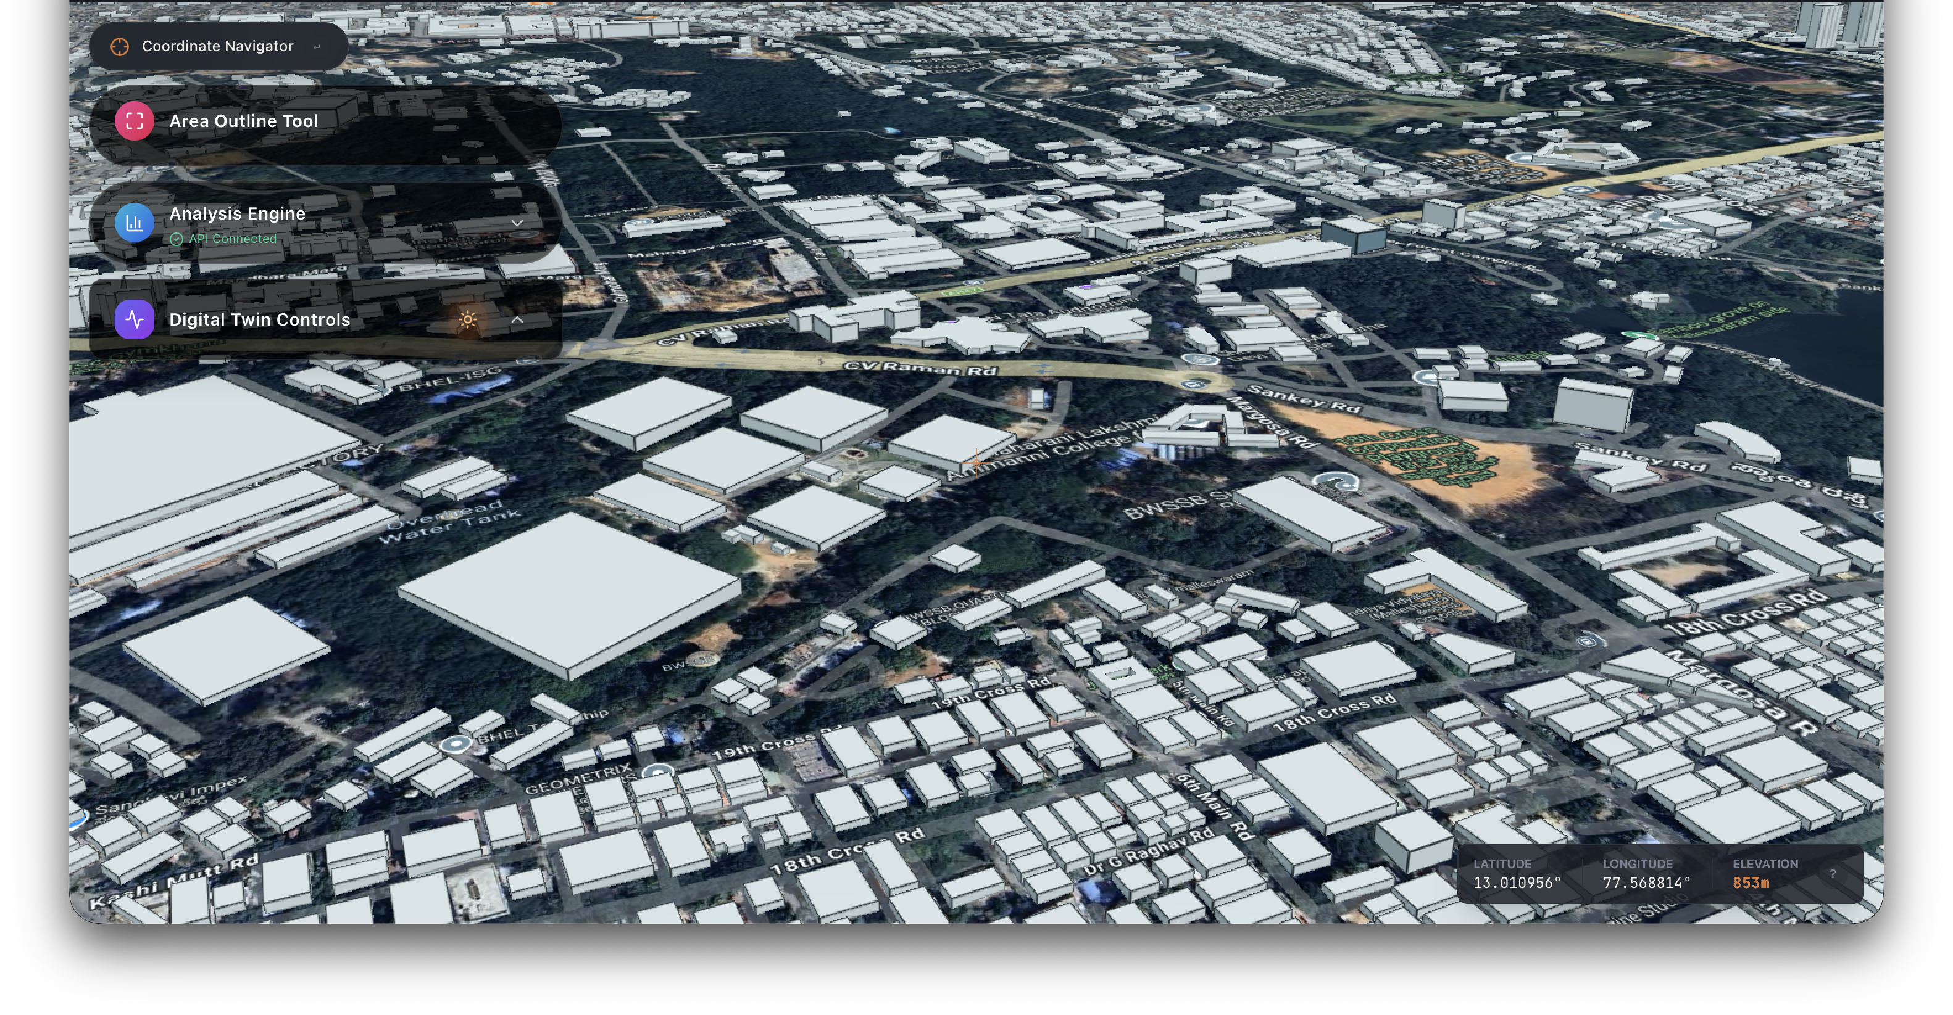
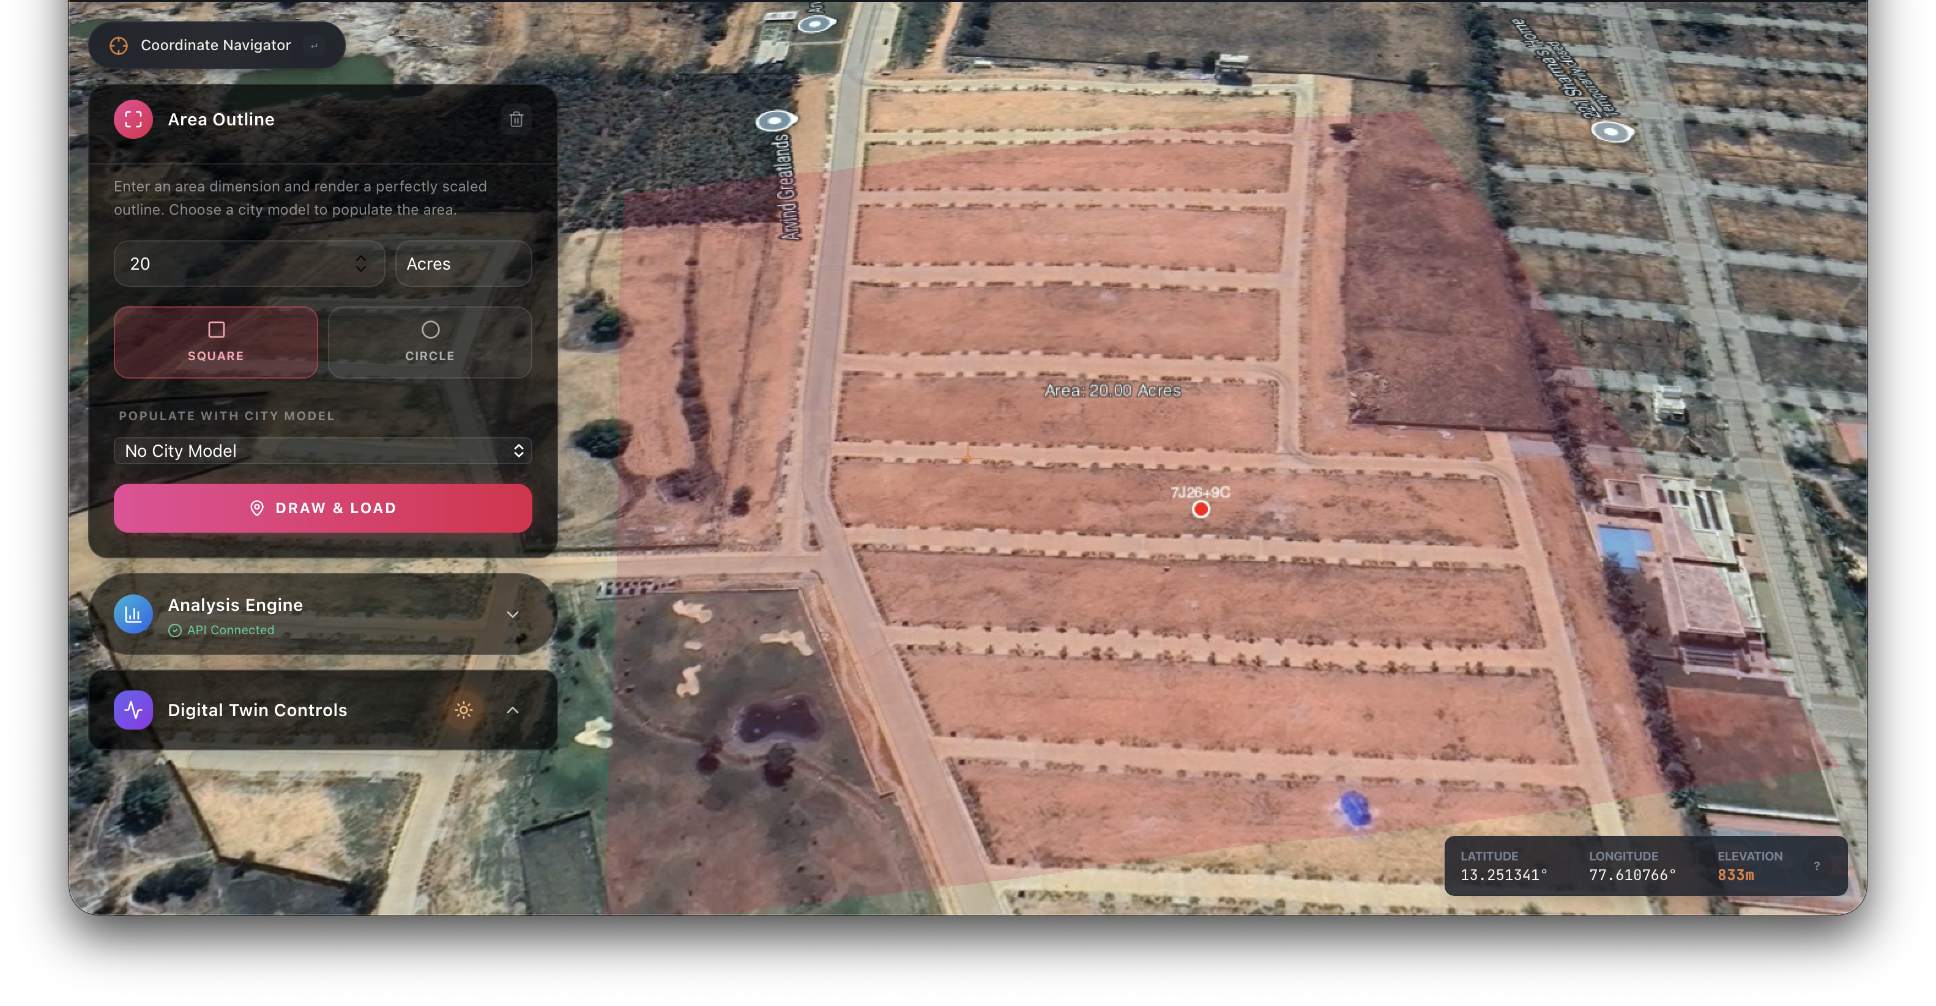
Frontend – React, TypeScript
Styling – Tailwind, Shadcn
Icons – Lucide
3D Engine – CesiumJS
Maps – Google Maps, OpenStreetMap
Geospatial – Turf, GeoPandas, Shapely
Raster – GDAL, Rasterio
AI/Algorithms – WMCA, KMeans, Graph Algorithms, Random Forest
Backend – Fast API
Database – PostgreSQL, PostGIS
3D Assets – GLTF
Technical Approach
Methodology and process for implementation
Smart Exploration
Precise Mapping
Immersive 3D Exploration
Navigate real-world terrain to understand surroundings and existing infrastructure.
Smart Location Search
Quickly find and evaluate any location using search or coordinates.
Precision Area Drawing
Users define exact land boundaries using polygon tools on real terrain.
Real-Time Area Insights
Instantly calculates area in square meters, acres, and hectares.
Explore and understand real-world location before selecting planning area.
Define precise land boundaries to begin accurate city planning.

Slide 6
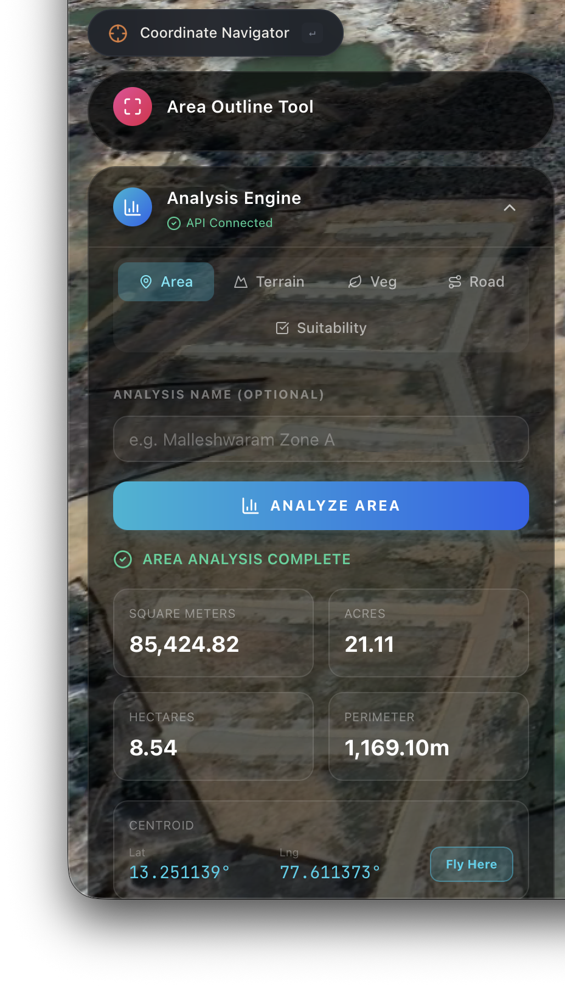
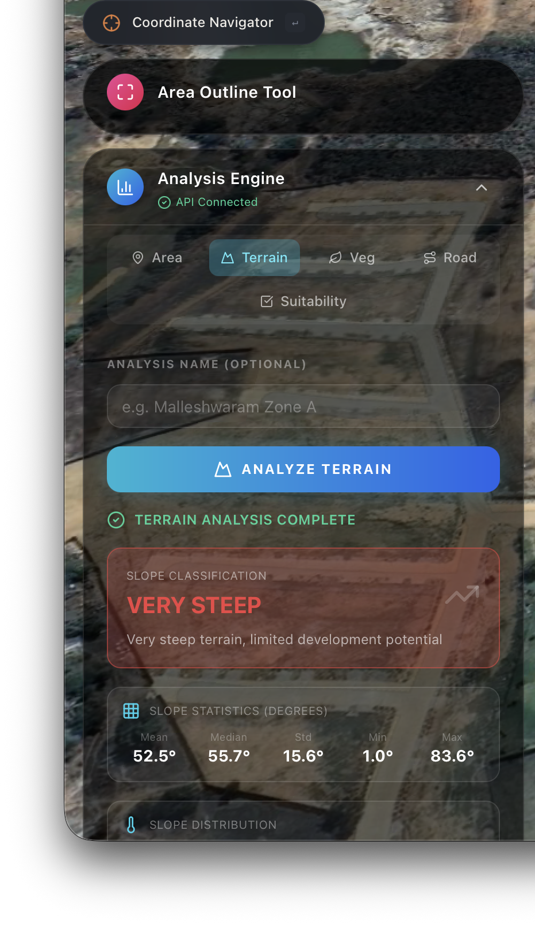
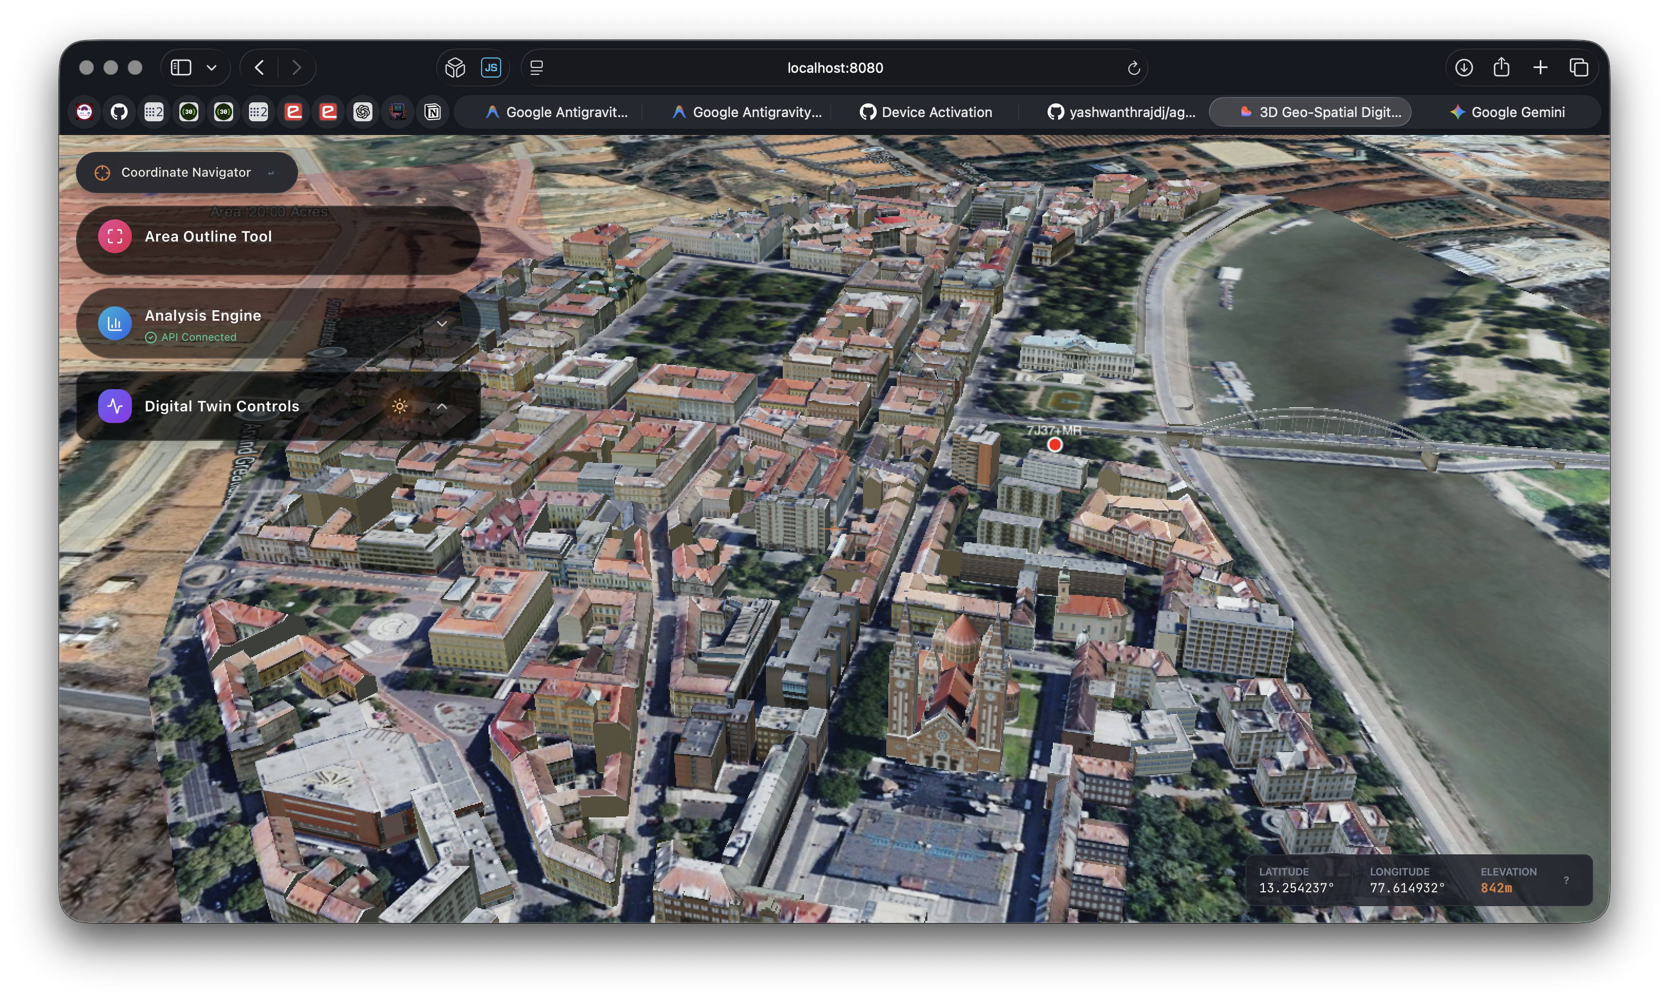
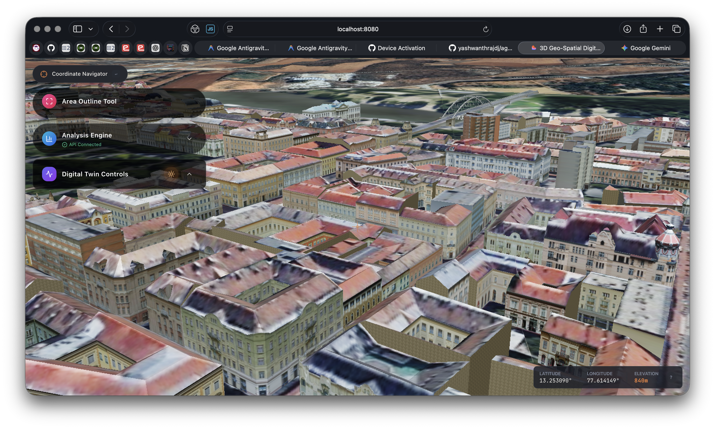
Methodology and process for implementation
Smart Planning
Smart Creation
AI-Driven Planning Guidance
System suggests zoning, infrastructure needs, and resource allocation based on analysis.
Actionable To-Do Framework
Provides clear steps to prepare the land for efficient city development.
Interactive City Building
Users design the city manually with roads, zones, and infrastructure (SimCity-style).
AI-Powered Auto Generation
System can automatically generate optimized city layouts with zoning, roads, and services.
Smart Analysis
Multi-Layer Intelligence
System analyses terrain, water, vegetation, and connectivity using geospatial data.
Insightful AI Report
Generates clear scores, risks, and recommendations for planning decisions.
Analyse land conditions using AI to guide smart city planning
Generate actionable planning strategies to prepare land for development.
Design or generate optimized city layouts using intelligent planning tools.

Slide 7
Feasibility and Viability
Feasibility Analysis:
Built on Proven TechnologiesUses reliable tools like CesiumJS, React, and Python GIS libraries, ensuring stability, scalability, and real-world applicability.
Uses Readily Available DataLeverages open datasets (satellite imagery, OpenStreetMap), making implementation cost-effective and immediately deployable.
  Modular & Scalable ArchitectureDesigned in independent modules (analysis, planning, rendering), allowing phased development and easy expansion from city to national level.Challenges & Risks:
Connectivity: Limited internet access in rural areas. Which is lower than expected.
User Adoption: Resistance from users unfamiliar with digital tools.
Challenges & Risks:
Data Reliability Inaccurate or outdated geospatial data can lead to poor planning decisions.
Real-World Complexity Difficult to capture all social, economic, and policy factors in algorithms.
Trust & Adoption Governments may hesitate to rely on AI without transparency and validation
Ensure Data Accuracy Use multiple data sources, real-time updates, and validation checks to improve reliability.
Strategies to Overcome Challenges:

Slide 8
Impact and Benefits
Potential impact on the target audience
Potential Impact on Target Audience
Faster & Smarter Decision-Making Cuts planning time from months to minutes with data-driven insights.
Better Cities, Better Living Ensures optimal placement of roads, hospitals, and services → improved quality of life.
Cost & Resource Optimization Reduces wasteful investments by planning infrastructure efficiently from the start.
Sustainable Urban Development Promotes green zones, balanced growth, and environmentally responsible planning.
Empowering Governments with Intelligence Transforms planning from guesswork into precise, AI-assisted decision-making.
Benefits of the solution (social, economic, environmental, etc.).
Benefits of the Solution
End-to-End Planning in One Platform Integrates land analysis, city design, and infrastructure planning—eliminating the need for multiple tools.
Accurate, Data-Driven Decisions Uses real geospatial data and algorithms to ensure reliable and scientifically backed planning.
Significant Time & Cost Reduction Automates complex processes, reducing manual effort, planning time, and unnecessary expenses.
Optimized Infrastructure Development Ensures efficient placement of roads, hospitals, schools, and utilities for maximum coverage and accessibility.

Slide 9
References and Research
YouTube Video Link: https://youtu.be/1XqRHLdOFYE
Link of the references and research work.
Explains how geospatial data integrates analysis, visualization, and decision-making for smart cities. -
https://www.mdpi.com/2220-9964/9/2/95
Karnataka’s official GIS platform providing integrated spatial data and decision support systems for government use - https://kgis.ksrsac.in/kgis1/portal
Digital land records platform providing ownership, crop, and land details for planning and verification.
https://www.rtcbhoomi.in
Provides satellite imagery and thematic layers (agriculture, water, land use) used by government planning systems
https://bhuvan.nrsc.gov.in/ngmaps

Slide 10

THANK YOU

