Slide 1
Secure Data Hiding in Images Using Steganography
CAPSTONE PROJECT
Presented By: Punit Pareshbhai Soni
Student Name: Punit Pareshbhai Soni
College Name: Indus University
Department : Information and Communication Technology

Slide 2
OUTLINE
Problem Statement
Technology used
Wow factor
End users
Result
Conclusion
Git-hub Link
Future scope

Slide 3
Problem Statement
In this digital time privacy and security of sensitive information have become crucial.
One effective way to hide sensitive data within digital images is through image steganography.
The challenge is to design a system that allows the secure encryption of hidden messages or data inside an image and the decryption of the hidden data without any major changes to the original image.

Slide 4
Technology used
Used VS Code IDLE For Coding.
Python Programming Language for Coding and Logic Implementation.
Using Windows Operating System.
Libraries:
open-cv library For Image processing,
numpy library For usage of multi-dimensional arrays and matrices.
Tkinter library For Graphical User Interface(GUI).

Slide 5
Wow factors
What makes this project stand out from other project(Unique features):
Easily Encryption and Descryption of the Sensitive Data.
User Friendly because of GUI (Graphical User Interface).
The Use of password protection, without valid password cannot decrypt or extract the data from the image.

Slide 6
End users
Who are the end users:
Individuals (Personal Use)
Corporate Sector (Enterprises)
Educational Institutions
Digital Forensics Experts
Application Developers (Developers of Security Solutions)

Slide 7
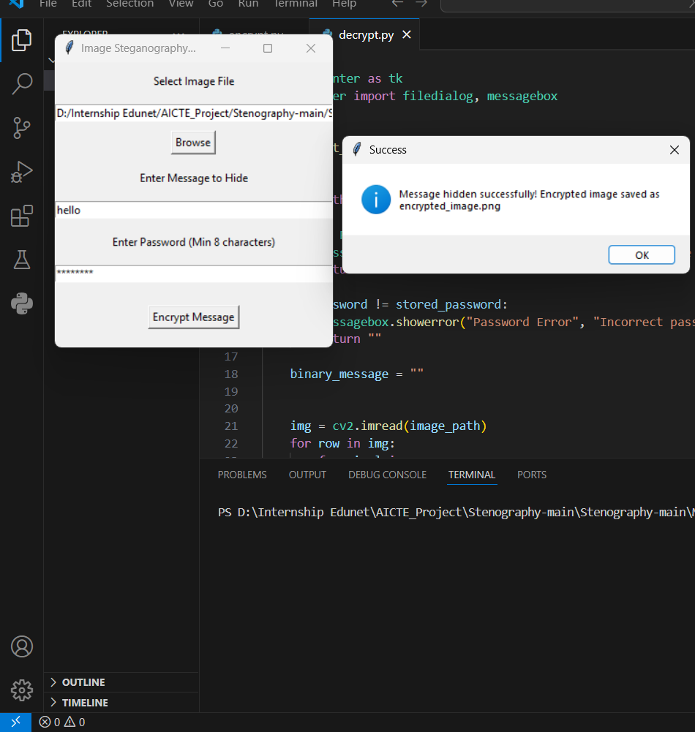
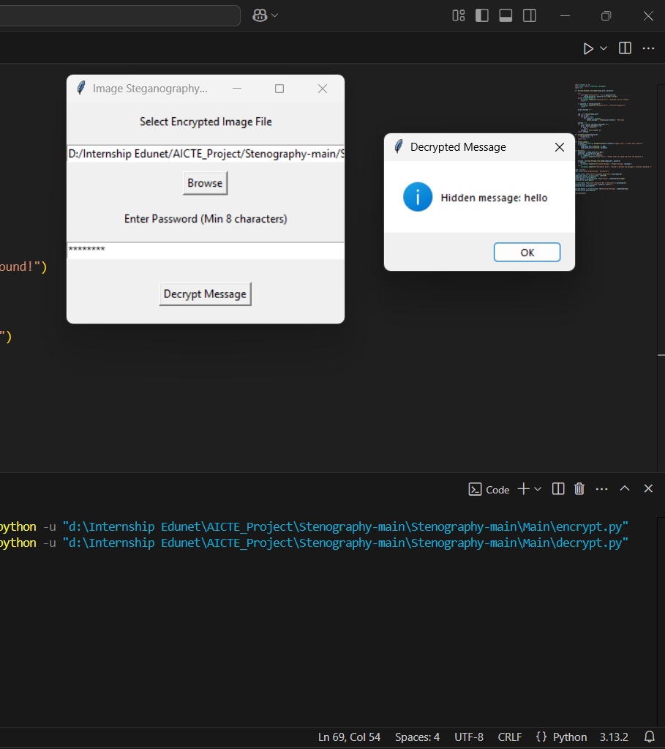
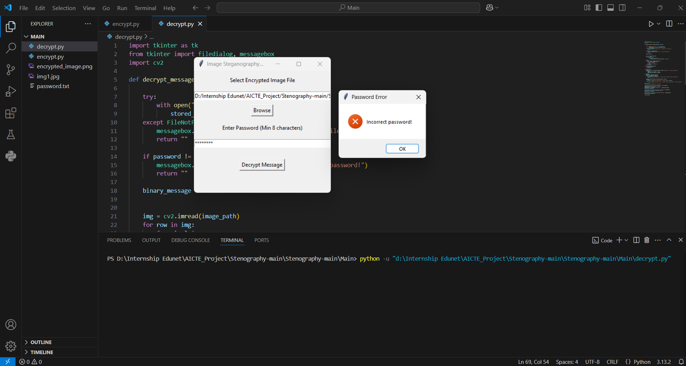
Results

Slide 8
Conclusion
The image steganography encryption and decryption project successfully solve the problem of securely embedding and extracting sensitive information within digital images.
Through the encryption phase, the project allows users to hide messages in a way that is undetectable by the human eye, ensuring the confidentiality of the information.
In the decryption phase, the system reliably recovers the hidden message from the stego-image or encrypted image without compromising the integrity of the original image.

Slide 9
GitHub Link
Make sure that there should be readme file
Github Link: https://github.com/Punit021/AICTE_Project.git

Slide 10
Future scope(optional)
The future of the Image Steganography Encryption and Decryption Project is expansive, with numerous opportunities for improvement and enhancement.
By incorporating advanced security measures, extending file type support, enhancing usability, and integrating with emerging technologies like AI and cloud computing, the system can be transformed into a comprehensive, secure, and efficient solution for protecting sensitive data.
The versatility of steganography and its potential applications in privacy, cybersecurity, digital forensics, and secure communication make it a promising area for further research and development.

Slide 11
THANK YOU

