Slide 1





Smart E-Learning Platform for Modern Learners
LEARN. PRACTICE. ASSESS. GROW.
PRESENTED BY
PUNITH M[1MJ25IS038]
R Parinita [1MJ25AI038]
Manoj kumar K [1MJ25AE038]
Indupriya H S [IMJ25EC038]
Harsha M S [1MJ25CSO38]
Sambit Kumar Maharana [1MJ25VL038]

Slide 2






The Problem
Fragmented Resources
Scattered materials across multiple disconnected
platforms.
Lack of Practice
Theory-heavy learning without integrated coding
environments.
Unstructured Paths
Confusion caused by a lack of clear, guided roadmaps.
Distraction-Heavy
Intrusive advertisements disrupting the focus of learners.

Slide 3


Objectives & Solution By Algorium
Objectives
ALGORIUM Solution
Centralized Learning
AIML
Web Dev
Practical Skill Development
Self-Paced Education
Data Science
Quizzes
Easy Access
Continuous Assessment
Notes
Compiler
Better Experience

Slide 4
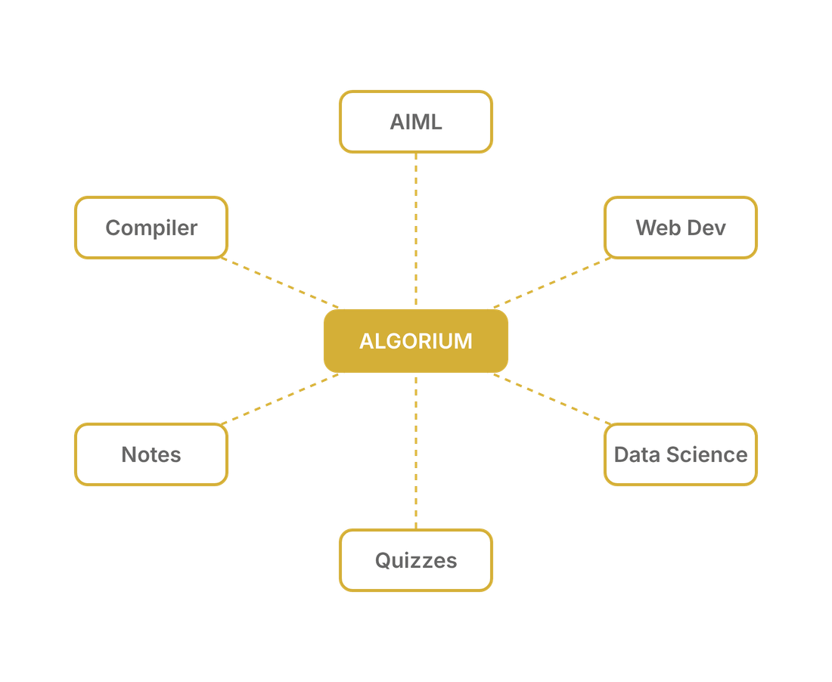

Central Hub Diagram
ALGORIUM acts as the central brain of the learning ecosystem, seamlessly connecting all essential services.
Eliminates platform hopping by integrating
AIML, Web Dev, and Data Science into one hub.
Our hub-and-spoke wireframe ensures that every tool—from compilers to quizzes—is just one click away.

Slide 5




Learning Features
Comprehensive course modules designed for depth and clarity
Rich Media Content
High-quality video lectures and layered educational materials
for immersive learning.
Interactive Quizzes
Real-time assessment to validate understanding and
reinforce concepts after each lesson.
Structured Documents
Detailed notes and documentation for offline study, reference,
and quick revision.

Slide 6





Practical Learning & Experience
Hands-on tools that bridge the gap between theory and implementation
Beginner-Friendly Paths
Curated learning tracks that guide users from basics to mastery
Online Compiler
Practice coding directly in the browser with multi-language support
Ad-Free Experience
Zero distractions to ensure maximum focus and deep learning
User-Friendly Interface
Modern, intuitive design optimized for cognitive ease

Slide 7





System Architecture
User Interface
ALGORIUM is built on a robust, scalable architecture designed to handle high-performance educational modules and seamless data flow.
ALGORIUM Platform
User Interface Layer
Responsive frontend designed for cross-device interaction.
Modules
Compiler
Core Platform Logic
Centralized management of sessions and module access.
Data Management
MongoDB
Secure storage using a centralized MongoDB database.

Slide 8




Technology Stack
Frontend Development
Built with HTML5, CSS3, and JavaScript. Utilizing Bootstrap for a responsive, mobile-first user interface.
Backend & Logic
Powered by Node.js for high-performance server-side operations, with EJS for dynamic content rendering.
Node.js
MongoDB
Bootstrap
EJS
Database Management
MongoDB provides a flexible, scalable NoSQL solution for managing complex educational data structures.

Slide 9



Advantages of ALGORIUM
ALGORIUM offers a superior learning ecosystem by integrating theory with immediate practical application.
Time Efficiency
Centralized resources save hours of searching and switching between platforms, allowing more time for actual learning.
Accelerated Growth Through Integrated Learning
Career Readiness
Focus on practical skills and real-world scenarios ensures students are industry-ready upon completion.

Slide 10



Future Enhancements
Expanding the ALGORIUM ecosystem for a more personalized, accessible learning journey.
AI Recommendations
Mobile Application
Personalized paths driven
Seamless, high-
by performance and goals.
performance learning on
the go.
Community Forums
Roadmap to a Complete Ecosystem
Peer-to-peer and expert
discussions in one place.

Slide 11




Conclusion
ALGORIUM is the definitive bridge between theoretical learning and practical implementation through a unified educational platform.
Unified Environment
Seamless integration of learning, practice, and assessment in
Bridging Learning & Implementation
one hub.
Student-Centric Design
Solving modern pain points with an ad-free, focused, and
intuitive interface.
Future-Ready Vision
A scalable platform evolving to empower every learner with
industry-ready skills.

Slide 12




Thank You
Join us in redefining the future of e-learning.
contact@algoriumhelp.@gmail.com
https://algorium.onrender.com
PUNITH M[1MJ25IS038]
R Parinita [1MJ25AI038]
Manoj kumar K [1MJ25AE038]
Indupriya H S [IMJ25EC038]
Harsha M S [1MJ25CSO38]
Sambit Kumar Maharana [1MJ25VL038]
LEARN. PRACTICE. ASSESS. GROW.

