Slide 1
Predicting Bridge Performance under Earthquakes with Supervised Learning
Logistic Regression · QDA · K-Nearest Neighbours
UE24CS352A – Machine Learning · Mini-Project Review
Notes:
Introduce the team and the problem number. Based on the public Stanford CS229 (2018) project by Jiang and Zhang; we re-ran the full code and verified the results.

Slide 2
Problem Statement
Performance-based seismic design needs to know how an existing bridge will behave in a future earthquake
Goal: predict whether a bridge is damaged (1) or undamaged (0) in a given earthquake
Why ML? Damage depends on several factors with unclear trends; a data-driven model can learn them from past events
INPUTS
Bridge age (years)
Earthquake magnitude (scale)
Distance to epicenter (miles)
OUTPUT
Damaged (1) / Undamaged (0)
Notes:
Binary classification. Inputs: age, magnitude, distance. Output: damaged or undamaged. Motivation: performance-based seismic design.

Slide 3
Dataset
249
21 : 228
199 / 50
bridge–earthquake records
damaged : undamaged (≈ 1 : 11)
train / test split
Damaged bridges: collected from U.S. government reports of historic earthquakes
Undamaged bridges: earthquakes near the site from the USGS catalog, assuming no recorded damage = undamaged
Features: age (x2), magnitude (x4), distance in miles (x5); label y1
Only 18 damaged bridges in training and 3 in the test set, so results must be read with care
Notes:
249 records. 21 damaged, 228 undamaged. Positives from government reports, negatives from USGS catalog under the no-recorded-damage assumption. Test set has only 3 positives.

Slide 4
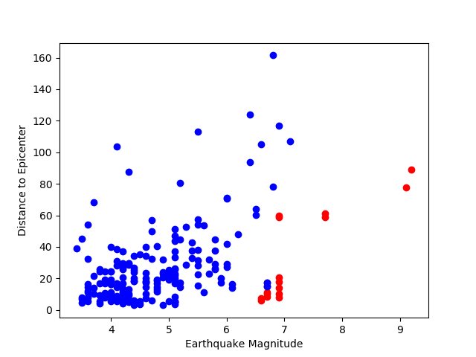
Exploring the Data
Damaged bridges are rare and cluster at higher magnitudes
Classes overlap heavily
Severe imbalance: always predicting ‘undamaged’ already gives ~91% accuracy
So we rebalance the training data and report per-class accuracy
Magnitude vs distance to epicenter (red = damaged)
Notes:
Damaged bridges (red) occur at higher magnitudes and short distances, but the classes overlap, so a simple linear boundary struggles.

Slide 5
Approach
1
2
3
4
Split
Bootstrap
Train
Evaluate
199 train
50 test
Up-sample damaged
ratio 0.2 → 1.0
LR · QDA · KNN
100 runs per ratio
Train, test and
per-class accuracy
Bootstrap resampling duplicates minority examples with replacement, so the models see a more balanced training set
Random resampling means one run is not enough: results are averaged over 100 iterations × 5 ratios
The test set is never resampled
Notes:
Bootstrap resampling of the positive class to five ratios, 100 iterations each, fit LR, QDA, KNN, average the accuracies.

Slide 6
Models
Logistic Regression
QDA
K-Nearest Neighbours
Linear boundary from maximising the log-likelihood of a sigmoid model.
Generative: one Gaussian (own mean and covariance) per class. Picks the more likely class, quadratic boundary.
Majority label among the K closest training points. K chosen from 1–10 on a validation set: K = 2.
scikit-learn: LogisticRegression (liblinear)
scikit-learn: QuadraticDiscriminantAnalysis
scikit-learn: KNeighborsClassifier
Notes:
LR linear boundary; QDA class-wise Gaussians with own covariance; KNN majority vote of K neighbours with K picked on validation set.

Slide 7
Implementation
util.py
loads CSV: x* columns = features, y* = label
Run it
pip install -r requirements.txt
cd Code
python predict_x2_x4_x5.py
# or: bash run_all.sh
predict_x2_x4_x5.py
MAIN: resample → fit → score for LR, QDA, KNN
KNN_optimal.py
chooses K = 1…10 on a validation set
predict_x4_x5.py
same study with magnitude + distance only
Python · NumPy · scikit-learn · Matplotlib. Full pipeline runs in under two minutes.
plot_data.py
scatter plot of the data
Notes:
Walk through the repository: util.py loader, predict_x2_x4_x5.py main experiment, KNN_optimal.py K selection, outputs in Output/. Everything runs with bash run_all.sh.

Slide 8
Results: QDA performs best
Model | Train | Test | Test: damaged | Test: undamaged
Logistic Regression | 95.3% | 74.0% | 82.7% | 73.4%
QDA | 97.8% | 94.8% | 99.5% | 94.5%
KNN (K = 2) | 99.1% | 80.6% | 29.9% | 83.8%
Mean of 100 bootstrap iterations × 5 ratios
QDA: best overall and on both classes
KNN misses ~70% of damaged test bridges
Test set has only 3 damaged bridges: damaged-class numbers are coarse
Notes:
Table: mean over 100 iterations and 5 ratios. QDA 94.8 percent test accuracy, KNN 80.6, LR 74.0. Chart: how test accuracy changes with the positive:negative ratio. KNN finds only about 30 percent of damaged test bridges.

Slide 9
Conclusions and Future Work
What we found
Limitations and next steps
QDA is best: 94.8% test accuracy, stable as the ratio grows
Logistic Regression’s linear boundary fits poorly (74.0%)
KNN memorises training data and finds only ~30% of damaged test bridges
Only 3 damaged bridges in the test set
Resampling duplicates data; it adds no new information
No recorded damage is assumed undamaged
Next: more damaged-bridge records, material / structure / traffic features, multi-class damage levels
Notes:
QDA is the best of the three. Be upfront about limitations: three positive test examples, resampling adds no new information, negative labels rest on an assumption.

Slide 10
Live Demo & Questions
cd Code && python predict_x2_x4_x5.py
Repository: bridge-earthquake-ml (README has setup and run steps)
Notes:
Run predict_x2_x4_x5.py live (about 10 seconds). It prints train and test accuracy for LR, QDA and KNN, and rewrites the plots in Output/.

