Slide 1
Jenkins CI/CD — Static Web App
Short Deck | Punith C | Nov 13, 2025
Notes:
Quick overview: goals, pipeline, results.

Slide 2
Summary
Goal: CI/CD for static site
Pipeline: Checkout, Build, Test, Deploy
Deployment: Docker (nginx) on 8090
Result: 100% success; ~15s
Notes:
Emphasize production-ready demo.

Slide 3
Architecture
GitHub → Jenkins → Docker Image → Nginx Container → Browser
Windows host; WSL2 agent
Base: nginx:alpine
Notes:
Keep it high-level.

Slide 4
Pipeline (Declarative)
Checkout → Build (validate.sh) → Test (validate.sh) → Deploy (docker)
Env: DEPLOY_METHOD=docker; PORT=8090
Notes:
Call out dir() usage for nested path.

Slide 5
Implementation
Make scripts executable; configure Jenkins
Add Jenkins to docker group; restart
Pre-pull nginx:alpine
Notes:
Key setup steps to avoid failures.

Slide 6
Deployment
Image: simple-webapp:latest
Container: simple-webapp-demo (8090→80)
Auto-stop old container on redeploy
Notes:
Why Docker over sudo copy.

Slide 7
Results
Build #10: SUCCESS (4/4)
~15s total runtime
URL: http://localhost:8090
JS alert verified
Notes:
Show concrete proof.

Slide 8
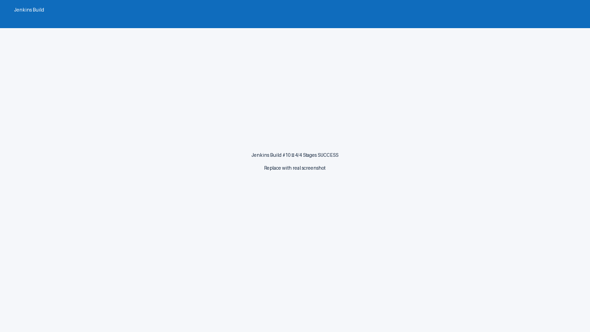
Jenkins Build
Notes:
Replace with actual screenshot.

Slide 9
Lessons & Next
Docker simplifies CI/CD
Repo structure matters (dir(), script path)
Next: UI tests, registry, blue/green
Notes:
Close with what’s next.

Slide 10
Thank You
Repo: github.com/Punith968/simple-webapp-jenkins-ci-cd
Questions welcome

