Slide 1

MALNAD COLLEGE OF ENGINEERING
(AN AUTONOMOUS INSTITUTION UNDER VTU, BELAGAVI)
HASSAN, KARNATAKA 573202, INDIA
“BRAIN TUMOR DETECTION USING ML”
Department of Computer Science and Engineering
Presenters :
Punith B S 4MC18CS101
Rohan D 4MC18CS108
Under the guidance of :
Mr. Tejonidhi M R
Assistant Professor

Slide 2
CONTENT
Introduction
System Design
1
2
3
4
5
Abstract
Requirements
Implementation

Slide 3
Abstract :
1
Brain tumor is one of the most life-threatening diseases at its advance stages.
Thus we aim to build a system which detects brain tumour using a machine learning.
Automatic segmentation of brain tumors from medical images is important for clinical assessment and treatment planning of brain tumors.
Our system using CNN (Convolutional Neural Network) will detect tumour in an magnetic resonance images.

Slide 4
Introduction :
2
Brain tumors are the consequence of abnormal growths and uncontrolled cells division in the brain.
Brain tumor segmentation techniques are a critical component in tumor detection. Using machine learning techniques that learn the pattern of brain tumor is useful because manual segmentation is time-consuming and being susceptible to human errors or mistakes.
We have used three MRI views of human brain. MRI scan is used because it is less harmful and more accurate than CT brain scan.
Comparing segmented images to evaluate the quality of segmentation is an essential part for measuring the progress the neural network.

Slide 5
Requirements :
3
Hardware requirement :
Software requirement :
Processor speed : 1.2ghz
RAM : 4 GB+
Hard disk : 50 GB+
Operating System : Windows 7+
Language: Python
IDE: Jupiter Notebook
Modules required :
Keras
Tensorflow
Numpy
Pandas

Slide 6
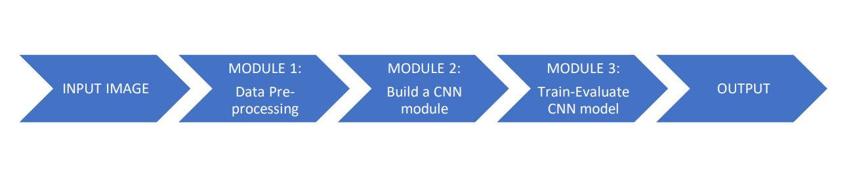
System design :
4
Input image
Data Pre processing
Build a CNN module
Train-Evaluate CNN model
OUTPUT

Slide 7
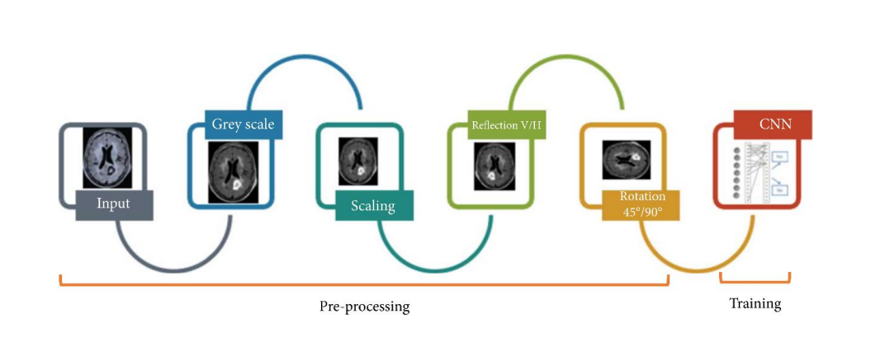
Implementation :
5
Data pre-processing
Bilateral filter
Image Enhancement
Edge detection

Slide 8
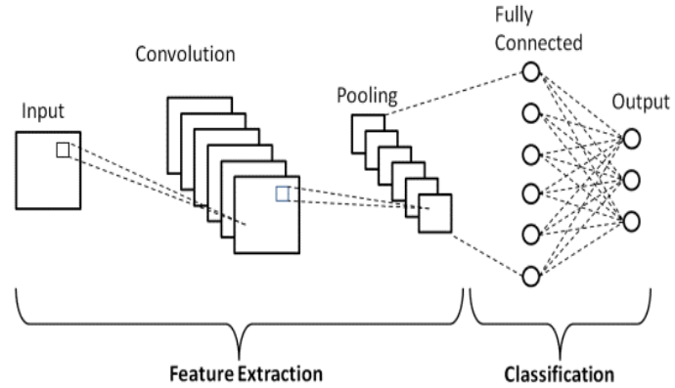
Implementation :
5
Build a CNN module
The Convolutional layer
Pooling layer
Fully Connected

Slide 9
Implementation :
5
Train-Evaluate CNN model
Accuracy
Loss Function
Computation Time

Slide 10
References :
5
IOT and AI Based System for Fish Farming: Case study of Benin http://researchgate.net
http://ijssst.info/Vol-19/No-3/paper14.pdf
Suresh Babu Chandanapalli, Sreenivasa Reddy E and Rajya Lakshmi D (2014) Design and Deployment of Aqua Monitoring System Using Wireless Sensor Networks and IAR-Kick
https://www.javatpoint.com/iot-internet-of-things

Slide 11
Thank You

