Slide 1
Mobility Trends and Performance Analysis
By Immaculate Punitha

Slide 2


Slide 3
Content
Introduction
Problem Statement
Dashboard overview
Primary Research
Secondary Research
Adhoc Queries
Recommendations
Conclusion

Slide 4
Introduction
I’m excited to present my analysis of Good Cabs' operational data. The objective of this project was to uncover insights into trip trends, passenger behavior, and target achievements to optimize their performance.

Slide 5
Problem Statement
Goodcabs, a leading cab service in tier-2 Indian cities, aims to evaluate its 2024 performance targets across key metrics like trip volume, passenger satisfaction, and repeat passenger rates. With the Chief of Operations requiring actionable insights urgently, the task was assigned to data analyst to provide a comprehensive performance assessment and support growth strategies.

Slide 6
Objective
This analysis aimed to evaluate trip demand patterns, passenger behaviors, and target achievement rates. We focused on identifying opportunities for improving operational efficiency and customer satisfaction.

Slide 7
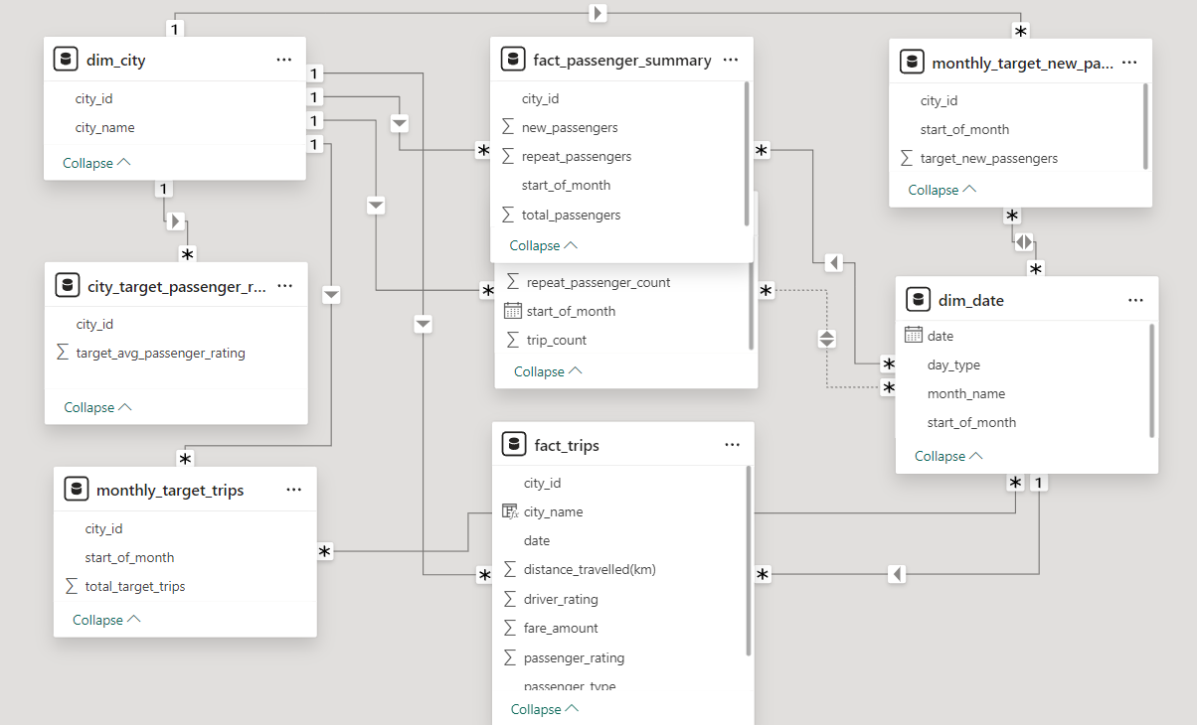
Data Model

Slide 8
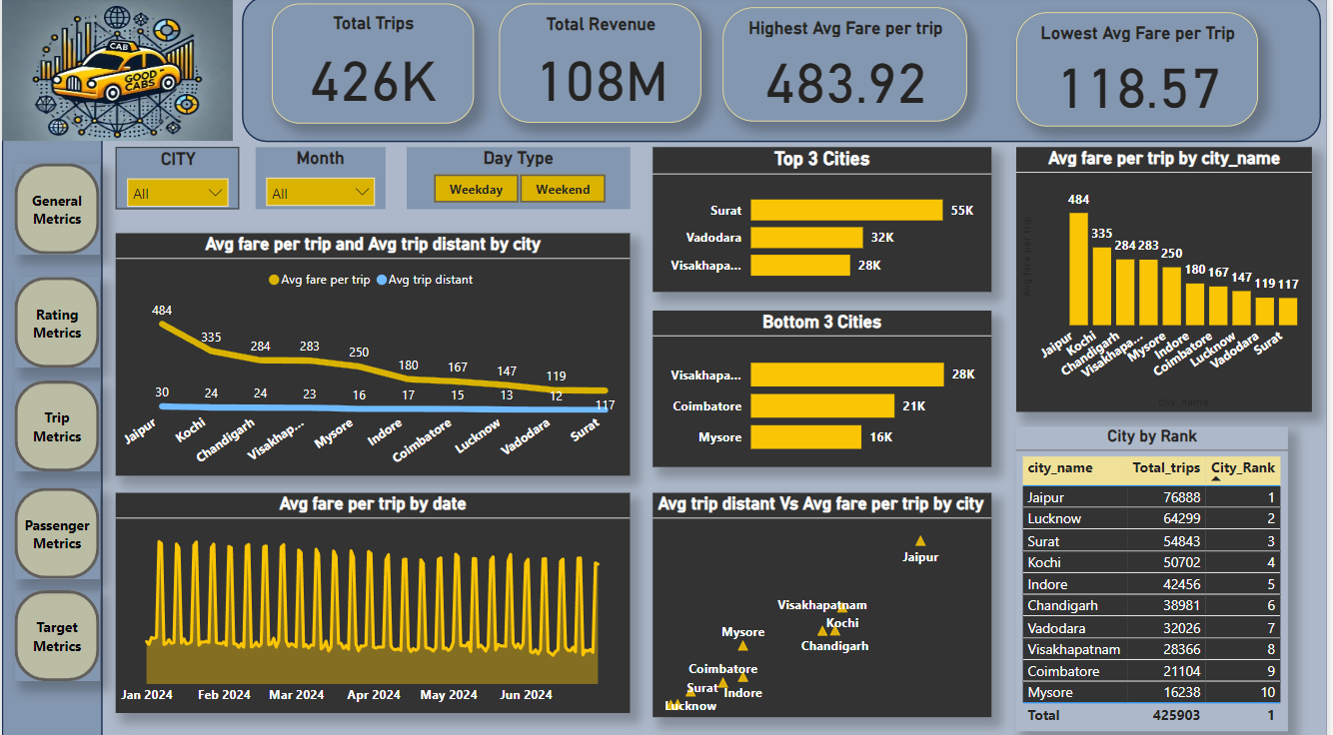
Dashboard Design – General Metrics

Slide 9
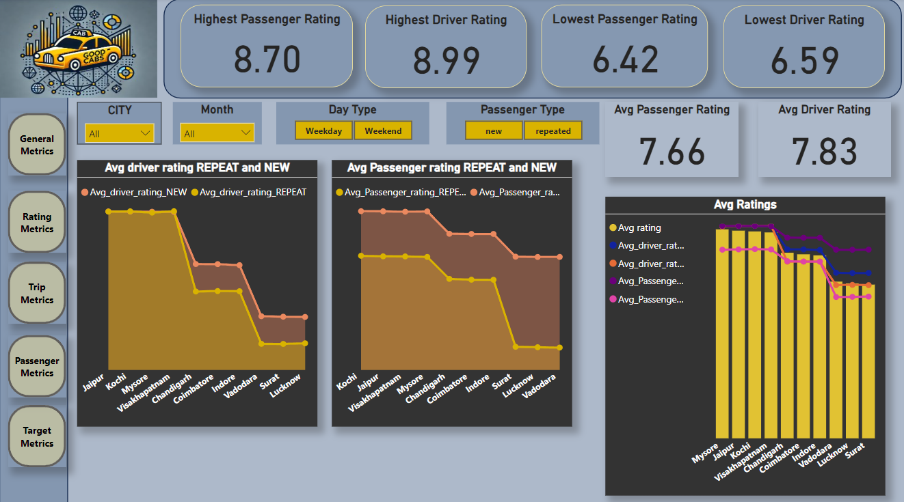
Rating Metrics

Slide 10
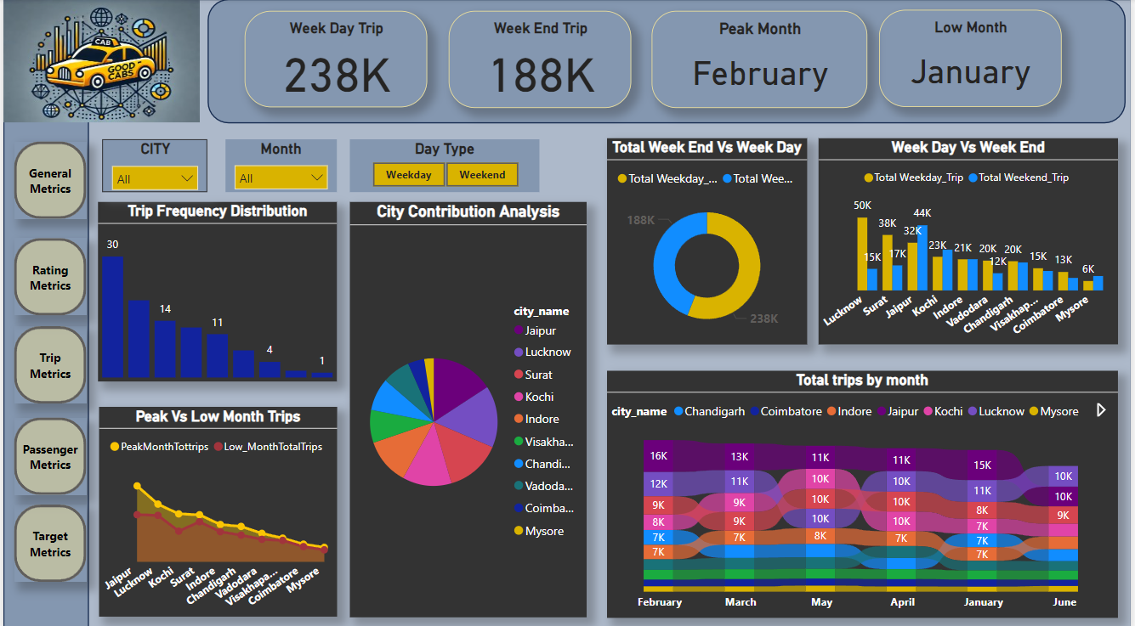
Trip Metrics

Slide 11
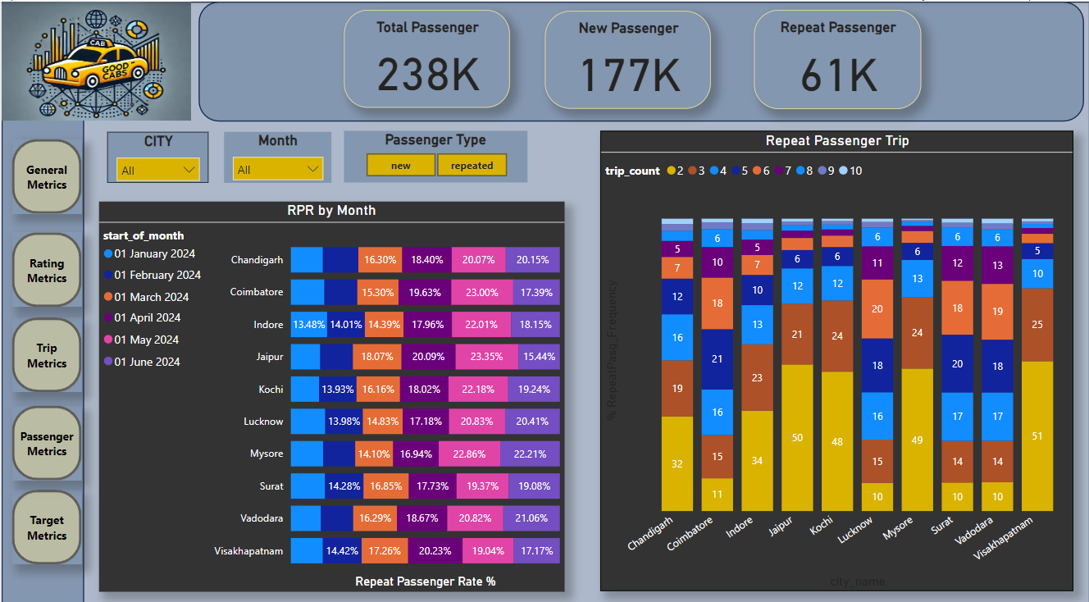
Passenger Metrics

Slide 12
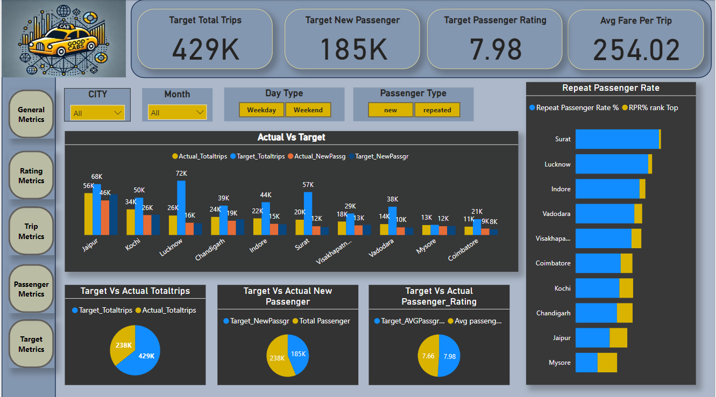
Target Metrics

Slide 13
Primary Research

Slide 14
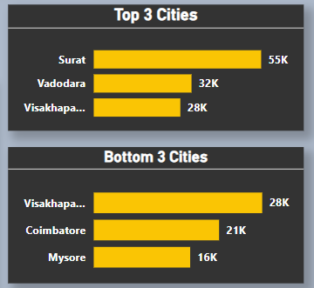
Top and Bottom Performing cities
Top 3 Performing Cities (by Total Trips): Surat (Gujarat),Vadodara and Vishakhapatnam(AP)
Bottom 3 Performing Cities (by Total Trips): Mysore (Karnataka), Coimbatore (Tamil Nadu), Vishakhapatnam (Andhra Pradesh).

Slide 15
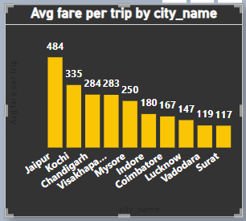
Average fare per trip
Cities with the Highest Average Fare per Trip: Jaipur (₹484) — indicates premium pricing or longer trips.
Cities with the Lowest Average Fare per Trip: Surat (₹117) — suggests low pricing or inefficiencies.
Comparison Insight: As the average trip distance increases, fares generally align proportionally, ensuring pricing efficiency.

Slide 16
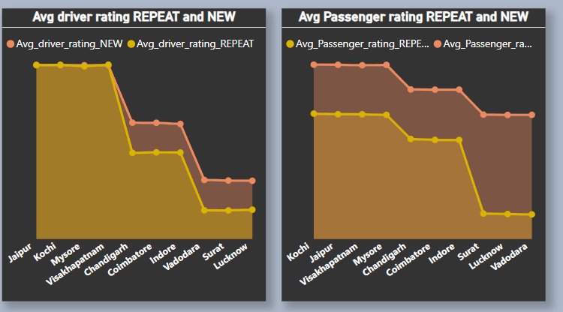
Average Ratings by city and Passenger Type
Highest Average Passenger Rating: Mysore.
Highest Average Driver Rating: Vishakhapatnam.
Passenger Type Insights:
New Passengers: Highest ratings in Jaipur (Drivers: 8.99) and Kochi (Passengers: 8.99).
Repeat Passengers: Consistently high ratings in Jaipur and Kochi.

Slide 17
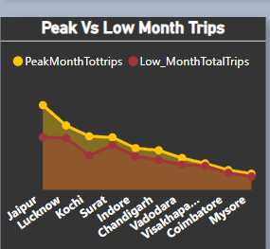
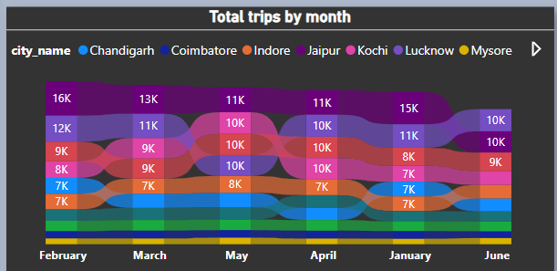
Peak and Low demand months by city
Peak Demand Months: April and May — potentially due to holiday seasons or events.
Low Demand Months: June and January — likely reflecting off-season periods.
Seasonal Trends:
Most cities exhibit similar seasonal patterns.
Resource allocation can be optimized based on these insights.

Slide 18
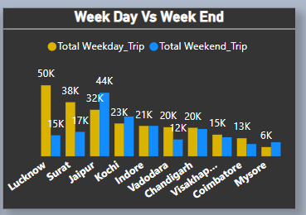
Weekend Vs Weekday trip demand by city
Cities with Higher Weekend Demand: Jaipur, Kochi, Mysore — tourism-driven cities.
Cities with Higher Weekday Demand: Lucknow, Surat — business-driven cities.
Demand Trends:
Weekend trips dominate in tourism-heavy locations.
Weekday trips are preferred in business hubs.

Slide 19
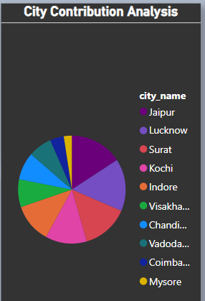
Top and Bottom Performing cities
Tourism-Focused Cities:
Lower repeat passenger rates and trip frequencies: Jaipur, Mysore, Vishakhapatnam.
Focus on enhancing experiences for one-time passengers.
Business-Focused Cities:
Higher repeat passenger rates and trip frequencies: Surat, Lucknow, Coimbatore, Vadodara.
Incentivize frequent passengers through loyalty programs.

Slide 20
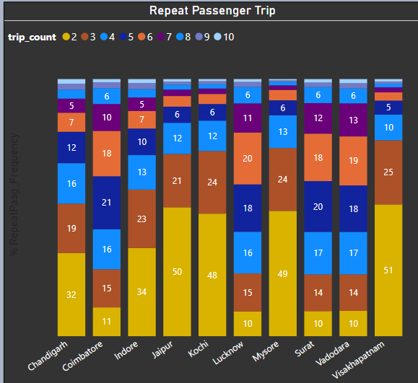
Repeat Passenger Frequency
Cities with lower trip frequencies could indicate tourist-focused locations, while higher frequencies may point to business hubs.
Lower frequency – Jaipur, Mysore, Vishakhapatnam – Tourism Focused Cities
High Frequency – Coimbatore, Lucknow, Surat , Vadodara – Business Focused cities

Slide 21
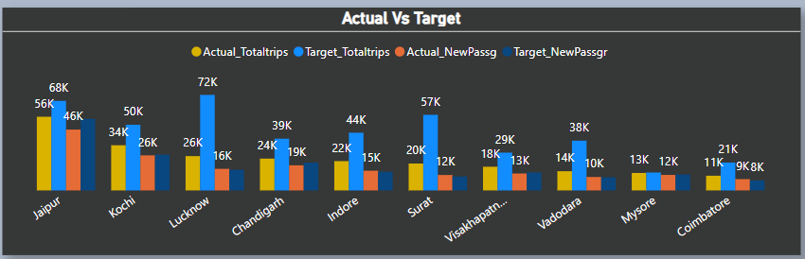
Monthly Target Achievement analysis for key metrics
Tourist Cities:
Tend to exceed targets for new passengers.
Often fall short on trip targets — suggesting seasonal fluctuations.
Business Cities:
Excel in trip targets but show slower growth in new passengers.
Targeted marketing can enhance passenger acquisition.

Slide 22
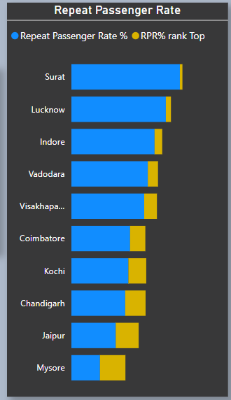
Highest and Lowest repeat passenger rate(RPR%) by city and month
Top Cities: Surat and Lucknow — strongest RPR%, indicating effective retention strategies.
Bottom Cities: Mysore and Jaipur — weaker RPR%, highlighting areas for improvement.
Monthly Insights:
Months with the highest RPR%: March.
Months with the lowest RPR%: June.
Seasonal analysis can guide strategies for improving passenger loyalty.

Slide 23

Secondary Research
Factors Influencing Repeat Passenger Rates
Driver and Passenger Ratings: Cities with higher average ratings (e.g., Kochi) correlate with stronger repeat passenger rates. Enhancing driver training and rewarding high-rated drivers could improve RPR%.
Pricing and Affordability: Low average fare cities like Surat show stronger passenger retention. Reviewing pricing strategies for cost-sensitive regions can further enhance loyalty.
Customer Experience: Tourism-heavy cities (e.g., Mysore) with lower RPR% highlight the importance of personalized experiences for one-time passengers.
Actionable Suggestion: Leverage customer feedback and loyalty incentives to convert one-time users into repeat customers.

Slide 24
Tourism vs. Business Demand Impact
Tourism-Centric Cities:
Higher weekend trip volumes but lower repeat passenger rates (e.g., Jaipur, Mysore).
Seasonal peaks demand flexible fleet management strategies.
Business-Centric Cities:
Consistent weekday demand and higher repeat passengers (e.g., Surat, Lucknow).
Demand for affordable, dependable rides necessitates competitive pricing and corporate tie-ups.
Actionable Suggestion: Customize city-specific strategies — promote weekend discounts in tourism cities and loyalty programs in business hubs.

Slide 25
Emerging Mobility Trends and Goodcabs’ Adaptation
Ridesharing and Micro-Mobility: Growing trends in shared rides and e-mobility demand an adaptive approach.
Eco-Conscious Choices: Promoting electric or hybrid cabs aligns with sustainability goals and attracts environmentally conscious customers.
Tech Integration: Implementing real-time tracking, predictive analytics, and app-based recommendations can enhance customer trust and operational efficiency.
Actionable Suggestion: Stay agile in adopting trends like EVs and ridesharing to cater to emerging customer preferences.

Slide 26
4. Partnership Opportunity with Local Businesses
Collaborations: Tie-ups with hotels, travel agencies, and local businesses can boost visibility and demand in tourism-heavy cities.
Corporate Accounts: Business-centric cities can benefit from partnerships with corporates, offering packages for employee transport or conferences.
Co-Marketing: Joint promotional campaigns with local brands can attract mutual benefits.
Actionable Suggestion: Build city-specific partnerships to tap into established customer bases and increase Goodcabs’ presence.

Slide 27
5. Data Collection for Enhanced Data-Driven Decisions
Passenger Behavior Analysis: Collect data on booking patterns, trip preferences, and feedback to tailor offerings.
Driver Performance Metrics: Monitor and optimize driver ratings, trip completion rates, and average fare efficiency.
External Factors: Use weather, event, and tourism data to predict demand surges and optimize fleet allocation.
Actionable Suggestion: Invest in advanced analytics tools and machine learning models to derive actionable insights from diverse data sources.

Slide 28
SQL
Business Request
Databases – trips_db, targets_db

Slide 29
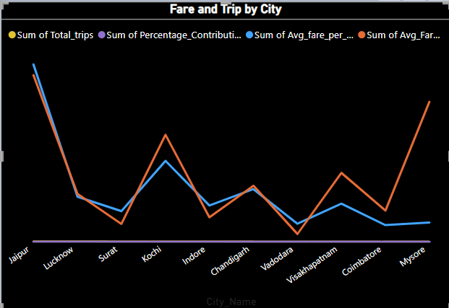
city level fare and trip summary report. Generate REPORT that displays total trips,avg fare per km,avg fare per trip,and % contribution of each city's trip to the over all trips.this report will help in assessing trip volume, pricing effiency, and each citys contribution to overall trip count. Fields - city_name,total_trips,avg_fare_per_km, avg_fare_per_trip, %contribution_of_total_trips.
City_Name | Total_trips | Avg_Fare_Per_KM | Avg_fare_per_trip | %_Contribution_of_Total_Trips
Jaipur | 76888 | 16.12 | 37207497 | 18.05
Lucknow | 64299 | 11.76 | 9463551 | 15.1
Surat | 54843 | 10.66 | 6431599 | 12.88
Kochi | 50702 | 13.93 | 16997596 | 11.9
Indore | 42456 | 10.9 | 7635228 | 9.97
Chandigarh | 38981 | 12.06 | 11058401 | 9.15
Vadodara | 32026 | 10.29 | 3797200 | 7.52
Visakhapatnam | 28366 | 12.53 | 8018282 | 6.66
Coimbatore | 21104 | 11.15 | 3523992 | 4.96
Mysore | 16238 | 15.14 | 4054745 | 3.81

Slide 30
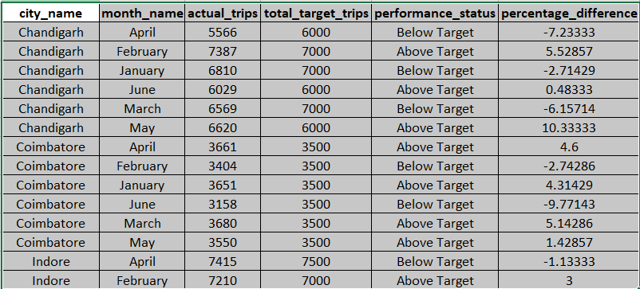
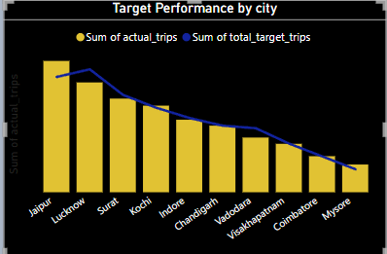
Monthly city level Trips target performance report Generate a report that evaluates the target performance for trips at the monthly and city level. For each city and month, compare the actual total trips with the target trips and categories the performance

Slide 31
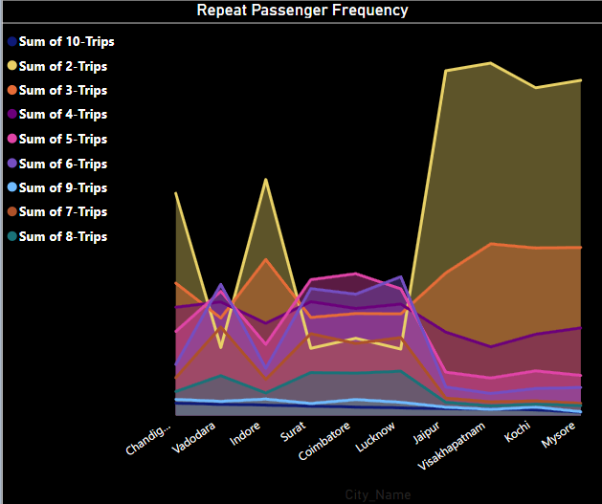
. City Level Repeat Passenger trip Frequency report Generate report that shows the percentage distribution of repeat passenger by the number of trips they have taken in each city. Calculate the percentage of repeat passengers who tool 2 trips,3 trips and so on up to 10 trips.
City_Name | 2-Trips | 3-Trips | 4-Trips | 5-Trips | 6-Trips | 7-Trips | 8-Trips | 9-Trips | 10-Trips
Chandigarh | 32.31 | 19.25 | 15.74 | 12.21 | 7.42 | 5.48 | 3.47 | 2.33 | 1.79
Coimbatore | 11.21 | 14.82 | 15.56 | 20.62 | 17.64 | 10.47 | 6.15 | 2.31 | 1.22
Indore | 34.34 | 22.69 | 13.4 | 10.34 | 6.85 | 5.24 | 3.26 | 2.38 | 1.51
Jaipur | 50.14 | 20.73 | 12.12 | 6.29 | 4.13 | 2.52 | 1.9 | 1.2 | 0.97
Kochi | 47.67 | 24.35 | 11.81 | 6.48 | 3.91 | 2.11 | 1.65 | 1.21 | 0.81
Lucknow | 9.66 | 14.77 | 16.2 | 18.42 | 20.18 | 11.33 | 6.43 | 1.91 | 1.1
Mysore | 48.75 | 24.44 | 12.73 | 5.82 | 4.06 | 1.76 | 1.42 | 0.54 | 0.47
Surat | 9.76 | 14.26 | 16.55 | 19.75 | 18.45 | 11.89 | 6.24 | 1.74 | 1.35
Vadodara | 9.87 | 14.17 | 16.52 | 18.06 | 19.08 | 12.86 | 5.78 | 2.05 | 1.61
Visakhapatnam | 51.25 | 24.96 | 9.98 | 5.44 | 3.19 | 1.98 | 1.39 | 0.88 | 0.92

Slide 32
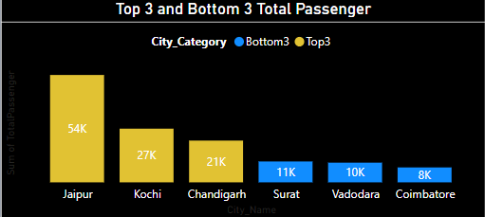
Identify cities with highest and lowest total new passengers. Generate a report that calculates the total new passengers for each city and ranks them based on this value. Identify the top 3 cities with the highest number of new passengers as well as bottom 3 cities with lowest number of new passengers. Categorising them as Top3 and Bottom3 accordingly.
City_Name | TotalPassenger | City_Category
Surat | 10500 | Bottom3
Vadodara | 9900 | Bottom3
Coimbatore | 7500 | Bottom3
Jaipur | 54000 | Top3
Kochi | 27000 | Top3
Chandigarh | 21000 | Top3

Slide 33
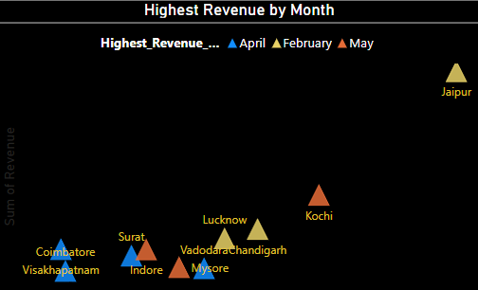
Identify Month with Highest Revenue for each city Generate report that identifies the month with the highest revenue for each city. For each city display the monthname, the revenue amont for that month, and the percentage contribution of that months revenue to the citys total revenue.
City_Name | Highest_Revenue_Month | Revenue | PercentageContribution
Chandigarh | February | 2108290 | 19.07
Coimbatore | April | 612431 | 17.38
Indore | May | 1380996 | 18.09
Jaipur | February | 7747202 | 20.82
Kochi | May | 3333746 | 19.61
Lucknow | February | 1777269 | 18.78
Mysore | May | 745170 | 18.38
Surat | April | 1154909 | 17.96
Vadodara | April | 706250 | 18.6
Visakhapatnam | April | 1390682 | 17.34

Slide 34
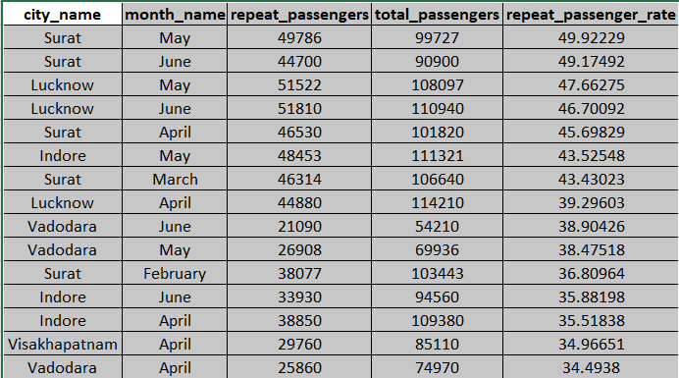
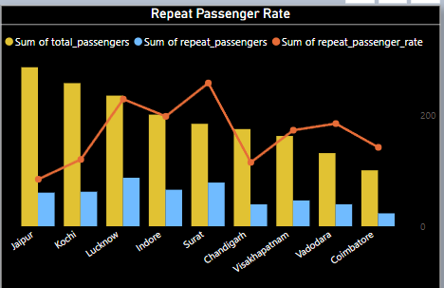
Repeat Passenger Rate Analysis Monthly repeat Passenger Rate :Calculate the repeat passenger rate for each city and month by comparing the number of repeat passengers to the total passengers.

Slide 35
Recommendations
How to Make Goodcabs More Data-Driven and Improve Performance Across Key Metrics
KPI Tracking: Establish clear KPIs such as RPR%, average trip fare, and on-time performance.
Real-Time Dashboards: Use tools like Power BI to track and visualize data in real time.
Predictive Analytics: Employ machine learning to anticipate demand surges and improve fleet utilization.
Feedback Integration: Use structured and unstructured customer feedback to enhance service quality.
Incentive Programs: Create data-backed incentives for high-performing drivers and loyal passengers.

Slide 36
THANK YOU

