Slide 1


Social Buzz

Slide 2


Today's agenda
Project recap
Problem
The Analytics team
Process
Insights
Summary

Slide 3

Social Buzz is a growing Company. They need our help for three main reasons.
An audit of their big practice
Recommendations for a successful IPO
An analysis of their content categories that highlights the top 5 categories with the largest popularity.
Project Recap

Slide 4

Problem
Unstructured Data
100000 content per day
Small team
How to utilize big bata efficiently?

Slide 5



Andrew Fleming (Chief Technical Architect)
The Analytics team
Marcus Rompton
(Senior Principle)
Immaculate Punitha
(Data Analyst)
Notes:
Andrew Fleming - CTA
Marcus Rompton - Sr.Principle
Immaculate Punitha- Data Analyst

Slide 6
Process
Data Understanding
1
Data Cleaning
2
Data Modelling
3
Data Analysis
4
5
Uncover Insights
Notes:
Collect all the required data from different resources
Found relevant 3 tables from 6 tables
Combined all the 3 tables to get a new data set
Cleaned the data set for analysis
Found the top 5 categories

Slide 7
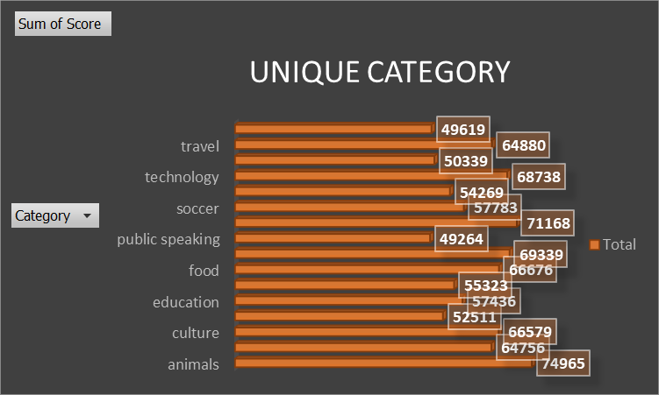

Insights

Slide 8
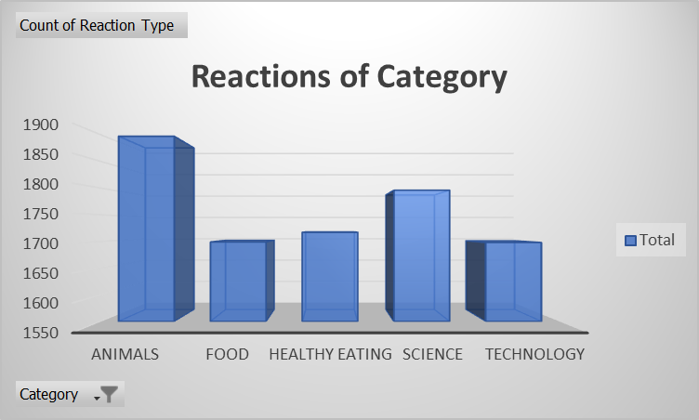

Slide 9
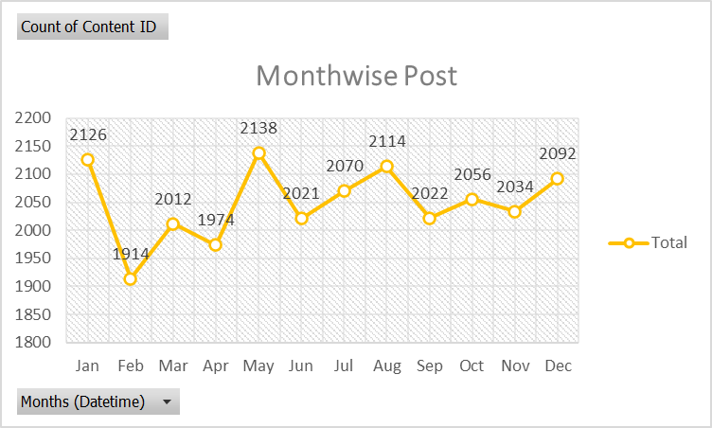
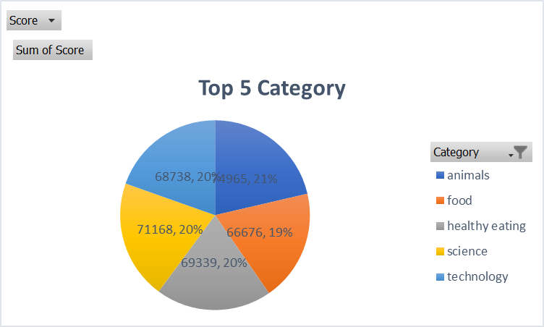

Slide 10

We have 16 unique categories
There are 1897 reactions for Animal category which is the highest
We have highest Post in the month of May followed by January
After carefully analysed the top 5 categories are Animal, Science, Healthy eating,
Technology and Food
Summary

Slide 11
Thank you!
ANY QUESTIONS?

