Slide 1
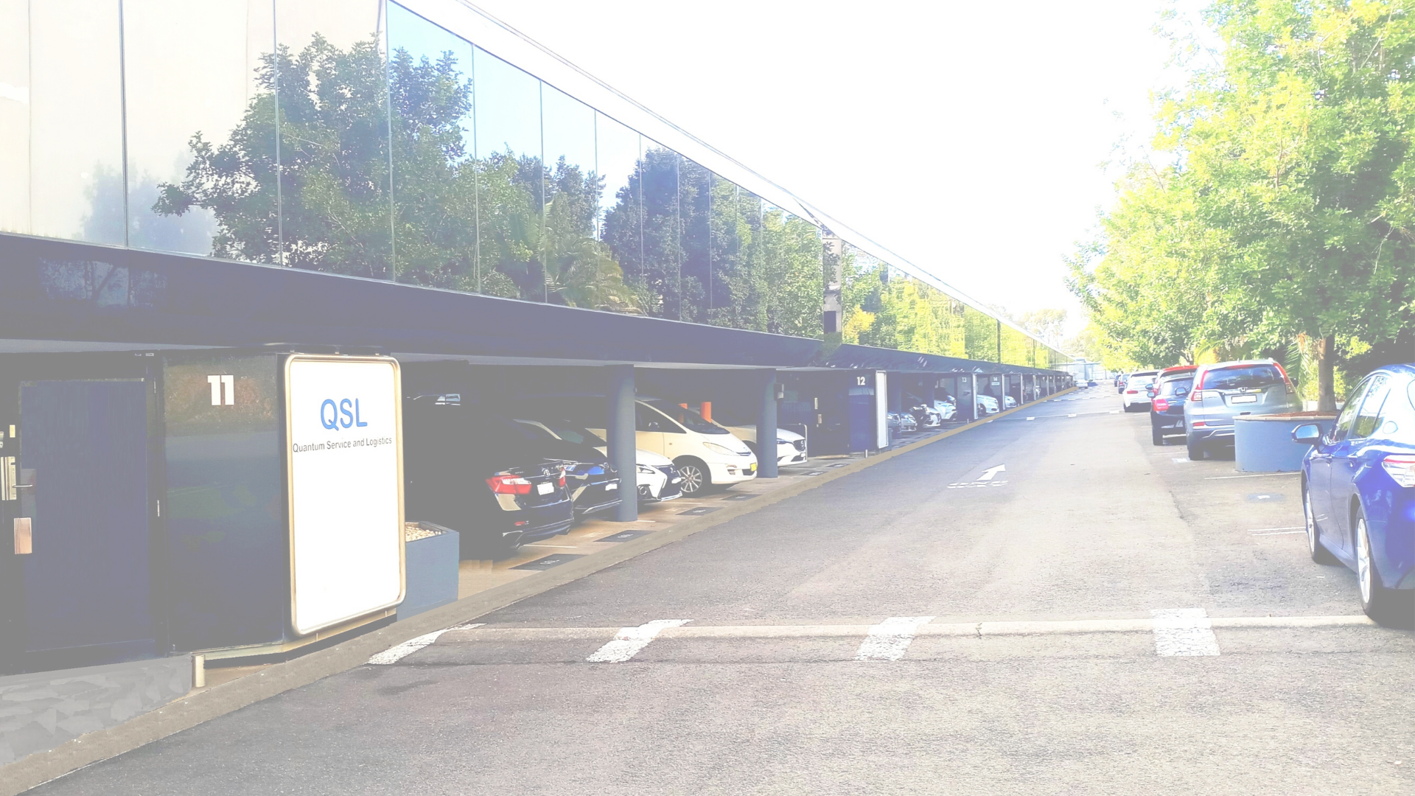
QSL Group was established in 2004 as Quantum Service and Logistics, based in Sydney, Australia. The Company has since experienced significant growth through expansion in service offerings, superior performances and establishment of a regional footprint within Asia Pacific countries.
Our range of pre-sales and reverse supply chain services are customized to suit the evolving business needs of our partners, adopting the specific requirements of the markets we support. We offer a single point of contact across the region.
Our operating model consists of fully owned subsidiaries, JV partnerships and strategic alliances with like minded companies to provide a unified and customer focused end to end solution.
We are flexible, approachable and work collaboratively with our partners to develop the right solution for their business needs.
Our head office & main operations are centrally located in Silverwater, NSW, close to major traffic routes and easy access to Sydney airport.
Regional Footprint
With over 600 employees across 5 countries, we are a leading service provider in Asia Pacific Region, headquartered at Silverwater in Greater Sydney, QSL has established entities and operations within the following countries:
Australia
New Zealand
Thailand
VIETNAM
Philippines
We have also established strategic alliance partnerships with like minded and cultured companies, at various locations where we do not have our own presence. The purpose of this alliance is to provide a range of services to our partners across the region, on a single point of contact and ownership.
Additional benefits of this alliance are:
Single contact for all account management across the region
Single standard of service and quality
Knowledge share among partners in every country
Efficiency in spare parts procurement and inventory management
Structured but flexible and approachable for customized services in each country

Slide 2
QSL Group was established in 2004 as Quantum Service and Logistics, based in Sydney, Australia. The Company has since experienced significant growth through expansion in service offerings, superior performances and establishment of a regional footprint within Asia Pacific countries.
Our range of pre-sales and reverse supply chain services are customized to suit the evolving business needs of our partners, adopting the specific requirements of the markets we support. We offer a single point of contact across the region.
Our operating model consists of fully owned subsidiaries, JV partnerships and strategic alliances with like minded companies to provide a unified and customer focused end to end solution.
We are flexible, approachable and work collaboratively with our partners to develop the right solution for their business needs.
Our head office & main operations are centrally located in Silverwater, NSW, close to major traffic routes and easy access to Sydney airport.
Regional Footprint
With over 600 employees across 5 countries, we are a leading service provider in Asia Pacific Region, headquartered at Silverwater in Greater Sydney, QSL has established entities and operations within the following countries:
Australia
New Zealand
Thailand
VIETNAM
Philippines
We have also established strategic alliance partnerships with like minded and cultured companies, at various locations where we do not have our own presence. The purpose of this alliance is to provide a range of services to our partners across the region, on a single point of contact and ownership.
Additional benefits of this alliance are:
Single contact for all account management across the region
Single standard of service and quality
Knowledge share among partners in every country
Efficiency in spare parts procurement and inventory management
Structured but flexible and approachable for customized services in each country

Slide 3
QSL Group was established in 2004 as Quantum Service and Logistics, based in Sydney, Australia. The Company has since experienced significant growth through expansion in service offerings, superior performances and establishment of a regional footprint within Asia Pacific countries.
Our range of pre-sales and reverse supply chain services are customized to suit the evolving business needs of our partners, adopting the specific requirements of the markets we support. We offer a single point of contact across the region.
Our operating model consists of fully owned subsidiaries, JV partnerships and strategic alliances with like minded companies to provide a unified and customer focused end to end solution.
We are flexible, approachable and work collaboratively with our partners to develop the right solution for their business needs.
Our head office & main operations are centrally located in Silverwater, NSW, close to major traffic routes and easy access to Sydney airport.
Regional Footprint
With over 600 employees across 5 countries, we are a leading service provider in Asia Pacific Region, headquartered at Silverwater in Greater Sydney, QSL has established entities and operations within the following countries:
Australia
New Zealand
Thailand
VIETNAM
Philippines
We have also established strategic alliance partnerships with like minded and cultured companies, at various locations where we do not have our own presence. The purpose of this alliance is to provide a range of services to our partners across the region, on a single point of contact and ownership.
Additional benefits of this alliance are:
Single contact for all account management across the region
Single standard of service and quality
Knowledge share among partners in every country
Efficiency in spare parts procurement and inventory management
Structured but flexible and approachable for customized services in each country

Slide 4
QSL Group was established in 2004 as Quantum Service and Logistics, based in Sydney, Australia. The Company has since experienced significant growth through expansion in service offerings, superior performances and establishment of a regional footprint within Asia Pacific countries.
Our range of pre-sales and reverse supply chain services are customized to suit the evolving business needs of our partners, adopting the specific requirements of the markets we support. We offer a single point of contact across the region.
Our operating model consists of fully owned subsidiaries, JV partnerships and strategic alliances with like minded companies to provide a unified and customer focused end to end solution.
We are flexible, approachable and work collaboratively with our partners to develop the right solution for their business needs.
Our head office & main operations are centrally located in Silverwater, NSW, close to major traffic routes and easy access to Sydney airport.
Regional Footprint
With over 600 employees across 5 countries, we are a leading service provider in Asia Pacific Region, headquartered at Silverwater in Greater Sydney, QSL has established entities and operations within the following countries:
Australia
New Zealand
Thailand
VIETNAM
Philippines
We have also established strategic alliance partnerships with like minded and cultured companies, at various locations where we do not have our own presence. The purpose of this alliance is to provide a range of services to our partners across the region, on a single point of contact and ownership.
Additional benefits of this alliance are:
Single contact for all account management across the region
Single standard of service and quality
Knowledge share among partners in every country
Efficiency in spare parts procurement and inventory management
Structured but flexible and approachable for customized services in each country

