Slide 1
Computational Haptics Laboratory
Prof. Dr.-Ing. Eckehard Steinbach
Haptic Model Quizgame
07.08.2015
Marc Dreiser and Julian Eiler

Slide 2
Our Work
Implement game logic
Create 3D objects
Handle user unputs
Connect voice coil actuator with CHAI 3D

Slide 3
Idea - Quizgame
Choose number of rounds to play
Game Consists of 4 Phases:
Initialization: Get an overview over the models (can be skipped)
Exploration: Touch the object and try to guess the object
Solving: Three options are displayed and the user should choose one
Solution: The user is informed, if his choice was correct
Show the user his performance

Slide 4
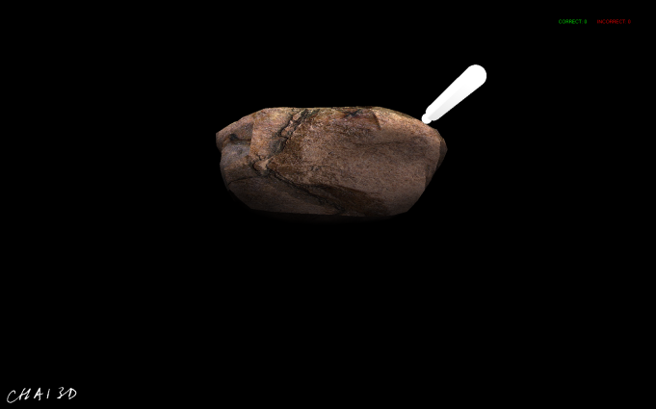
3D Objects

Slide 5
3D Objects
Design objects according to the soundfiles we got
Similar in shape in order to make it not ot easy
Different in texture

Slide 6
Voice Coil Actuator
Soft Iron
(fixed)
Air gap
Electric coil
Coil holder
(sliding)
Permanent Magnet

Slide 7
Need for Voice Coil
Dynamics of intervening linkages, joints, and cables distort the output of the motors → interferes especially with the display of high freqency vibrations *
“Haptography handle“ generates vibrotactile frequencies (20-1000 Hz) in real time
BASS_Init(1,44100,0,0,NULL);
https://books.google.de/books?id=MMeaI1TMvyMC&pg=PA256&lpg=PA256&dq=phantom+omni+voice+coil&source=bl&ots=xb_XcUQzxx&sig=kQPPNpT3BscUGyFQ3oj-Q3hHIPo&hl=de&sa=X&ved=0CCUQ6AEwAGoVChMIn7qNgeCNxwIVxAiSCh1a-AJU#v=onepage&q=phantom%20omni%20voice%20coil&f=false
* Robotics Research, The 14th International Symposium ISRR

Slide 8
Force and Velocity measurements
Velocity (V)
F = const.
V = const.
V = const.
F = const.
Force
(F)

Slide 9
Incresing Velocity
Small Velocity
Large Velocity

Slide 10
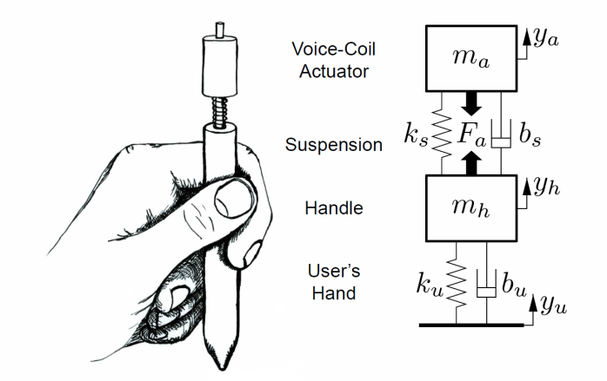
Voice Coil Actuator
McMahan, William, and Katherine J. Kuchenbecker. "Dynamic modeling and control of voice-coil actuators for high-fidelity display of haptic vibrations." Haptics Symposium (HAPTICS), 2014 IEEE. IEEE, 2014.

Slide 11
Force and Velocity: Approach 1
Five soundfiles for different velocities
Aplitude constant (independet of penetration depth /force)
Velocity
Five discrete values
Constant
Force

Slide 12
Force and Velocity: Approach 2
Five soundfiles for different velocities
Aplitude linear to penetration depth
Aplitude
Force
Velocity

