Slide 1
Computational Haptics Laboratory
Prof. Dr.-Ing. Eckehard Steinbach
Haptic Memory
07.08.2015
Marc Dreiser and Julian Eiler

Slide 2
Concept - Quizgame
Game Consists of 4 Phases:
Initialization: Get an overview over the models (can be skipped)
Exploration: Touch the object and try to guess the object
Solving: Three options are displayed and the user should choose one
Solution: The user is informed, if his choice was correct
Features:
Choose number of rounds to play
Display the user performance
Time for exploring the object
Hide handle

Slide 3

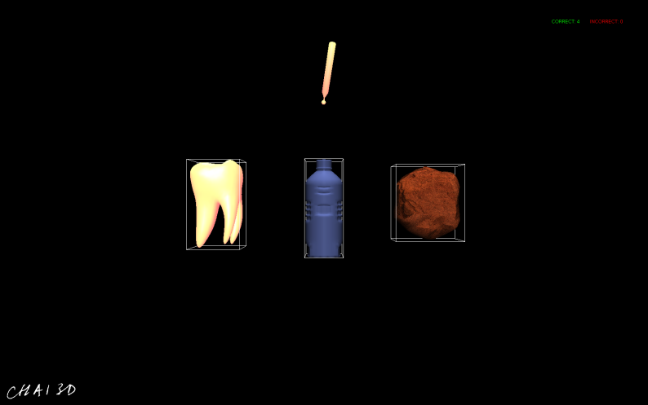

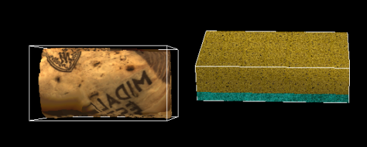
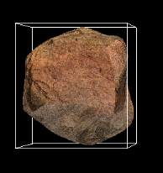
Solution Phase

Slide 4
Concept - Quizgame
Game Consists of 4 Phases:
Initialization: Get an overview over the models (can be skipped)
Exploration: Touch the object and try to guess the object
Solving: Three options are displayed and the user should choose one
Solution: The user is informed, if his choice was correct
Features:
Choose number of rounds to play
Display the user performance
Time for exploring the object
Hide handle

Slide 5
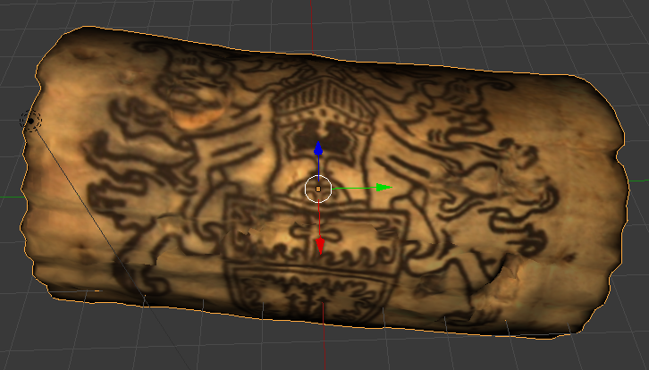
3D Object: Cork

Slide 6

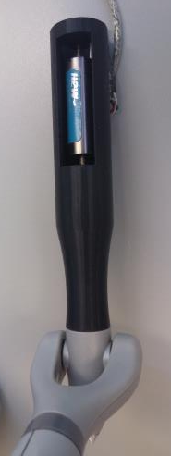

Voice Coil Actuator
Voice Coil Actuator
Translation

Slide 7
Voice Coil Actuator
Dynamics of intervening linkages, joints, and cables distort the output of the motors → interferes especially with the display of high freqency vibrations *
Generates vibrotactile frequencies (20-1000 Hz) in real time
Play acceleration file with the Bass library
* Robotics Research, The 14th International Symposium ISRR
https://books.google.de/books?id=MMeaI1TMvyMC&pg=PA256&lpg=PA256&dq=phantom+omni+voice+coil&source=bl&ots=xb_XcUQzxx&sig=kQPPNpT3BscUGyFQ3oj-Q3hHIPo&hl=de&sa=X&ved=0CCUQ6AEwAGoVChMIn7qNgeCNxwIVxAiSCh1a-AJU#v=onepage&q=phantom%20omni%20voice%20coil&f=false

Slide 8
Force and Velocity measurements
Velocity (V)
F = const.
V = const.
V = const.
Should Haptic Texture Vibrations Respond to User Force and Speed?
Heather Culbertson and Katherine J. Kuchenbecker
F = const.
Force
(F)

Slide 9
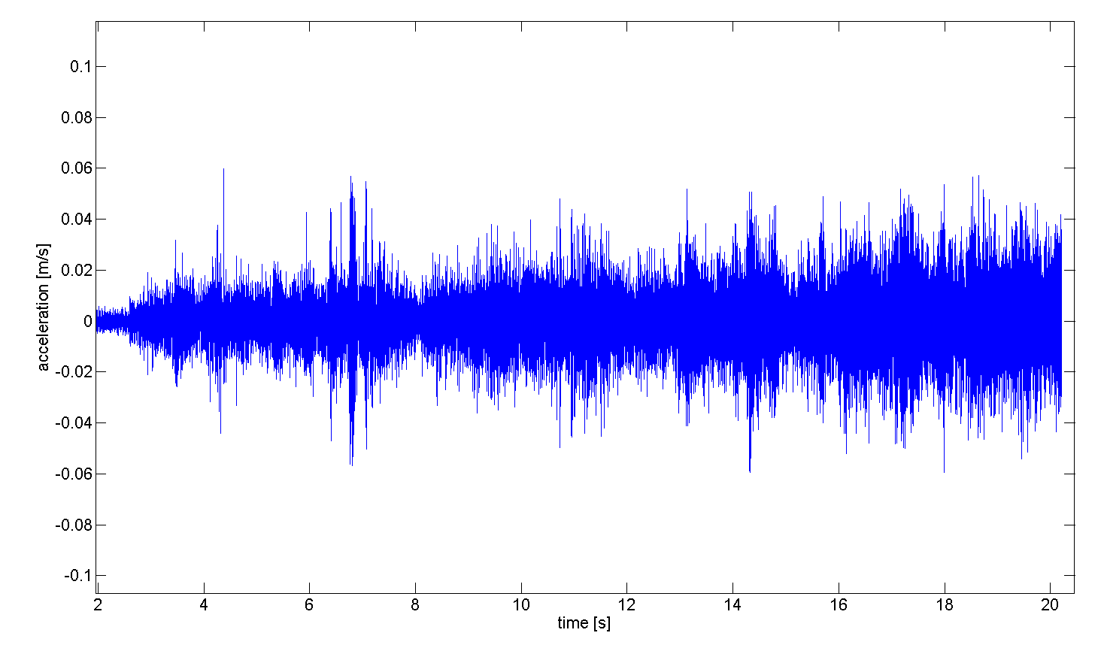
Acceleration file
F = const. / V increases over time
Acceleration [m/s]
Time [s]

Slide 10
Force and Velocity: Approach 1
Five soundfiles for different velocities
Amplitude constant (independet of penetration depth/force)
Velocity
Five discrete values
Constant
Force

Slide 11
Force and Velocity: Approach 2
Amplitude
Five soundfiles for different velocities
Amplitude linear to penetration depth/force
Force
Velocity

Slide 12
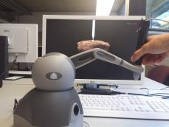
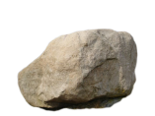
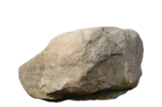
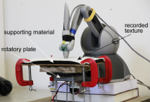
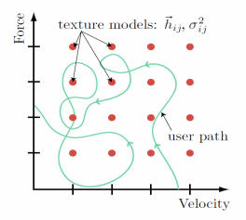
Optimal Design Process
Real Object
Virtual Object
Model object properties
Record object properties
A Haptic Texture Database for Tool-mediated Texture Recognition and Classification, Strese et al.
Automatic Filter Design for Synthesis of Haptic
Textures from Recorded Acceleration Data. Kuchenbecker et al.

Slide 13
Optimal Design Process
?
Real Object
Virtual Object
Model object properties
Record object properties
Data only time dependent
Values from various literature sources
A Haptic Texture Database for Tool-mediated Texture Recognition and Classification, Strese et al.
Automatic Filter Design for Synthesis of Haptic
Textures from Recorded Acceleration Data. Kuchenbecker et al.

Slide 14
Problems
Voice coil actuator
Not always available
Not properly working (spring missing)
Acceleration files
Unknown force and velocity
Not location based
Irregular velocity / force
Computational Constraints
Problems with the haptics loop (play sound files)
Simple 3D Objects (< 5,000 vertices)

Slide 15
Result
Simple game logic
12 blender objects with soundfile, stiffness, and friction
Different modifications possible
2 modes for handling the penetration depth
Display movement of the handle
Created a framework for displaying acceleration files over the sound port of the computer with a voice coil actuator

Slide 16

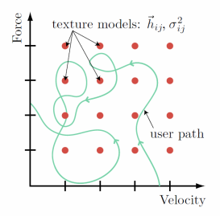
Optimal Design Process
?
Real Object
Generate Force-Velocity Map for every Position
Time dependent
Values from various literature sources
Render Object and display force and velocity according to object friction, stiffness and other properties of the real object
Virtual Object

Slide 17
Incresing Velocity
Small Velocity
Large Velocity

Slide 18
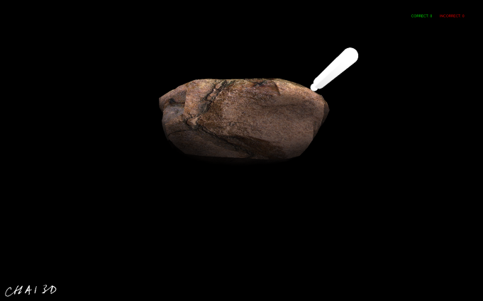
3D Objects

Slide 19
Voice Coil Actuator
Soft Iron
(fixed)
Air gap
Electric coil
Coil holder
(sliding)
Permanent Magnet

Slide 20
3D Objects
Design objects according to the soundfiles we got
Similar in shape in order to make it not too easy
Different in texture

Slide 21
Our Work
Implement game logic
Create 3D objects
Handle user unputs
Connect voice coil actuator with CHAI 3D

