Slide 1
An Introduction To Elastic-Search
Lecturer : Noppachanin Kongsathitporn
Ph.D. Student, ICT, Mahidol University
Modified from Pisol Ruenin (2023)

Slide 2
Prerequisites : Resources
Elasticsearch(Distributed database)
https://www.elastic.co/downloads/elasticsearch
Kibana(Dashboard)
https://www.elastic.co/downloads/kibana
Python(Flask)
https://www.python.org/downloads/
Workshop materials
** Kibana and ElasticSearch version must be similar

Slide 3
Prerequisites : python module
pip install elasticsearch
pip install ndjson

Slide 4
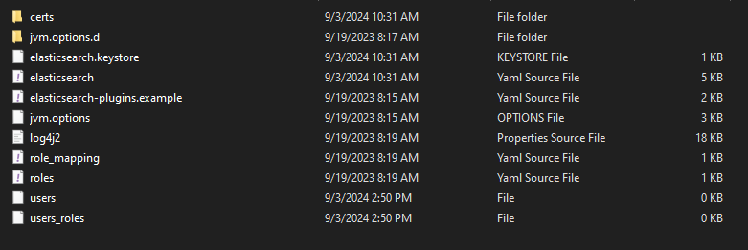
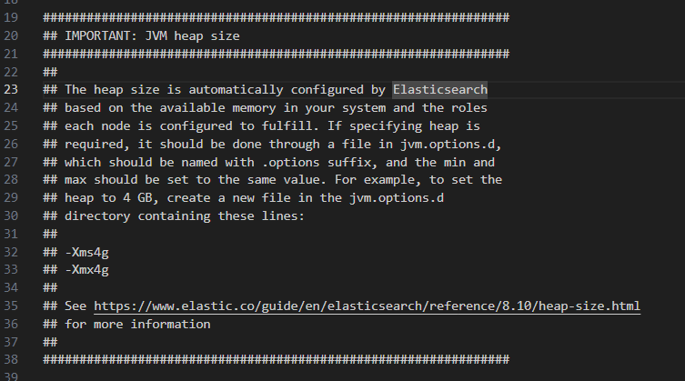
Problem : Insufficient memory
/elasticsearch/config/jvm.options
Change -Xms4g -Xmx4g to –Xms2g –Xmx2g

Slide 5
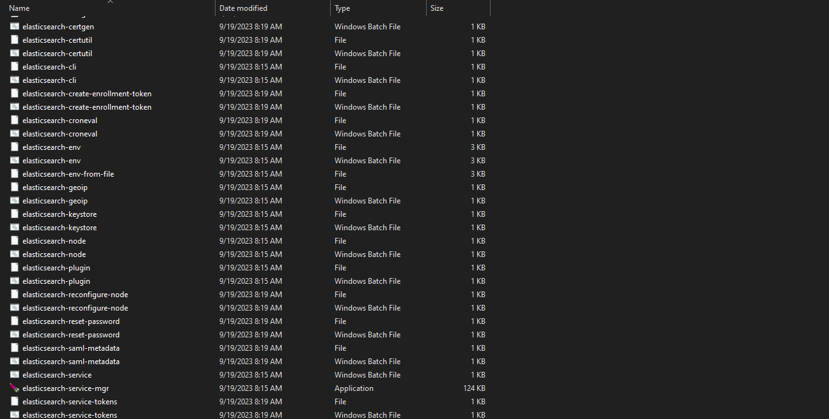
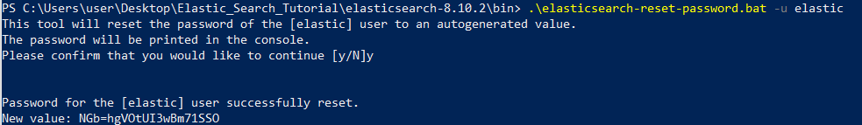
Problem : Forget Password
Command : .\elasticsearch-reset-password.bat -u elastic

Slide 6
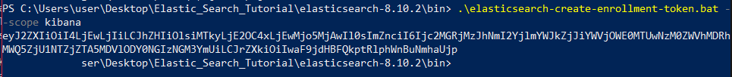
Problem : Forget enrollment tokens
Command : .\elasticsearch-create-enrollment-token.bat

Slide 7




What is ElasticSearch?
Opensource analytics and full-text search engine.
Also structured data such as numbers and aggregate data.
Written in Java, built on Apache Lucene.

Slide 8
Basic Architecture
Cluster
Node A
Node B
Node C

Slide 9
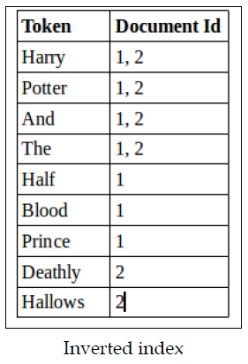
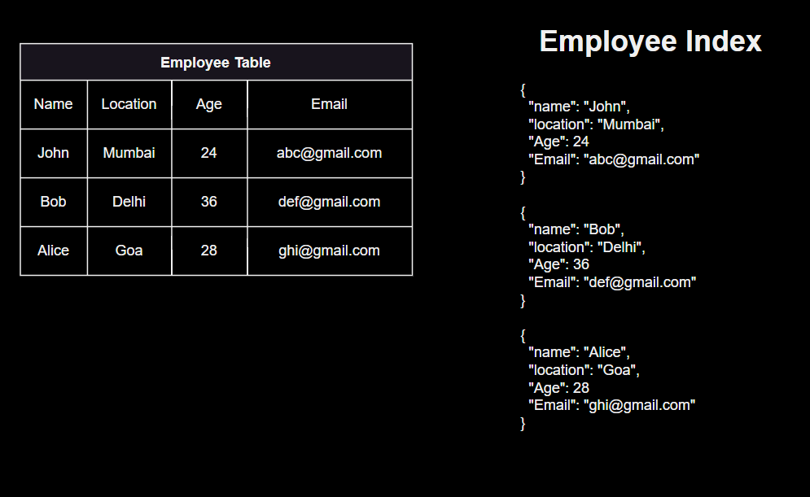
Basic Architecture
A collection of documents is stored as Index(Inverted Index)
Distributed database
JSON Document
Distributed (ElasticSearch) vs Relational Database
Reference : What exactly does the data structure of the inverted index in SOLR looks like - Stack Overflow
Reference : Elasticsearch database introduction and terminology (nagasudhir.blogspot.com)

Slide 10

Basic Architecture
Documents
Similar to row in relational databases
{
"firstName": "John",
"lastName": "Doe",
"interests": ["Programming", "Elasticsearch"]
}

Slide 11
Basic Architecture
Node A
Node B
capacity: 100 GB
capacity: 100 GB
Index
150 GB
Shard A
Shard B

Slide 12
Basic Architecture
Node A
Node B
Shard A
Shard B
Replica B1
Replica A1
Replica B2
Replica A2
Shard
Replica

Slide 13
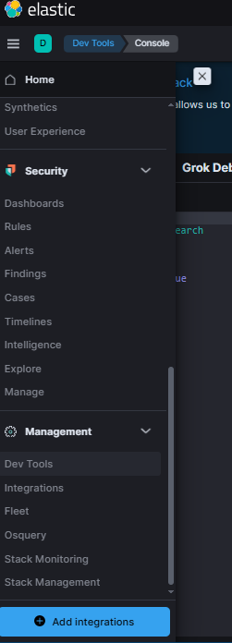
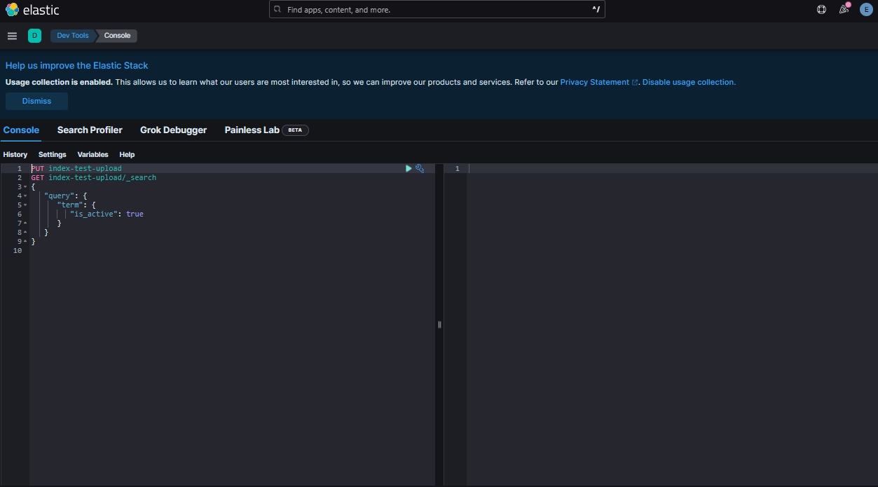
Dev tool

Slide 14
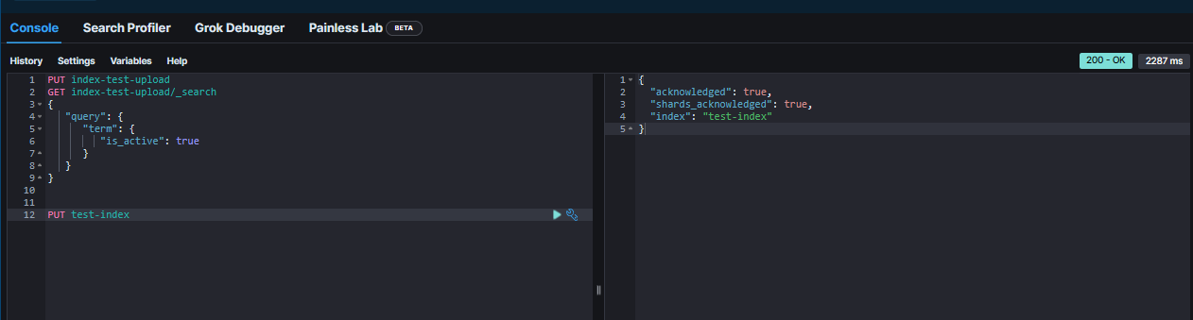
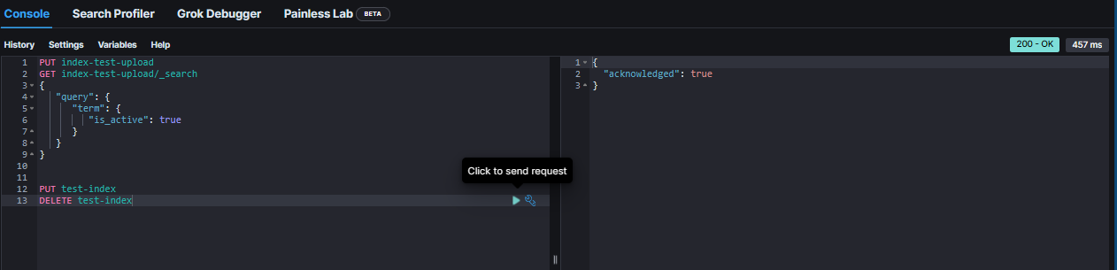
Creating & deleting indices
Creating index
PUT <index_name>
Deleting index
DELETE <index_name>

Slide 15
Indexing documents
POST <index_name>/_doc
{
"field1": value,
"field2": value
}

Slide 16
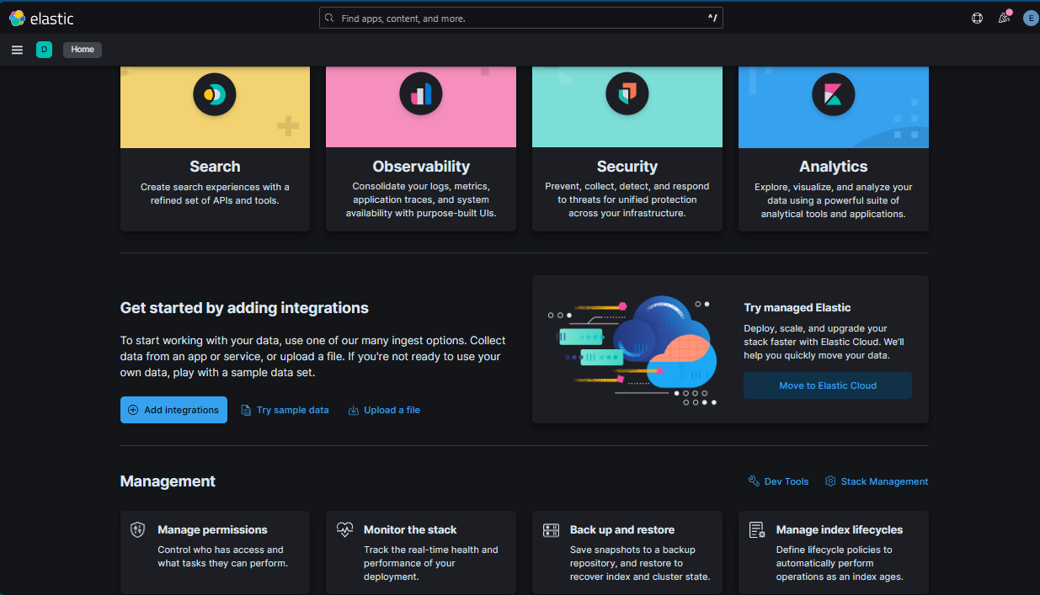
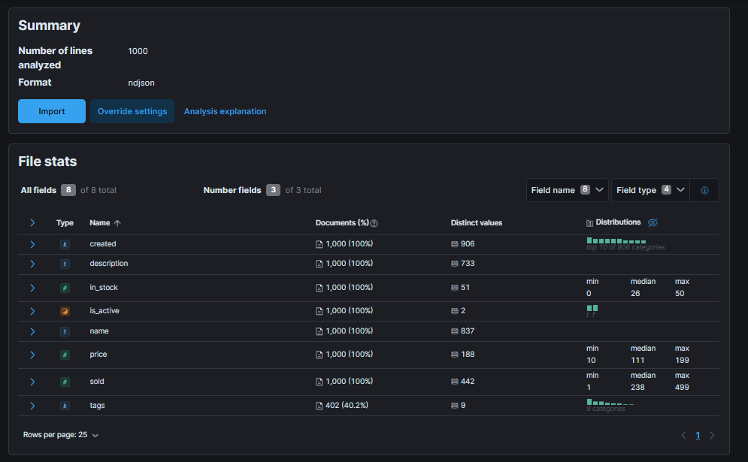
Indexing documents
Upload JSON documents to ElasticSearch

Slide 17
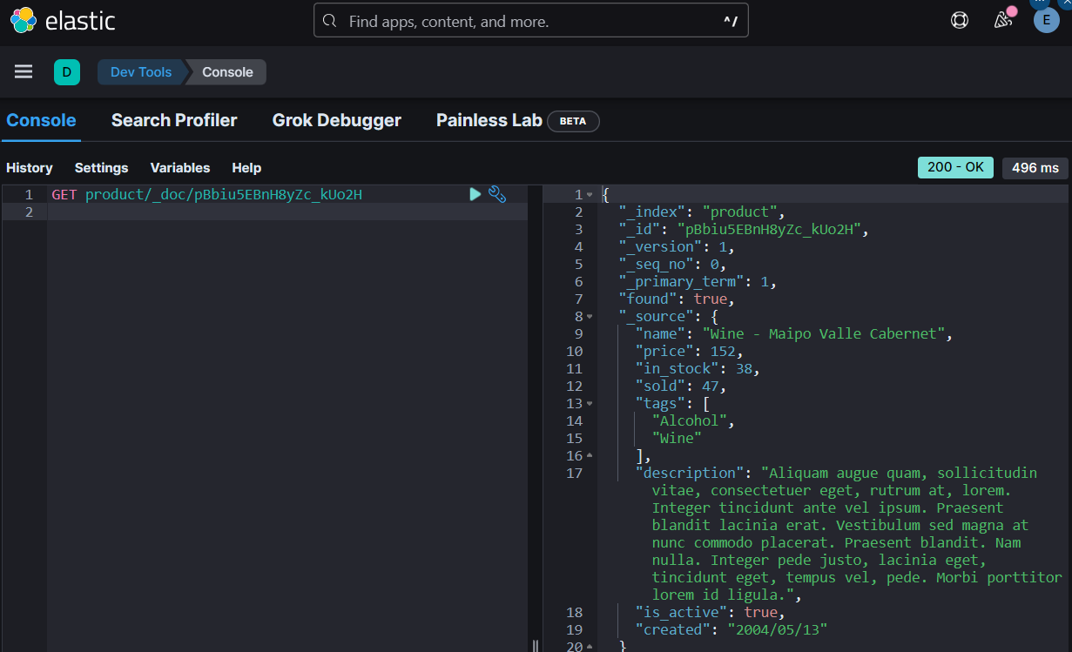
Basic managing documents
Retrieving document by ID
GET <index_name>/_doc/<document_id>
Updating document
POST <index_name>/_update/<document_id>
{
"doc": {
"<field_name>": <value>
}
}
Deleting document
DELETE <index_name>/_doc/<document_id>

Slide 18
mapping
https://www.elastic.co/guide/en/elasticsearch/reference/current/mapping-params.html
Defines a type of a field.
Explicit mapping : Add field and its data types manually
Dynamic mapping : Detect and add fields and their data types to the index as new documents are ingested
Similar to a table’s schema in a relational database.

Slide 19
Adding explicit mapping
PUT <index_name>
{
"mapping": {
"properties: {
"<field_name>": { "type": <field_type> },
"<field_name>": { "type": <field_type> }
}
}
}
PUT reviews
{
"mappings": {
"properties": {
"rating": { "type": "float" },
"content": { "type": "text" },
"product_id": { "type": "integer" },
"author": {
"properties": {
"first_name": { "type": "text" },
"last_name": { "type": "text" },
"email": { "type": "keyword" }
}
}
}
}
}
Retrieving mapping
GET <index_name>/_mapping

Slide 20
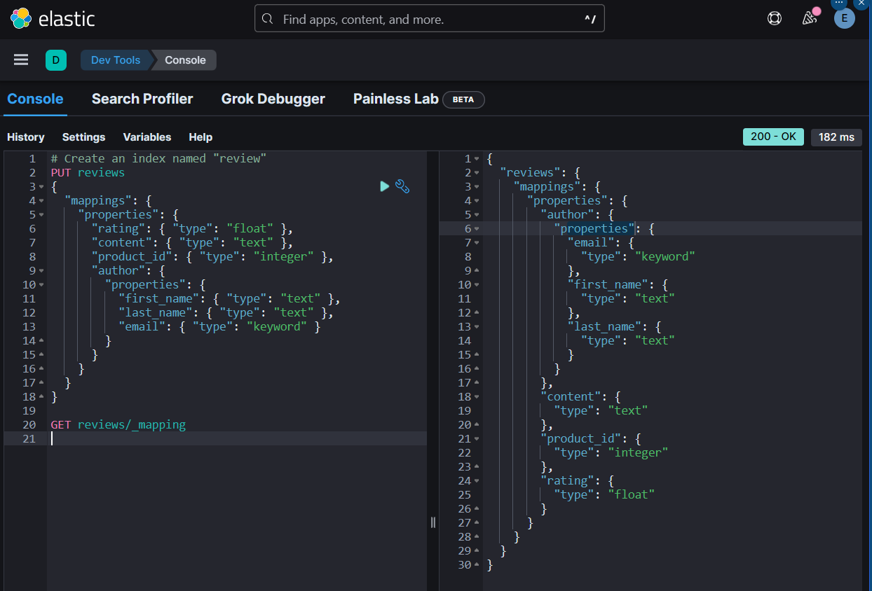
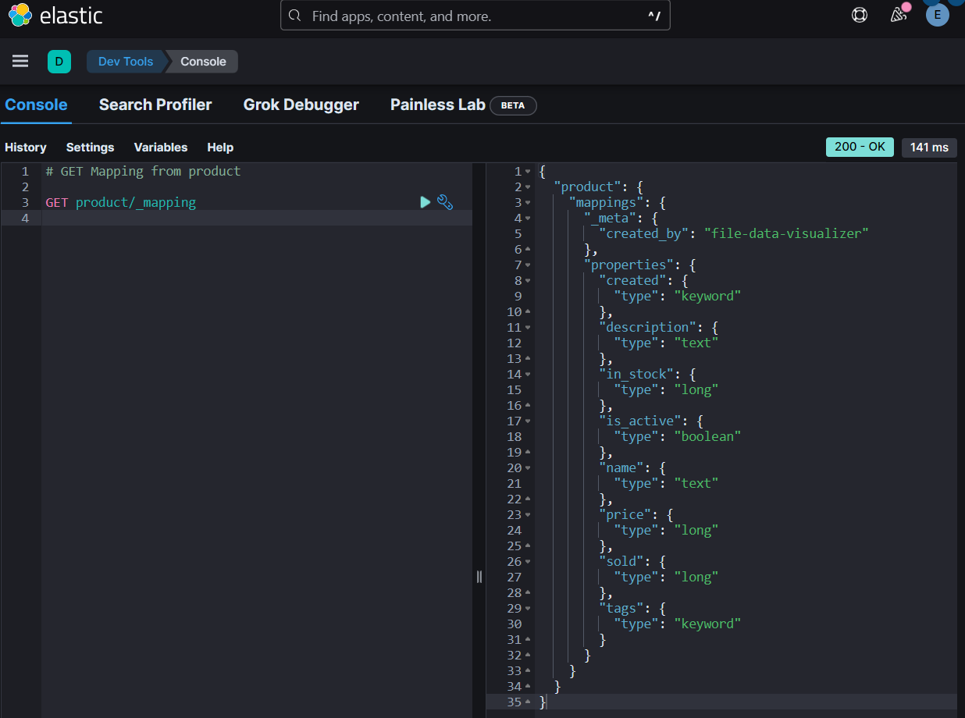
Get explicit/dynamic mapping
Explicit Mapping : “reviews”
Dynamic Mapping : “product”

Slide 21


Analyzer
Document
Analyzer
Storage
Character filters
Tokenizer
Token filters

Slide 22
Defining analyzer on the field
{
"properties": {
"<field_name>": {
"type": "<type>",
"analyzer": "<analyzer_name>"
}
}
}

Slide 23
Test Analyzer
POST _analyze
{
"analyzer": "standard",
"text": "The quick brown fox."
}

Slide 24
Built-in analyzers
https://www.elastic.co/guide/en/elasticsearch/reference/current/analysis-analyzers.html
Standard analyzer
Splits text a word boundaries and removes punctuation.
Lowercases letters with the lowercase token filter
Contains the stop token filter
e.g.
"Is that Peter’s cute-looking dog?"
["is", "that", "peter’s", "cute", "looking", "dog"]

Slide 25
Built-in analyzers
https://www.elastic.co/guide/en/elasticsearch/reference/current/analysis-analyzers.html
Simple analyzer
Similar to the standard analyzer
Splits into tokens when encountering anything else than letters
e.g.
"Is that Peter’s cute-looking dog?"
["is", "that", "peter", "s", "cute", "looking", "dog"]

Slide 26
Built-in analyzers
https://www.elastic.co/guide/en/elasticsearch/reference/current/analysis-analyzers.html
Whitespace analyzer
Splits text into tokens by whitespace
Does not lowercase letters
e.g.
"Is that Peter’s cute-looking dog?"
["Is", "that", "Peter’s", "cute-looking", "dog?"]

Slide 27
Built-in analyzers
https://www.elastic.co/guide/en/elasticsearch/reference/current/analysis-analyzers.html
Keyword analyzer
No-op analyzer that leaves the input text intact
Used for keyword fields by default
e.g.
"Is that Peter’s cute-looking dog?"
["Is that Peter’s cute-looking dog?"]

Slide 28
Built-in analyzers
https://www.elastic.co/guide/en/elasticsearch/reference/current/analysis-analyzers.html
Pattern analyzer
A regular expression is used to match token separators
This analyzer is very flexible
The default pattern matches all non-word characters
Lowercases letters by default
e.g. (default)
"Is that Peter’s cute-looking dog?"
["is", "that", "peter", "s", "cute", "looking", "dog"]

Slide 29
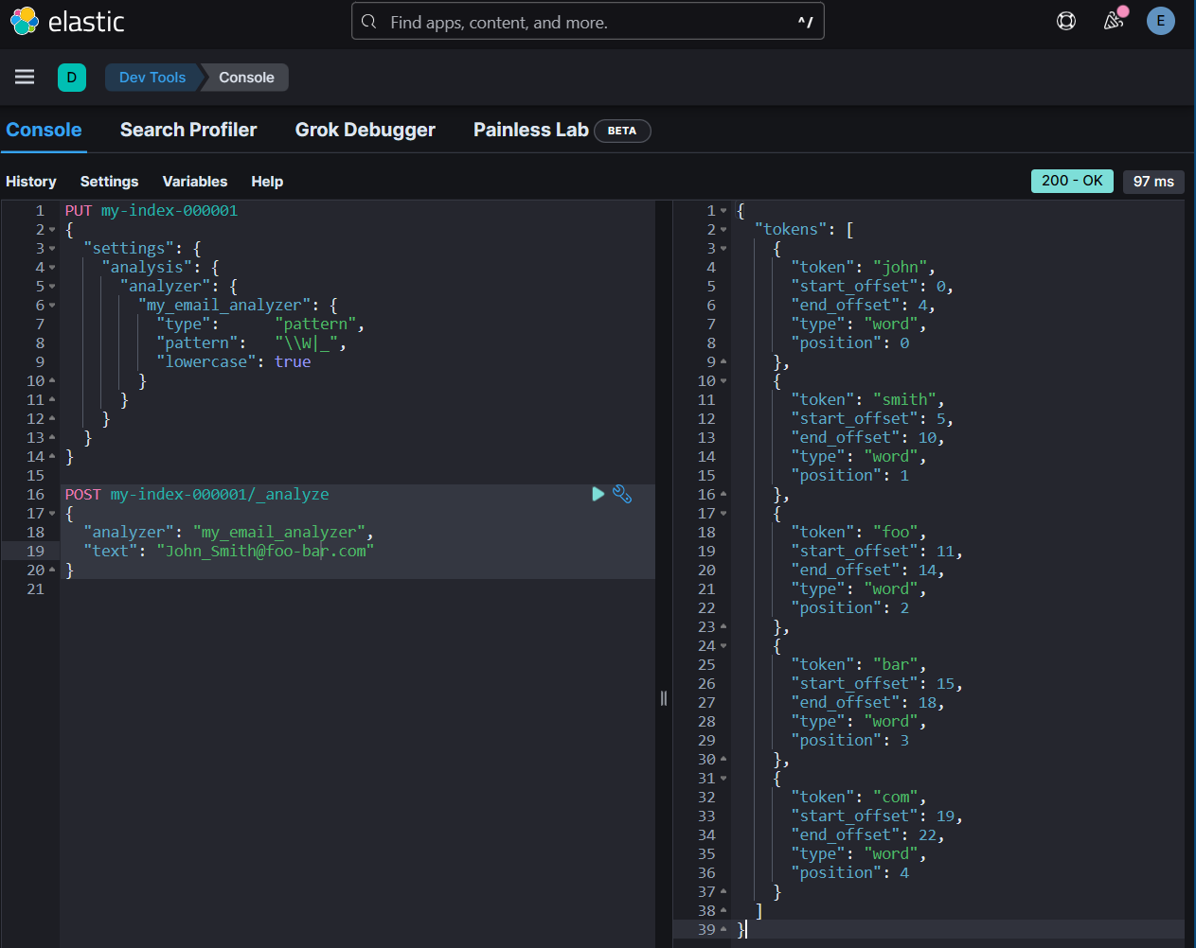
Built-in analyzers
https://www.elastic.co/guide/en/elasticsearch/reference/current/analysis-analyzers.html
Pattern analyzer : Split email addresses on non-word characters or on underscores (\W|_), and to lower-case the result
PUT my-index-000001
{
"settings": {
"analysis": {
"analyzer": {
"my_email_analyzer": {
"type": "pattern",
"pattern": "\\W|_",
"lowercase": true
}
}
}
}
}
POST my-index-000001/_analyze
{
"analyzer": "my_email_analyzer",
"text": "John_Smith@foo-bar.com"
}

Slide 30
Creating custom analyzers
Format
Example
PUT <index_name>
{
"settings": {
"analysis": {
"analyzer": {
"<analyzer_name>": {
"type": "custom",
"char_filter": ["<char_filter>"],
"tokenizer": "<tokenizer>",
"filter": [
"<filter>"
]
}
}
}
}
}
PUT analyzer_test
{
"settings": {
"analysis": {
"analyzer": {
"my_custom_analyzer": {
"type": "custom",
"char_filter": ["html_strip"],
"tokenizer": "standard",
"filter": [
"lowercase",
"stop",
"asciifolding"
]
}
}
}
}
}

Slide 31
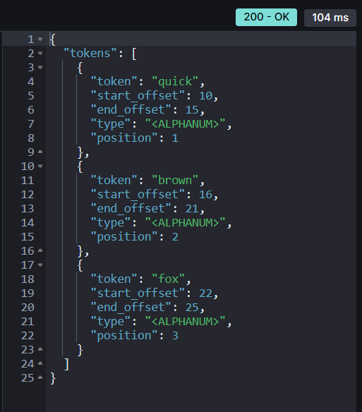
Creating custom analyzers
Custom analyzer vs Standard
POST _analyze
{
"analyzer": "standard",
"text": "<html>The quick brown fox. </html> "
}
POST analyzer_test/_analyze
{
"analyzer": "my_custom_analyzer",
"text": "<html>The quick brown fox. </html> "
}

Slide 32
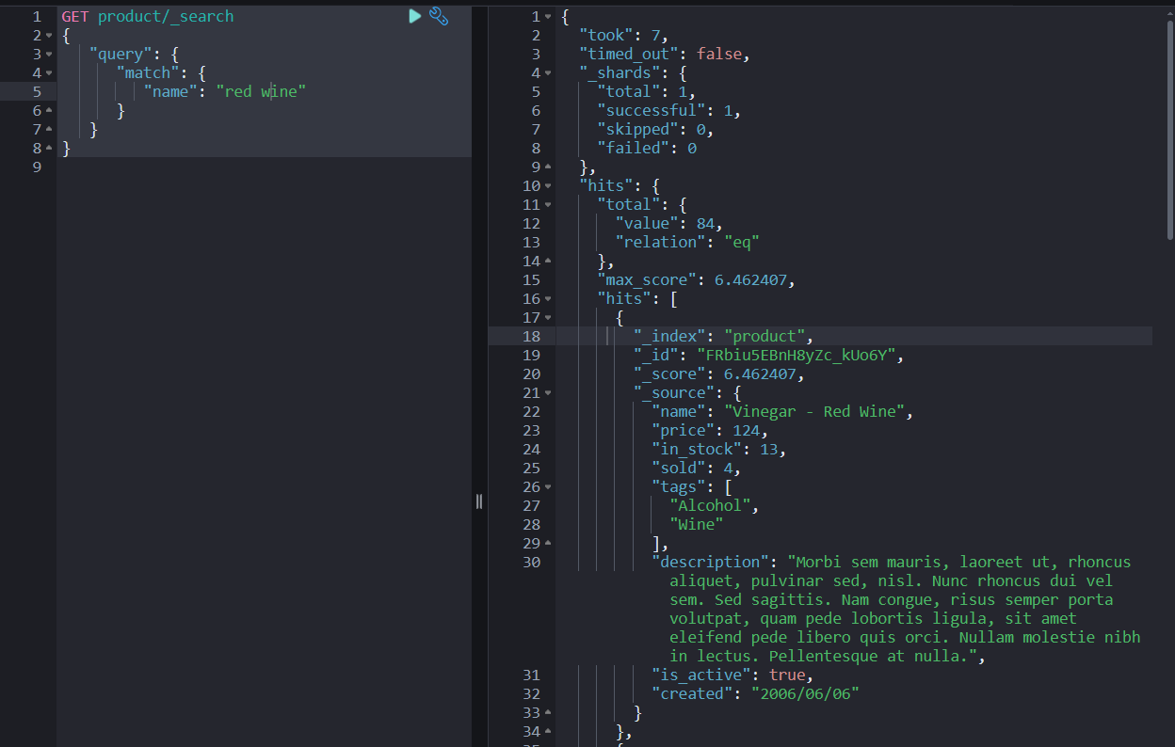
Search methods
Match
GET product/_search
{
"query": {
"match": {
"name": "red wine"
}
}
}

Slide 33
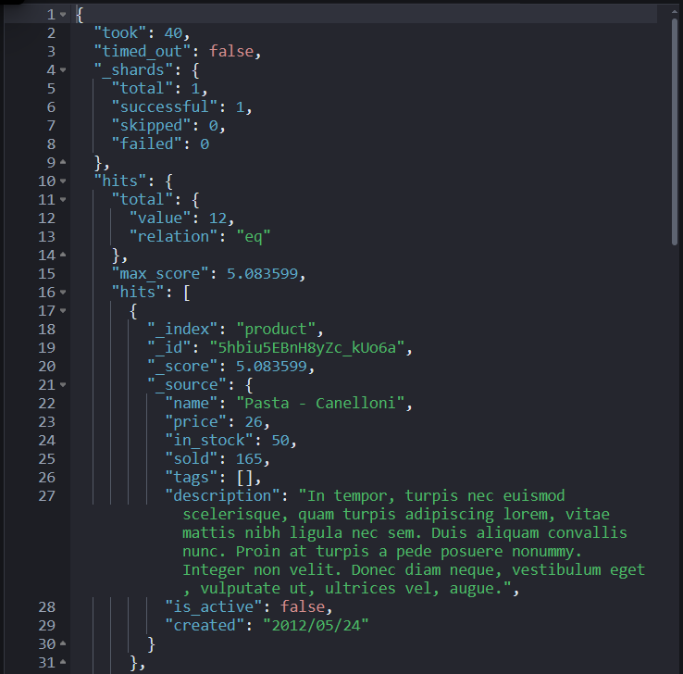
Search methods
Short Query
GET product/_search?q=name:pasta
String Query
GET product/_search
{
"query": {
"query_string": {
"query": "name:pasta"
}
}
}

Slide 34
Relevance score
https://www.elastic.co/guide/en/elasticsearch/reference/current/index-modules-similarity.html
Okapi BM25 algorithm
The relevance scoring algorithm currently used by Elasticsearch
Term Frequency (TF)
How many times foes the term appear in the field for a given document?
Inverse Document Frequency (IDF)
How often does the term appear within the index (i.e. across all documents)?
Field-length norm
How long is the field?

Slide 35
Available similarities
BM25 similarity
DFR similarity
DFI similarity
IB similarity
LM Dirichlet similarity
LM Jelinek Mercer similarity

Slide 36
Implementing a similarity
Configuring a similarity
Using a similarity
PUT index
{
"settings": {
"index": {
"similarity": {
"my_similarity": {
"type": "DFR",
"basic_model": "g",
"after_effect": "l",
"normalization": "h2",
"normalization.h2.c": "3.0"
}
}
}
}
}
PUT index/_mapping
{
"properties" : {
"title" : {
"type" : "text",
"similarity" : "my_similarity"
}
}
}

Slide 37
Define Scripted similarity
"similarity": {
"scripted_tfidf": {
"type": "scripted",
"script": {
"source": "double tf = Math.sqrt(doc.freq); double idf = Math.log((field.docCount+1.0)/(term.docFreq+1.0)) + 1.0; double norm = 1/Math.sqrt(doc.length); return query.boost * tf * idf * norm;"
}
}
}

Slide 38

Term queries vs Full-text queries
"Lobster"
X
Term Query
Inverted Index
"lobster“
(All lowercase)
"Lobster"

Match Query
Analyzer
Inverted Index

Slide 39
Term level query (single)
Format
Example
GET <index_name>/_search
{
"query": {
"term": {
"<field>": <value>
}
}
}
GET product/_search
{
"query": {
"term": {
"is_active": true
}
}
}

Slide 40
Term level query (multiple)
Format
Example
GET <index_name>/_search
{
"query": {
"terms": {
"<field>": [
<value>,
<value>
]
}
}
}
GET product/_search
{
"query": {
"terms": {
"tags": [
"Soup",
"Cake"
]
}
}
}

Slide 41
Full-text level query
Queries was proceeded by the analyzer before matching
Format
Example
GET <index_name>/_search
{
"query": {
"match": {
"<field>": "<text>"
}
}
}
GET recipe/_search
{
"query": {
"match": {
"title": "Recipes with pasta or spaghetti"
}
}
}

Slide 42
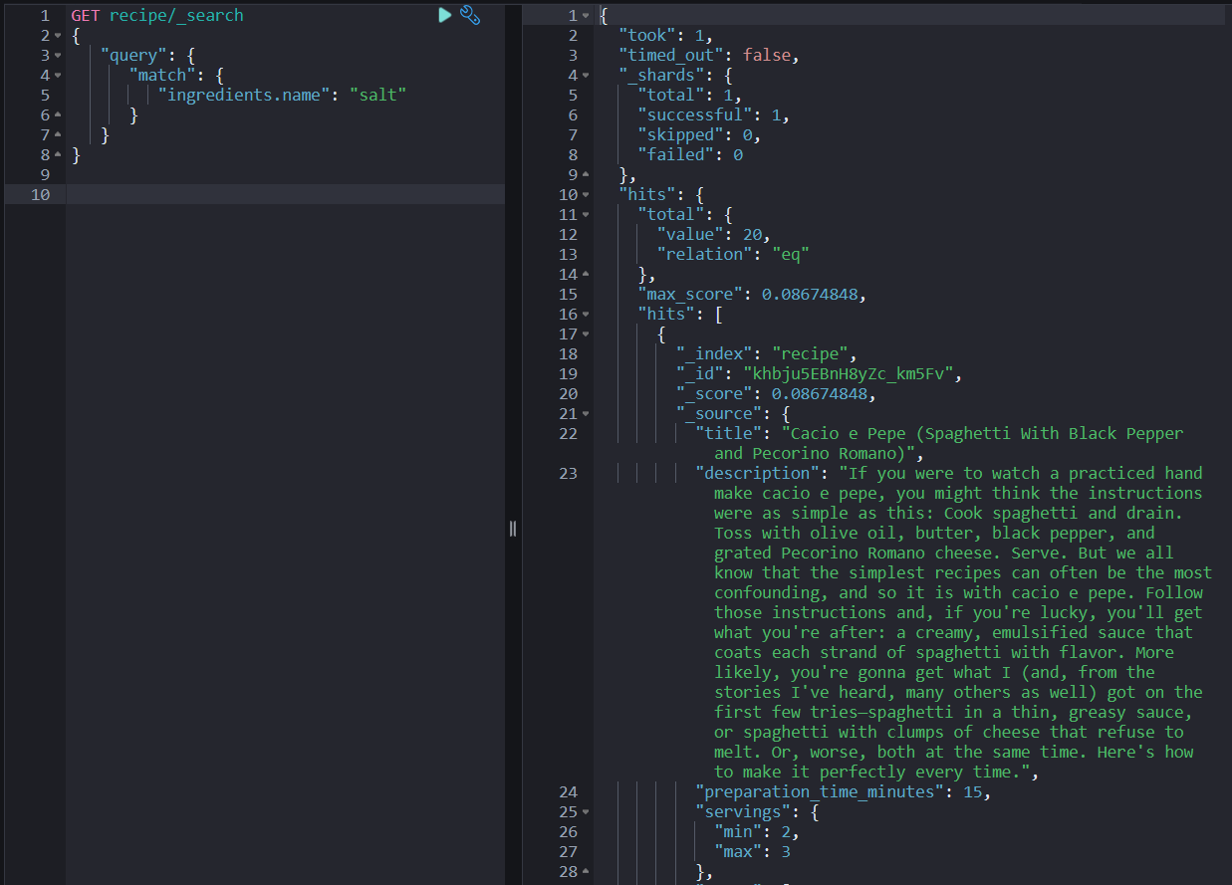
Full-text level Nested query
Queries was proceeded by the analyzer before matching
GET recipe/_search
{
"query": {
"match": {
"ingredients.name": "salt"
}
}
}

Slide 43
Full-text level query (Matching phrases)
Format
Example
GET <index_name>/_search
{
"query": {
"match_phrase": {
"<field>": "<text>"
}
}
}
GET recipe/_search
{
"query": {
"match_phrase": {
"title": "spaghetti puttanesca"
}
}
}

Slide 44
Full-text level query (Multiple fields)
Format
Example
GET <index_name>/_search
{
"query": {
"multi_match": {
"query": "<text>",
"fields": [<field>, <field>]
}
}
}
GET recipe/_search
{
"query": {
"multi_match": {
"query": "pasta",
"fields": ["title", "description"]
}
}
}

Slide 45
Full-text level query (Nested FIeld)
Nested query | Elasticsearch Guide [8.15] | Elastic
Format
Example
GET <index_name>/_search
{
"query": {
"multi_match": {
"query": "<text>",
"fields": [<field>.<subfield>]
}
}
}
GET recipe/_search
{
"query": {
"multi_match": {
"query": "pasta",
"fields": ["title", "description " ,
"ingredients.name"]
}
}
}

Slide 46
Matching with range values
Format
Example
GET <index_value>/_search
{
"query": {
"range": {
"<field>": {
"gte": <value>,
"lte": <value>
}
}
}
}
GET product/_search
{
"query": {
"range": {
"in_stock": {
"gte": 1,
"lte": 10
}
}
}
}
gte (greater than or equal, >=)
lte (less than or equal, <=)
The value type must be a number.

Slide 47
Matching based on prefix
Format
Example
GET <index_value>/_search
{
"query": {
"prefix": {
"<field>": "<text>"
}
}
}
GET product/_search
{
"query": {
"prefix": {
"tags": "Vege"
}
}
}

Slide 48
Boolean logic to queries
Example
Format
GET recipe/_search
{
"query": {
"bool": {
"must": [
{
"match": {
"ingredients.name": "parmesan"
}
}
]
}
}
}
GET recipe/_search
{
"query": {
"bool": {
"should": [
{
"match": {
"ingredients.name": "parsley"
}
}
]
}
}
}
GET recipe/_search
{
"query": {
"bool": {
"must": [
{
"match": {
"ingredients.name": "parmesan"
}
}
],
"must_not": [
{
"match": {
"ingredients.name": "tuna"
}
}
],
"should": [
{
"match": {
"ingredients.name": "parsley"
}
}
],
"filter": [
{
"range": {
"preparation_time_minutes": {
"lte": 15
}
}
}
]
}
}
}
GET recipe/_search
{
"query": {
"bool": {
"must_not": [
{
"match": {
"ingredients.name": “tuna"
}
}
]
}
}
}
GET recipe/_search
{
"query": {
"bool": {
"filter": [
{
"range": {
"preparation_time_minutes": {
"lte": 15
}
}
}
]
}
}
}

Slide 49
Controlling query results
Source filtering
Format
Example
GET <index_name>/_search
{
"_source": "<field>",
"query": {
"match": { "<field>": "<text>" }
}
}
GET recipe/_search
{
"_source": "created",
"query": {
"match": { "title": "pasta" }
}
}
GET recipe/_search
{
"_source": ["created", "title"],
"query": {
"match": { "title": "pasta" }
}
}
** Display only “created” field
** Display “created” and “title” fields

Slide 50
Controlling query results
Result size
Format
Example
GET <index_name>/_search
{
"size": <size>,
"query": {
"match": { "<field>": "<text>" }
}
}
GET recipe/_search
{
"size": 2,
"query": {
"match": { "title": "pasta" }
}
}
** Display only first 2 hits in total hits

Slide 51
Controlling query results
Sorting results
Format
Example
GET <index_name>/_search
{
"query": {
"match_all": {}
},
"sort": [
{ "<field>": "desc" or "asc" }
]
}
GET recipe/_search
{
"query": {
"match_all": {}
},
"sort": [
{ "created": "desc" }
]
}
** Sorting numbers and time

Slide 52
Controlling query results : pagination
Specifying an offset
total_pages = ceil(total_hits/page_size)
from = (page_size * (page_number-1))
0
1
2
Documents
1 | 2 | 3 | 4 | 5 | 6 | 7 | 8 | 9 | …
size: 2
from: 0
Pagination
1 | 2 | 3 | 4 | 5 | 6 | 7 | 8 | 9 | …

Slide 53
pagination
total_pages = ceil(total_hits/page_size)
from = (page_size * (page_number-1))
0
1
2
Documents
1 | 2 | 3 | 4 | 5 | 6 | 7 | 8 | 9 | …
size: 2
from: 2
Pagination
1 | 2 | 3 | 4 | 5 | 6 | 7 | 8 | 9 | …

Slide 54
Controlling query results
Specifying an offset
Format
Example
GET <index_name>/_search
{
"size": <value>,
"from": <value>
"query": {
"match": { "<field>": "<text>" }
}
}
GET recipe/_search
{
"size": 2,
"from": 0,
"query": {
"match": { "title": "pasta" }
}
}

Slide 55
Improving search results
Proximity searches
Fuzzy match query (handling typo)
Adding synonyms
Stemming

Slide 56
Improving search results
Proximity searches
 | Position 1 | Position 2 | Position 3
Document | spicy | tomato | sauce
Query | spicy | sauce
Slop 1 | spicy |  | sauce
Slop2 | spicy

Slide 57
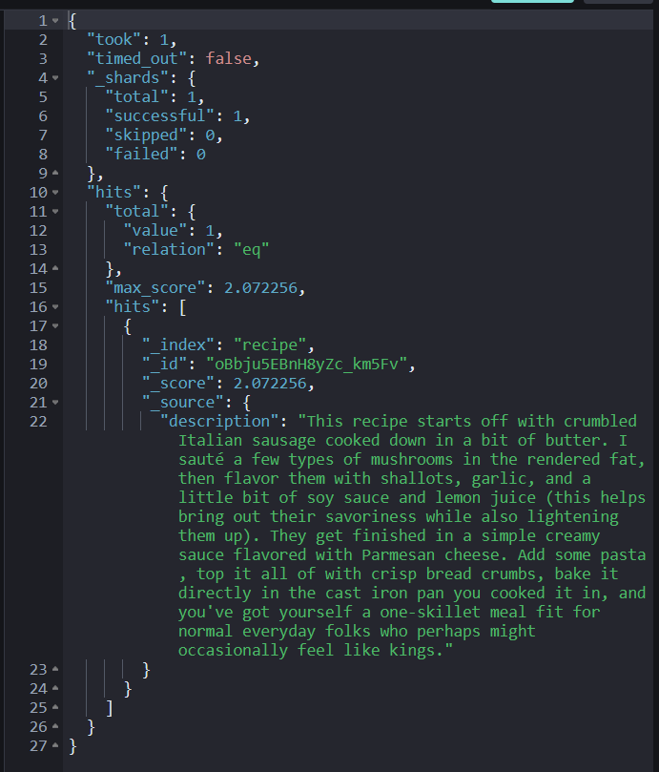
Improving search results
Proximity searches
GET <index_name>/_search
{
"query": {
"match_phrase": {
"<field>":{
"query": "<text>",
"slop": <value>
}
}
}
}
GET recipe/_search
{
"_source": "description",
"query": {
"match_phrase": {
"description": {
"query":"types mushrooms",
"slop": 0
}
}
}
}

Slide 58

Improving search results
Fuzzy match query
"L0bster"
X
Term Query
Inverted Index

"L0bster"
Match Query
Fuzziness
Inverted Index

Slide 59
Improving search results
Fuzzy match query
Term length | Maximum edit distance
1-2 | 0
3-5 | 1
>5 | 2

Slide 60
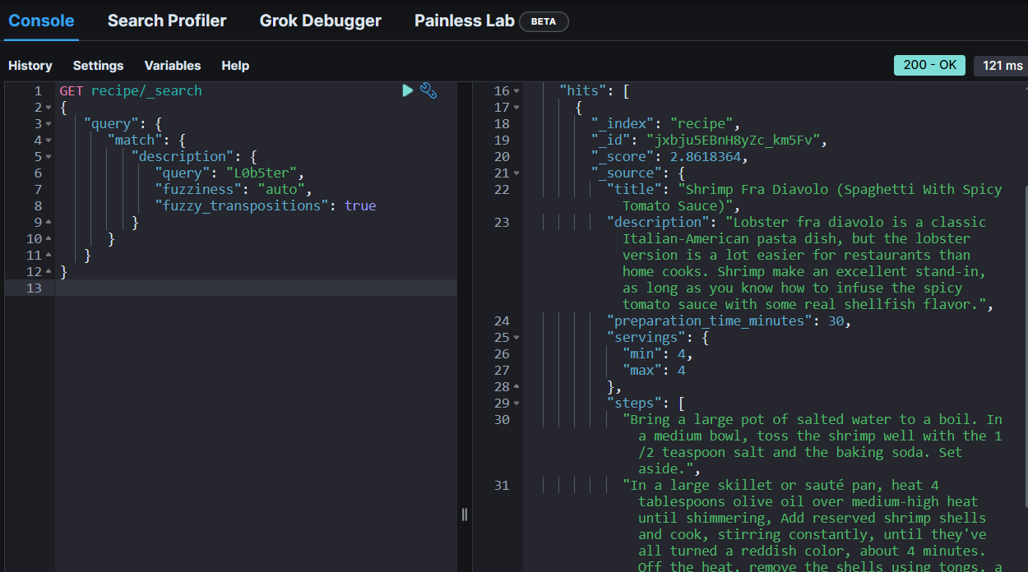
Improving search results
Fuzzy match query
GET <index_name>/_search
{
"query": {
"match": {
"<field>": {
"query": "<text>",
"fuzziness": <number> or "auto",
"fuzzy_transpositions": true or false
}
}
}
}
GET recipe/_search
{
"query": {
"match": {
"description": {
"query": "L0b5ter",
"fuzziness": "auto",
"fuzzy_transpositions": true
}
}
}
}

Slide 61
Improving search results
Adding synonyms
Synonyms
awful => terrible
awesome => great, super
Noodle => Pasta
PUT synonyms
{
"settings": {
"analysis": {
"filter": {
"synonym_test": {
"type": "synonym",
"synonyms_path": "synonyms.txt"
}
},
"analyzer": {
"my_analyzer": {
"tokenizer": "standard",
"filter": [
"lowercase",
"synonym_test"
]
}
}
}
},
"mappings": {
"properties": {
"description": {
"type": "text",
"analyzer": "my_analyzer"
}
}
}
}
POST synonyms /_analyze
{
"analyzer": "my_analyzer",
"text": “Noodle Pasta Awful terrible"
}

Slide 62
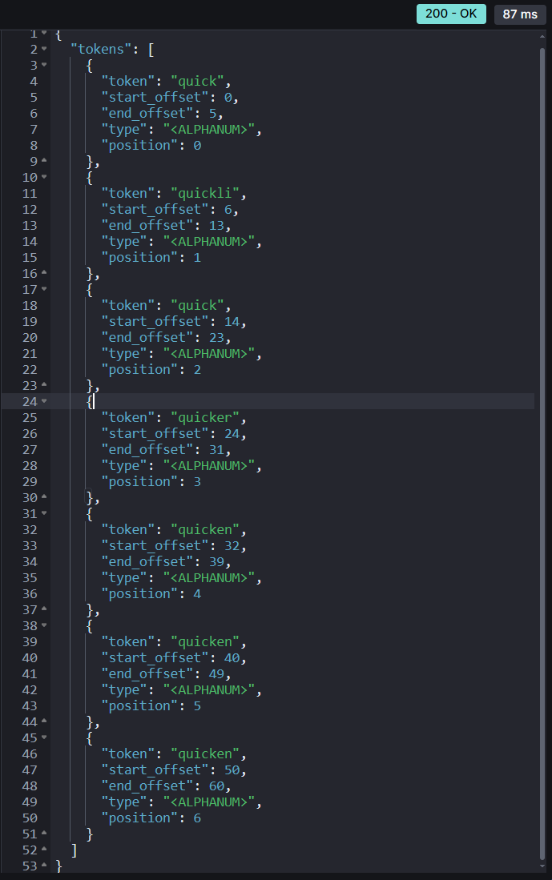
Improving search results
Stemming : Stemming is the process of reducing a word to its root form. This ensures variants of a word match during a search.
PUT stemming_test
{
"settings": {
"analysis": {
"filter": {
"stemmer_test" : {
"type" : "stemmer",
"name" : "english"
}
},
"analyzer": {
"my_analyzer": {
"tokenizer": "standard",
"filter": [
"lowercase",
"stemmer_test"
]
}
}
}
},
"mappings": {
"properties": {
"description": {
"type": "text",
"analyzer": "my_analyzer"
}
}
}
}
POST stemming_test/_analyze
{
"analyzer": "my_analyzer",
"text": "quick quickly quickness quicker quicken quickened quickening"
}

Slide 63
Integration with search engine using Flask

Slide 64
Prerequisites : python setup
Checklists
- Python 3.6+ is required.
- Install Flask : pip install Flask
In App Folder
- Create python file: “app.py”
Note : Run server using “flask run”

Slide 65
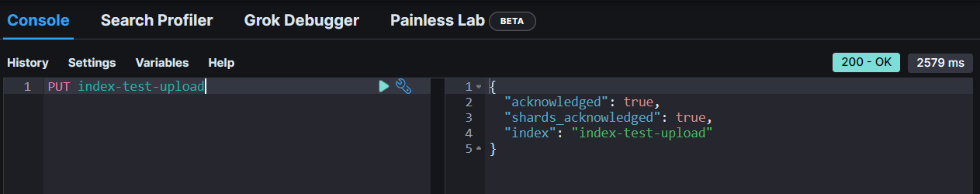
Import file using python
1. Create an index in elasticsearch : PUT index-test-upload
2. Change password into your password

Slide 66
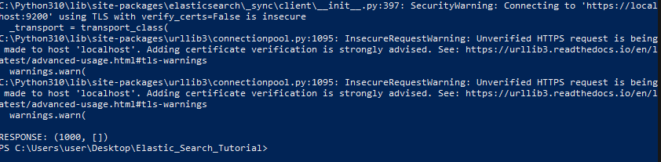
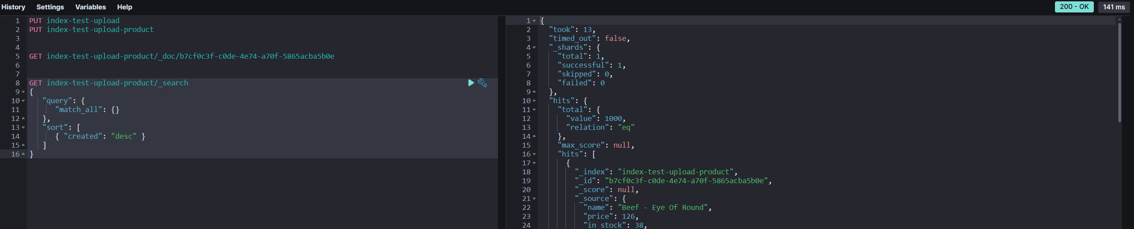
Import file using python
3. Run python file :
python .\elasticsearch_loader.py --file .\product-bulk.json --index test-upload-index

Slide 67
Prerequisites : python setup
App and Environment paths
Bash
export FLASK_APP=app
export FLASK_ENV=development
CMD
set FLASK_APP=app
set FLASK_ENV=development
Powershell
$env:FLASK_APP = “app”
$env:FLASK_ENV = “development”

Slide 68
Application using flask
Simple implementation
- Add this following code to app.py
from flask import Flask
app = Flask(__name__)
@app.route("/")
def hello_world():
return "<p>Hello, World!</p>"

Slide 69
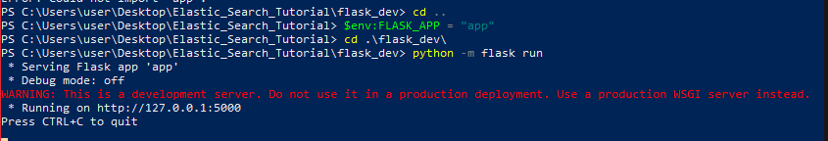
Prerequisites : python setup
Flask Initiation
- Flask run (Conda Env) or python3 –m flask run (Powershell, cmd)

Slide 70
Application using flask
HTML Escaping
from markupsafe import escape
@app.route("/<name>")
def hello(name):
return f"Hello, {escape(name)}!"

Slide 71
Application using flask
Routing
@app.route('/')
def index():
return 'Index Page'
@app.route('/hello')
def hello():
return 'Hello, World'

Slide 72
Application using flask
Variable Rules
from markupsafe import escape
@app.route('/user/<username>')
def show_user_profile(username):
# show the user profile for that user
return f'User {escape(username)}'
@app.route('/post/<int:post_id>')
def show_post(post_id):
# show the post with the given id, the id is an integer
return f'Post {post_id}'
@app.route('/path/<path:subpath>')
def show_subpath(subpath):
# show the subpath after /path/
return f'Subpath {escape(subpath)}'
string | (default) accepts any text without a slash
int | accepts positive integers
float | accepts positive floating-point values
path | like string but also accepts slashes
uuid | accepts UUID strings

Slide 73
Application using flask
Rendering Template
from flask import render_template
@app.route('/hello/')
@app.route('/hello/<name>')
def hello(name=None):
return render_template('hello.html', name=name)
<!doctype html>
<title>Hello from Flask</title>
{% if name %}
<h1>Hello {{ name }}!</h1>
{% else %}
<h1>Hello, World!</h1>
{% endif %}

Slide 74
Reference
Bo Andersen, Complete Guide to Elasticsearch, Udemy.
https://flask.palletsprojects.com/en/2.2.x/

