Slide 1
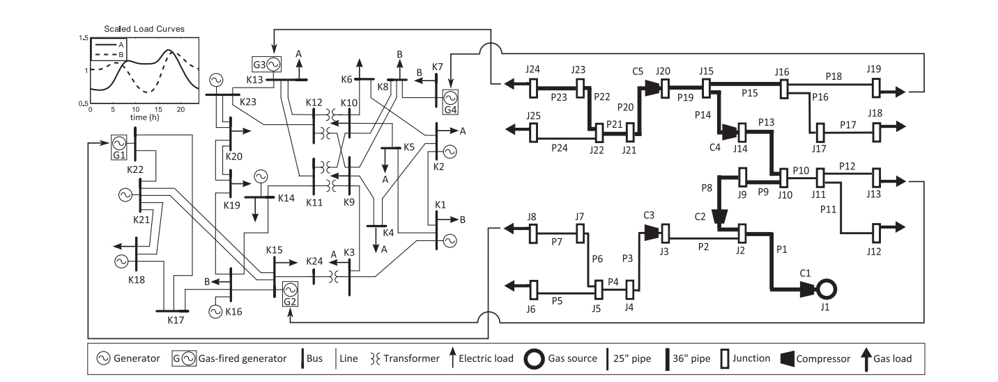
Notes:
49 node network
Schematic of integrated electric and gas test networks (data online [43]). IEEE RTS96 One Area 24 node power system (left) coupled with the 24 pipe benchmark gas system (right) through gas-fired generators (G1 to G4). Electric buses (K1 to K24), gas pipes (P1 to P24), pipe junctions or network nodes (J1 to J25), and gas compressors (C1 to C5) are indicated.
Ref.: https://sci-hub.tw/https://ieeexplore.ieee.org/abstract/document/7440893

