Slide 1




Value at risk

Slide 2


Risk management
Risk management aims to provide financial predictability for a company.
Every day, firms face various financial risks.
Examples of financial risks include:
Interest rate volatility
Exchange rate volatility
Default on loans
Changes in credit ratings.

Slide 3
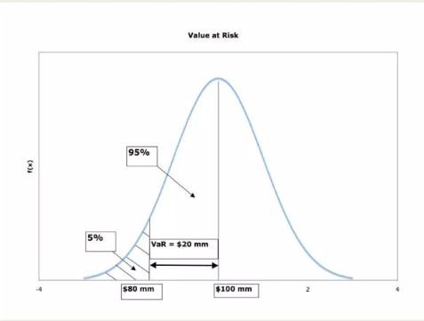
What is vaR?
Foundational concept in financial risk management
Tool that quantifies the potential loss in value of a financial portfolio or investment over a specified period for a given confidence level.
VaR = Potential loss at a specific confidence level over a certain time period

Slide 4
Significance of VaR in Risk Management
Quantifies Risk in Financial Terms VaR gives a clear, dollar-value estimate of potential losses, helping in decision-making.
Helps Set Risk Limits Organizations use VaR to set trading limits and control how much risk a desk, trader, or portfolio can take.
Standard Risk Metric Across the Industry VaR is widely accepted by banks, asset managers, and regulators, making it useful for benchmarking and reporting.
Regulatory Compliance Financial institutions use VaR to comply with regulatory requirements, such as Basel Accords, which require banks to maintain capital based on risk levels.
Capital Allocation Firms use VaR to allocate capital efficiently across different portfolios or units based on the risk they carry.
Stress Testing and Scenario Analysis VaR can be extended to test extreme scenarios to see how portfolios behave under adverse conditions.

Slide 5
Methods to Calculate VaR
Historical Method
Uses past market data to simulate potential future losses.
Variance-Covariance Method (Parametric)
Assumes returns are normally distributed and uses mean and standard deviation.
Monte Carlo Simulation
Uses random sampling and modeling to simulate thousands of potential outcomes.

Slide 6
Example(variance-covariance method)
Imagine a simple stock with a 1-year standard deviation of 20% and an average annual return of 10%. If we want to calculate the 95% one-year VaR using the delta-normal method (also known as the variance-covariance method), we can follow these steps:
Define Confidence Level:
We want the 95% VaR, which means we're looking at the 95th percentile of potential losses.
Determine the Z-score:
For a 95% confidence level, the Z-score is approximately 1.645.
Calculate the VaR:
VaR = (Portfolio Value) * (Z-score) * (Standard Deviation)
Let's assume the portfolio value is $100,000.
VaR = $100,000 * 1.645 * 0.20 = $32,900
Interpretation:
This means there is a 95% chance that the portfolio will not lose more than $32,900 over the next year.

Slide 7
THANK YOU

