Slide 1

AgriIntelligence: An Explainable AI-Based Agricultural Decision Support System
Project Review-1
 | Under the Guidance of Dr N Sunanda Assistant Professor, Department of Computer Science and Engineering, KLH CSE Bowrampet Campus
Team Members Meghna- 2420030401 Thanusree – 2420030442 Rasagna - 2420030117

Slide 2
Outline of Research Work
Focus
Introduction
Literature Survey
Challenges
Research Objectives
Conclusion & Future Work
References
Publications Details

Slide 3
Problem Statement
Farmers must make high-stakes crop decisions with fragmented, incomplete information — navigating unpredictable weather, shifting soil conditions, and volatile market prices, often without integrated guidance.
Current Situation :
  Crop selection relies on traditional knowledge. Weather is unpredictable, and market prices fluctuate often causing financial losses.
Information Gap :
  Existing systems address crop, weather, or market data in isolation. Datasets are collected at different intervals, making integration difficult.
Farmer Risk :
  Without unified intelligence, farmers face compounded uncertainty — choosing crops without full visibility into environmental suitability and economic viability..
"Farmers need an adaptive decision-support system that integrates crop/soil, weather, and market information to recommend suitable crops and support better yield and profitability decisions."

Slide 4
Objectives
Unified Data Integration
Integrate crop/soil, weather, and market-price datasets into one cohesive system.
Crop Suitability Prediction
Predict suitable crops based on soil properties and environmental conditions.
Weather Impact Analysis
Analyze how weather patterns influence crop growth and expected yield.
Market Price Forecasting
Forecast market-price trends to support economically profitable crop selection.
Multi-Rate Data Handling
Align datasets collected at different intervals through preprocessing and synchronization.
Farmer-Friendly Interface
Deliver clear, actionable recommendations through an intuitive decision-support dashboard.

Slide 5
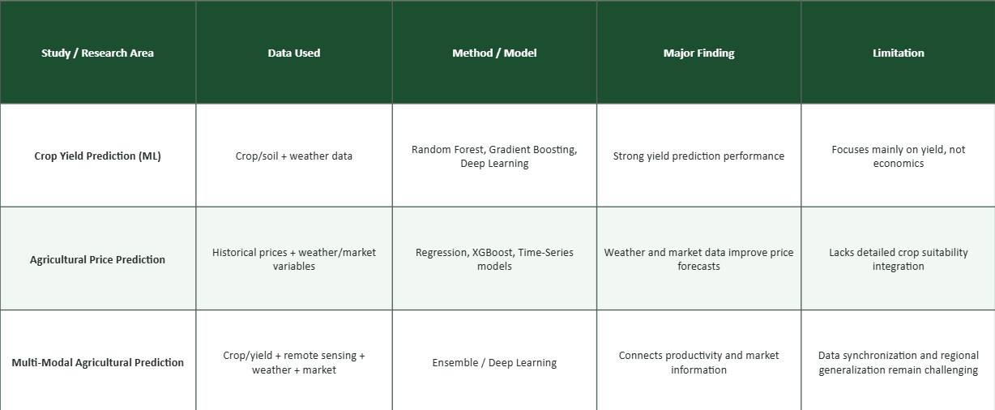
Literature Survey

Slide 6
Research Gap Identification
Data Synchronization
Weather, crop, and market data follow different reporting frequencies, making unified analysis difficult.
Regional Adaptability
Models trained for one region often fail elsewhere due to differing soil, climate, and market conditions.
Unexpected Market Events
Policy shifts, export restrictions, and fuel-price changes create sudden disruptions traditional models miss.
Post-Harvest Factors
Most systems focus on production but overlook storage, transportation, and crop perishability.

Slide 7
Innovation, Creativity, and Novelty
Innovation
Integration of three critical agricultural data sources — crop/soil, weather, and market price — into a single adaptive system.
Creativity
Complex multi-source agricultural data is distilled into simple, actionable recommendations any farmer can understand and act on.
Novelty
Instead of asking "Which crop can grow?", the system answers: "Which crop is suitable and economically promising under current conditions?“
Future directions may include: news/policy event analysis, regional model adaptation, and post-harvest logistics integration.

Slide 8
Feasibility
Technical Stack
Python, Pandas, Scikit-learn, ML models, PostgreSQL/Firebase, REST APIs, and a web dashboard for visualization.
Data Sources
Public agricultural datasets, historical crop/yield records, weather APIs, and agricultural market-price databases.
Operational Design
Dashboard-based recommendations designed for easy interpretation. Adaptable to specific regional contexts.
Economic Viability
Built on open-source software and publicly available datasets. No expensive hardware required for the initial prototype

Slide 9
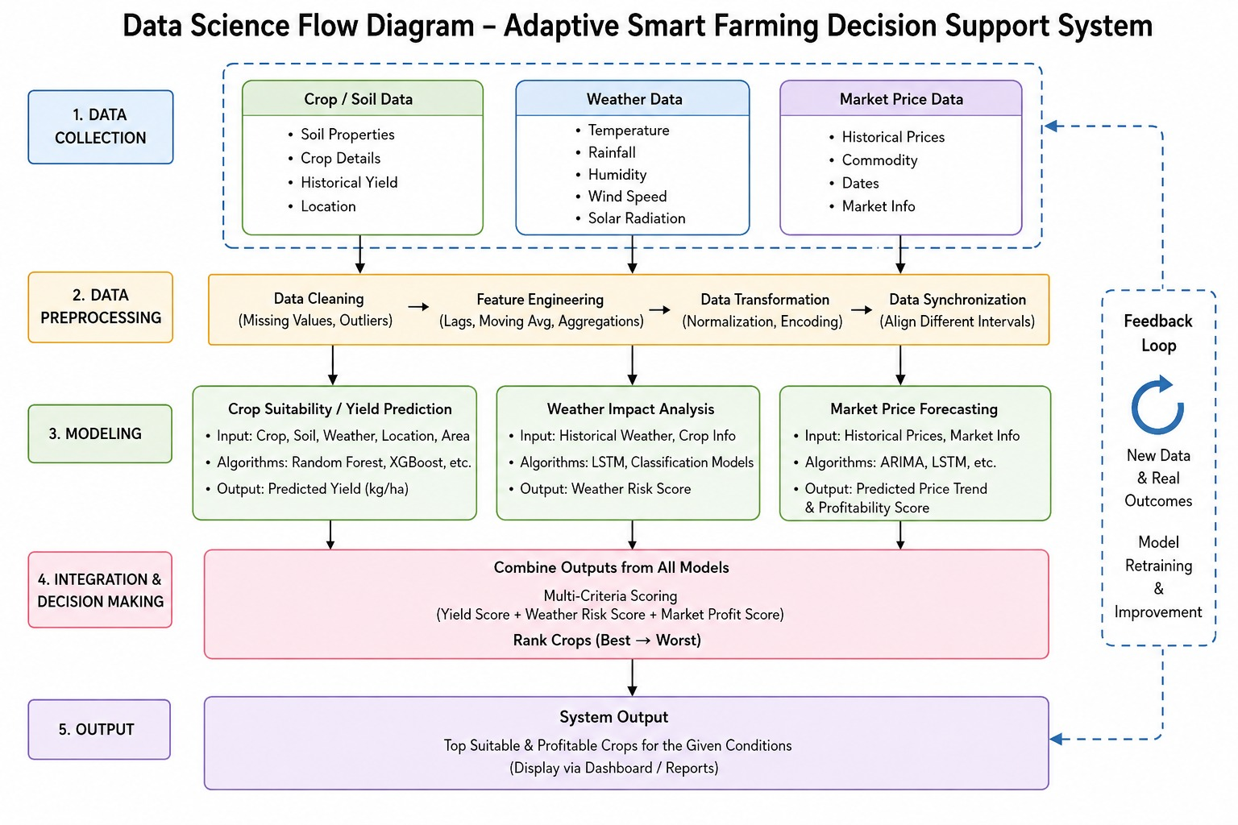
Project Plan

Slide 10
